Slide 1
Predicting Cyber Bulling On Social Media
Submitted by:
Yuvasri.D
Dhivya.PV
Anand Kumar.S
Selva Maari Ganesh. R
3rd year B.Tech Information Technology
Date:27/05/2022
Mini Project

Slide 2
Agenda
Abstract
Project Overview
System Specification
System Analysis
1.Existing System
2.Proposed System
System Design

Slide 3
ABSTRACT
This project provides insights on the overall process for cyberbullying prediction.
The recent developments of communication technologies have considerably transcended the temporal and spatial limitations of traditional communications. These social technologies have created a revolution in user-generated information, online human networks, and rich human behavior-related data.
The misuse of social technologies such as social media (SM) platforms, has introduced a new form of aggression and violence that occurs exclusively online.

Slide 4
MODULE DESCRIPTION
MODULES:
Data Collection
Machine Learning Algorithms
Cyber bullying Prediction

Slide 5
DATA COLLECTION
Data extracted from Social Media websites are used to select training and testing datasets.
Supervised prediction models aim to provide computer techniques to enhance prediction performance in defined tasks on the basis of observed instances (labeled data).

Slide 6
Machine Learning Algorithms:
In this project we have used supervised machine learning algorithms.
an algorithmic model that allows for the accurate encoding of the facts is selected
most researchers selected and compared many supervised classifiers to determine the ideal ones for their problem

Slide 7
Cyber bullying Prediction:
A lexicon-based model that involves computing orientation for a document from the semantic orientation of words .
the lexicon in lexicon-based models can be constructed manually or automatically by using seed words to expand the list of words.
The primary reason is that the texts on SM websites are written in an unstructured manner, thus making it difficult for the lexicon-based approach to detect cyberbullying based only on lexicons

Slide 8
SYSTEM REQUIREMENTS:
HARDWARE REQUIREMENTS:
System : Pentium IV 2.4 GHz.
Hard Disk : 40 GB.
Floppy Drive : 1.44 Mb.
Ram : 1GB

Slide 9
SOFTWARE REQUIREMENTS:
Operating system : - Windows 10.
Coding Language : ASP.NET, C#.NET
Data Base : MS SQL SERVER
Platform : MS VISUAL STUIDO

Slide 10
SYSTEM ANALYSIS
EXISTING SYSTEM: A study that examined 14 groups of adolescents confirmed there is a need for automatic monitoring and prediction models for cyberbullying because traditional strategies for coping with cyberbullying in the era of big data and networks do not work well.
DISADVANTAGES OF EXISTING SYSTEM:
The cyberbullying has increased on SM(social media) websites, which support public and anonymous scenarios of cyberbullying. These characteristics make SM websites, such as Twitter, a dangerous platform for committing cyberbullying.

Slide 11
PROPOSED SYSTEM:
The major keywords used for the literature search were coined in relation to social media as follows: cyberbullying, aggressive behavior, big data, and cyberbullying models.
Api developer key has been used to retrieve real time tweets from twitter.
Analyze the tweets from twitter
Its high speed, scalability, capability to predict intrusions in real time, and update training patterns dynamically.

Slide 12
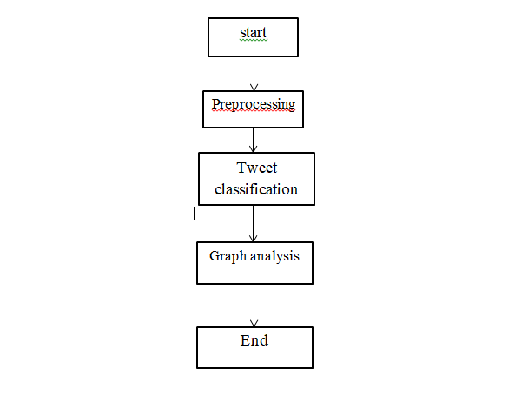
DATAFLOW DIAGRAM
Figure 2 Data Flow Diagram

Slide 13
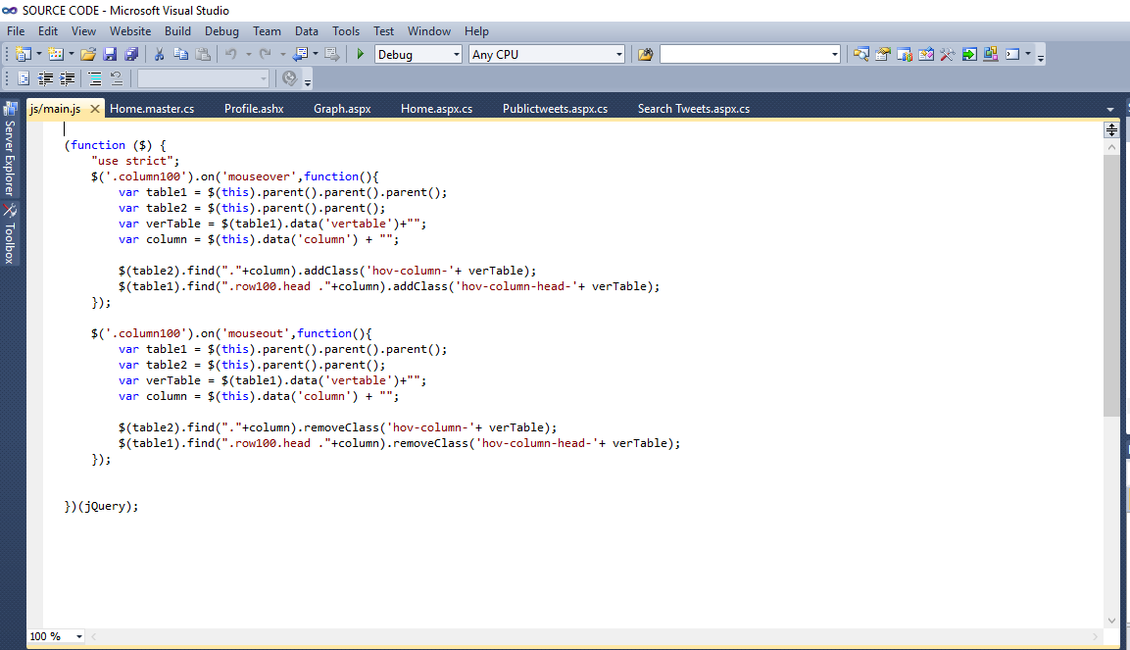
SAMPLE CODING

Slide 14
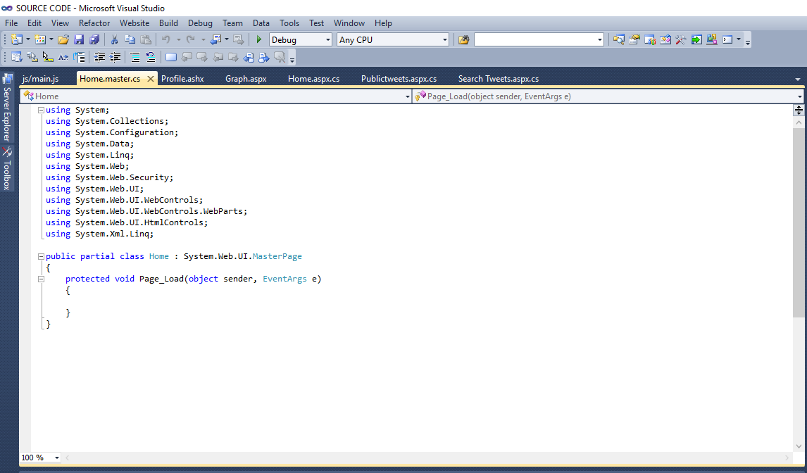

Slide 15
SYSTEM TESTING
Unit Testing:
Unit testing is usually conducted as part of a combined code and unit test phase of the software lifecycle, although it is not uncommon for coding and unit testing to be conducted as two distinct phases.
Test strategy and approach
Field testing will be performed manually and functional tests will be written in detail.
Test objectives
All field entries must work properly.
Pages must be activated from the identified link.
The entry screen, messages and responses must not be delayed.
Features to be tested
Verify that the entries are of the correct format
No duplicate entries should be allowed
All links should take the user to the correct page.

Slide 16
Integration Testing
Software integration testing is the incremental integration testing of two or more integrated software components on a single platform to produce failures caused by interface defects.
The task of the integration test is to check that components or software applications, e.g. components in a software system or – one step up – software applications at the company level – interact without error.
Test Results: All the test cases mentioned above passed successfully. No defects encountered.

Slide 17
Acceptance Testing
User Acceptance Testing is a critical phase of any project and requires significant participation by the end user. It also ensures that the system meets the functional requirements.
Test Results: All the test cases mentioned above passed successfully. No defects encountered

Slide 18
CONCLUSION
This project reviewed existing literature to detect aggressive behavior on SM websites by using machine learning approaches.
We specifically reviewed four aspects of detecting cyberbullying messages by using machine learning approaches, namely, data collection, feature engineering, construction of cyberbullying detection model, and evaluation of constructed cyberbullying detection models.

Slide 19
FUTURE ENCHANMENT
The plan to use Natural language process to bulid a system to detect Cyber bulling.
Buliding on previous work in English NLP to process data.
Data will consist of tweets from twitter. It will be used to train and test ML classifiers algorithm.

Slide 20
THANK YOU

