Slide 1

Performance of logistics & supply chain management

Slide 2
Performance Management
Performance management in logistics involves the systematic process of monitoring, measuring, and improving the efficiency and effectiveness of logistics operations. It plays a critical role in ensuring that supply chains run smoothly, costs are minimized, and customer satisfaction is maximized.

Slide 3
Benchmarking
Benchmarking for supply chain improvement means looking at how the best companies manage their supply chains and comparing it to how your company does things. The goal is to find ways to make your supply chain work better, faster, and cheaper by learning from others who are already doing it well.

Slide 4
Core of benchmarking
1. Measurement
2. Comparison
3. Learning
4. Improvement

Slide 5
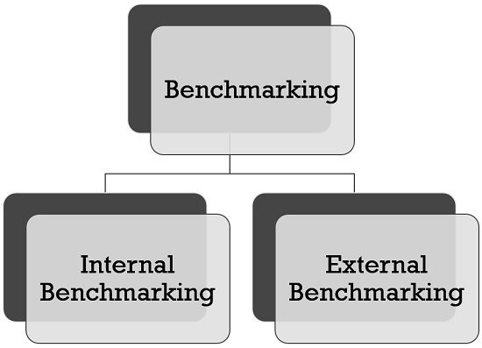
Categories of Supply chain benchmarks

Slide 6
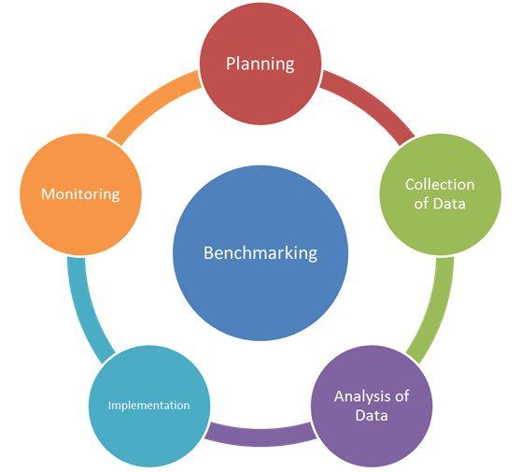
Benchmarking process

Slide 7
Tools used in supply chain benchmarking
1. Parametric Analysis
2. Non - Parametric Analysis:
Balanced Scoreboard (BSC)
Data Envelopment Analysis (DEA)

Slide 8
SCOR MODEL
The SCOR (Supply Chain Operations Reference) model is a framework designed to help businesses improve their supply chain management. It stands for Supply Chain Operations Reference and provides a standard way to map, measure, and optimize supply chain activities.

Slide 9
Benefits of using SCOR MODEL
1.Standardization
2.Performance improvement
3. Enhanced decision making
4. Increased efficiency

Slide 10
Level of measurement
LEVEL1: Defining scope , including geographies , segments and context.
LEVEL 2: Configuration of the supply chain, including geographies, segments and products.
LEVEL 3: Process element details , identifying key business activities within the chain.

Slide 11

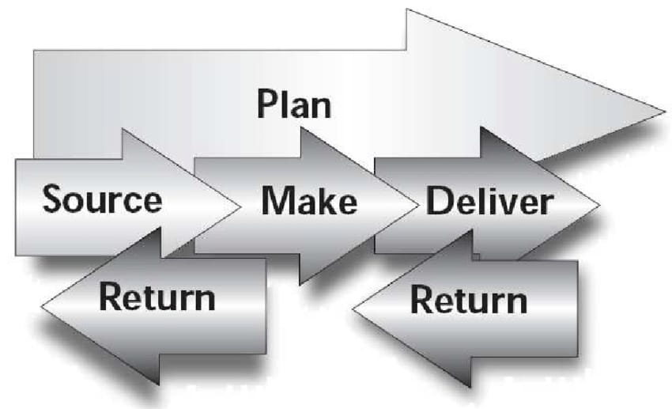
Scor process

Slide 12
ADVANTAGES :
High credibility
Standardized metrics
Universal scoreboard
DISADVANTAGES :
Manual evaluation process
Static not dynamic
Results not directly actionable

Slide 13
Activity Based Costing {ABC}
Activity-Based Costing (ABC) is a method used to figure out the true cost of making a product or providing a service. Instead of just adding up general costs and spreading them evenly, ABC looks at all the specific activities that go into making something—like setting up machines, designing, or shipping—and assigns costs based on how much each activity costs.

Slide 14
Objectives
1. Accurate cost allocation
2. Improved decision making
3. Cost control and reduction
4. Support strategic planning
5. Enhanced profitability analysis

Slide 15
Steps involved in ABC
1. Identifying the activities
2. Determining cost pool
3. Determining cost driver for each major activity
4. Calculation of activity cost driver rate
5. Charging activity cost to the product cost.

Slide 16

Economic Value Added analysis:
Economic Value Added (EVA) analysis is a way to measure a company’s financial performance by calculating how much value it has created beyond the cost of the capital it used.

Slide 17
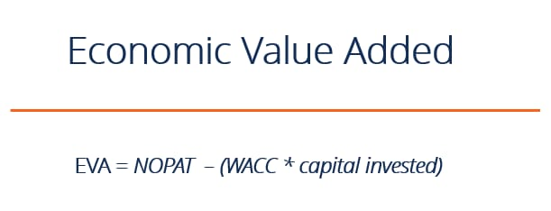
Calculation of EVA

Slide 18
Advantages of EVA :
Focus on true profitability
Encourages efficient capital use
Incentive for improvement
Disadvantages of EVA :
Complexity
Focus on short term results
Not universally applicable

Slide 19
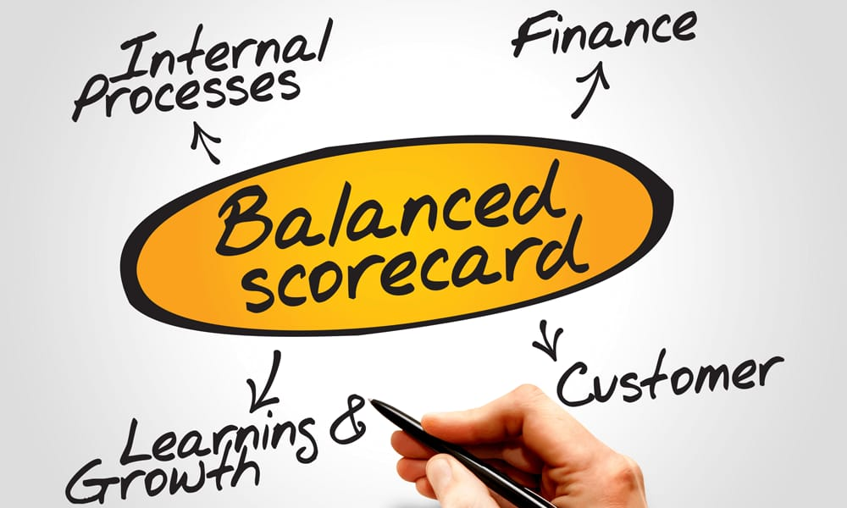
Balanced Scorecard (BSC)
The Balanced Scorecard is a tool used by organizations to track and manage their performance from multiple perspectives.

Slide 20
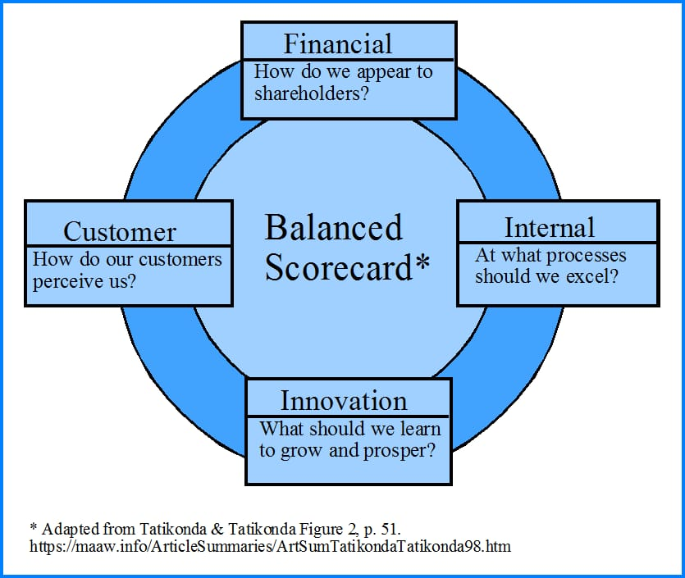
Elements of BSC :

Slide 21
Advantages of BSC :
Brings structure to business strategy
Makes communication easier
Facilitates better alignments
Disadvantages of BSC :
It must be tailored to the organization
It needs to be applied top to bottom
It can be complicated.

Slide 22
Logistical Scoreboard
Logistical Scoreboard is a tool used to track and evaluate the performance of a company's logistics operations. It includes key metrics and indicators, such as delivery times, inventory levels, and transportation costs, to show how well the logistics processes are working. This helps companies monitor their efficiency, identify areas for improvement, and ensure that their logistics operations support overall business goals effectively.

Slide 23
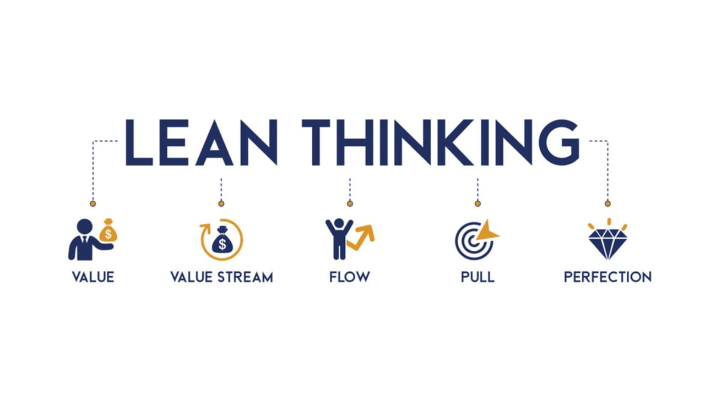
Lean thinking and Six sigma approach in supply chain:
LEAN THINKING :
Lean thinking is a way of improving how a business operates by focusing on reducing waste and increasing efficiency.

Slide 24
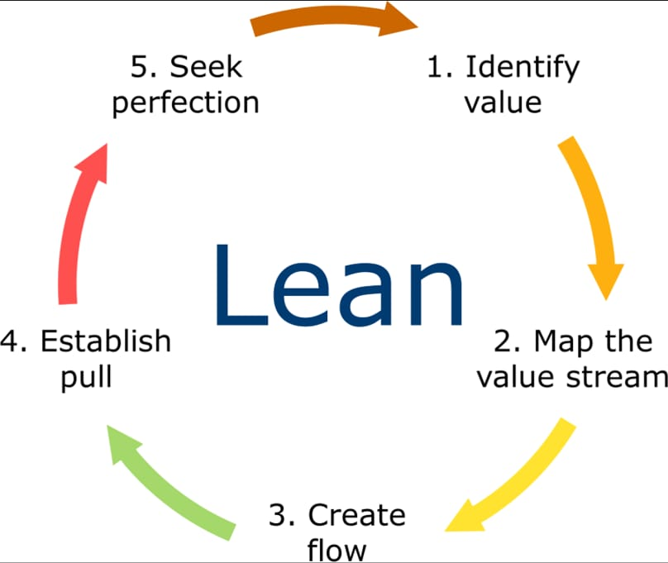
Principles of lean

Slide 25
Six sigma
It’s about finding problems in how things are done, fixing those problems, and then making sure everything stays on track to improve efficiency, cut costs, and satisfy customers.

Slide 26
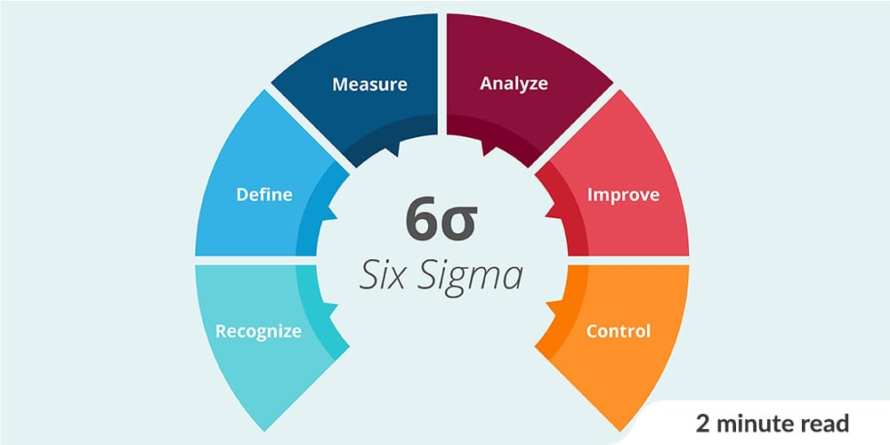

Slide 27


