Slide 1



  G H RAISONI UNIVERSITY, AMRAVATI
Department of Computer Science and Engineering
Project Progress Seminar III
On
// BhumiGuide Intelligence //
Guide
Asst. Prof. Ashish Trivedi
Name of Projectees
1) Pratik Kale F-58 | 2) Yuvraj Naktode H-21
3) Saurabh Bansod H-13 | 4) Avantika Chaudhari H-03
5) Vrushali Lade H-20 | 6) Roshni Kirnapure H-09
Date: 10 / 09 / 2026

Slide 2
Contents
Introduction
Literature Survey
Objectives of Project
Flow Chart
Mentor's Suggestion
Innovative Work
Work Done
Result & Discussion
Future Scope
Work Plan
References

Slide 3
Introduction
Land buying in India is a complex process.
Rules and documents differ by State, District, and Taluka.
People depend on brokers and multiple government portals.
BhumiGuide Intelligence provides all information with steps guidance on one platform.
AI helps users to understand any legal procedures ,documents in simple language.

Slide 4
Literature Survey
Sr. No. | Paper Title and its Author | Details of Publication | Findings
1 | “Online legal information system for Indian environment: a user’s perspectives”- Raj Kumar Bhardwaj, Madhusudhan Margam. | Publisher — Emerald Publishing Journal — Library Review Volume 65, Issue 8/9, pages 593–609 ISSN 0024-2535 Year 2016 | For ordinary users the difficulty lies in retrieving relevant legal information, not in whether it is available.
2 | “Land records on Blockchain for implementation of Land Titling “ - Vinay Thakur , M.N. Doja , Yogesh K. Dwivedi , Tanvir Ahmad , Ganesh Khadanga. | Publisher — Elsevier Journal — International Journal of Information Management Volume 52, Article 101940 ISSN 0268-4012 Year 2020 | Digitisation makes land records easier to reach and improves transparency. Computerisation reduces manual paperwork and the disputes that follow.
3 | “Query Optimization in a Blockchain-Based Land Registry Management System”- Amrendra Singh Yadav, Dharmender Singh Kushwaha | Publisher — IIETA Journal — Ingénierie des Systèmes d'Information Volume 26, Issue 1, pages 13–21 ISSN 1633-1311 Year 2021 | A digital land-administration layer improves the accessibility and efficiency of land services. Digital systems reduce paperwork and improve transparency.

Slide 5
Literature Survey
Sr. No. | Paper Title and its Author | Details of Publication | Findings
4 | “A Survey Analysis on Decentralized Land Registry System Using Blockchain and Smart Contracts” K Narayanaprakash,P. D. Sheba Kezia, Malarchelvi, S, Ranjithkumar, R Sridevi. | Publisher — IEEE 2023 International Conference on Computer Science and Emerging Technologies (CSET) Year 2023 | A tamper-resistant ledger keeps a traceable history of ownership changes. Smart contracts can automate parts of a land transfer.
5 | “Natural Language Understanding (NLU)- Powered Information Retrieval from Indian Legal Property Graph”-Nikita ,Krishna Shreeram ,Atharv Patil ,Aditi Agawal,Dipti P. Rana ,Rupa G. Mehta. | Publisher — Elsevier Journal — Procedia Computer Science Volume 258 ISSN 1877-0509 Year 2025 | A natural-language interface answers property questions that a keyword search cannot reach.

Slide 6
Literature Survey
Sr. No. | Paper Title and its Author | Details of Publication | Findings
6 | "Importance of development context in ICT4D projects: A study of computerization of land records in India" — Amit Prakash, Rahul De'. | Publisher — Emerald Publishing Journal — Information Technology & People Volume 20, Issue 3, pages 262–281 ISSN 0959-3845 Year 2007 | How the state defines development shapes the design of a land-records ICT project. Technology alone does not decide the outcome.
7 | "Going digital: Credit effects of land registry computerization in India" — Klaus Deininger, Aparajita Goyal. | Publisher — Elsevier Journal — Journal of Development Economics Volume 99, Issue 2, pages 236–243 ISSN 0304-3878 Year 2012 | Computerisation across 387 sub-registry offices in Andhra Pradesh raised credit supply in urban areas. The same roll-out produced no comparable gain in rural areas.
8 | "Women's land ownership in India: Evidence from digital land records" — Charu Jain, Disha Saxena, Somnath Sen, Deepak Sanan | Publisher — Elsevier Journal — Land Use Policy Volume 133, Article 106835 ISSN 0264-8377 Year 2023 | Digital land records from twelve Indian states and UTs can be analysed at scale. Women hold sole title less often, and their parcels are smaller and of lower quality.

Slide 7
Objective of Project
Simplify land purchase process.
Provide location-based government information.
Explain required documents.
Display registration charges statewise.
Provide user document personal verification format guidance.
Use AI chatbot for user support.

Slide 8
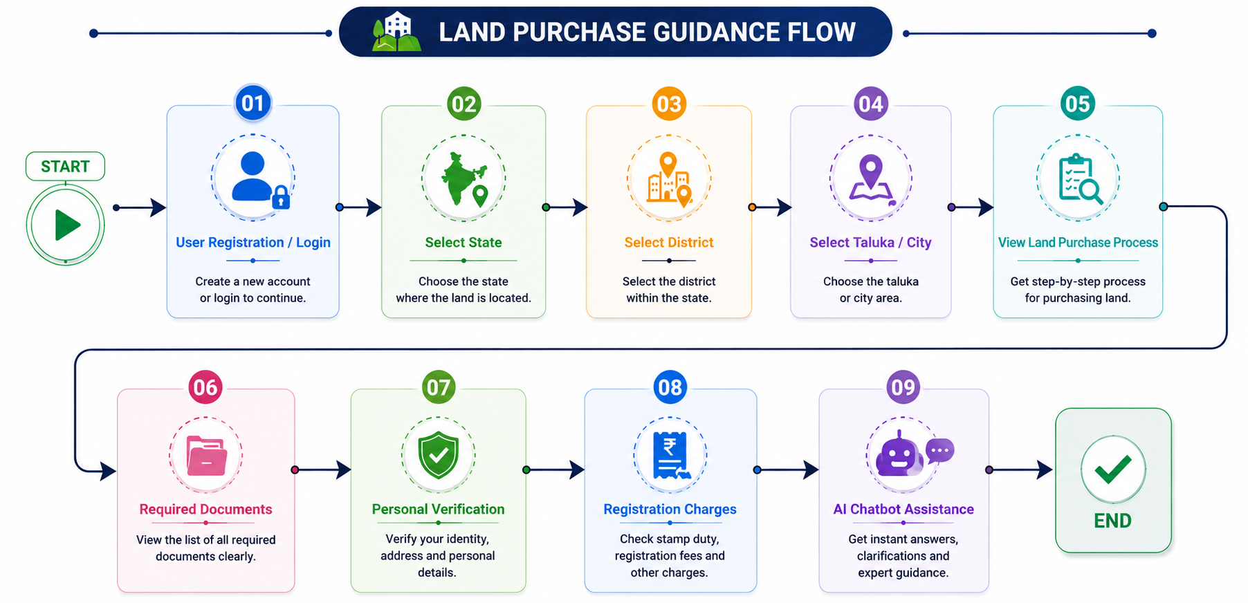
Flow Chart

Slide 9
Mentor’s Suggestion
Ground level survey.
User authentication login.
Keep interface more simple.
Enhance chatbot capabilities.
Scalability of project reach

Slide 10
Innovative Work
AI-powered legal assistant.
Location-based guidance system.
Document recommendation — Aadhaar card, PAN card, passport-size photograph, sale deed, previous title deeds, encumbrance certificate, property tax receipt, identity proof, address proof and NOC where required.
Registration charges calculator.
Direct links to government portals for document verification.
Tehsil office and notary contact information.

Slide 11
Work done
Database Gathered about states.
Designed a simple and user friendly interface.
Added government links for document verification.
Frontend/Backend is completed.
Tehsil Office and Notary contact details available.
Map Implementation.

Slide 12
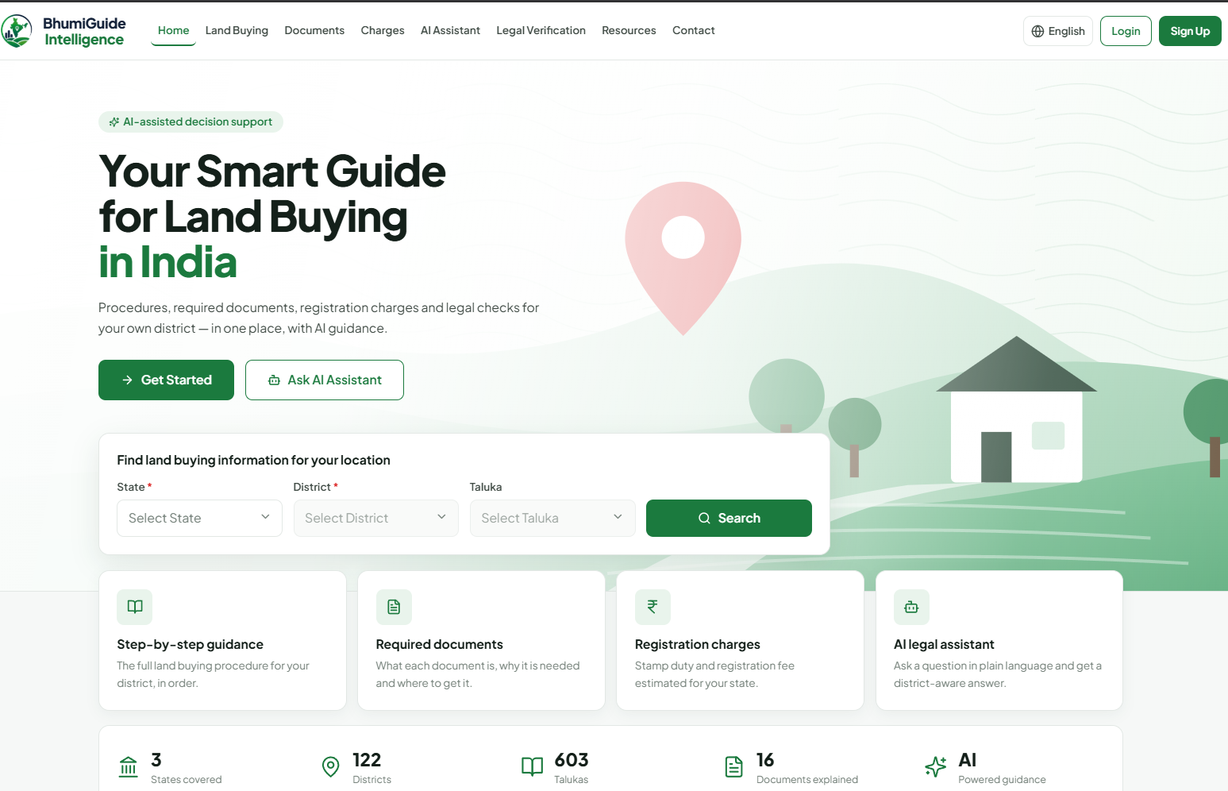
Frontend Interface

Slide 13
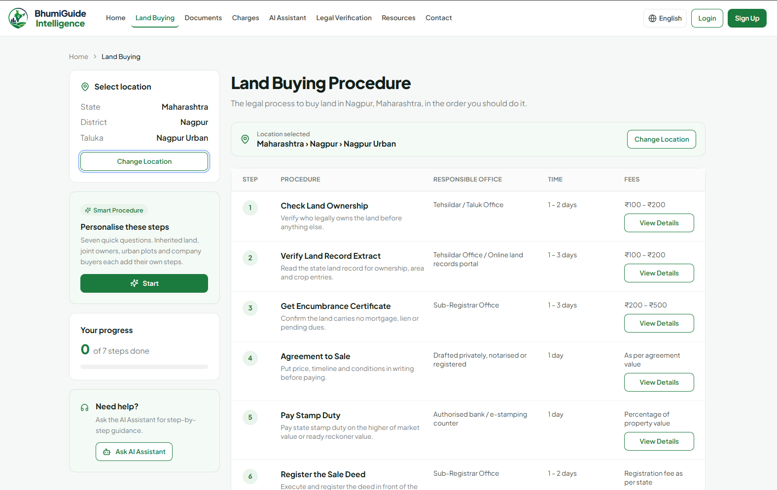
Frontend Interface

Slide 14
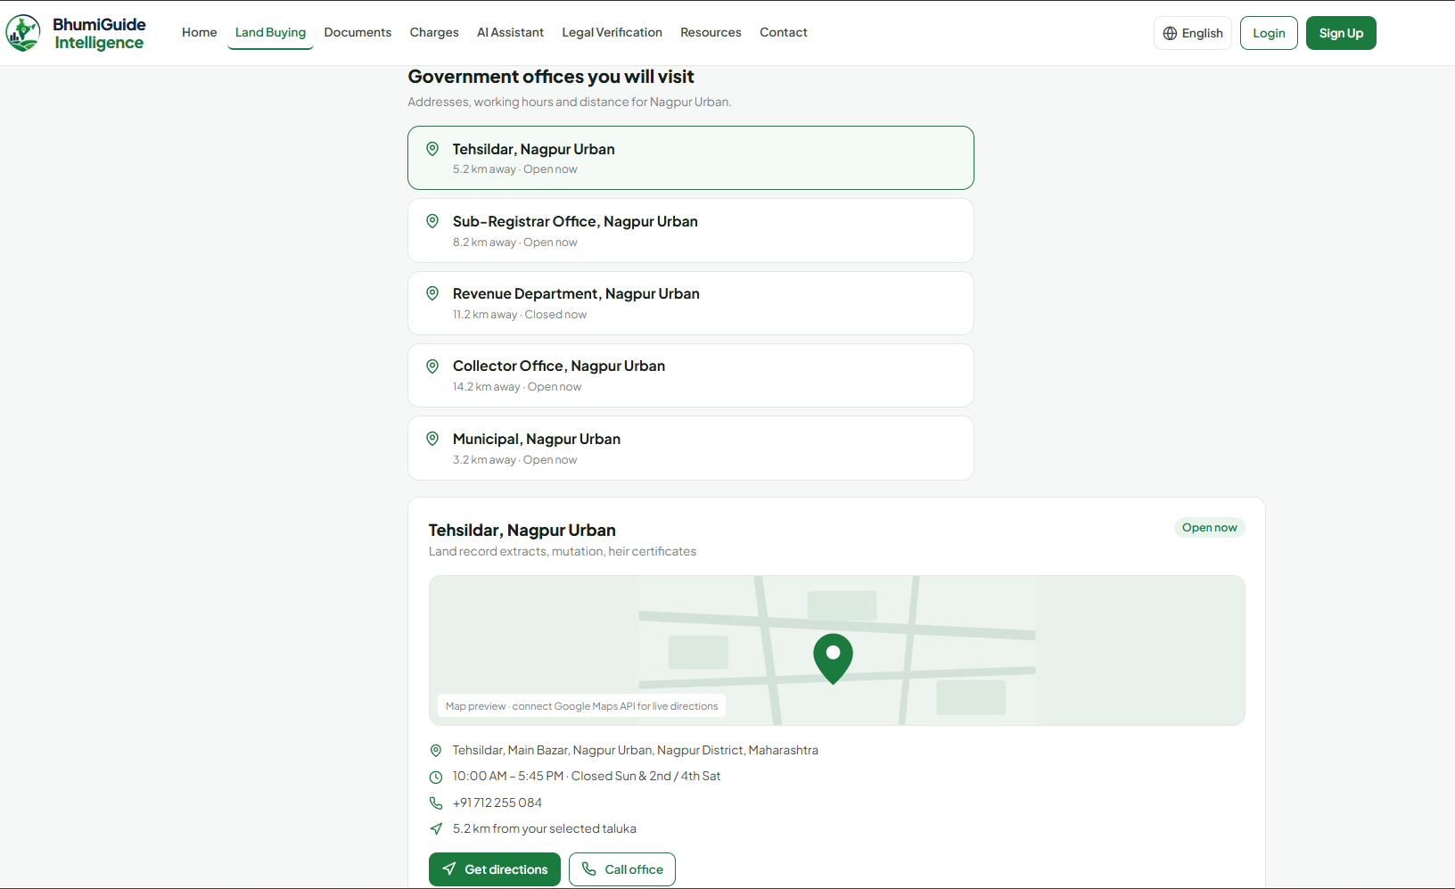
Frontend Interface

Slide 15
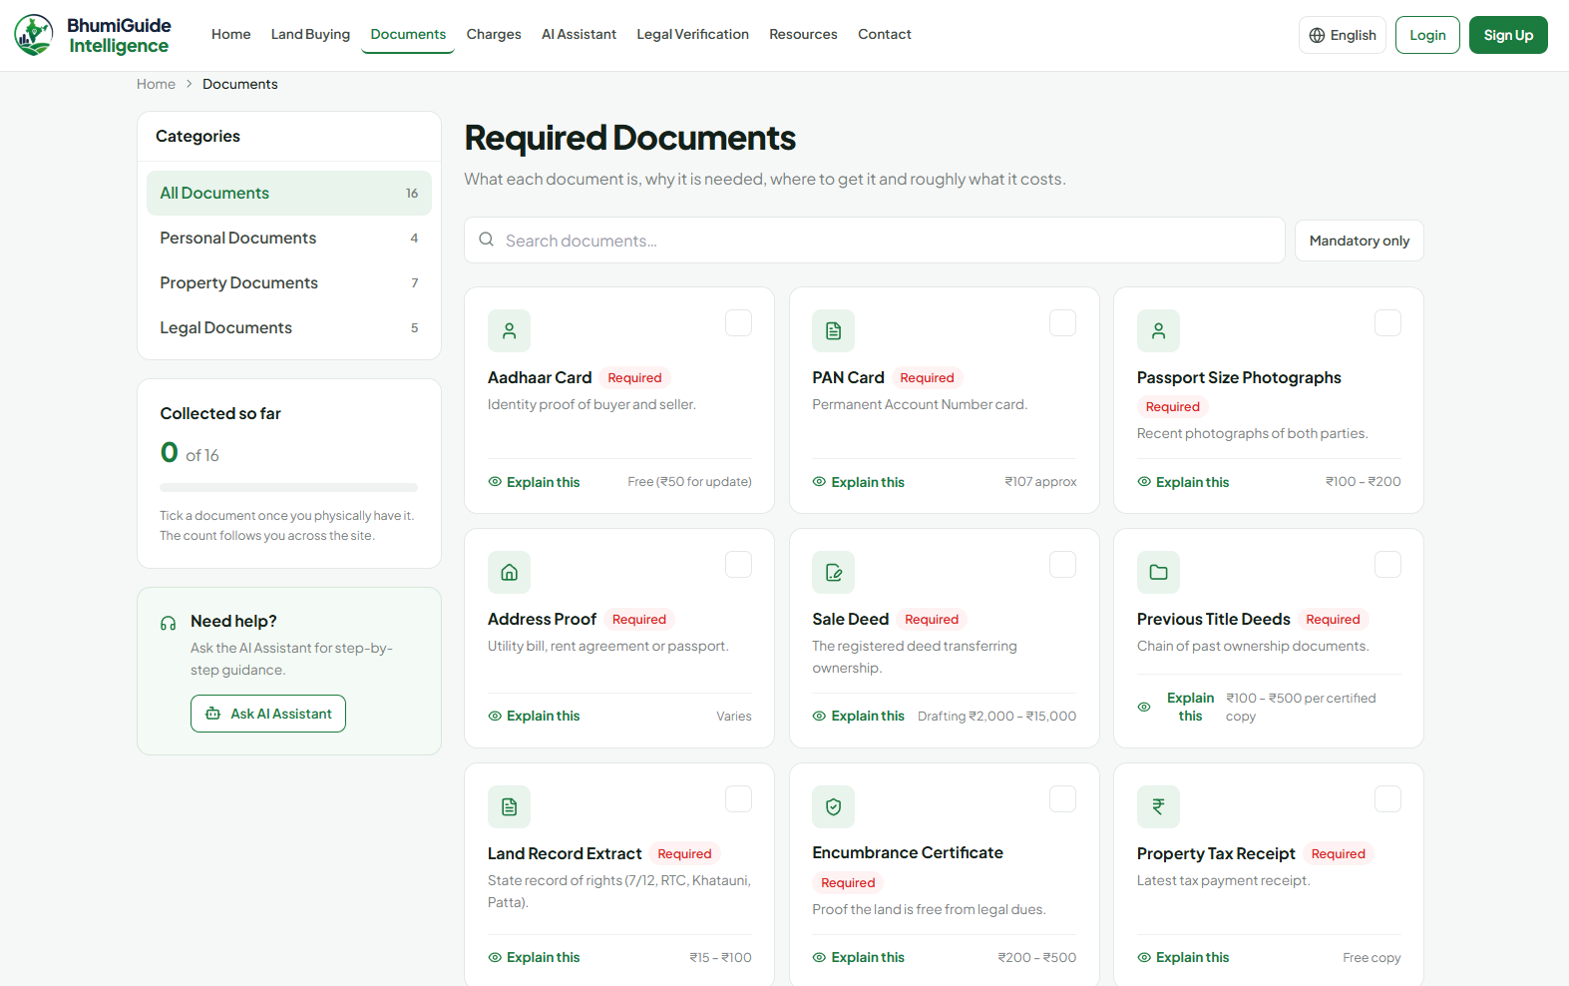
Frontend Interface

Slide 16
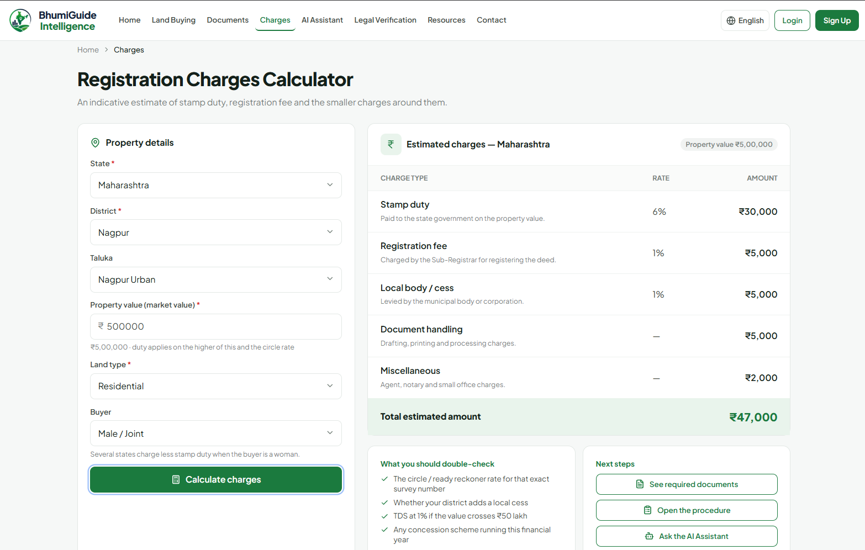
Frontend Interface

Slide 17
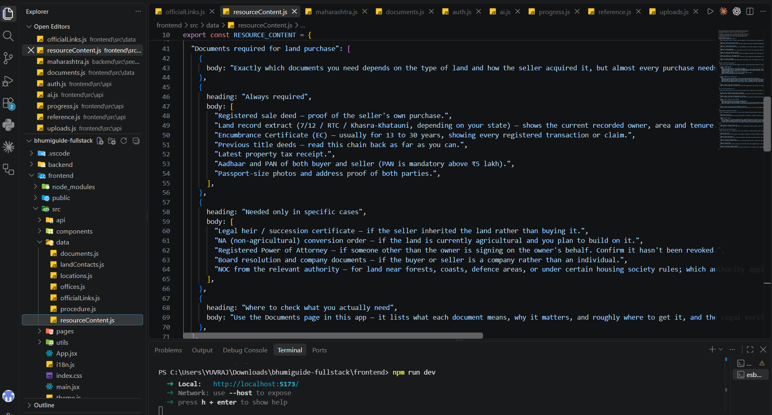
Backend Structure

Slide 18
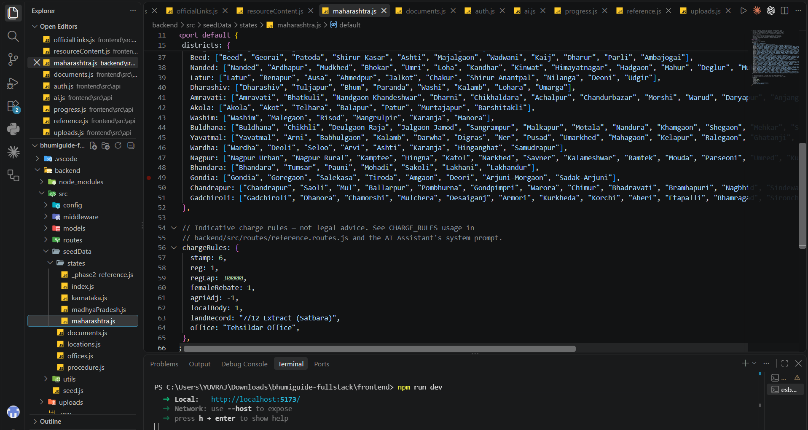
Backend Structure

Slide 19
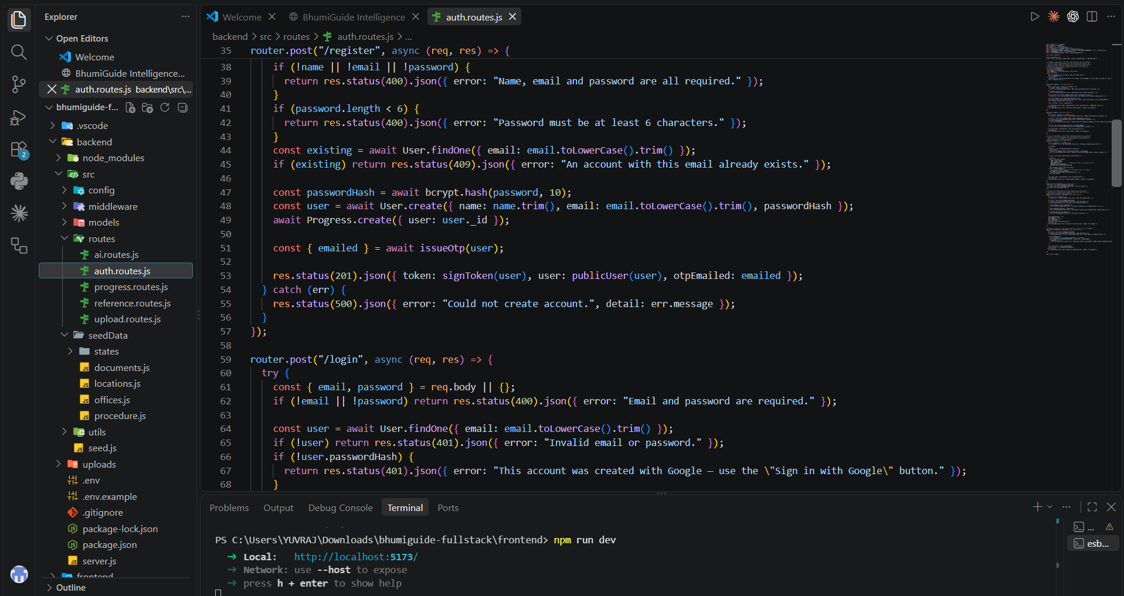
Backend Structure

Slide 20
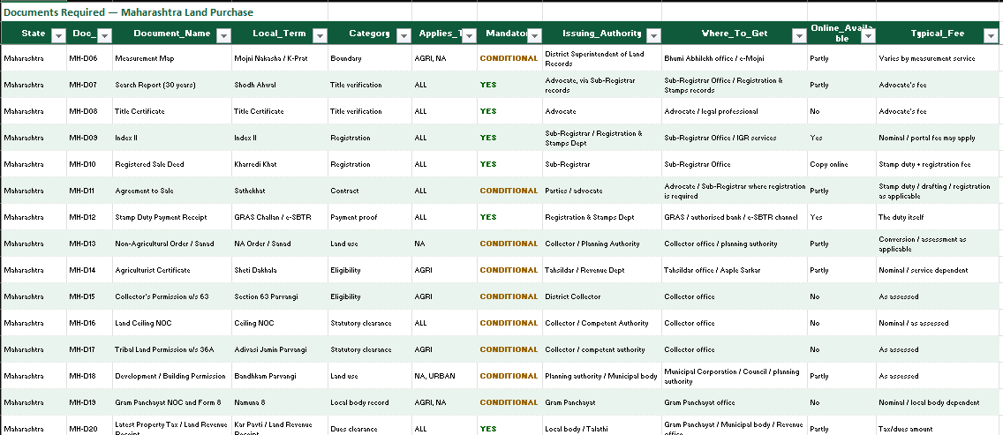
Database View

Slide 21
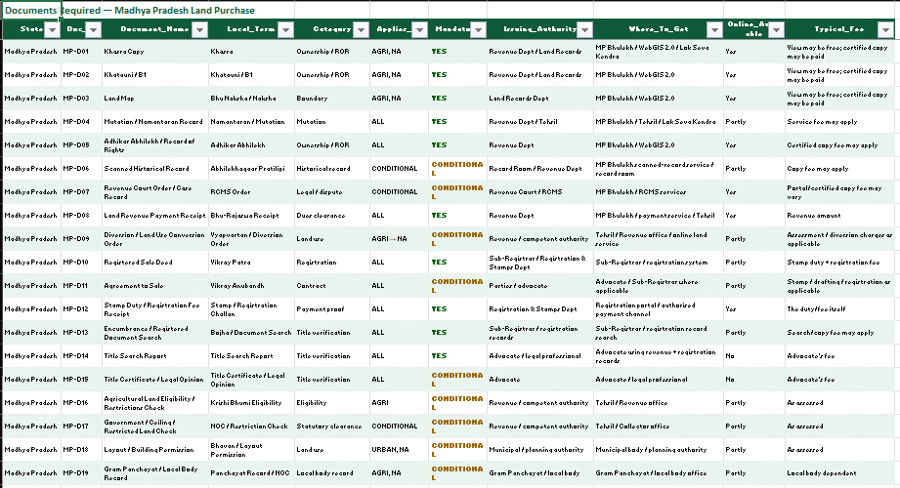
Database View

Slide 22
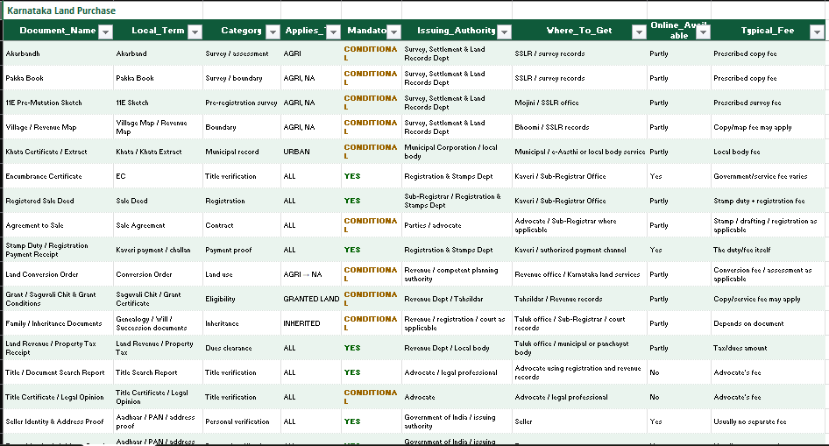
Database View

Slide 23
Result & Discussion
Displays State, District, and Taluka-wise land buying procedures.
Shows the required documents and registration details.
Provides links to Government portals for user document verification.
Offers AI-powered assistance for land-related queries.
Helps users make informed decisions while saving time and reducing confusion.

Slide 24

Future Scope
Run a user study with first-time buyers in the covered districts.
Extend to more states — Uttar Pradesh, Tamil Nadu and West Bengal — each added only with its sources attached.
Complete the office directory for Gujarat and Rajasthan.
Replace filename matching with OCR, so the record extract itself is read and checked.
Move the assistant to retrieval-augmented answering, citing the exact provision behind every statement.
Release an Android application for buyers who work entirely from a phone.

Slide 25
Work – Plan
Months Activities | JUL’26 | AUG’26 | SEPT’26 | OCT’26 | NOV’26
Literature Reviews | √ | √ | √ | √
Component Identification & Selection |  | √ | √ | √
Designing |  | √ | √ | √
Fabrication |  |  | √ | √
Experimental Analysis |  |  | √ | √
Testing and Debugging |  |  | √ | √
Preparation of Project Report |  |  |  | √
Thesis and Poster Submission

Slide 26
References
List of papers/books/websites refer for project
[01] "Importance of development context in ICT4D projects: a study of computerization of land records in India"
Amit Prakash, Rahul De'. Emerald Publishing — Information Technology & People, Volume 20, Issue 3, pages 262–281, ISSN 0959-3845, Year 2007.
https://doi.org/10.1108/09593840710822868
[02] "Going digital: Credit effects of land registry computerization in India"
Klaus Deininger, Aparajita Goyal. Elsevier — Journal of Development Economics, Volume 99, Issue 2, pages 236–243, ISSN 0304-3878, Year 2012.
https://doi.org/10.1016/j.jdeveco.2012.02.007
[03] "Online legal information system for Indian environment: a user’s perspectives"
Raj Kumar Bhardwaj, Madhusudhan Margam. Emerald Publishing — Library Review, Volume 65, Issue 8/9, pages 593–609, ISSN 0024-2535, Year 2016.
https://doi.org/10.1108/LR-02-2016-0022
[04] "E-Government and the digital divide: a study of English-as-a-second-language users’ information behaviour"
David Brazier, Morgan Harvey. Springer — Advances in Information Retrieval (ECIR), LNCS Volume 10193, pages 266–277, Year 2017.
https://doi.org/10.1007/978-3-319-56608-5_21

Slide 27
References
List of papers/books/websites refer for project
[05] "Land Records and Titles in India"
Prachee Mishra, Roopal Suhag. Analytical report, PRS Legislative Research, New Delhi, Year 2017.
https://prsindia.org/policy/analytical-reports/land-records-and-titles-india
[06] "Land records on blockchain for implementation of land titling"
Vinay Thakur, M. N. Doja, Yogesh K. Dwivedi, Tanvir Ahmad, Ganesh Khadanga. Elsevier — International Journal of Information Management, Volume 52, Article 101940, ISSN 0268-4012, Year 2020.
https://doi.org/10.1016/j.ijinfomgt.2019.04.013
[07] "Query optimization in a blockchain-based land registry management system"
Amrendra Singh Yadav, Dharmender Singh Kushwaha. IIETA — Ingénierie des Systèmes d’Information, Volume 26, Issue 1, pages 13–21, ISSN 1633-1311, Year 2021.
https://doi.org/10.18280/isi.260102

Slide 28
References
[08] "Women’s land ownership in India: evidence from digital land records"
Charu Jain, Disha Saxena, Somnath Sen, Deepak Sanan. Elsevier — Land Use Policy, Volume 133, Article 106835, ISSN 0264-8377, Year 2023.
https://doi.org/10.1016/j.landusepol.2023.106835
[09] "A survey analysis on decentralized land registry system using blockchain and smart contracts"
K. Narayanaprakash, P. D. Sheba Kezia Malarchelvi, S. Ranjithkumar, R. Sridevi. IEEE — 2023 International Conference on Computer Science and Emerging Technologies (CSET), Year 2023.
https://doi.org/10.1109/CSET58993.2023.10346967
[10] "Natural Language Understanding (NLU)-powered information retrieval from Indian legal property graph"
Nikita, Krishna Shreeram, Atharv Patil, Aditi Agrawal, Dipti P. Rana, Rupa G. Mehta. Elsevier — Procedia Computer Science, Volume 258, ISSN 1877-0509, Year 2025.
https://doi.org/10.1016/j.procs.2025.05.163

Slide 29
Thank you !

