Slide 1
DATA COMMUNICATION USING LI-FI
Ece Section 2
6th sem Project
Uday Sirohi UE165120
Yashi Sharma UE165127
Yuvish Goyal UE165128
Shubham Tyagi UE165111

Slide 2
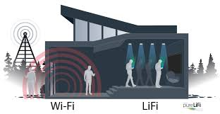
WHAT IS LI-FI?
Wireless Mode of Communication
How it compares to Wi-Fi
Working
Advantages-Disadvantages of LI-FI
Future Scope

Slide 3
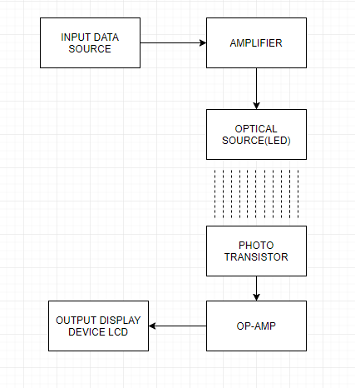
IMPLEMENTATION

Slide 4
COMPONENTS REQUIRED
Hardware:
Arduino Uno
Power Supply
Resistors
LED
Photo Diode (LDR)
LCD (or any other display device)
Connecting Clamps and Screws or Jumper Wires

Slide 5
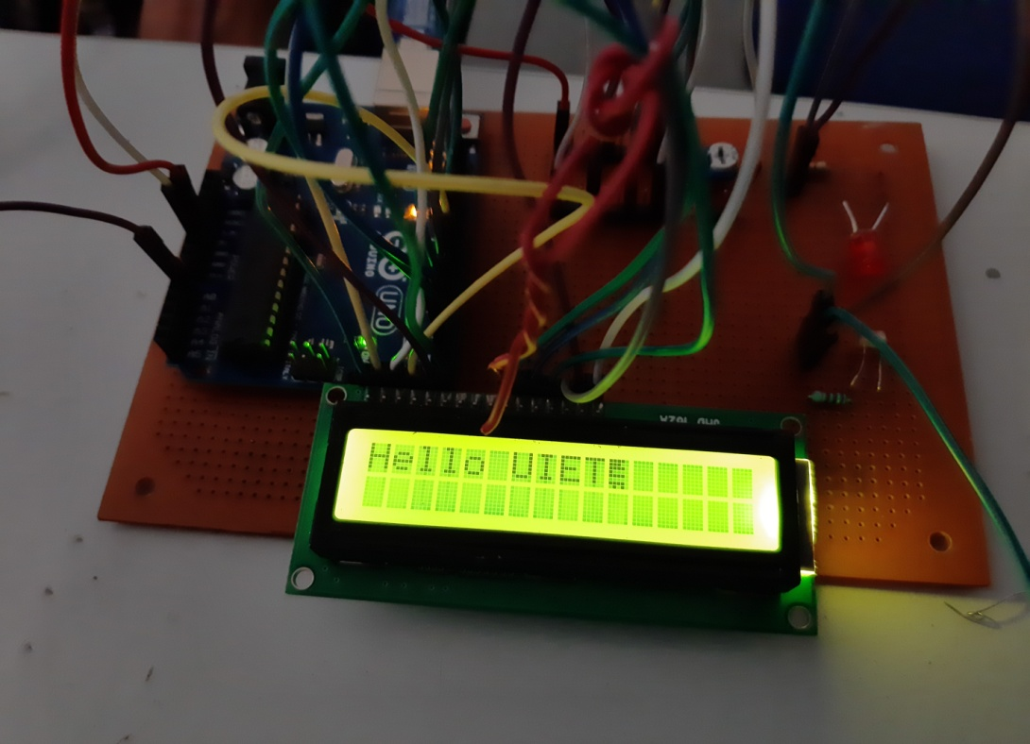
METHODOLOGY
The communication process involves a LED in the transmission section and LDR in the receiver section.
The information (text) is entered using the Serial monitor of Arduino IDE & converted into binary data.
This binary data is transmitted by the flickering of LED.
The flickering is analyzed by LDR and converted back into original Data format.
Hardware Implementation

Slide 6
CONCLUSION
LI-FI is an emerging technology and it has vast potential. Researchers are developing micron sized LEDs which flicker on and off 1000 times faster than larger LEDs.
Li-Fi provide faster data transfer and also take up less space.
Amount of available bandwidth is unlimited.
It will allow internet access in places such as operation theaters and aircraft where internet access is usually not allowed.
We can conclude, Li-Fi is the future of communication technology.

Slide 7
FUTURE SCOPE
Underwater Explorations and Communications
Medical and Healthcare
Road Traffic
Green Information technology
Power Plants and Hazardous Environments

