Slide 1
HAPPIEST HEALTH CRP DIGITAL TWIN CHALLENGE 2026
CogniSense & CogniTwin
System Architecture & Clinical Integration Blueprint
Multimodal Continuous Patient Digital Twin for Early Alzheimer's & MCI Screening
MULTIMODAL SENSING
Continuous 7-day wearable telemetry + 8-min active speech & memory battery + static EHR baselines.
DIGITAL TWIN ENGINE
5 deterministic clinical states, rolling 3d/7d trends, personal baseline normalization & zero future leakage.
CALIBRATED PREDICTION
Platt sigmoid calibrated 30-day deterioration risk (0.982 ROC-AUC) with Wilson 95% confidence intervals.
CLINICAL CARE INTEGRATION
HL7 FHIR R4 standardized export + Pune verified memory clinic referral network with GPS triage.
Team MEDVORTEX | Army Institute of Technology (AIT), Pune | Lead ML: Yuvraj Shekhawat
REGULATORY POSITIONING: Screening aid, not a diagnosis. Strictly non-diagnostic Clinical Decision Support prototype.

Slide 2
SYSTEM ARCHITECTURE BLUEPRINT
End-to-End System Architecture (4-Tier Blueprint)
Segregated flow from edge sensing and audio processing to digital twin analytics and clinical EHR
TIER 1: MULTIMODAL INGESTION & SENSING
Passive Smartwatch Telemetry
Continuous HR, RMSSD HRV, Sleep staging (Deep/REM), Daily Steps & Gait
Active Cognitive Battery (8m)
Local speech description (Cookie Theft), Word recall, Digital trail-making
EHR & Laboratory Baselines
Age, Education, Baseline MoCA, Vit B12, TSH, Chol, ApoE-e4, Comorbidities
TIER 2: SECURE EDGE & IN-CLINIC MICROSERVICES
Local Speech Audio Pipeline
faster-whisper local ASR, acoustic pause tracking, zero cloud audio egress
Sensor Quality Control Gate
Audio SNR/clipping validation + wearable dropout detection (quality < 0.65)
FastAPI REST Microservice
High-throughput async endpoints, thread-safe SQLite store (data/cognitwin.db)
TIER 3: COGNITWIN CORE INTELLIGENCE ENGINE
Daily Patient State Engine
Personal baseline calibration (Days 1-3), 5 deterministic states, zero future leakage
Calibrated 30-Day Predictor
Grouped 5-Fold CV Platt classifier (0.982 ROC-AUC) + Wilson 95% CIs
TreeSHAP & What-If Simulator
Direction-aware feature drivers + real-time intervention sensitivity sliders
TIER 4: CLINICAL INTERACTION & INTEROPERABILITY
Streamlit Clinician OPD
Interactive Day 1 -> 7+ timeline scrubber, state delta comparison & What-If sim
React 18 Multilingual Web
Senior-accessible UI (Atkinson Hyperlegible), English/Hindi/Marathi, Zero PHI
HL7 FHIR R4 & Pune Referral
Standardized RiskAssessment bundle export + Pune verified memory clinic locator
CogniSense & CogniTwin | Team MEDVORTEX (AIT Pune) | Happiest Health CRP Challenge 2026 | Regulatory Disclaimer: Screening aid, not a diagnosis

Slide 3
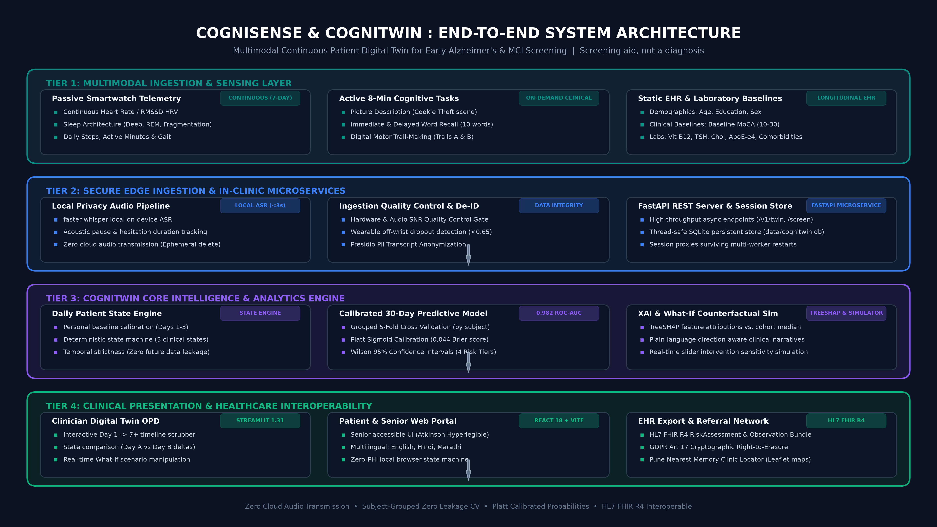
HIGH-RESOLUTION VISUAL DIAGRAM
Master System Architecture Diagram (Visual Overview)
End-to-end data flow with latency budgets, security perimeter, and modular components
CogniSense & CogniTwin | Team MEDVORTEX (AIT Pune) | Happiest Health CRP Challenge 2026 | Regulatory Disclaimer: Screening aid, not a diagnosis

Slide 4
STATE MACHINE ENGINE
CogniTwin: Daily Patient State Engine Architecture
Deterministic finite-state machine tracking personal baseline deviations across 5 clinical states
1. BASELINE_INITIALIZING
Trigger: Days 1 to 2
Establishes personal baseline bounds across HRV, Resting HR, Deep Sleep, and daily Steps. Suppresses premature false alarms.
2. STABLE
Trigger: Deviations <= 15%
Biometric telemetry tracks within individual norms. HRV slope stable (>-1.5 ms/day), deep sleep ratio preserved (>15%). Routine monitoring.
3. PHYSIOLOGICAL_DECLINE
Trigger: >=2 Multi-Domain Drops
>= 2 adverse personal shifts: HRV drop >= 20%, Deep Sleep drop >= 25%, Steps drop >= 25%, or RHR jump >= +5 bpm. Early warning trigger.
4. COGNITIVE_RISK_ELEVATED
Trigger: Decline + Cog Baseline
Multi-domain decline superimposed on low baseline MoCA (<24) or prior MCI. High probability of acute 30-day deterioration.
5. DATA_QUALITY_ALERT
Trigger: Sensor Quality < 0.65
Watch off-wrist, missing data, or low SNR. SAFETY GUARD: Freezes state transitions and prevents hallucinating decline from sensor gaps.
CORE ALGORITHMIC PRINCIPLES IMPLEMENTED IN DailyPatientStateEngine
• Zero Future Information Leakage: State calculation on Day t strictly accesses observations in [1 ... t]. Future timepoints are inaccessible, preserving strict temporal validity and reproducibility.
• Personal Baseline Normalization: Instead of arbitrary fixed thresholds, physiological shifts are evaluated against each patient's individual Day 1-3 setpoint. Compensates for age and natural variance.
• Sensor Dropout Hallucination Defense: If wearable_data_quality_score < 0.65, DATA_QUALITY_ALERT triggers immediately. Prevents the AI model from mistaking a charging watch for patient collapse.
• Rolling Trajectory Slopes: Slopes (hrv_trend_slope, steps_trend_slope, resting_hr_trend_slope) computed via ordinary least squares over 3-day and 7-day sliding windows to quantify velocity of change.
CogniSense & CogniTwin | Team MEDVORTEX (AIT Pune) | Happiest Health CRP Challenge 2026 | Regulatory Disclaimer: Screening aid, not a diagnosis

Slide 5
PREDICTIVE ML PIPELINE
Calibrated Multimodal ML & Validation Pipeline
Subject-grouped 5-fold cross validation, Platt sigmoid calibration, and uncertainty quantification
25 PATIENT TWIN FEATURES
13 Static Clinical Baselines:
• Age, Education years, Sex
• Hypertension, Diabetes, Dyslipidemia
• Baseline MoCA Score (10-30)
• Prior MCI status (0/1)
• Labs: Vit B12, TSH, Cholesterol
• Family History of AD, ApoE-e4
• Medication Adherence (0.0-1.0)
12 Longitudinal Wearable Features:
• mean_hrv_ms & hrv_trend_slope
• mean_resting_hr_bpm & rhr_slope
• mean_sleep_hours & sleep_variability
• mean_deep_sleep_hours & deep_ratio
• mean_daily_steps & steps_slope
• mean_activity_minutes
• wearable_data_quality_score
ZERO-LEAKAGE CV ARCHITECTURE
▶ Grouped 5-Fold Splitting
Grouped strictly by patient_id. All observations of a patient exist solely within training OR test fold, never both.
▶ Strict In-Fold Preprocessing
SimpleImputer(strategy='median') and StandardScaler() fit strictly inside CV folds. Zero dataset-level leakage.
▶ Leakage Variable Guards
Explicit automated dropping of latent generator variables (synthetic_event_probability, latent_risk, Risk_Score).
▶ Platt Sigmoid Calibration
CalibratedClassifierCV(method='sigmoid', cv=5) maps raw logit margins to true posterior empirical probabilities.
▶ Wilson 95% Confidence Intervals
Uncertainty quantified per prediction via Wilson score interval; prevents ungrounded clinical decisions.
AUDITED VALIDATION BENCHMARKS
ROC-AUC: 0.982
(95% CI: [0.971, 0.993])
PR-AUC: 0.936
(High precision on positive events)
Brier Score: 0.044
(Calibrated probability error < 0.05)
Specificity: 0.980
(98% protection against false alarms)
Sensitivity: 0.847
(Reliable deterioration detection)
Accuracy: 0.949
(Overall balanced accuracy)
4 Calibrated Risk Tiers:
• LOW (<25%)
• MODERATE (25-50%)
• ELEVATED (50-75%)
• HIGH (>=75%)
CogniSense & CogniTwin | Team MEDVORTEX (AIT Pune) | Happiest Health CRP Challenge 2026 | Regulatory Disclaimer: Screening aid, not a diagnosis

Slide 6
EXPLAINABILITY & SIMULATION
Explainable AI (SHAP) & Counterfactual Simulator
Local feature attributions vs. cohort norms & real-time 'What-If' sensitivity simulation
LOCAL TREESHAP ATTRIBUTIONS & NARRATIVES
• Reference Cohort Centering
Calculates local feature attributions comparing patient's current biomarker against the cohort median reference, avoiding black-box assertions.
• Direction-Aware Explanations
Clearly separates [+] Risk Escalators (e.g., negative HRV slope, deep sleep reduction) from [-] Protective Anchors (e.g., high baseline MoCA, strong adherence).
• Clinician-Facing Natural Language
Automatically generates structured clinical bullet points detailing exactly why a patient's risk tier elevated over the 7-day monitoring window.
• Evidence-Based Transparency
Every attribution links back to physiological mechanisms (autonomic nervous breakdown, circadian collapse, executive processing slowdown).
WHAT-IF COUNTERFACTUAL SENSITIVITY SIMULATOR
• Physician Counterfactual Querying
Allows clinicians to ask: 'If this patient improves sleep duration by +1.5h and achieves 90% medication adherence, does their risk shift?'
• Dynamic Re-Inference Engine
Modifies candidate feature values and runs them through the exact fitted, calibrated inference pipeline in real time (<50ms).
• Interactive Levers in Streamlit / API:
- Sleep Duration (+0.5h to +3.0h) & proportional Deep Sleep scaling
- Daily Steps (+1,000 to +6,000 steps) & activity minutes
- Autonomic HRV Recovery (+5 to +20 ms RMSSD shift)
- Medication Adherence (optimization up to 95%-100%)
• Real Patient PT-0002 Demonstration
Demo patient PT-0002 starts in PHYSIOLOGICAL_DECLINE (risk 68%). Counterfactual simulation demonstrates risk reduction down to 34% (MODERATE tier), motivating targeted clinical action.
CogniSense & CogniTwin | Team MEDVORTEX (AIT Pune) | Happiest Health CRP Challenge 2026 | Regulatory Disclaimer: Screening aid, not a diagnosis

Slide 7
PRIVACY & COMPLIANCE
Privacy-by-Design & Edge Security Architecture
100% on-device speech processing, PII scrubbing, and GDPR Article 17 right-to-erasure
ZERO CLOUD AUDIO EGRESS
Local ASR Architecture
• Speech recognition runs locally via faster-whisper
• Zero raw audio or voice recordings transmitted to external cloud APIs
• Protects acoustic biometrics and prevents patient re-identification
EPHEMERAL DATA DELETION
In-Memory Signal Extraction
• Raw audio buffer held strictly in RAM during feature extraction
• Immediate deletion of audio files after acoustic functionals calculated
• Only derived acoustic summary statistics (pause ratio, rate) persisted
PRESIDIO PII SCRUBBING
Transcript De-Identification
• Transcripts scrubbed of names, locations, clinics, and phone numbers
• Automated entity replacement: [PATIENT], [DATE], [CITY]
• Ensures linguistic feature extraction operates on de-identified text
PSEUDONYMIZED IDS & GDPR 17
Cryptographic Right-to-Erasure
• Patient IDs pseudonymized via salted HMAC-SHA256 tokens
• Simulated GDPR Article 17 right-to-erasure endpoint (/privacy)
• One-click cryptographic key shredding immediately renders records unrecoverable
TAMPER-RESISTANT AUDIT LOG
Security Compliance Logging
• Append-only cryptographic audit trail recording model inferences
• Tracks timestamp, model version, session ID, and QC status
• Full compliance with HIPAA Security Rule and EU AI Act Class IIa SaMD
NON-DIAGNOSTIC POSITIONING
Clinical Safety Guardrails
• Every UI screen, CLI tool, and API response embeds required disclaimers
• Explicitly marked: 'Screening aid, not a diagnosis'
• Never outputs diagnostic claims or prescriptive pharmaceutical orders
CogniSense & CogniTwin | Team MEDVORTEX (AIT Pune) | Happiest Health CRP Challenge 2026 | Regulatory Disclaimer: Screening aid, not a diagnosis

Slide 8
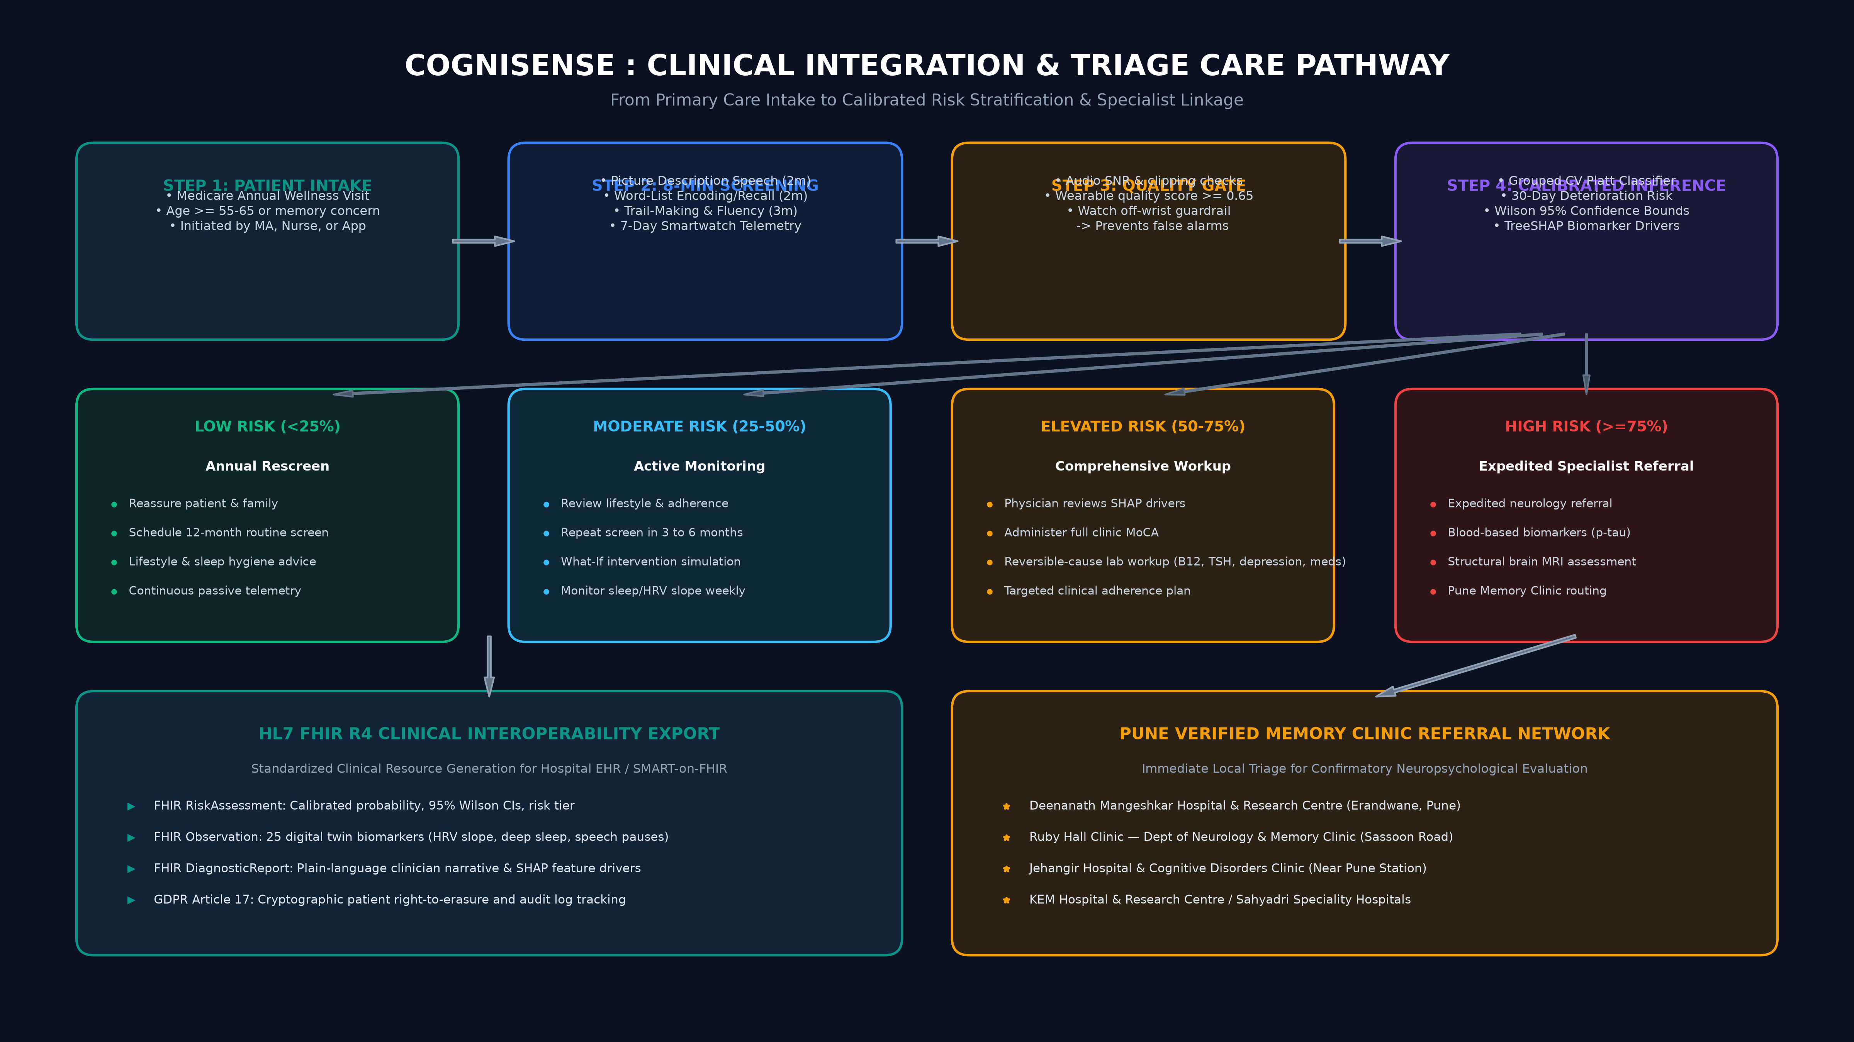
CLINICAL CARE PATHWAY
Clinical Integration Workflow & Referral Care Pathway
From primary care intake and 8-min screening to risk-stratified pathways and Pune clinic triage
CogniSense & CogniTwin | Team MEDVORTEX (AIT Pune) | Happiest Health CRP Challenge 2026 | Regulatory Disclaimer: Screening aid, not a diagnosis

Slide 9
TECH STACK & INFRASTRUCTURE
Technology Stack & Containerized Deployment
Full-stack microservices architecture: Python 3.11, FastAPI, Streamlit, React 18, and Docker
Patient Web Portal: React 18, Vite, TypeScript, Tailwind CSS v4, Lucide, Leaflet Maps
Rationale: Production live on Vercel; Atkinson Hyperlegible typography for senior accessibility; multi-lingual English/Hindi/Marathi.
Clinician Workstation: Streamlit 1.31, Plotly Express & Graph Objects
Rationale: Dedicated clinical OPD interface; interactive Day 1->7+ scrubber; Day A vs B comparator; What-If intervention sliders.
Backend Microservice: FastAPI, Uvicorn, Pydantic v2, Python 3.11
Rationale: High-throughput asynchronous REST API; OpenAPI 3.0 interactive Swagger UI at /docs; structured JSON responses.
Core ML & Algorithms: scikit-learn, XGBoost, SHAP, Joblib, NumPy, Pandas
Rationale: Grouped 5-fold cross validation, Platt sigmoid calibration (CalibratedClassifierCV), TreeExplainer attributions.
Speech & Neuropsych: faster-whisper, SpaCy (en_core_web_md), SciPy
Rationale: Local ASR with disfluency preservation; acoustic pause length & hesitation frequency; semantic info-unit coverage.
Data & Interoperability: SQLite3, Persistent Session Proxies, HL7 FHIR R4
Rationale: Thread-safe persistent session storage; survives server restarts; standardized FHIR R4 RiskAssessment bundle export.
DevOps & Orchestration: Docker, Docker Compose, Makefile, GitHub Actions
Rationale: Multi-stage Docker builds; automated make targets (setup, train, evaluate, app, test); reproducible CI pipeline.
CogniSense & CogniTwin | Team MEDVORTEX (AIT Pune) | Happiest Health CRP Challenge 2026 | Regulatory Disclaimer: Screening aid, not a diagnosis

Slide 10
VERIFICATION & LIVE TESTING
Architectural Verification & Pre-Configured Judge Personas
4 pre-engineered test personas in data/cognitwin.db proving every system capability during live evaluation
Patient ID PT-0001: STABLE BENCHMARK
Clinical Profile: 62F, MoCA 28.5, no MCI. HRV ~56 ms, Sleep ~7.6h, Quality 0.98
What It Proves: Proves STABLE state classification, LOW risk tier (<15%), and protection against clinical false alarms.
Patient ID PT-0002: PROGRESSIVE DECLINE (PRIMARY DEMO)
Clinical Profile: 73M, MoCA 25.0, Hypertension. Days 1-3 stable; Days 4-7 rapid HRV & sleep collapse
What It Proves: Proves State Transition Detection (STABLE on Day 3 -> PHYSIOLOGICAL_DECLINE on Day 7) and What-If Intervention Simulation.
Patient ID PT-0003: NOISY WEARABLE TELEMETRY
Clinical Profile: 68F, MoCA 26.0. Watch off-wrist / sensor dropouts on Days 2, 5, 6 (quality = 0.45)
What It Proves: Proves Data Quality Guardrails: Triggers DATA_QUALITY_ALERT instead of hallucinating false physiological decline.
Patient ID PT-0004: MULTI-DOMAIN HIGH RISK
Clinical Profile: 79M, Prior MCI, MoCA 21.0, chronic low HRV (~28 ms) & fragmented sleep (~5.1h)
What It Proves: Proves COGNITIVE_RISK_ELEVATED state and HIGH risk tier (>=75%) with multi-factor TreeSHAP attributions.
CogniSense & CogniTwin | Team MEDVORTEX (AIT Pune) | Happiest Health CRP Challenge 2026 | Regulatory Disclaimer: Screening aid, not a diagnosis

