Slide 1
Figures and Tables
When Does a Forecasting Model Actually Work?
Yuvraj Bharadia · CJSJ 2026–2027

Slide 2
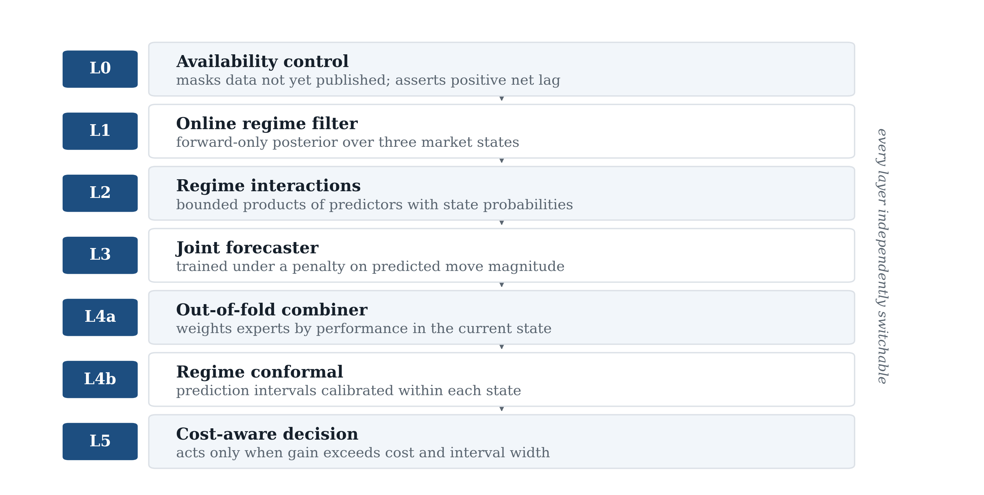
Figure 1. Seven-layer architecture. Each layer can be disabled independently, which is how the contribution of each was measured.

Slide 3
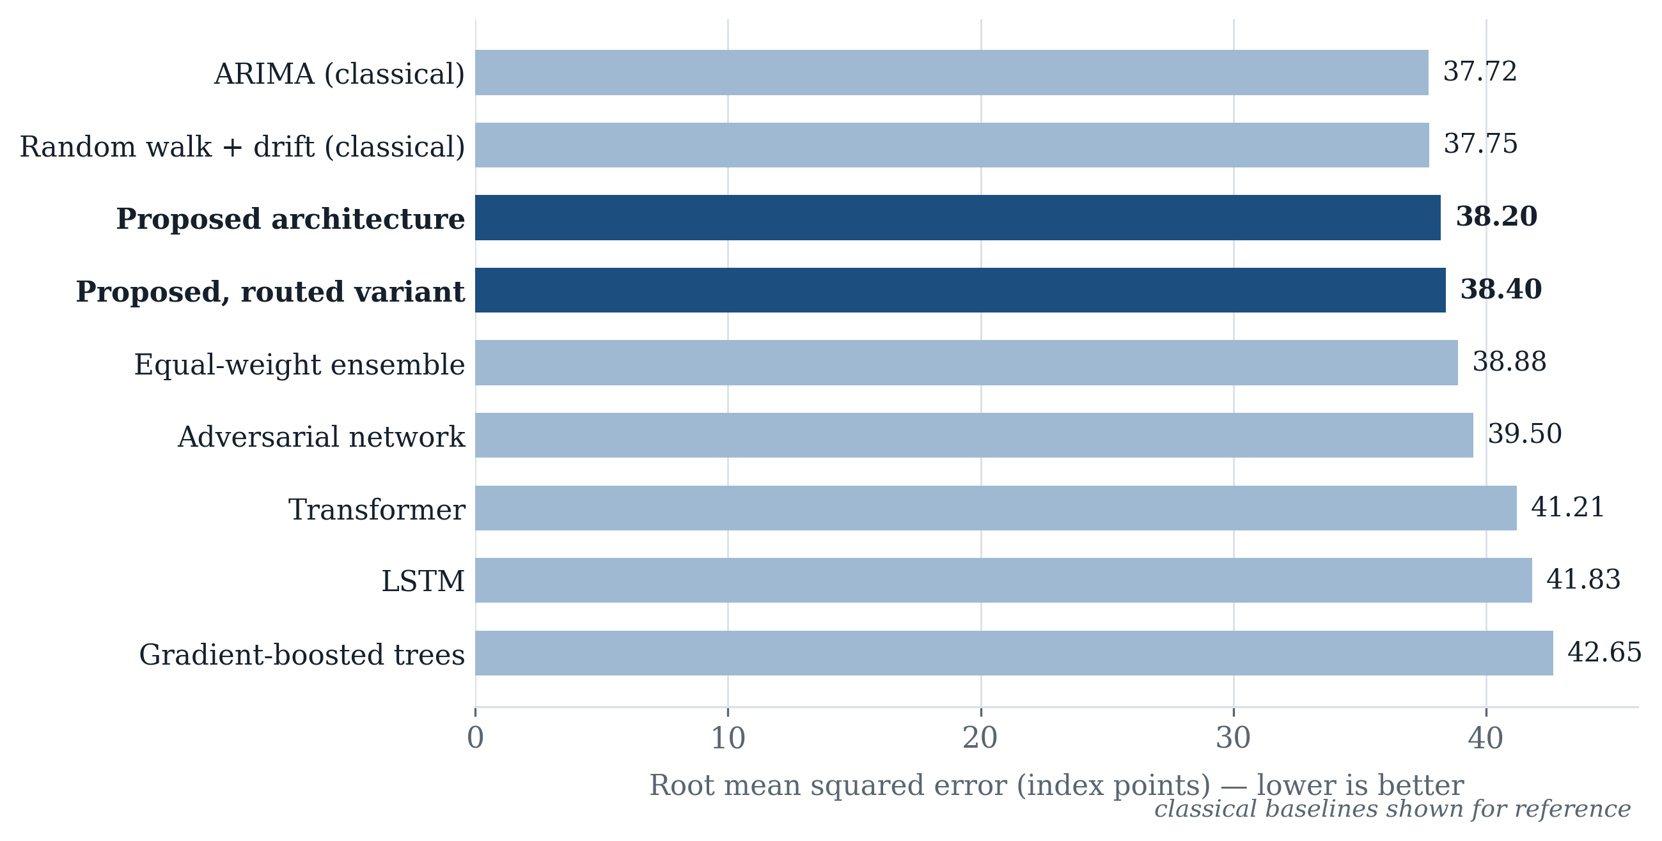
Figure 2. Aggregate forecast error by model, in index points, averaged over the three horizons and pooled across folds and seeds. Lower is better.

Slide 4
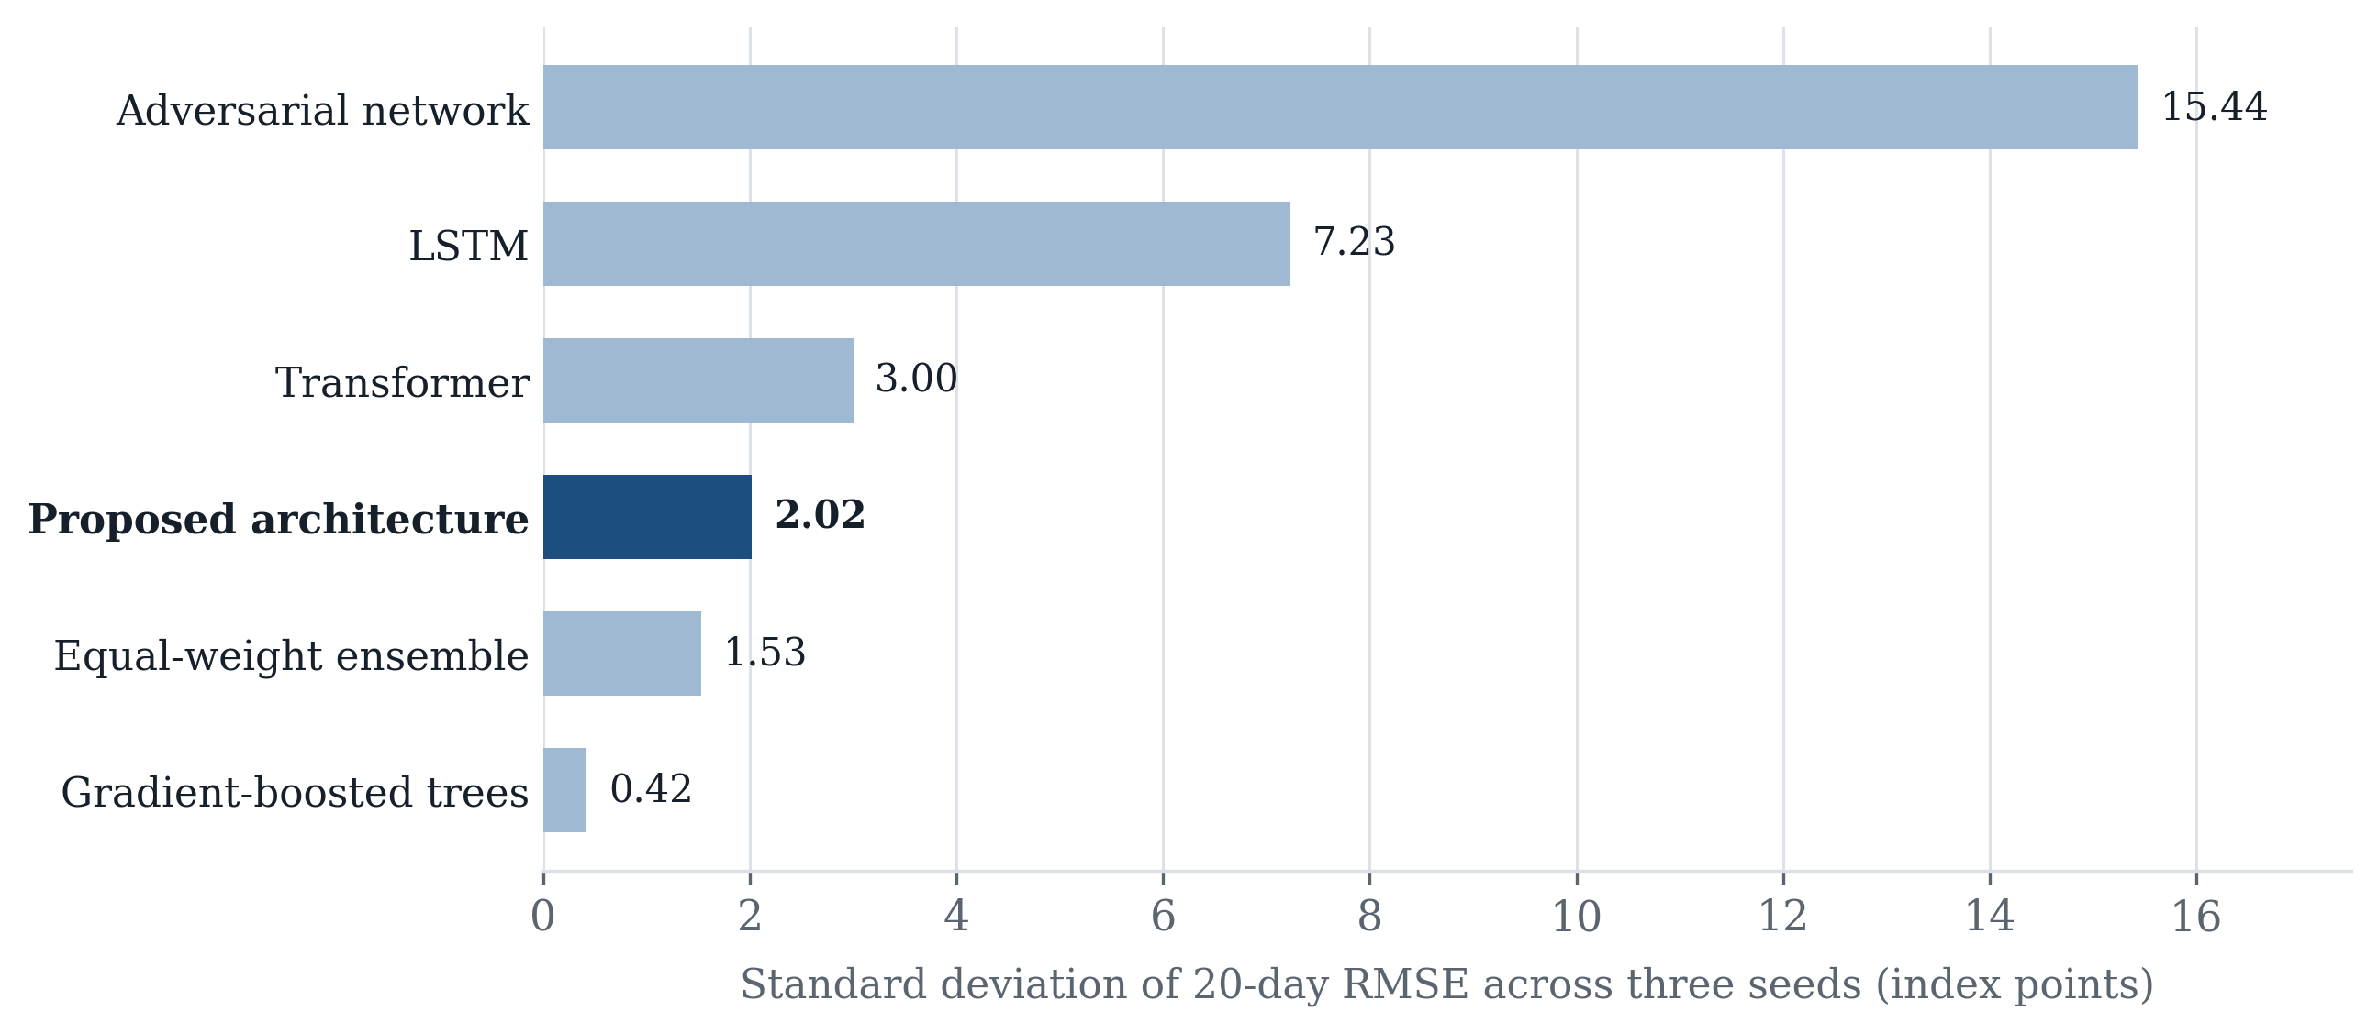
Figure 3. Standard deviation of twenty-day RMSE across three random seeds, in index points. Lower indicates a result that depends less on initialisation.

Slide 5
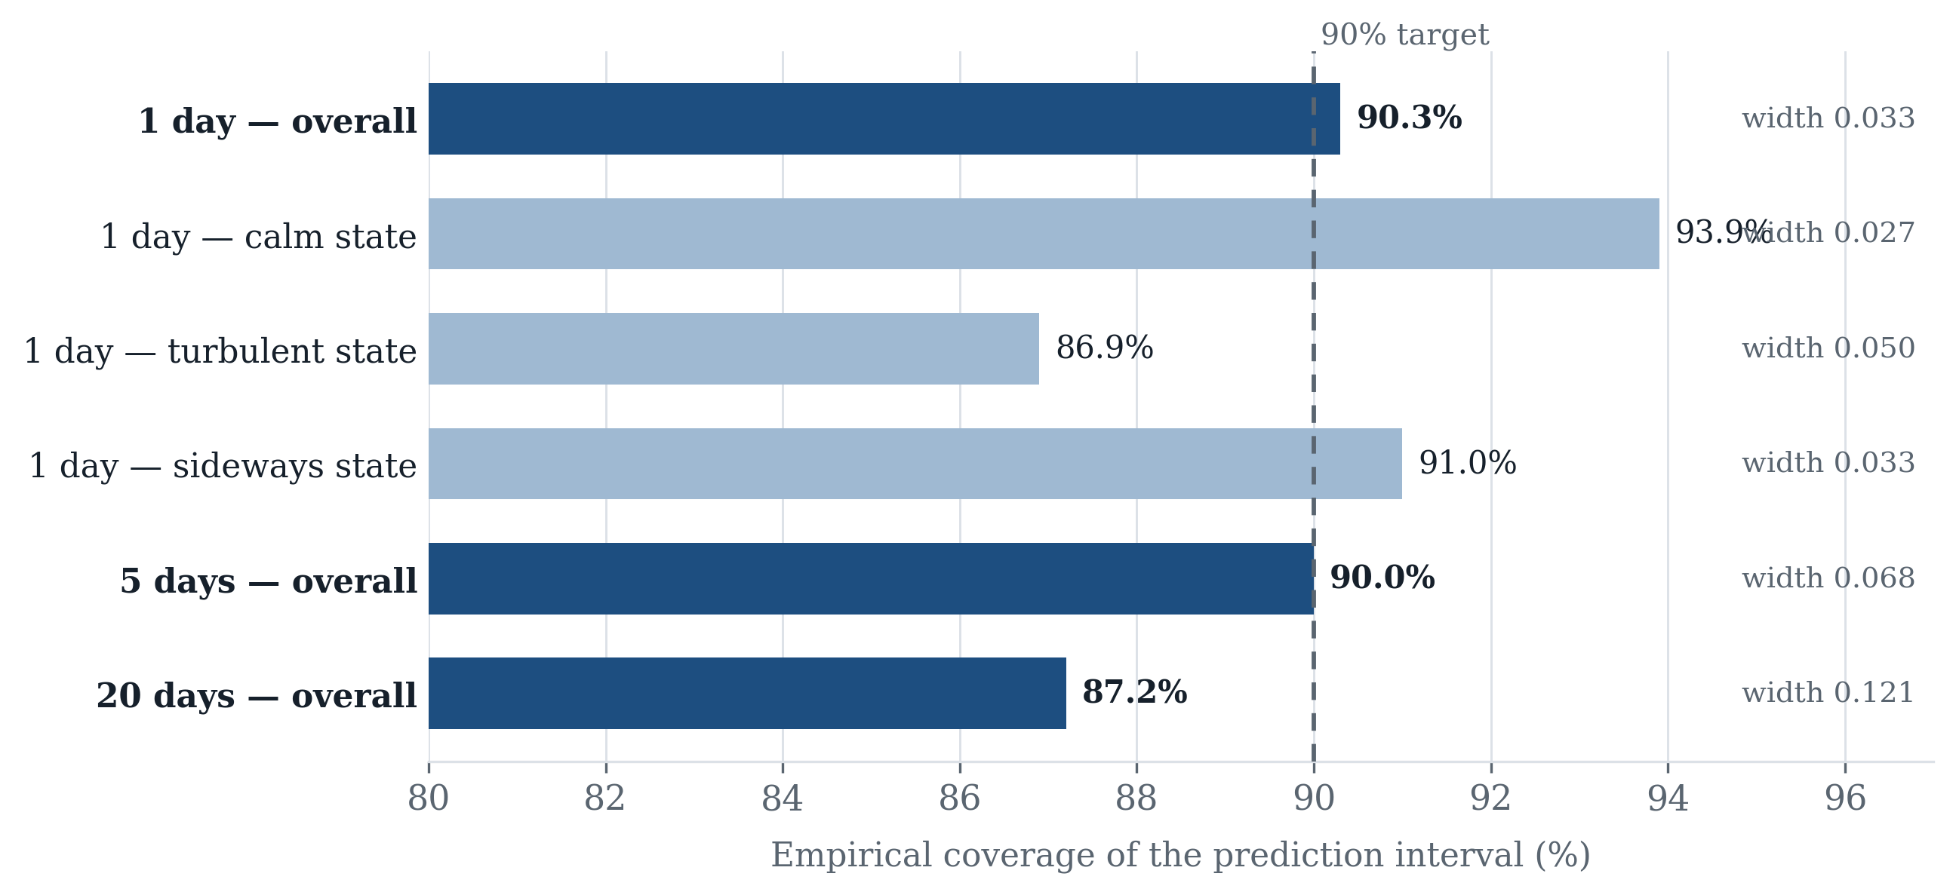
Figure 4. Empirical coverage of prediction intervals against a 90% target, overall and within each market state, with interval half-widths.

Slide 6
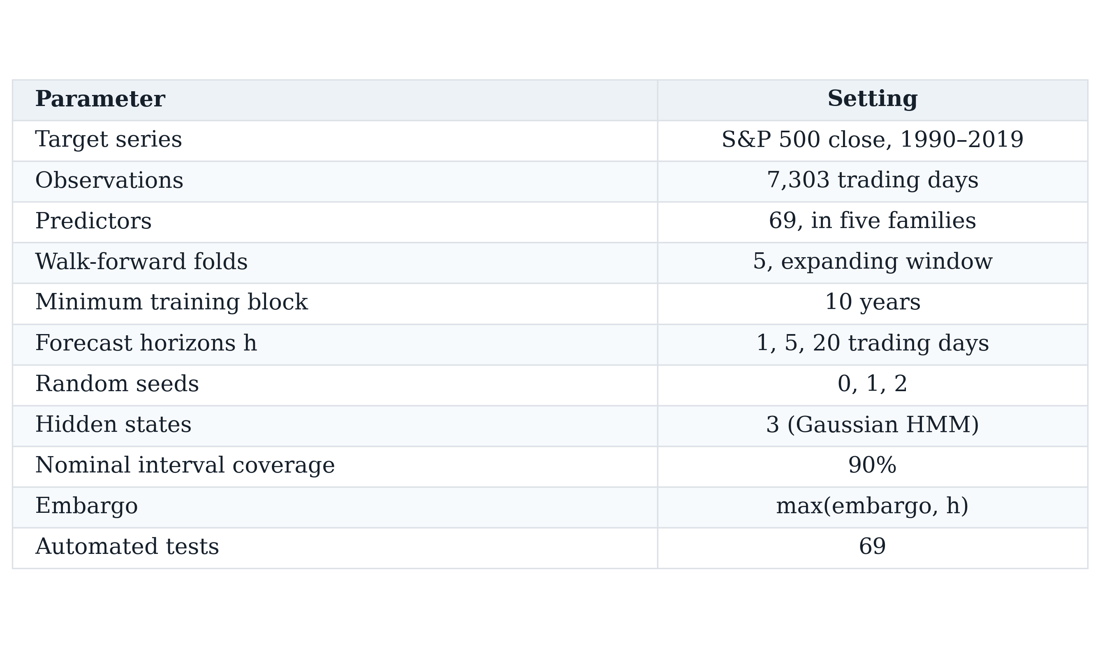
Table I. Study protocol and fixed parameters. Every value was set before any modelling and held constant across all models and folds.

Slide 7
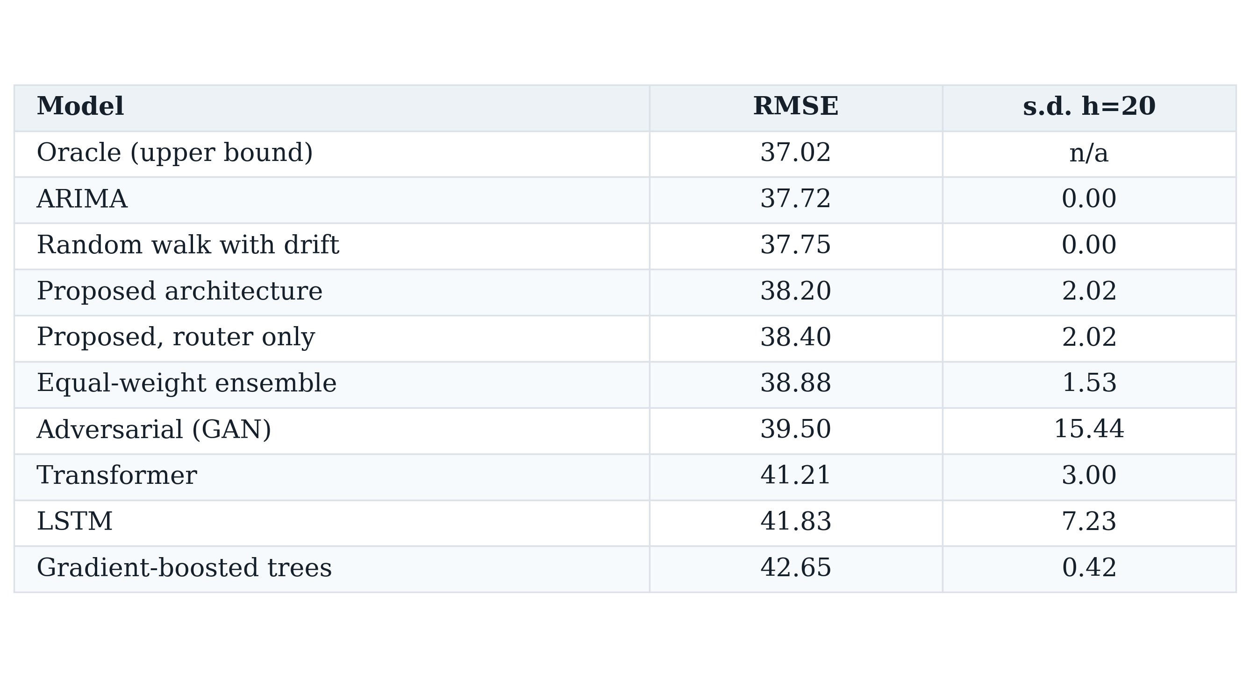
Table II. Aggregate root mean squared error in index points, with the standard deviation of twenty-day RMSE across three random seeds.

Slide 8
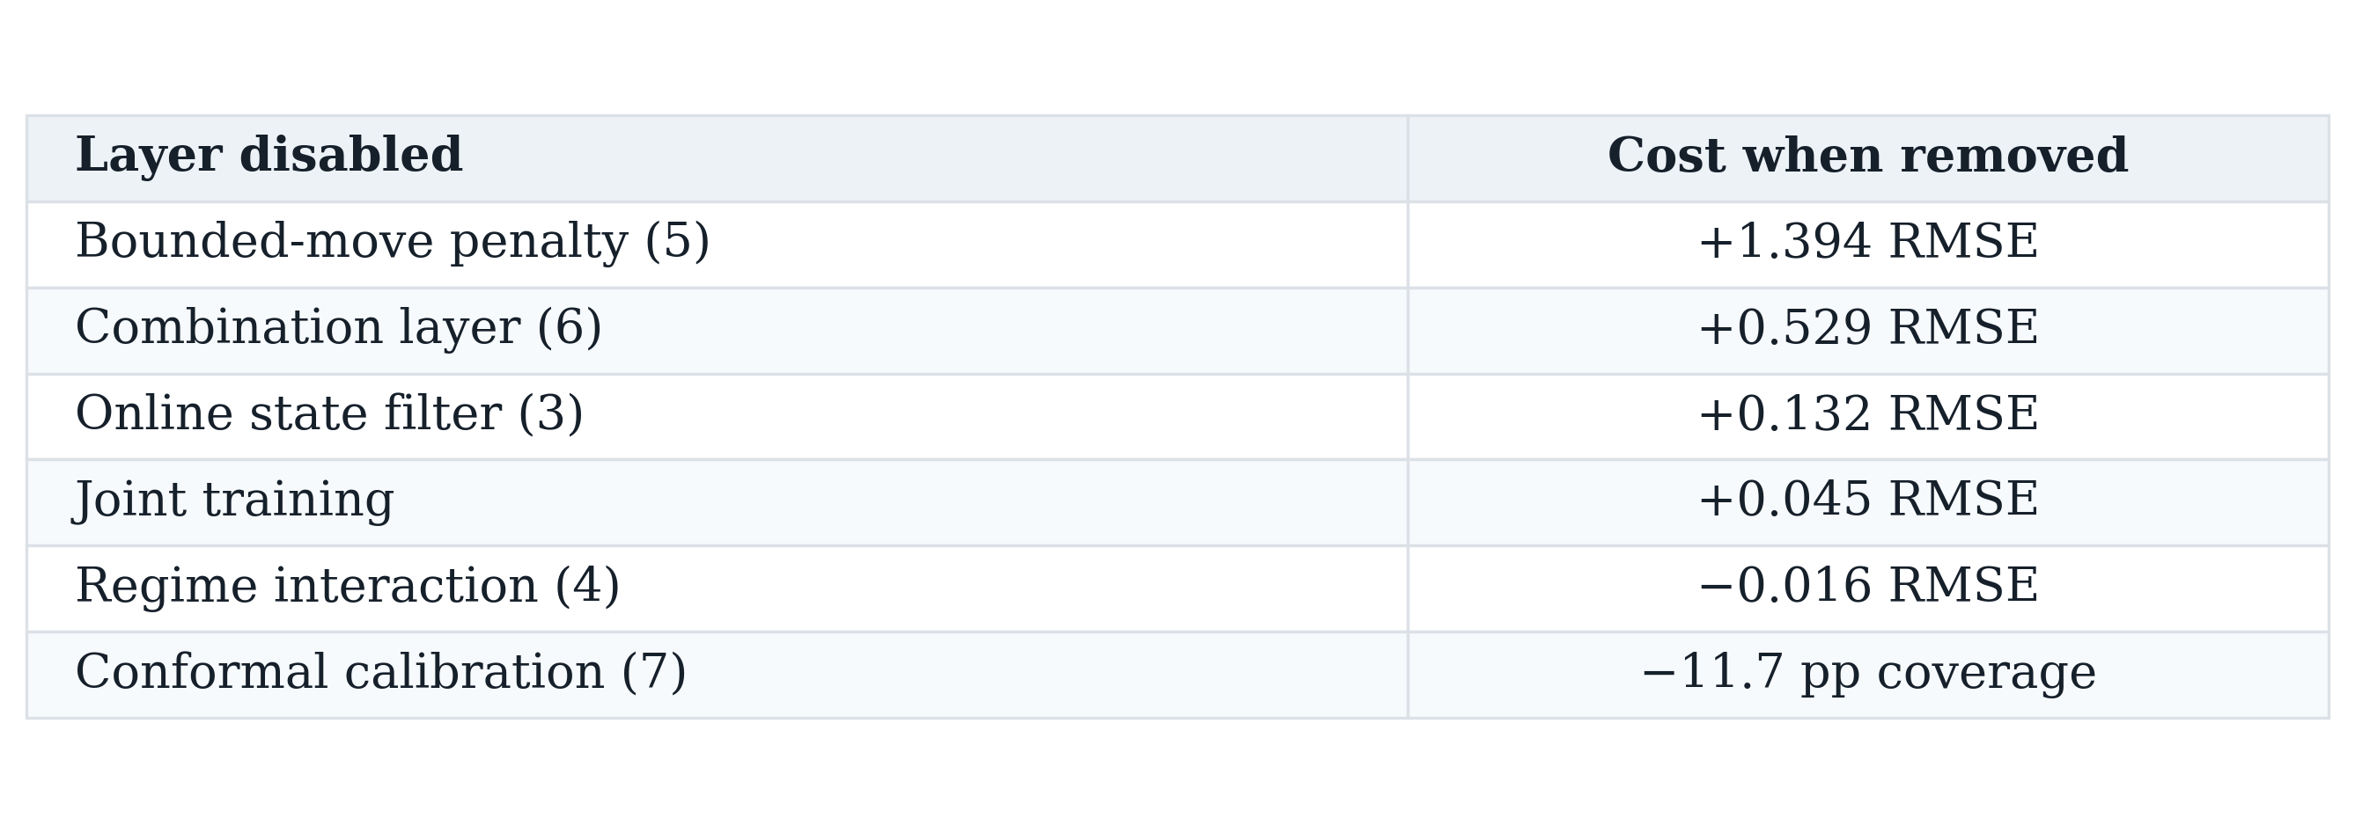
Table III. One-factor-at-a-time ablation. Each row disables a single layer with seeds, folds and hyper-parameters held fixed.

Slide 9
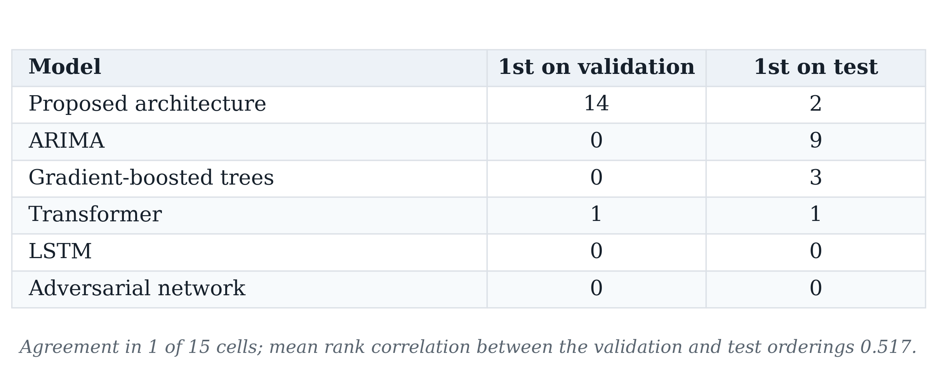
Table IV. Selection instability. For each fold and horizon, the model ranked first on validation data compared with the model ranked first on the subsequent test block.

