Slide 1


Slide 2
Spotify

Slide 3


Slide 4

PREDICTING SONG PREFERENCES

Slide 5


INTRODUCTION
ABOUT THE DATASET

Slide 6
song_preference
DEPENDENT / TARGET
VARIABLE
DV = 0 This means the song is disliked
DV = 1 This means the song is liked
INDEPENDENT /
EXPLANATORY
VARIABLES
Danceability
Duration_ms
Energy
Instrumentalness
Key
Liveness
Loudness
Model
Tempo
Time_signature
valance

Slide 7
Danceability
Duration_ms
Energy
Instrumentalness
Key
Liveness
Loudness
Mode
Tempo
Time_signature
valance
0.0- Least Danceable 1.0- Most Danceable
The overall loudness of a track in decibels (dB).
Duration of the track in milliseconds
Mode indicates the modality (major or minor) of a track.
0.0- Least Energetic
1.0- Highly Energetic
The overall estimated tempo of a track in beats per minute (BPM).
Value<0.5 - More Vocal
Value>0.5 - More Instrumental
Specifies how many beats are there in a single bar.
Key/Pitch, the song is in.
0.0 - Most negative vibes
1.0 - Most positive vibes
Detects the presence of an audience in the recording.

Slide 8
Danceability
Duration_ms
Energy
Instrumentalness
Key
Liveness
Loudness
Mode
Tempo
Time_signature
valance

Slide 9
SONG FEATURES’S NORMALITY

Slide 10
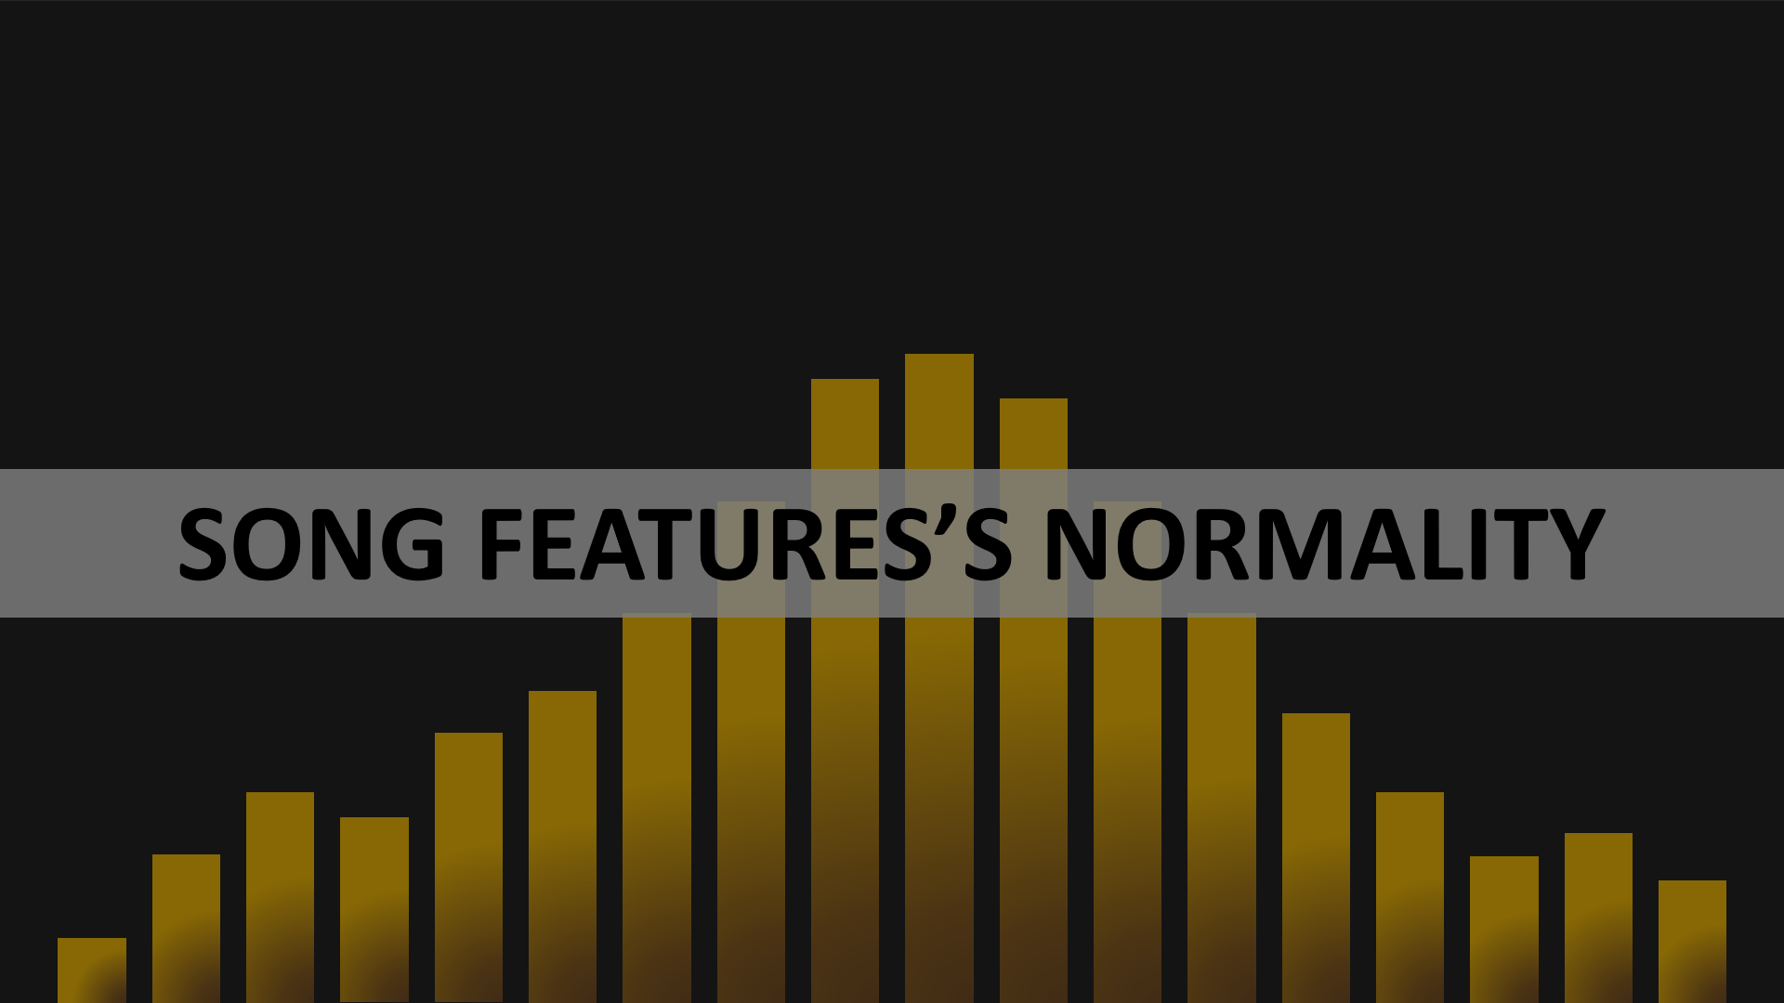

Slide 11
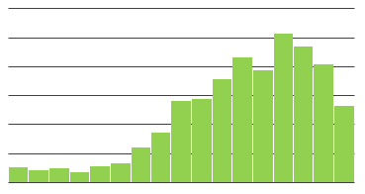
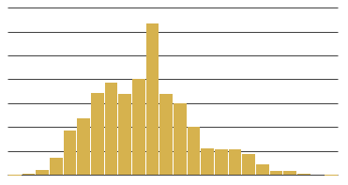
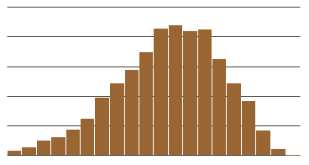
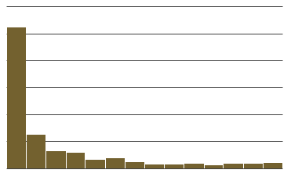
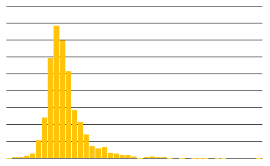
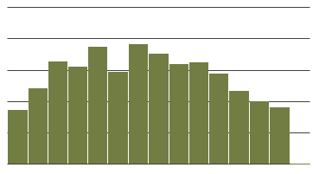
Duration_ms
Acousticness
Tempo
Danceability
Energy
Valance

Slide 12
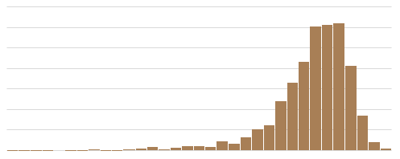
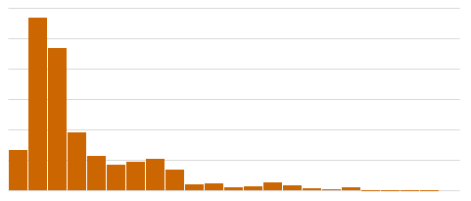
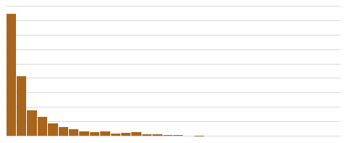
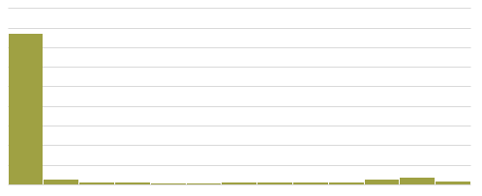
Instrumentalness
Liveness
Loudness
Speechiness

Slide 13

NORMALITY
TREATEMENT
Square Root Transformation
acousticness
s1$acousticness<-sqrt(s1$acousticness)
Log Transformation
liveness
s1$liveness<-log10(s1$liveness)
speechiness
s1$speechiness<-log10(s1$speechiness)
Treatment of Outliers
outloud<-boxplot(s1$loudness)$out
length(outloud)
s1<-s1[-which(s1$loudness %in% outloud),]
boxplot(outloud)
loudness
outduration<-boxplot(s1$duration_ms)$out
length(outduration)
s1<-s1[-which(s1$duration_ms %in% outduration),]
boxplot(outduration)
duration_ms

Slide 14
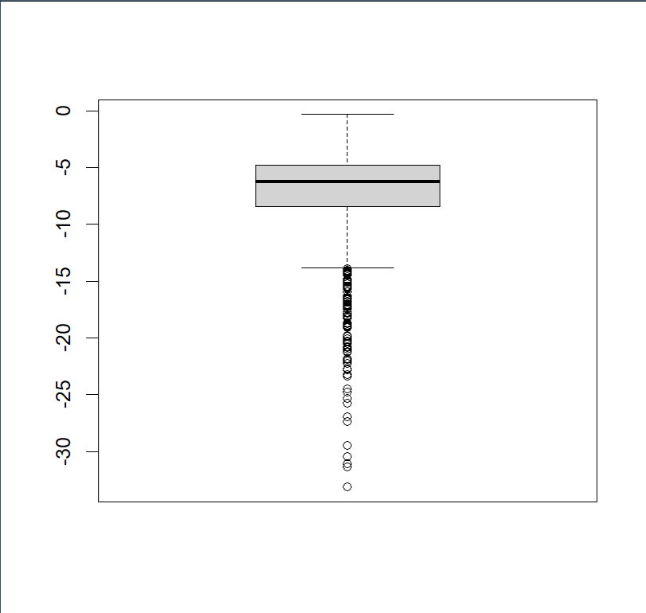
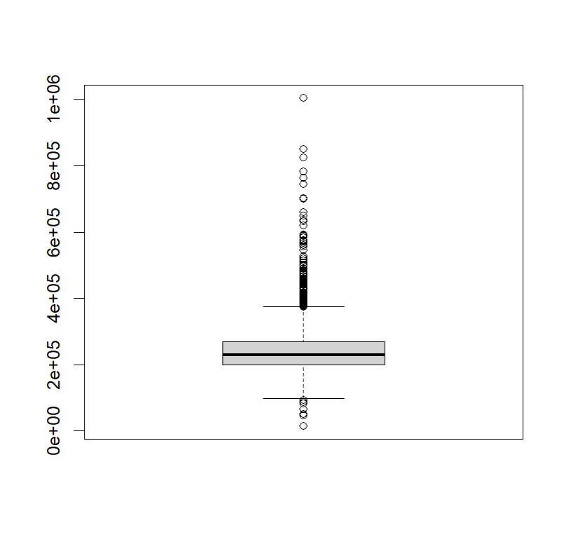
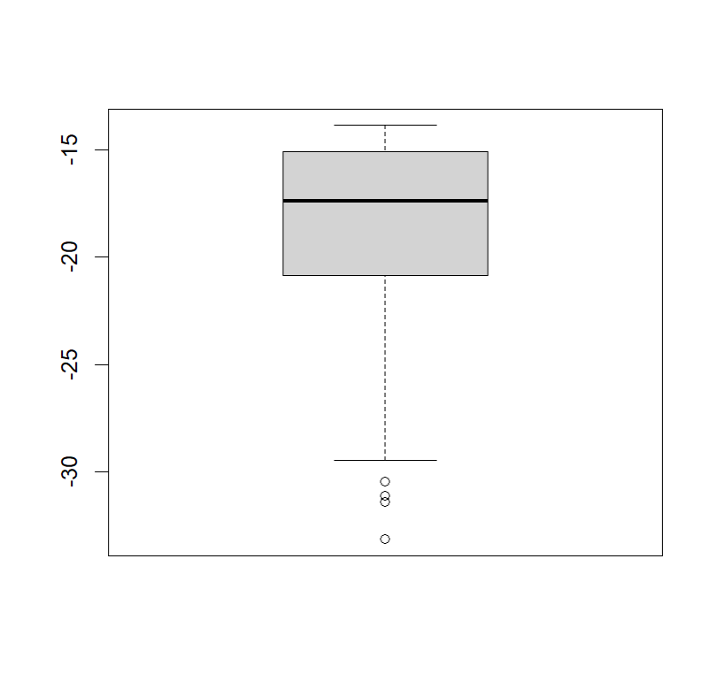
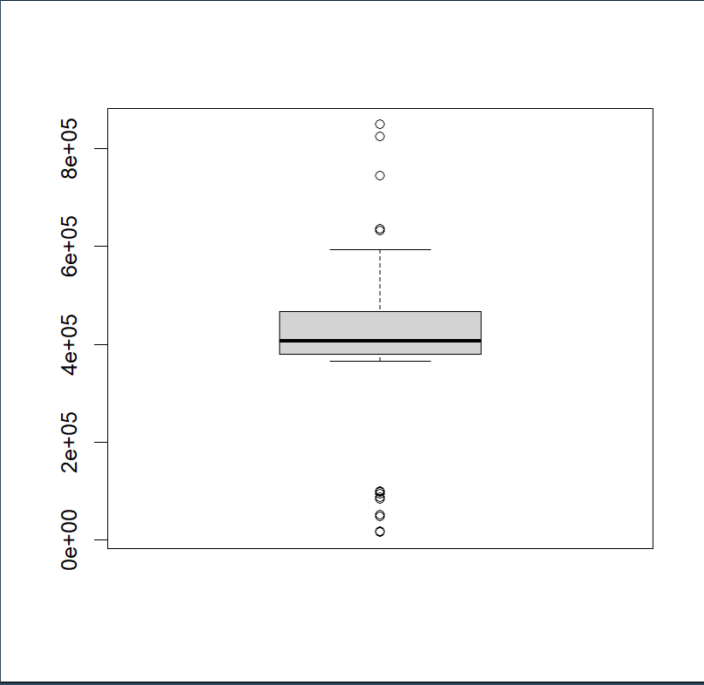
NORMALITY
TREATEMENT
loudness
duration_ms

Slide 15
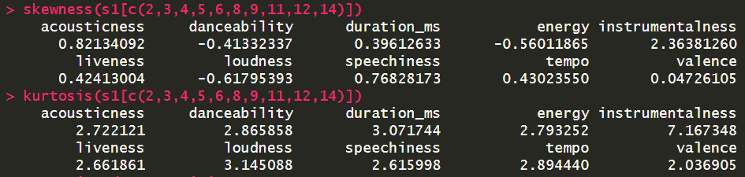

Slide 16
THE PREDICTIVE MODELS

Slide 17
Performance Metric Selection
Observations and learnings from the models
Trying to maximise the metrices
Conclusion and project summary

Slide 18
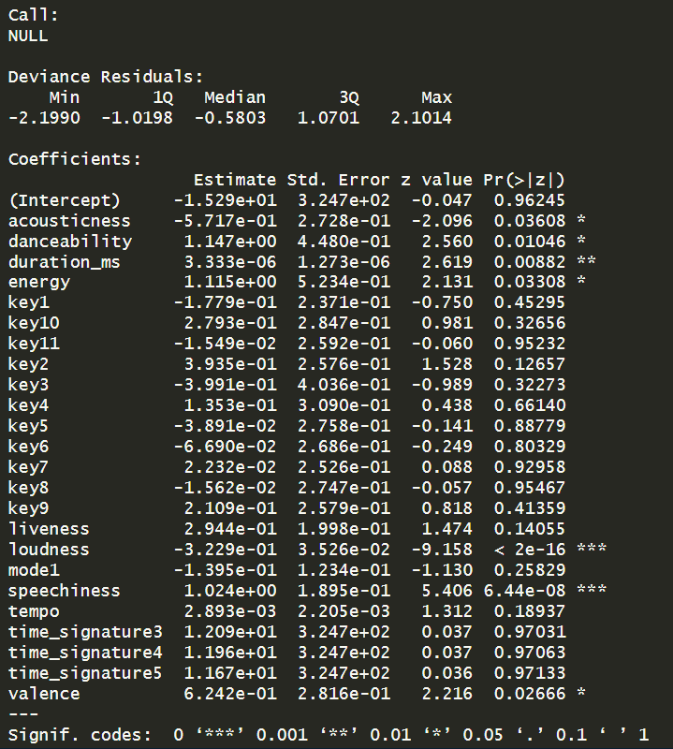
LOGISTIC REGRESSION
MODEL NUMBER 1
All the independent variable except artist and song name were included
It was observed that when considered all the features, the insignificant predictors were the ones that were more technical, like key and mode, which only a musician would understand than a lay-man.

Slide 19
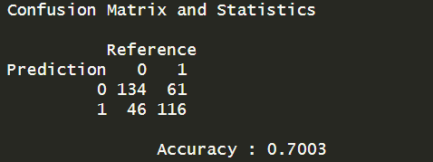
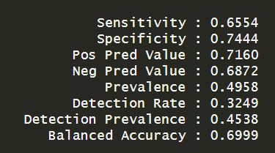
LOGISTIC REGRESSION & NAÏVE BAYES
MODEL NUMBER 2
The highest accuracy we could attain with logistic regression.
Variables included - danceability+energy+loudness+speechiness
MODEL NUMBER 3
The highest specificity we could attain with naïve bayes.
Variables included - danceability+energy+loudness+speechiness

Slide 20
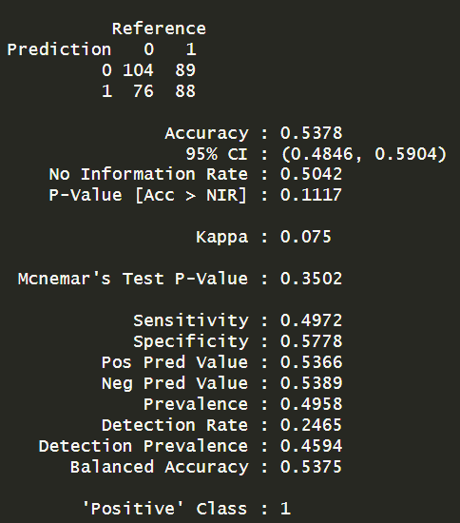
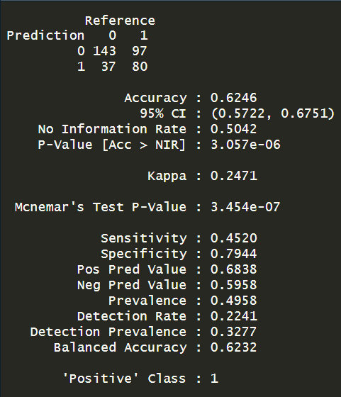
IMPACT OF INSTRUMENTALNESS
#WITHOUT
#WITH

Slide 21
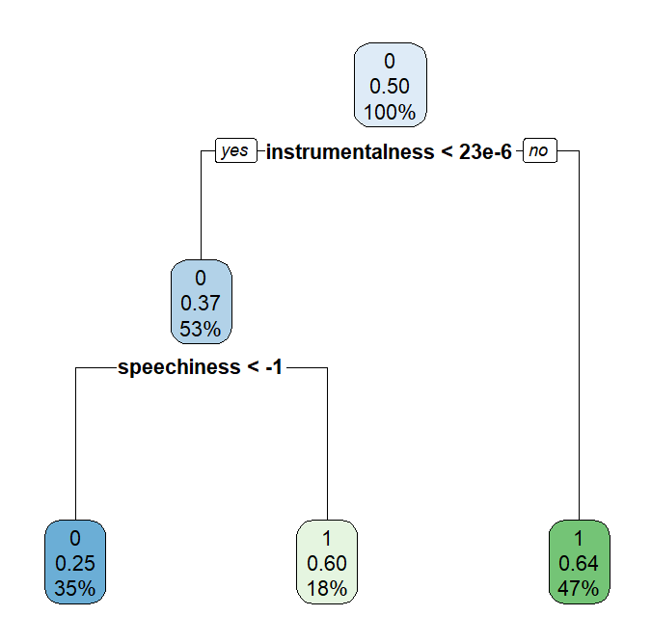
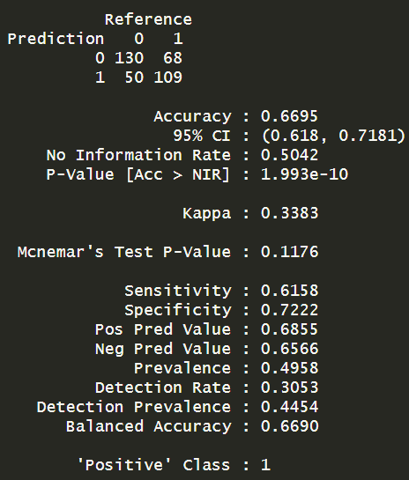
DECISION TREES
MODEL NUMBER 1
When all the independent variables were included

Slide 22
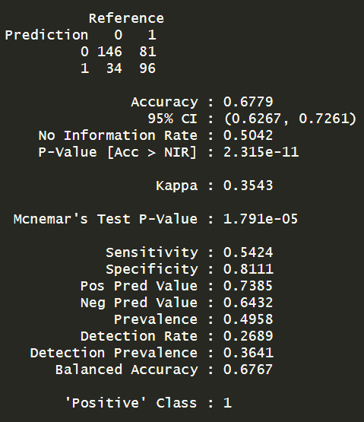
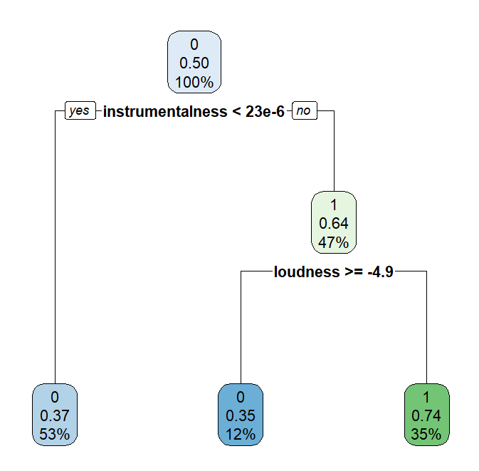
DECISION TREES
MODEL NUMBER 2
The highest specificity I could attain with decision tree.
Variables included – danceability, instrumentalness, energy, loudness.
There weren’t any changes between gini index and information gain

Slide 23
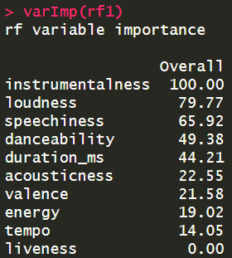
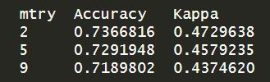
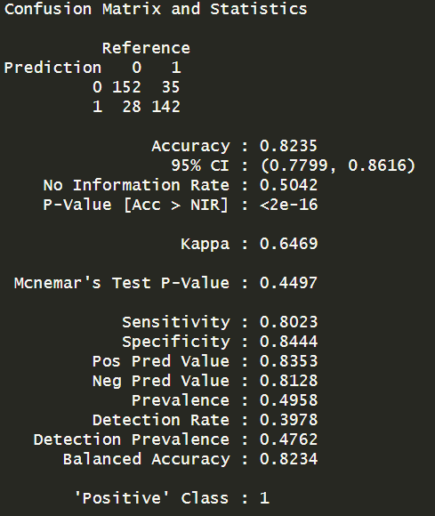
RANDOM FORESTS
MODEL NUMBER 1
Model with the highest specificity.
Accuracy was used to select the optimal model using the largest value. The final value used for the model was mtry = 2. this means that No. of variables tried at each split: 2

Slide 24
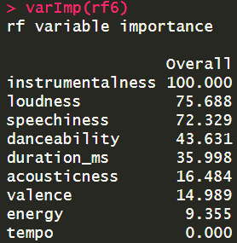
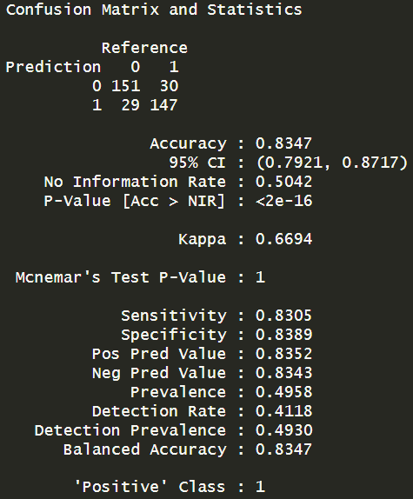
RANDOM FORESTS
MODEL NUMBER 2
Model with the highest overall accuracy.
Accuracy was used to select the optimal model using the largest value. The final value used for the model was mtry = 2. this means that No. of variables tried at each split: 2

Slide 25
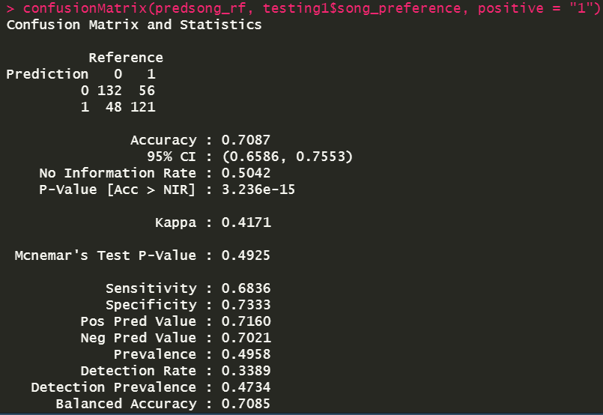
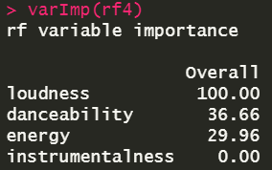
RANDOM FORESTS

Slide 26
CONCLUSION
Presented By:-
Yuvraj Singh Dua
Kamal Garg
Vinayak Kumar
Aftab Aalam

