Slide 1

Institute of Aeronautical Engineering COMPUTER SCIENCE AND ENGINEERING(CYBER SECURITY) PROJECT TITLE EXTENDING USE OF BIOMETRIC SYSTEM FOR ACCESS OF CLOUD SERVICES REVIEW 2 Mentor :Dr R.Obulakonda Reddy
Presented by,
KITTUR SAMIKSHA(20951A6242)
SHETLA YUVARAJ(20951A6259)
VANKDOTH SAI ROHITHA(20951A6236)

Slide 2
ABSTRACT
Cloud services are now an emerging technology .Many services which are being provided now-a-days are done by the ways of biometric mode for ensuring the secure way of accessing the services of an organization. Here we will see the new way of biometric based secure accessing of cloud services which will not only give access control to the user but it will also provide security to the data present in the cloud server and protect the data which maybe misused by the intruders. The method here which we will be discussing will have two parts (i)first to authenticate the user (ii)to provide access to the resources based on the role of the user. This particular method will have fingerprint and iris scan which is in-a-way called “1 auth 1 access” .The fingerprint of the user will be used to generate a secret code which will authenticate the user first. Then by the iris scan we will give access control to the resources based on the user.Automated Validation of Internet Security Protocols and Applications(AVISPA) tool will be used for security when the resources will be used through the cloud server.
KEYWORDS: biometric-based security ,fingerprint ,iris scan ,authentication , access control

Slide 3
INTRODUCTION
Cloud services are a norm in our society. However, providing secure access to cloud services is not a trivial task, and designing robust authentication, authorization and accounting for access is an ongoing challenge, both operationally and research-wise.
Now-a-days for a secure way of accessing the cloud services ,we are using the biometric way.
Biometric authentication is used in computer science as a form of identification and access control.
Some of the ways where a person gives biometric are:
Fingerprints Facial
Voice Iris and
Palm or finger vein patterns.

Slide 4
The proposed will provide a secure way of accessing the resources from the cloud as it will take the fingerprint and authenticate the user. After authentication process, the user must scan his/her iris which will give the access control to the user based on the role he/she is working in the organization .
During this a session key will be generated for the securing the sites from being attacked by the attackers.
The following will describe the method in a more brief way:
When the user scan his/her fingerprint ,the image of the fingerprint will retrieve the code related to the image.

Slide 5
After this when the user scans the iris the unique key related to that particular iris will be matched with the code of the fingerprint.
If the keys of both the biometrics are same then only it will grant the access control to the user or else it will not.
In the case of a new user, the fingerprint and iris will be scanned and unique keys will be provided to them

Slide 6
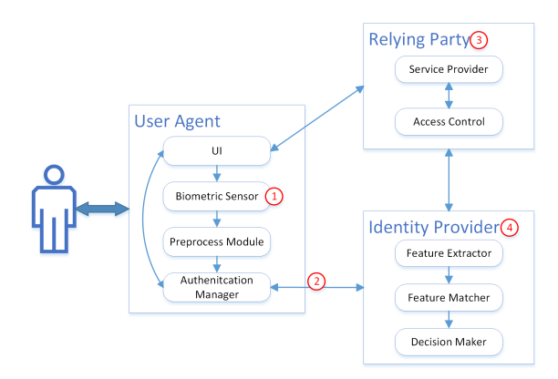
PICTORIAL REPRESENTATION

Slide 7
LITERATURE SURVEY
“One key limitation in existing authentication mechanisms is that the user’s credentials are stored in the authentication server, which can be stolen and (mis)used to gain unauthorized access to various services.”(Designing Secure and Efficient Biometric-Based Secure Access Mechanism for Cloud Services ).
“Uni-biometric systems suffer from problems such as variation in biometric data, low recognition rate, spoofed easily and many more.”(A Study of Biometric Identification and Verification System).
“The probabilistic matching may lead to errors like false rejection rate (FRR) and false acceptance rate (FAR) that depend on many influences, specifically, on the matching algorithm.”(A systematic review on Fingerprint based Biometric Authentication System).

Slide 8
PROBLEM STATEMENT
The problem states that “using uni-biometric systems is their susceptibility to security breaches and fraud. Uni-biometric systems rely on a single biometric trait, such as fingerprint or iris recognition, to identify and authenticate individuals. If an attacker manages to compromise or duplicate that specific trait, they can potentially gain unauthorized access to the system or impersonate another individual.”

Slide 9
OBJECTIVES
The main objective of the proposed solution is about providing secure access to biometric based services in a manner that the limitations of the proposed solution is reduced.
For, this particular solution focuses of the secure way of Efficient Biometric-Based Secure Access Mechanism for Cloud Services.
The biometric ways being used here will not only provide the services but will also provide security to the data and the identity of the user working in that organization.

Slide 10
PROJECT OUTCOMES
The outcome which we will be expecting from this project are stated as follows:
Security to the resources will be ensured.
The access control which are given to a particular user will be provided effectively.
The chances of biometric proxy can be reduced.

Slide 11
THANK YOU

