Slide 1

RESEARCH BASED LEARNING
A Review On Road Surveillance Drones
TEAM MEMBERS DETAILS
1 | Saimaniteja | 20951a6235@iare.ac.in
2 | S.Yuvaraj | 20951a6259@iare.ac.in

Slide 2
Abstract
This project, aims at monitoring the real time environment with help of drone like surveillance of hanks, highly crowded areas, aerial traffic and Security watch etc. This project intended to design and fabricate a low cost, light weight surveillance drone. A drone in structure of quad rotor that houses a camera with a wireless transmission system is to be designed. This provides a live feed from camera to the ground station via telemetry. It is also intended to be able to carry a payload for future developments GPS will be used to predict the location of drone and inertial measurement unit (IMU) sensors will be used to predict proper acceleration and detection of changes in rotational attributes roll, pitch and yow IMU is consists of 3-axis accelerometer, 3- axis gyroscope and 3-axis digital compass. Kalman Filter will be used to maintain the stability of flight.

Slide 3
Introduction
A quadcopter is an aerial vehicle that uses four rotors for lift, steering, and stabilization. Unlike Other aerial vehicles, the quadcopter can achieve vertical flight in a more stable condition. Furthermore, due to the quadcopter's cyclic design, it is easier to construct and maintain. As the technology becomes more advanced and more accessible to the public, many engineers and researchers have started designing and implementing quadcopters for different uses. One of the main use is surveillance. Surveillance is critical for security operations. In the past, helicopters were used for these types of missions. Recently, drones are (have grown in popularity and are an excellent resource that can be) utilized for surveillance missions. The drones are helpful to observe, analyze, and get information and transfer it to base station. Drones are able to perform missions with high level of complexity and. at the same time, they require less human operator involvement due to their autonomous behavior. The additional advantage is, they are agile in nature and can have degree of freedom up to 10.

Slide 4
Literature Review
The goal of this project is to build an drone in in structure of x shaped quad rotor that houses a camera with a wireless transmission system. This drone will be used for campus surveillance. Aerial surveillance will be done by monitoring the real time environment with help of drone . Surveillance of banks, highly crowded areas, aerial traffic and security watch can be easily done with the help of this drone.
This drone also delivers objects and necessary products automatically to the entered destinations using GPS.

Slide 5
Methodology
The following diagram show the design approach which have been considered for the project. The first and most important factor is the identification of problem which is identified as the need of aerial surveillance . The best solution is identified as unmanned aerial vehicle in form X shaped quadcopter structure. After that design of the prototype have been done on several stage which involved static thrust calculation, total weight, flight time and power consumption calculation. Next step are also implemented and evaluated.

Slide 6
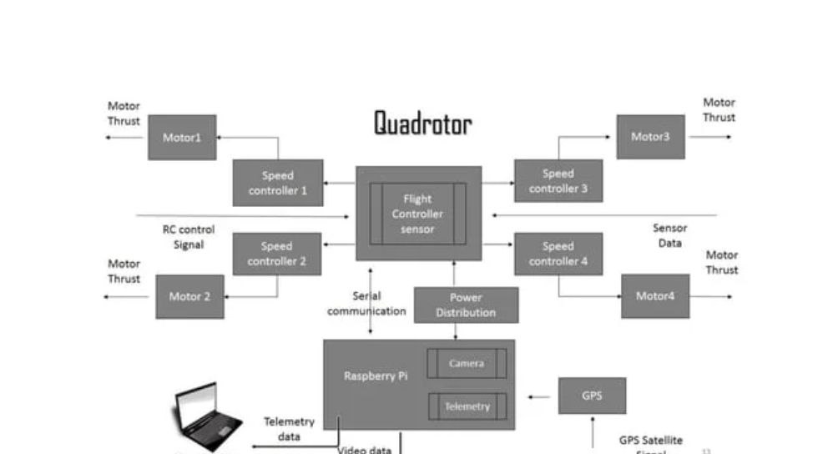

Slide 7
The technical specifications are divided in the following in engineering module on the basis of application and engineering involved
Mechanical & Electrical Module
Quad rotor Frame
Landing Stand
4 x Electrical Motor
4 x Propellers
2300 mAh LiPo Battery & charger
Power Distribution System

Slide 8
Sensor Technology Module
IMU/3 Axis Digital Compass/ Digital Pressure Sensor
On board camera
GPS
Telemetry
Embedded System & other Electronics Module
Flight Controller Using Arduino UNO board
On-board Processor using Raspberry Pi
ESC (Electronic Speed Control)
Transceiver (RF Remote Control)

Slide 9
Software Module
CadSoft EAGLE, Fritzin
Matlab/Simulink (Drake Tool Box)
Arduino IDE, Linux, Opencv
Python

Slide 10
Mechanical & Electrical
Quad copter is a novel appearance, superior performance VTOL aircraft, which has a simple structure, flexible operation, high load capacity and other characteristics, have important civilian and military value. According to our design, we have select the necessary materials and structures that meet the strength and stiffness the system needs. They are designed to be strong and lightweight.
important parts
1) The center plate where the electronics are mounted.
2) Four arms mounted to the center plate.
3) Four motor brackets connecting the motors to the end of the arms.

Slide 11
Sensor Technology
A telemetry module was needed in order to telemeter the GPS to the ground station. It was also needed to communicate payload camera images and video data back to the ground control computer. The module we chose for the project is a 2.4 GHz, XBee-PRO S1 Module. The XBee-PRO modules are capable of deploying point-to-point, peer-to-peer and point-to- multipoint networks. Designed for maximum range, the XBee-PRO is ideal for solutions where RF penetration and absolute transmission distance are paramount to the application. The XBee- PRO communicates with the computer serially, through a virtual com port at a baud rate of 57600.

Slide 12
Embedded System & other Electronics
An electronic speed control or ESC is an electronic circuit with the purpose to vary an electric motor's speed, its direction and possible also to act as a dynamic brake. ESCs are often used on electrically powered radio controlled models, with the variety most often used for brushless motors essentially providing an electronically generated three-phase electric power low voltage source of energy for the motor.
ESC supplies power from battery but not constant, it varies according to input signal. ESC also has BEC (Battery Eliminated Circuit), BEC is nothing but 5V output from ESC that can power up receiver, servo motor (for camera gimbal) and FC. But how to select ESC for our multirotor? Well it's really simple. One only need to keep in mind that Ampere rating of ESC should be higher than max amp rating of motor. For example the motor we selected draws maximum 15 Amp so your ESC rating should be higher than 15amp. Say 18-20Amp. One can select ESC between ranges of 18A to 22A. We have selected 20 Amps as our designed requirement.

Slide 13
Software
Fritzing is an open-source hardware initiative that makes electronics accessible as a creative material for anyone. Software community offer services in the spirit of Processing and Arduino, fostering a creative ecosystem that allows users to document their prototypes, share them with others, teach electronics in a classroom, and layout and manufacture professional pcbs. This software module is used to design the circuit diagram and interfacing of sensor with Arduino board.
MultiWii is a general purpose software to control a multirotor RC model. It can now use various sensors but was initially developed to support Nintendo Wii console gyroscopes and accelerometers. Multiwir software module is used here as flight simulator and to get the visualization and plotting of flight data. It also used to calibrate the ESC, tuning the flight, sensor graph, video capture etc.

Slide 14
Results and Discussion
The Aerial Surveillance System is designed to monitor the real time environment like surveillance of banks, highly crowded areas, aerial traffic and security watch etc, on a quadcopter platform using marginal sensor input. The project consists of wireless communication system, Camera, GPS and a quadcopter aerial platform. The quadcopter is controlled by a 2.4 GHz RF transceiver system wirelessly. PID control technique will be exploited to perform the flight stabilization. This project intended to design and fabricate a low cost, light weight surveillance drone in structure of quad rotor. It is also intended to be able to carry a payload for future developments.

Slide 15
Reference
Towards A Swarm of Agile Micro Quadrotors, Alex Kushleyev, Daniel Mellinger, Vijay Kumar GRASP Lab, University of Pennsylvania.
Design considerations of a small UAV platform carrying medium payloads, Juan Alberto Benito, Guillermo Glez-de-Rivera, Javier Garrido Human Computer Technology Laboratory (HCTLab) Univ. Autonoma de Madrid, Spain guillermo.gdrivera@uam.es
[ Jun Li, YunTang Li (2011). "Dynamic Analysis and PID Control for a Quadrotor" 2011 International Conference on Mechatronics and Automation.

Slide 16
Atheer L. Salih, M. Moghavvemil, Haider A. F. Mohamed and Khalaf Sallom gacid (2010). "Flight PID controller design for a UAV Quadcopter." Scientific Research and Essays Vol. 5(23), pp. 3660-3667, 2010.
A multi-point Metropolis scheme with generic weight functions Luca Martino, Victor Pascual Del Olmo, Jesse Read Department of Signal Theory and Communications, Universidad Carlos III de Madrid. Avenida de la Universidad 30, 28911, Leganes, Madrid, Spain
http://fritzing.org/home/
http://sal.aalto.fi/publications/pdf-files/eluull public.pdf
http://www.gpsinformation.org/dale/nmea.htm
http://www.flyzipline.com

