Slide 1


Minor Project
Title: Intelligent Research Assistant
Presented by: Yuvraj Bhardwaj
Aryan Kumar
Gaurav Yadav
Arnav Singh
Guided by: Milton Kumar

Slide 2
Content
Abstract
Introduction
Literature Review
Problem Statement
Objective
Methodology
Pert Chart
Conclusion
9. References

Slide 3
Abstract
It is an intelligent research assistant designed to automate comprehensive research tasks using a multi-agent artificial intelligence system. The project employs multiple specialized AI agents that collaboratively perform web searching, data scraping, fact-checking, information validation, and report generation. A central orchestrator coordinates the agents to ensure accurate, reliable, and well-structured research outputs. The system aims to reduce manual effort, improve research efficiency, and generate professional-quality reports with verified information. It is highly configurable, fault-tolerant, and suitable for academic as well as professional research applications.

Slide 4
2. Introduction
With the rapid growth of information on the internet, conducting accurate and reliable research has become increasingly challenging. Manual research is time-consuming and prone to errors, misinformation, and data overload. Artificial Intelligence provides effective solutions to automate research tasks and improve accuracy.
It is developed as an intelligent research assistant that uses a multi-agent architecture to perform research efficiently. Each agent has a specific role such as searching, scraping, fact-checking, and summarization. The system integrates these agents to produce structured research reports, making it useful for students, researchers, and professionals

Slide 5
3.Literature Review
Previous research systems mainly relied on single-agent architectures or basic web search tools. Traditional research tools lack proper validation, context understanding, and structured reporting. Recent advancements in AI and multi-agent systems have demonstrated improved performance in distributed problem-solving and knowledge synthesis.
Studies show that multi-agent AI systems enhance accuracy, scalability, and fault tolerance compared to single-agent models. However, limited systems effectively integrate fact-checking and report generation. It addresses these limitations by combining intelligent query analysis, multi-source data collection, and automated validation.

Slide 6
4. Problem Statement
Manual research is inefficient, time-consuming, and vulnerable to misinformation due to unverified online sources. Existing research tools lack automation, structured output, and reliable fact-checking mechanisms. There is a need for an intelligent system that can automate research, verify information, and generate accurate reports with minimal human intervention

Slide 7
5. Objectives
To design and develop an intelligent research assistant using AI.
To implement a multi-agent system for distributed research tasks.
To automate web searching, data scraping, and information validation.
To generate structured and professional research reports.
To reduce human effort and improve research accuracy.

Slide 8
6.Methodology
Query Analysis – User research query is analyzed to plan research strategy
Agent Coordination – Central orchestrator assigns tasks to specialized agents
Web Search & Scraping – Agents collect data from multiple online sources
Fact Checking – Information is validated to detect inconsistencies
Data Processing – Relevant content is filtered and summarized
Report Generation – Final structured report with citations is generated

Slide 9
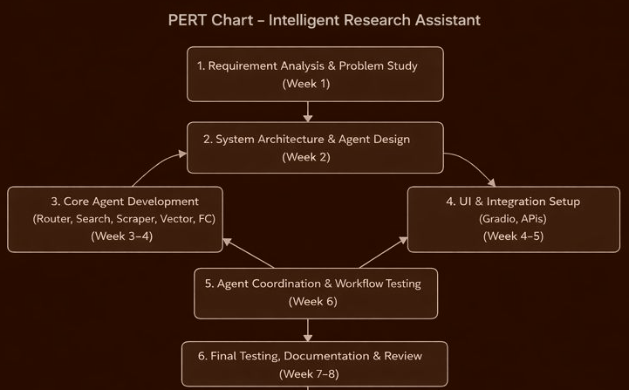
7. PERT Chart

Slide 10
8. Conclusion
It successfully demonstrates the use of a multi-agent AI system to automate research activities. The project improves research efficiency by reducing manual effort and ensuring information accuracy through fact-checking. The system is scalable, configurable, and suitable for academic research applications. Future enhancements may include improved NLP capabilities, real-time collaboration, and integration with more data sources.

Slide 11
9. References
Research papers on Multi-Agent Systems.
Artificial Intelligence and Machine Learning journals.
Online AI research articles.

Slide 12
Thank You

