Slide 1


NEXT GEN EMPLOYABILITY PROGRAM
CREATING A FUTURE-READY WORKFORCE
Student Name :
Yuvraj Singh Rathore
Student ID :
College Name :
STU642eec0be0b991680796683
Poornima Institute of Engineering and Technology

Slide 2
CAPSTONE PROJECT SHOWCASE
Project Title
Exploratory Data Analysis on Space Exploration Missions using Power BI
Abstract | Problem Statement | Project Overview | Proposed Solution | Technology Used | Modelling & Results | Conclusion | Q&A

Slide 3
Abstract
1
Data Exploration: We leverage a comprehensive space mission dataset to conduct an exploratory data analysis (EDA).
2
Key Insights: Our focus is on overall success rates, leading companies/rockets, frequently used launch locations, and spacecraft status and their cost.
3
Technology & Tools: Power BI is our primary platform for data cleaning, transformation, visualization, and communication of findings.
4
Impact: This analysis unveils trends informing future space exploration endeavors and maximizing success rates and find factors that affects the success rate.

Slide 4


Problem Statement
The field of space exploration is experiencing exponential growth, with advancements occurring at a rapid pace. Data analysis plays a crucial role in informing future endeavors and maximizing success rates. This project addresses the need for a comprehensive analysis of space exploration missions. By conducting an EDA, we aim to answer critical questions such as:
How have overall mission success rates evolved over time?
Are there specific companies or rocket types that boast a higher success rate?
Which launch locations are most frequently utilized for space missions?

Slide 5

Project Overview
We will follow a structured approach for data analysis, ensuring data accuracy and insightful results. Here's the roadmap:
Data Acquisition and Cleaning: We will acquire the space exploration mission dataset and meticulously clean it to ensure data integrity and consistency.
Data Transformation: The data will be transformed into a format suitable for analysis within Power BI, a powerful data visualization tool.
Exploratory Data Analysis: Utilizing Power BI's functionalities, we will conduct an in-depth EDA, uncovering trends, patterns, and relationships within the data.
Visualization and Communication: Compelling charts, graphs, and dashboards will be created using Power BI to effectively communicate the findings of our analysis.

Slide 6
Proposed Solution
The proposed solution is an extensive EDA of space exploration missions using Power BI. This analysis will provide valuable insights into various aspects of spaceflight, including:
Success Rate Trends: We will explore how overall mission success rates have changed over time, identifying any upward or downward trends.
Company and Rocket Performance: We will analyze the success rates of missions undertaken by different companies and the performance of various rocket types.
Launch Location Analysis: We will investigate the most frequently used launch locations for space missions, potentially revealing geographical preferences.
Spacecraft Status (if applicable): The current status of the spacecrafts (active, retired, etc.) will be considered if the data allows, providing a broader picture of space exploration efforts.

Slide 7
Technology used
Power BI: Our Data Analysis Command Center
Power BI will be our primary tool for data exploration and visualization. This software provides the essential functionalities we need to unlock the insights hidden within our space mission data. With Power BI, we can:
Clean and transform the data to ensure accuracy and consistency.
Explore the data from various angles to identify trends and patterns.
Create clear and compelling visualizations like charts and graphs to communicate our findings effectively.
Power BI acts as our mission control center, empowering us to analyze and present the data effectively, revealing the secrets of space exploration.

Slide 8
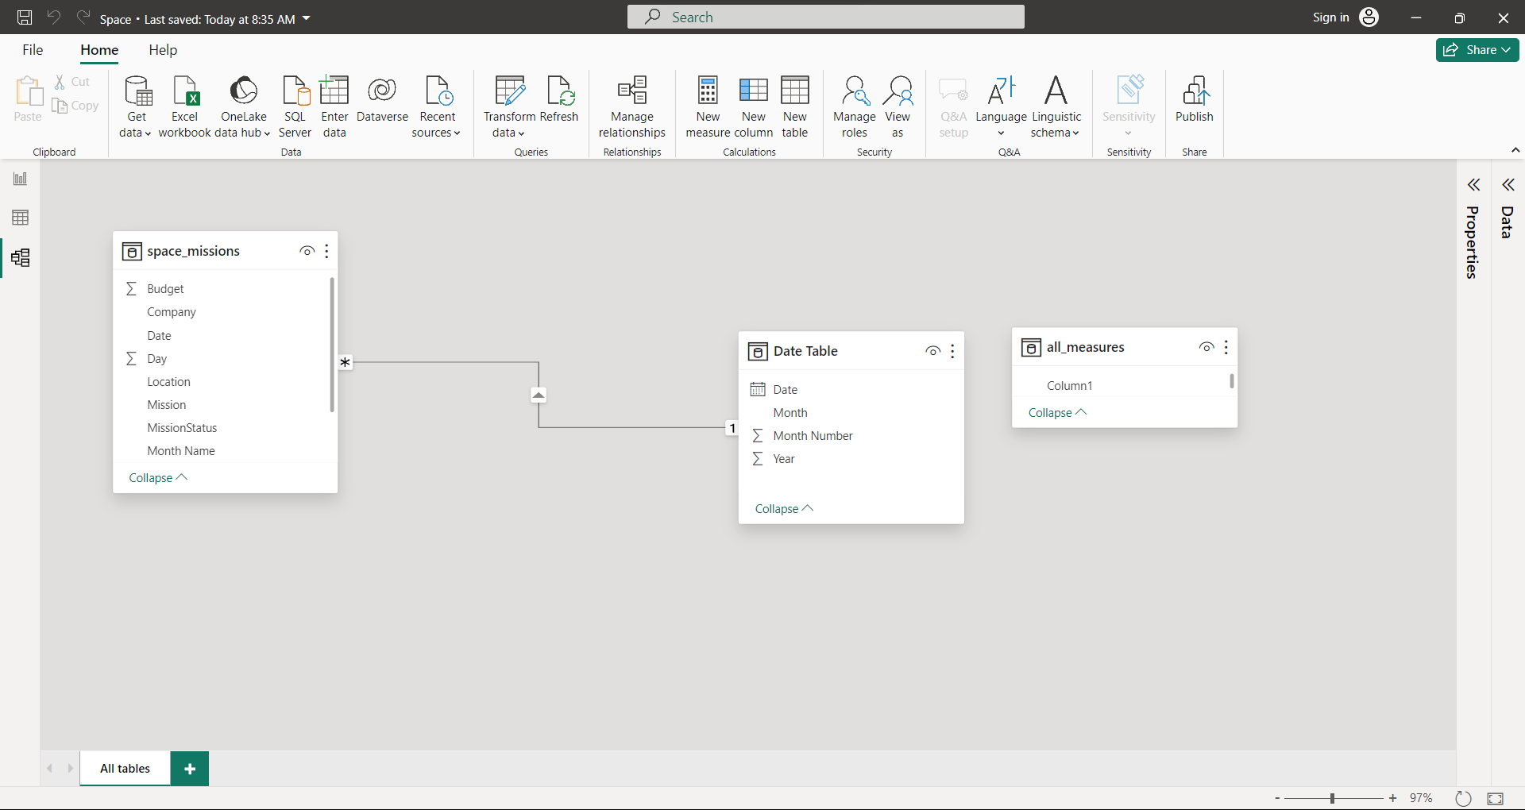
Modelling & Result

Slide 9
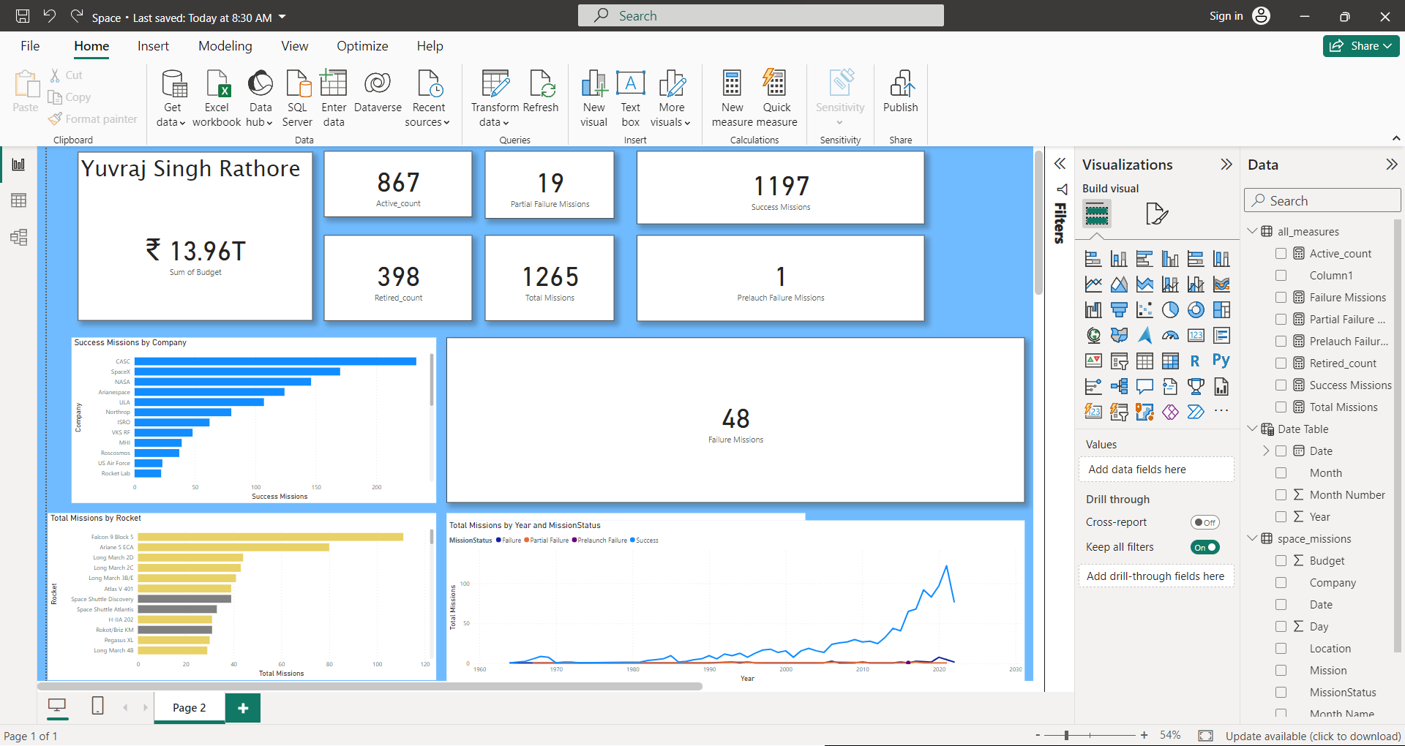
Modelling & Result

Slide 10
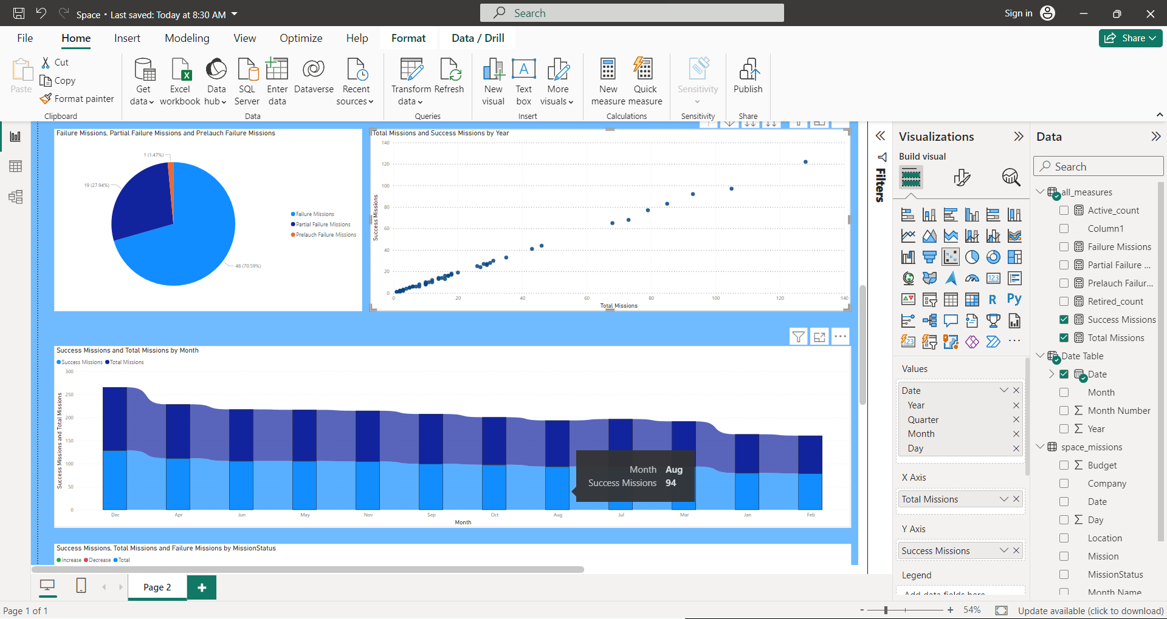
Modelling & Result

Slide 11

Conclusion
Total Missions Trend: The upward trend in total missions by rocket indicates a growing interest in space exploration and satellite deployment.
Success Missions by Location: Certain locations consistently achieve higher success rates, suggesting the importance of factors like infrastructure, weather conditions, and launch facilities.
Budget and Success Missions: The sum of budget and success missions by year shows that investment correlates with mission success. Efficient resource allocation is critical for achieving positive outcomes.
Partial Failure Reasons: Understanding the reasons behind partial failures is crucial. Companies should focus on addressing specific issues to improve overall success rates.

Slide 12


Notes:
Thank You !!

