Slide 1

Computer Engineering Department
A.P. Shah Institute of Technology
G.B.Road,Kasarvadavli, Thane(W), Mumbai-400615
UNIVERSITY OF MUMBAI
Academic Year 2019-2020

Slide 2
A Project Report on
Autonomous Traffic Monitoring and Controlling
Submitted in partial fulfillment of the degree of
Bachelor of Engineering(Sem-7) in
Computer Engineering
By
Yuvraj Yadav(16102040)
Ashwin Shenolikar(16102037)
Tanmay Sule(16102032)
Under the Guidance of
Amol Kalugade

Slide 3
1.Project Conception and Initiation

Slide 4
1.1 Abstract
Traffic rules are introduced in order to make roads traffic-free and convenient. However, the enforcement of these is not always as good.
This implementation proposes a way to enforce traffic rules in a way that violators are actually held liable for breaking traffic rules.
This implementation aims to accomplish this using a combination of image processing, machine learning algorithms and optical character recognition.

Slide 5
1.2 Objectives
Detection and categorization of vehicles from a live CCTV video feed.
Detection of violation of zebra crossing rule at traffic signals and enforcement of traffic rules
Detection of lane cutting incidents and enforcement of traffic rules
Data analysis done of vehicle density to avoid traffic jams and accumulation of vehicles at certain spots

Slide 6
1.3 Literature Review
Automatic Number Plate Recognition System for Vehicle Identification Using Optical Character Recognition.
Authors: Muhammad Tahir Qadri; Muhammad Asif
The solution provided by the authors is divided into 3 major modules: Image Capture, Number plate recognition and extraction, and finally, Character Recognition.

Slide 7
1.4 Problem Definition
The main problem is traffic delays for which the root cause is as follows:
Overspeeding, lane cutting in dense traffic situations give rise to phantom traffic jams, vehicles crossing traffic signals irrespective of whether their lane had a green light or not, and other such reasons.
The main issue faced while tackling these issues is the appropriate handling of recorded instances. The culprits may get away with breaking traffic rules without any repercussions.
Minimization of such instances so that traffic rules are followed by everyone is the aim of the project.

Slide 8
1.5 Scope
The scope of current implementation includes an autonomous system consisting of a vehicle classifier, which can distinguish classes of vehicles into two-wheelers, 4-wheelers, and transport vehicles in real time using CCTV cameras mounted at traffic signals.
The scope is divided into the following modules:
Module 1:- Vehicle Identification & Categorization.
Module 2:- Enforcement of traffic rules.
Module 3:- Data analytics & training.

Slide 9
1.6 Technology stack
Module 1:- Vehicle Identification & Categorization:-
Implementation will be done using Convolutional Neural Networks and OpenCV, an Image Processing Library.
Module 2:- Enforcement of traffic rules:-
1. Deep Belief Networks used in conjunction with the ‘You Only Look Once(YOLO)’ and some other approaches.
2. Backend implementation for fining violators.
Module 3:- Data analytics & training:-
Tensorflow and Cloud based framework for Python

Slide 10
1.7 Benefits for environment & Society
Smoke emission done by vehicles makes up for 94.5% of the carbon footprint in the years 2003–2004 and has increased since then. With this system, it is possible to reduce occurence of traffic jams and by extension reduce the time individual vehicles spend on roads.
A simple lane cutting incident can slow down an entire lane and subsequently, the entire commute. Reducing these incidents is one of the main goals of the project. This will hold liable only those people who have done the traffic violation, and not the bystanders. Additionally, this can reduce occurrences of traffic jams which will save people a lot of time.

Slide 11
2. Project Design

Slide 12
2.1 Proposed System
Recognise vehicles and classify them using CNN model YOLO
Identify vehicle movement and identify those breaking traffic rules.
Number plate recognition using OCR to determine vehicle owner information.
Generation of challan.

Slide 13
2.2 Design(Flow Of Modules)
Use CCTV Cameras as live input to model.
Trained model identifies vehicles and keeps track of movement.
Vehicles recognized to cut lanes or ignore traffic rules are tagged.
Use OCR to read the number plates of these vehicles.
Maintain a database to store such violations for review.
Create challan for approved violations.

Slide 14
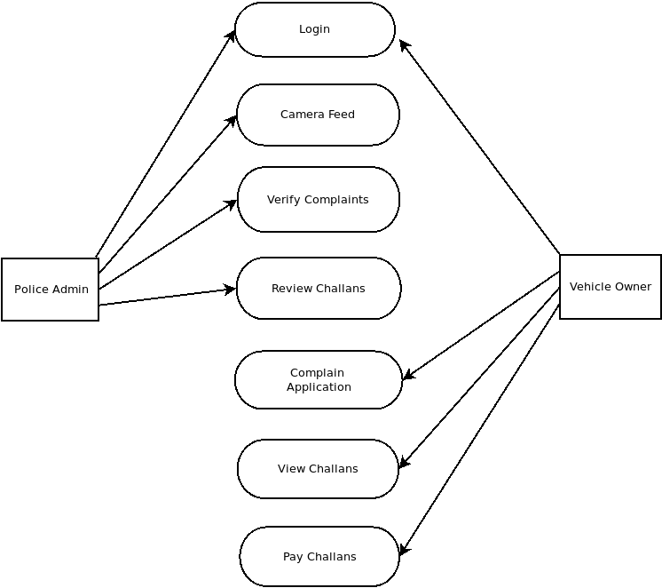
2.3 Description Of Use Case

Slide 15
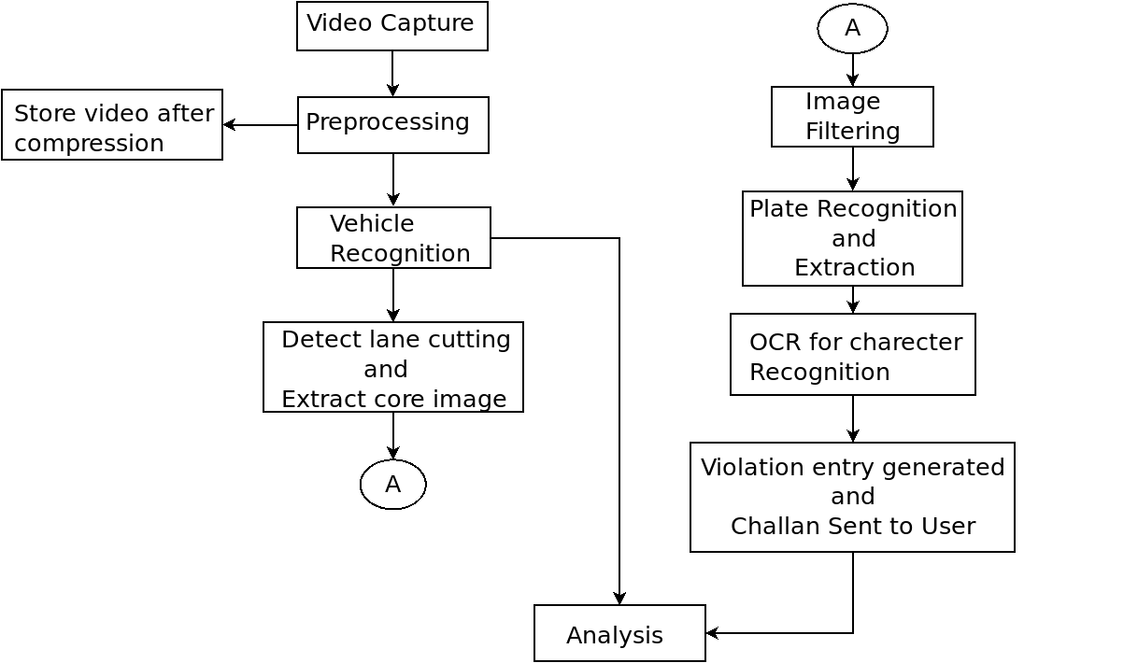
2.4 Activity diagram

Slide 16
2.6 Module-1 : Vehicle Identifcation and Classification
Usage of YOLOv2 with trained weights in real time feed.
Classification Categories: Vehicle and Not-Vehicle.
If vehicle, recognization of vehicle class:
1. Motor Cycle
2. Light Motor Vehicle
3. Heave Motor Vehicle
Accuracy:

Slide 17
Module-2: Enforcement Of Traffic Rules
Training the model to identify when a vehicle commits violation of traffic rules.
Using model in real time using CCTV cameras placed on traffic lights.
After recognizing a vehicle to break rules, use Optical Character Recognition to identify number plate of said vehicle.
Adding entry in database containing traffic rule violation and vehicle and vehicle owner details.
Handing out e-challan to offender.

Slide 18
Module-3: Data Analytics & Training
Use installed cameras and vehicle classifier for determination of traffic density at various points in the network.
Using this data, we can adjust traffic signal durations to help avoid congestion and bottlenecking.

Slide 19
2.7 References
1. https://www.informs-sim.org/wsc15papers/025.pdf
EVALUATING ADVANTAGE OF SHARING INFORMATION AMONG VEHICLES TOWARDAVOIDING PHANTOM TRAFFIC JAM
Author: Shota Ishikawa and Sachiyo Arai
2. https://journals.aps.org/pre/abstract/10.1103/PhysRevE.48.R2335
Cluster effect in initially homogeneous traffic flow
Author: B. S. Kerner and P. Konhäuser

Slide 20
3.Planning for next semester

Slide 21
Planning
Module 2 and Module 3 to be completed in the future.
Further possible applications:
1. Specific Vehicle Tracking
2. Analysis of the traffic in the city

Slide 22
Thank You

