Slide 1
Autonomous Traffic Monitoring and Controlling
Yuvraj Yadav
Ashwin Shenolikar
Tanmay Sule

Slide 2
Introduction
The daily commute of each citizen usually consists of detrimental factors.
Due to various reasons delays are caused in the daily commute,leading to increased travel times which adds to the hectic schedule.

Slide 3
Introduction
Our model aims to ease this part of the citizen’s life by enforcing traffic rules in an automated fashion.
The usage of machine learning and image processing is done in order to achieve this.

Slide 4
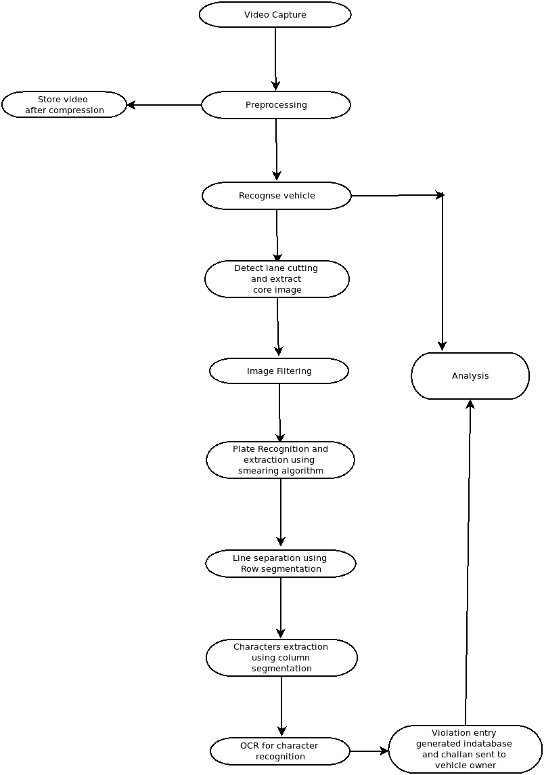

Slide 5
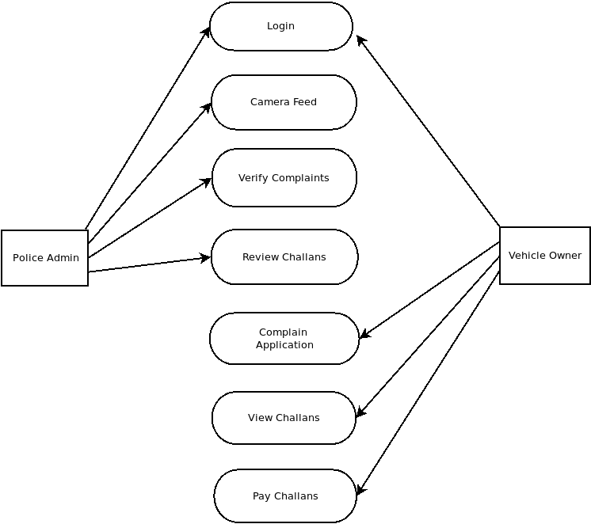
Use Case Diagram

Slide 6
Implementation
YOLO(You Only Look Once):-
General purpose object detection
Principle – Speed, Accuracy, Varied Recognition.
State of the art Image Detection Algorithm

Slide 7
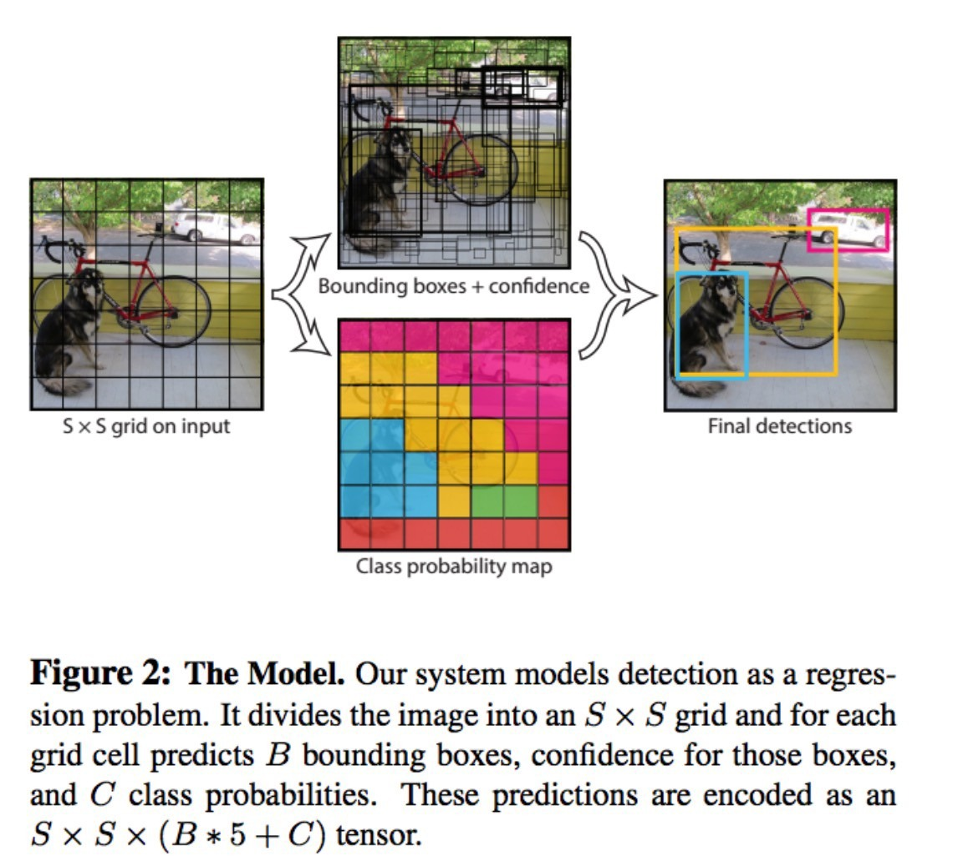
Concept

Slide 8
YOLO features
Batch Normalization
Hi-res Detector
Convolutional Network
Anchor Boxes

Slide 9
Heirarchy
YOLO
Faster R-CNN
Fast R-CNN
Deep MultiBox
OverFeat
MultiGrasp

Slide 10
Publication Referred:
https://arxiv.org/pdf/1612.08242.pdf YOLOv2
https://arxiv.org/pdf/1506.02640.pdf YOLO
https://ieeexplore.ieee.org/document/5169511 Number Plate Recognition

Slide 11
Thank You!

