Slide 1
Downlink Triage (PS 1.4)
Round 2: Satellite Computer and Ground Station
Team 35 | Kepler Aerospace special statement
On-device TinyML visual triage and confidence-aware bandwidth optimizer

Slide 2
Problem statement
PS 1.4 | Track 1: Technology and Innovation
On-Device TinyML Visual Triage & Confidence-Aware Bandwidth Optimizer for Constrained Telemetry Links
Remote edge-sensing nodes and low-Earth-orbit nanosatellites capture gigabytes of optical and radar imagery daily, yet operate over intermittent radio downlinks (such as 256 kbps S-band passes lasting only 10 minutes) and ultra-tight onboard memory envelopes (<= 4.2 MB SRAM), where transmitting cloud-obscured or empty frames wastes critical bandwidth and delays real-time alerts. Teams must build an end-to-end hardware-aware model compression and smart-downlink triage platform.

Slide 3
What changed since Day 1
Part | Day 1 | Now
Model output | Stand-in probabilities | Our trained model, run on the satellite computer
Satellite | Simulated in the browser at 1200x | satellite_agent.py with a real-time clock
Link | Simulated | Throttled sender with emulated loss and re-send
Ground station | Part of the same page | Local receiver server saving real files
Operator controls | Changed the local simulation | Uplink commands applied at the next pass opening
Orbit timing | 10-minute pass | 60 s pass every 180 s, first pass at 20 s

Slide 4
System split: two computers
Satellite computer
Ground station
Holds the images
Runs the model on each frame
Scores relevance, decides full / preview / drop
Queue, storage cap, pass clock
Throttled sender with emulated loss
Downlink: frames, link samples, telemetry
Receives the bytes, saves the files
Inbox and detail view
Link quality, pass reports, comparison
Sends operator commands
Browser page is the ground station only
Uplink: profile, request_full, fault (applied at next pass)

Slide 5
Model: custom MobileNetV3-Small
Classes: Forest, Cropland, Urban, Water, Cloud, CloudShadow, Ship
Backbone: MobileNetV3-Small features only
Input: 64x64 tiles, upscaled to 96x96 inside the model graph
ImageNet head removed; new 7-class fully connected layer, one score per class
Quantization-aware training, then packed to int8: 1.27 MB
Host RAM 13.54 MB idle; SRAM peak vs the 4.2 MB limit: [TBD]
Scored on EuroSAT (4 classes), CloudSEN12 (Cloud, CloudShadow) and HRSID radar (Ship)
0.8780
Macro AP, INT8 (same as Float32)
~0.93 M
Parameters (stock model: ~2.54 M)
1.27 MB
INT8 size (Float32: 4.03 MB)

Slide 6
Fitting the model on board
Resolution handling
Custom int8 packing
Camera tiles stay 64x64 in storage
A bilinear interpolation node inside the ONNX graph upscales them to 96x96 in memory
More features for the model without larger stored images
Standard converters crashed on our QAT model
A custom graph script removes the 4-byte Float32 arrays
It computes the quantization equations itself and writes 1-byte int8 arrays back, past ONNX Identity nodes

Slide 7
Float32 vs INT8
Metric | Original (Float32) | Packed (INT8) | Change
Model size | 4.03 MB | 1.27 MB | -68.5%, under the 4.2 MB limit
Data format | 32-bit float | 8-bit integer | 1 byte per weight instead of 4
Parameters | ~930,000 | ~930,000 | Same MobileNetV3-Small architecture
Macro AP | 0.8780 | 0.8780 | No change after quantization
Inference speed | - | ~0.83 ms / image | 63,600 tiles in 53.02 s on CPU
Active RAM (idle) | - | 13.54 MB | Idle process memory on the host computer
Max RAM (batch) | - | 479.37 MB | Peak during 512-image batch processing

Slide 8
Per-class AP, INT8 model
Land cover (Urban, Forest, Cropland, Water): AP 0.979 to 0.989
Cloud: AP 0.919
Ship (0.671) and CloudShadow (0.621) are the hard cases
Macro AP 0.8780

Slide 9
Per-class results: PyTorch Float32
Class | Scored on | Positives | AP | Best F1 | Precision | Recall | Threshold
Forest | EuroSAT | 465 | 1.000 | 0.998 | not computed | not computed | not computed
Cropland | EuroSAT | 1,085 | 1.000 | 0.997 | not computed | not computed | not computed
Urban | EuroSAT | 1,249 | 1.000 | 0.996 | not computed | not computed | not computed
Water | EuroSAT | 801 | 1.000 | 0.995 | not computed | not computed | not computed
Cloud | CloudSEN12 | 10,912 | 0.961 | 0.897 | 0.878 | 0.917 | 0.288
CloudShadow | CloudSEN12 | 5,262 | 0.743 | 0.662 | 0.660 | 0.663 | 0.561
Ship | HRSID (radar) | 966 | 0.710 | 0.717 | 0.794 | 0.654 | 0.972
Macro AP |  |  | 0.916
Float32 PyTorch model, best epoch 18, full calibration split of 63,600 tiles. Held-out test numbers: [TBD]

Slide 10
Choosing the threshold
Class | Precision at 0.5 | Recall at 0.5 | Best-F1 threshold | Precision there | Recall there
Cloud | 0.901 | 0.880 | 0.288 | 0.878 | 0.917
CloudShadow | 0.636 | 0.683 | 0.561 | 0.660 | 0.663
Ship | 0.461 | 0.747 | 0.972 | 0.794 | 0.654
Ship is only about 2.4% of the calibration tiles, while the model trained on a much more balanced mix
At the default 0.5, Ship precision is 0.461; at its best-F1 threshold of 0.972 it rises to 0.794 (recall 0.654)
So the threshold chosen for each class matters, not just the model

Slide 11
Satellite agent: what runs on board
Capture clock
Inference
Relevance
Decision
Queue + storage
Throttled sender
Capture and inference run continuously between passes
Each frame becomes full, preview or drop, and waits in the queue under a storage cap
Pass clock opens the window; the sender drains the queue by priority
Operator commands received during a gap are applied only when the next pass opens
Telemetry out (queue, storage, counts) and commands in, so it can be tested with a script

Slide 12
Relevance and the triage decision
Model gives a probability per class
Mission profile picks the classes that matter now
Relevance score from selected classes: [formula TBD]
Clouds are dropped onboard; ambiguous targets (40-75% confidence) are flagged for human review; ships go straight to ground control
"How picky" sets the cut between full, preview and drop
Day-1 default 0.70 was tuned on stand-in probabilities that sum to 1; it is retuned on the real spread of our outputs
Full image
High relevance
Preview
Middle band; operator can request full later
Drop
Low relevance, frees storage

Slide 13
Pass timing and link budget
256 kbps
60 s
180 s
~1.9 MB
S-band link rate (32 KB/s)
Pass length
Pass every, first at 20 s
Budget per pass (256 kbps x 60 s)
Day 1 used a 10-minute pass (19.2 MB); the live demo uses 60 s so a real transfer fits
The satellite computer shapes the rate, adds packet loss and rain fade, and re-sends lost packets
A link_sample (rate, loss, elevation) goes out every 10 s of the pass and drives the link-quality chart
A Wi-Fi or cable link has no S-band behaviour, so the link shape is emulated and labelled as such

Slide 14
Messages between the two computers
Direction | Message | Carries
Satellite to ground | pass_start, pass_end | Pass number, time; pass_end adds frames still waiting and whether one was cut off
Satellite to ground | frame_meta, chunk, delivered | Frame id, full or preview, probabilities, relevance, then image bytes in packets
Satellite to ground | link_sample | Rate, loss, elevation every 10 s of the pass
Satellite to ground | telemetry | Queue, storage used, counts
Ground to satellite | profile | Classes, how picky, preview window
Ground to satellite | request_full | Frame id of a delivered preview
Ground to satellite | fault | Ground dropout, power sag, rain fade
profile, request_full and fault are applied at the next pass opening.

Slide 15
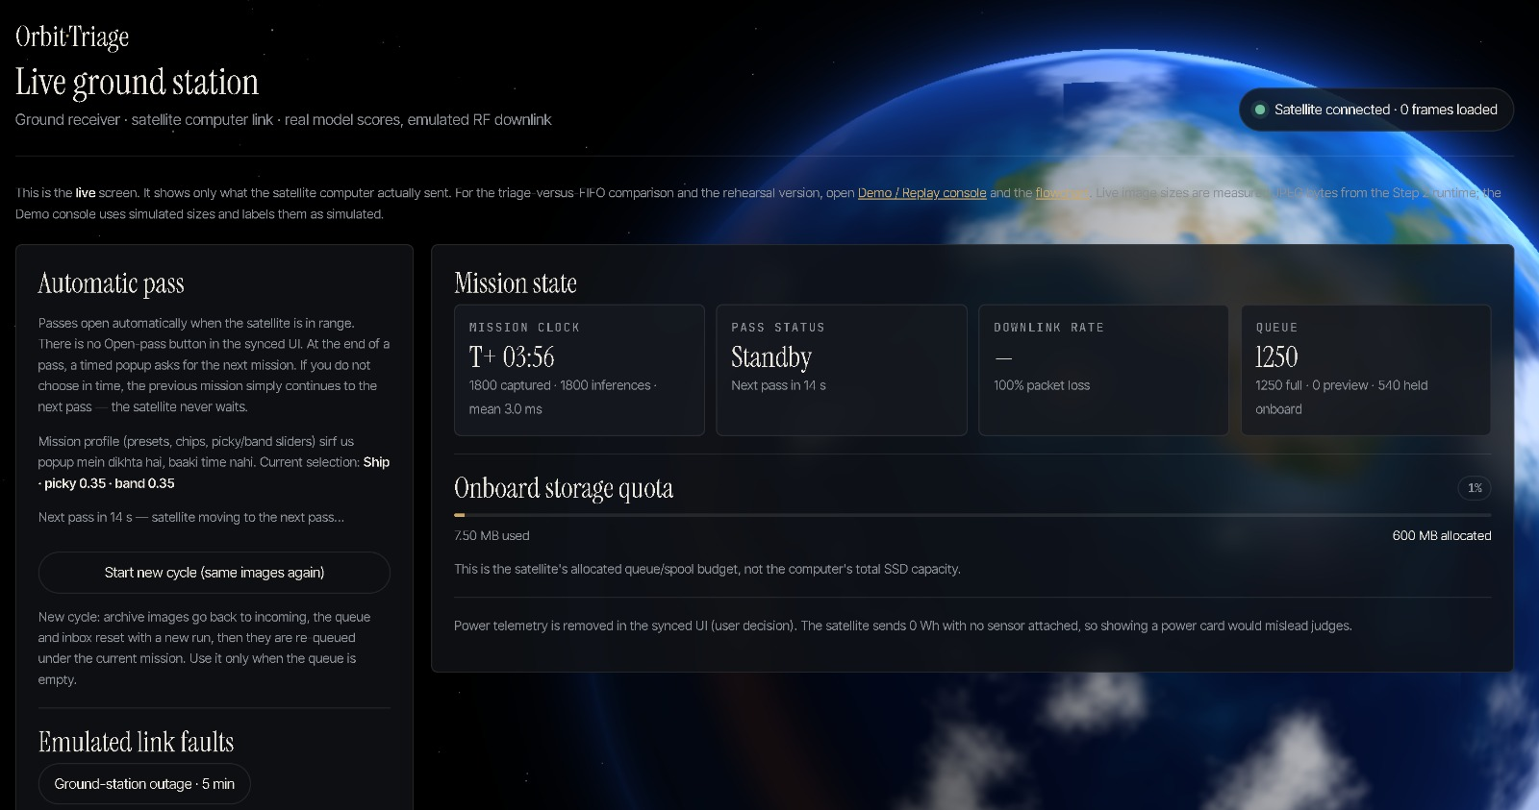
Ground station and UI
Shows only what the satellite computer actually sent
Mission clock, pass status, downlink rate, queue
1800 frames scored, mean 3.0 ms per inference
Storage quota: 600 MB queue budget on the satellite
Link faults are buttons that send uplink commands
Live ground station between passes (standby). The baseline comparison stays simulated and is labelled as such.

Slide 16
Feasibility
Technical
Memory
Runs on CPU via ONNX, ~0.83 ms per image
Real transfer between two computers
Mission changes need no retraining
Limit: peak memory under 4.2 MB
INT8 file 1.27 MB; host RAM 13.54 MB idle
SRAM peak on target: [TBD]
Bandwidth
Operations
About 1.9 MB per 60 s pass at 256 kbps
Relevant frames go down in full
Others go as previews or are dropped
Operator retasks by uplink at next pass
Fault buttons test link problems
Tested end to end on two machines

Slide 17
Limitations
The 256 kbps link shape, packet loss and rain fade are emulated; a Wi-Fi or cable link has no S-band behaviour
No power telemetry: no power sensor is attached, so power and battery are not shown
The baseline comparison is simulated on the same frames and passes
Labels come from three datasets (EuroSAT, CloudSEN12, HRSID); the weak classes are Ship (INT8 AP 0.671) and CloudShadow (0.621)
Results are from the 63,600-tile calibration split; held-out test results [TBD]; no flight imagery
Runs on a general-purpose computer: RAM figures (13.54 MB idle, 479.37 MB at a 512-image batch) are process memory, and SRAM is not measured on a microcontroller
Pass timing is shortened (60 s every 180 s) so a real transfer fits a live demo

Slide 18
Future scope
Port the model to flight-class hardware and measure SRAM, latency and energy
Test over a real radio link (S-band hardware or SDR) instead of an emulated one
Grow from 7 to 8-12 classes and add more radar / SAR classes
Make "how picky" adapt to link quality and storage pressure automatically
Add priority alerts that jump the queue
Extend to several satellites sharing one or more ground stations

Slide 19
Conclusion
We built a working triage chain: model, relevance scoring, queue, throttled downlink and ground station on two computers
The model decides per frame whether to send in full, send a preview or drop, so scarce pass time goes to what matters
Operators change the mission by uplink without retraining the model
What is emulated or assumed is labelled on screen
0.8780
Macro AP, INT8, 7 classes
1.27 MB
INT8 model size
~1.9 MB
Budget per 60 s pass at 256 kbps

Slide 20
References
TinyML Enhances CubeSat Mission Capabilities. https://arxiv.org/html/2603.20174v1
EuroSAT Sentinel-2 Land Cover Benchmark Dataset. https://zenodo.org/records/7711810
HRSID High-Resolution SAR Ship Detection Dataset. https://github.com/chaozhong2010/HRSID
SpaceNet, AWS Open Data Registry. https://registry.opendata.aws/spacenet/
CloudSEN12, Sentinel-2 cloud and cloud shadow dataset [TBD: add link]

Slide 21
Thank you
Team 35 | Downlink Triage (PS 1.4)

