Slide 1
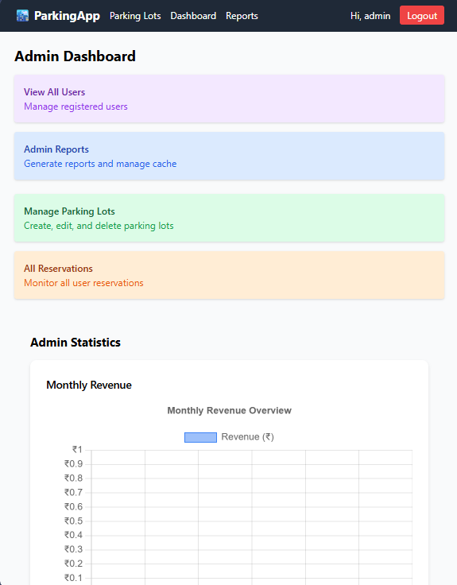
ParkWise
Smart Parking Management System
A full-stack web application solving urban parking inefficiencies through real-time visibility, automated reservations, and intelligent analytics.

Slide 2







The Parking Problem
Driver Frustration
Operator Blindness
Time wasted searching for available spots without centralized visibility.
No real-time system for occupancy tracking, reservations, or usage analytics.
Manual Inefficiency
Slow billing, error-prone reporting, and poor communication channels.

Slide 3
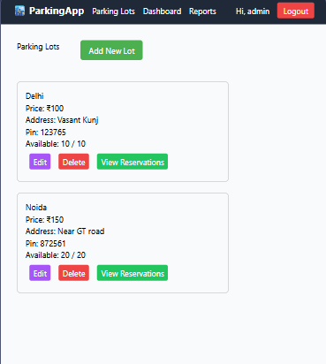
Project Objectives
Core Goals
Key Features
Real-time lot discovery and reservation
Transparent duration-based pricing
Admin control over all operations
Automated CSV exports and reports
Visual analytics dashboards
Background task monitoring
Role-based access control

Slide 4

System Architecture
Background Workers
Celery tasks for emails
Cache Layer
Redis for sessions and caching
Data Layer
SQLite via SQLAlchemy
Flask API
REST endpoints with JWT auth
Vue 3 Frontend
SPA with Router, Pinia, Axios
01
02
Vue 3 SPA
Flask REST API
Frontend with Vue Router, Pinia state management, and Axios for API calls.
JWT authentication, SQLAlchemy ORM, and role-based endpoint protection.
03
04
Data Layer
Async Processing
SQLite persistence with relational models for users, lots, spots, and reservations.
Celery workers with Redis broker handle CSV exports, reminders, and reports.

Slide 5

Reservation Lifecycle
Available Spots
Reserved
Released
Occupied
Core Business Rules
API Endpoints
One active reservation per user enforced
Spot occupancy status tracking (Available/Occupied)
Automatic cost calculation based on duration
POST /api/reserve-spot to book
PUT /api/release-spot/{id} to release
Automatic state transitions

Slide 6
Performance & Analytics
Redis Caching
Celery Background Jobs
Live Task Tracking
Reduced database reads for parking lot lists, improving response times.
Prevented API blocking for heavy operations like CSV generation.
Frontend polls task status every 2 seconds for real-time progress feedback.
Observable KPIs
Total lots, spots, occupied vs available
Active reservations count
User spending and duration profiles
Revenue and reservation trends
Lot utilization percentages
Task status monitoring

Slide 7
Current Limitations
State Inconsistency
Hardcoded URLs
Reservation status naming varies (completed vs parked out) affecting computed summaries.
Mix of absolute (http://localhost:5000) and relative paths complicates deployment.
Secrets Management
Testing Gap
No robust environment-based strategy for JWT keys and mail credentials yet.
No test suite or benchmark scripts for formal latency-throughput reporting.

Slide 8





Future Roadmap
Payment Integration
Add payment gateway and invoice generation for complete transaction flow.
Map Navigation
Introduce geolocation-based lot discovery and turn-by-turn routing.
Test Suite
Implement automated testing with CI pipeline for reliability.
Containerization
Docker Compose and Kubernetes for scalable, production-ready deployment.

