Slide 1
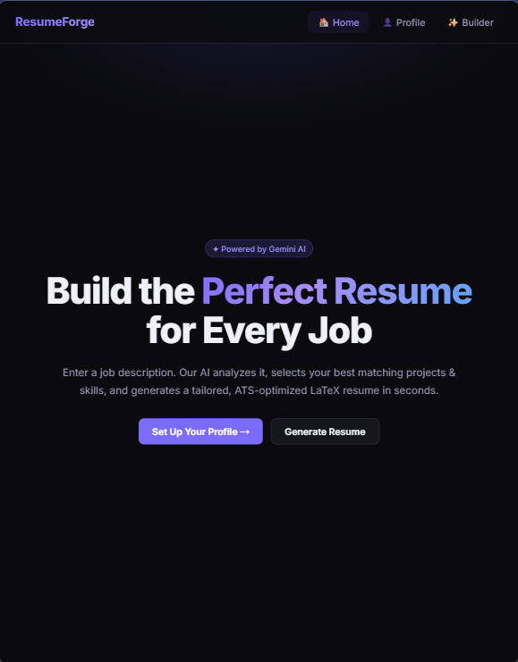
ResumeForge
AI-Assisted Resume Generation for Modern Job Applications

Slide 2




The Problem
Manual resume customization is slow, repetitive, and inconsistent. Generic resumes miss JD keywords and fail ATS screening.
Time Overhead
Relevance Mismatch
Manual rewriting of summaries, projects, and skills for every application
Generic resumes miss JD keywords and fail ATS screening
Version Chaos
No structured history of generated resume variants

Slide 3
Project Objectives
01
02
03
Full-Stack Web App
AI-Powered Selection
LaTeX Output
Profile-driven resume generation platform
Relevant content matching for target JD
Clean, compilable, ATS-friendly format
04
05
History Tracking
Token Efficiency
Generated-resume history with snapshots
Minimize cost by sending only dynamic fields

Slide 4

System Architecture
Frontend
Database
React SPA with responsive UI
MongoDB with Mongoose schemas
Profile management interface
JD input and generation
History view and actions
User profiles
Generated resumes
Resume snapshots
Backend
AI Layer
Node.js + Express REST API
Provider-switchable service
Profile CRUD operations
LaTeX generation
Ollama (local)
Gemini (cloud)
JSON output contract

Slide 5
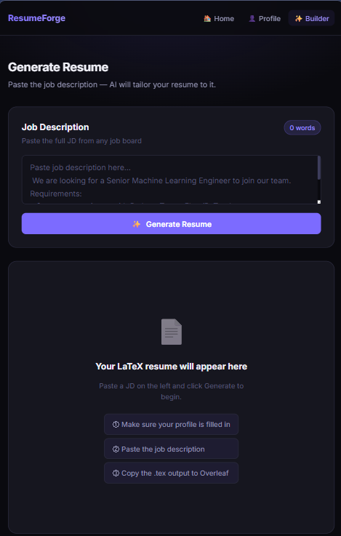







Generation Methodology
Save Profile
User creates master profile with all sections
Paste JD
Job description input on builder interface
AI Processing
Lightweight context sent for relevance matching
JSON Output
Structured selection of summary, projects, skills
LaTeX Build
Deterministic template-based rendering
History Store
Complete snapshot with JD and AI decisions
Token-Efficient Design: Only selectable fields sent to AI.
Static fields (personal info, education) excluded from prompts.

Slide 6
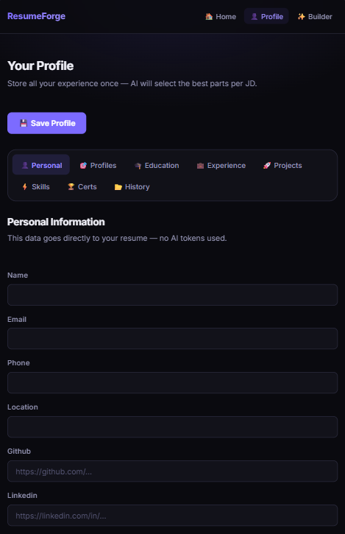
Key Features
Multi-Section Profile
Personal info, education, experience, projects, skills, certifications managed in tabbed interface
JD-Aware Generation
AI selects and rewrites most relevant content for target job description
History Management
View, copy, download, delete, and restore profile from generated resume snapshots
LaTeX Export
Copy to clipboard or download .tex file for compilation

Slide 7
Results & Performance
Achievements
Current Limitations
End-to-end pipeline operational
Structured JSON to valid LaTeX
History supports auditing and restoration
Multi-profile support for varied tracks
No automated benchmark suite for latency, token statistics, or ATS score comparison.
Limited test coverage for generation paths.
Performance Characteristics
Lower token usage via lightweight payloads
Reliable output with structured contracts
Scalable UX with save-once model

Slide 8






Future Roadmap
Authentication
Per-user isolated profiles with secure accounts
PDF Export
Direct server-side LaTeX compilation to PDF
Metrics Dashboard
Generation time, token costs, success rates tracking
Test Coverage
API, parser robustness, and LaTeX builder verification
Enhanced AI
Schema validation, retries, similarity scoring, recommendations
Multiple Templates
Additional themes beyond current Jake-style format

