Slide 1

Cardiovascular Health:
An In-Depth Analysis
This presentation explores a comprehensive analysis of factors impacting cardiovascular health. We will explore a rich dataset, uncover key insights, and present a compelling visualization of findings.
By Yuvraj Singh Shekhawat

Slide 2
Need for Analysis
Cardiovascular disease is the leading cause of death globally, with significant impacts on public health and healthcare systems. Despite advances in treatment, prevention strategies are often underutilized, particularly in certain demographics.
Problem Statement:
There is a growing need to better understand the risk factors associated with cardiovascular disease, especially in relation to lifestyle, mental health, and demographic factors. Current public health initiatives may not be adequately targeting these areas.
Objectives:
Identify key risk factors for cardiovascular disease across different demographics.
Understand the relationship between mental health (depression) and cardiovascular health.
Provide actionable insights to guide public health interventions and resource allocation

Slide 3
Dataset Overview: Sources and Metrics
Data Sources
Key Metrics
The dataset for this analysis was obtained from Kaggle. It includes key factors derived from the BRFSS Dataset (Behavioral Risk Factor Surveillance System).
The analysis focused on several important lifestyle and demographic factors that can influence cardiovascular health, including:
BRFSS Overview: The Behavioral Risk Factor Surveillance System (BRFSS) is the nation’s premier system of health-related telephone surveys. It collects state-level data on U.S. residents concerning their health-related risk behaviors, chronic health conditions, and use of preventive services.
Exercise: whether physically active or not.
BMI (Body Mass Index): An indicator of body fat and overall health.
Sex: Differences in health risks and outcomes between males and females.
Purpose: This dataset helps analyze cardiovascular health across different age groups by providing valuable insights into various health and lifestyle factors.
Age: The impact of aging on cardiovascular health.
Smoking: Whether people with a smoking history had heart diseases or not.
Depression: Examined the relationship between depression, smoking, and cardiovascular disease.

Slide 4
Key Insights: Demographic Trends
Age
The data suggests that heart disease risk increases with age, especially from 50 onwards. This insight could guide targeted interventions or screenings for older age groups
Sex
Even though the number of female respondents are more, Men tend to have higher rates of cardiovascular disease than women.
Physical Activity
a significant majority of the population may be at higher risk for cardiovascular issues due to lack of physical activity. Promoting physical activity could be a key intervention to reduce heart disease prevalence.
Health Perception
Perception of good health does not always correlate with actual health status. This could indicate that individuals may be unaware of their heart disease risk or symptoms, highlighting the importance of regular health screenings.
Depression and Smoking
Individuals with depression might be using smoking as a coping mechanism. This self-medicating behavior can exacerbate both physical and mental health issues, creating a vicious cycle where smoking leads to worse health outcomes, which in turn can worsen depression.

Slide 5
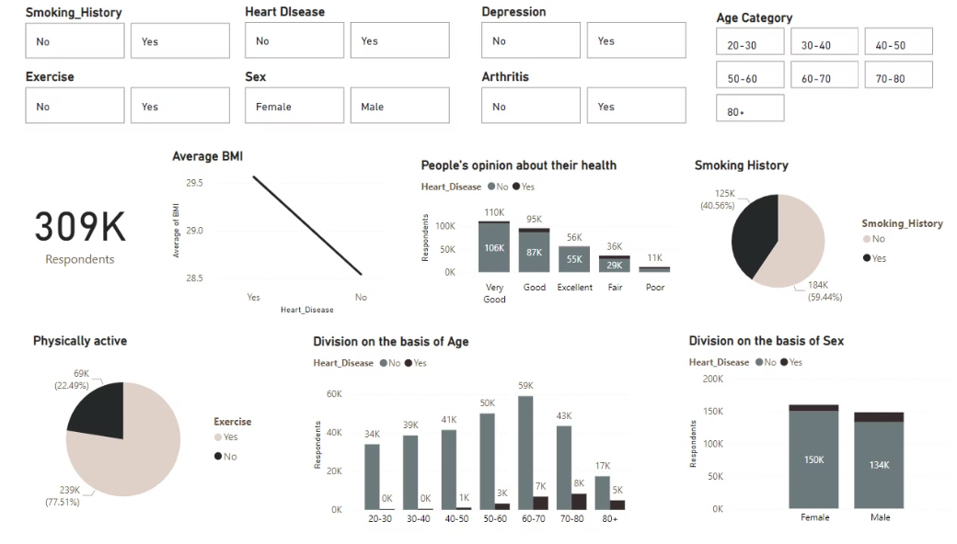
Dashboard Section: Visualizing the Data
Purpose
The dashboard is designed to provide a comprehensive analysis of factors influencing cardiovascular health among a population of around 309,000 respondents. It aims to identify key risk factors and demographic trends to inform public health strategies and interventions.

Slide 6
Key Features of the Dashboard:
Demographic Filters: The top section allows filtering of data by age category, sex, smoking history, depression, arthritis, and exercise habits. This enables users to explore how these factors intersect with cardiovascular health.
Mental Health and Lifestyle: There is a notable correlation between depression and smoking, suggesting that individuals with depression might use smoking as a coping mechanism, which can further exacerbate their health risks.
Health Insights: Heart Disease and Age: The dashboard shows a clear trend of increasing heart disease risk with age, particularly for those over 50. Sex Differences: Despite a higher number of female respondents, men show a higher prevalence of cardiovascular disease. Physical Activity: A significant portion of the population is physically inactive, highlighting a major risk factor for heart disease.
Health Perception: The dashboard includes respondents' self-reported health status, revealing a possible disconnect between perceived and actual health, particularly in relation to heart disease.

Slide 7

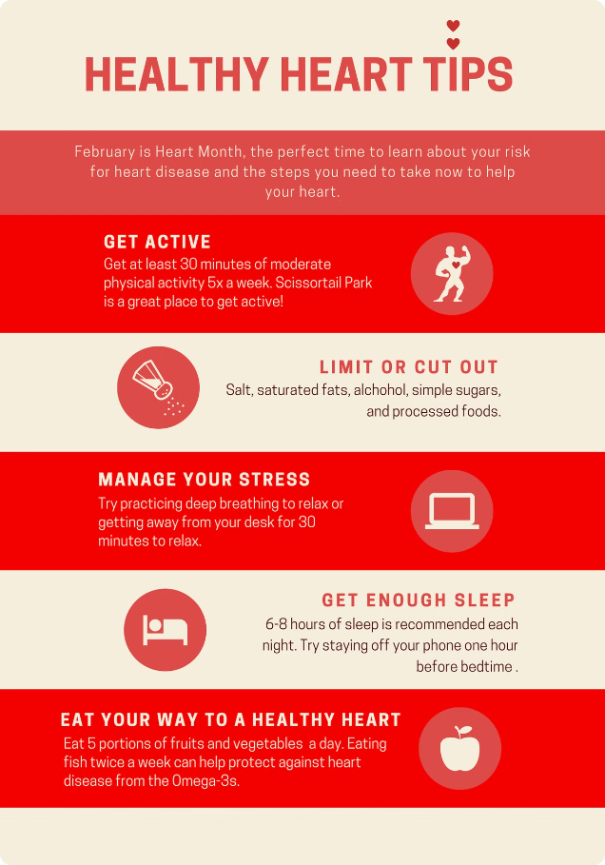
Takeaways and Recommendations
Focus on implementing targeted screening programs and preventive measures for individuals aged 50 and above. Tailored interventions can help detect and manage heart disease at an earlier stage in this high-risk group.
Develop gender-specific health campaigns and interventions. Although men are at higher risk, both genders would benefit from increased awareness and preventive measures for cardiovascular health.
Promote and facilitate physical activity through community programs, workplace wellness initiatives, and public health campaigns. Encouraging regular exercise can be a key strategy in reducing heart disease prevalence.
Increase public education on the importance of regular health screenings and accurate self-assessment. Healthcare providers should emphasize the need for routine check-ups even for those who feel healthy.
Integrate mental health support with smoking cessation programs. Addressing both mental health issues and smoking can help break the cycle and improve overall health outcomes.

Slide 8
Thank You!
Thank you for exploring my project and engaging with the insights provided. Your interest and support mean a lot.
I appreciate your time and attention.

