Slide 1
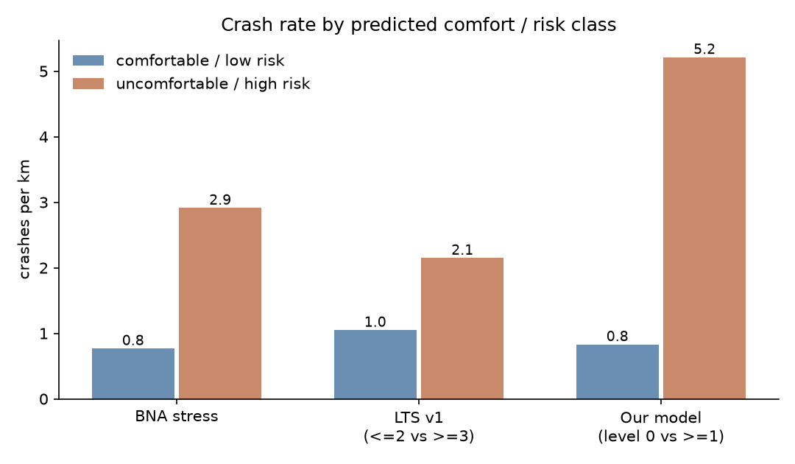
Calm on the map, crashes on the street
Checking RideScore DC's LTS & BNA against 5 years of DC bike crashes · Challenge 1 (ideas 4.3 + 4.2)
Yuvraj Gupta · github.com/YuvrajGupta1808/CivicTech
Problem: RideScore colours DC streets by design (LTS). Nobody had checked those colours against where cyclists actually crash.
What we did: Joined 3,089 bike crashes (Crashes in DC, 2021–2026) to 19,554 DDOT blocks. Trained a crash model on OSM + DDOT street design (OSM↔DDOT cross-attention + boosting + safety-performance formula). Tested only on wards it never saw.
Finding: the 10% of blocks our model ranks riskiest hold 44% of crashes. LTS: 13%. BNA: 18%. Random: 10%.
Crashes per km: 'comfortable' vs 'uncomfortable' streets

Slide 2
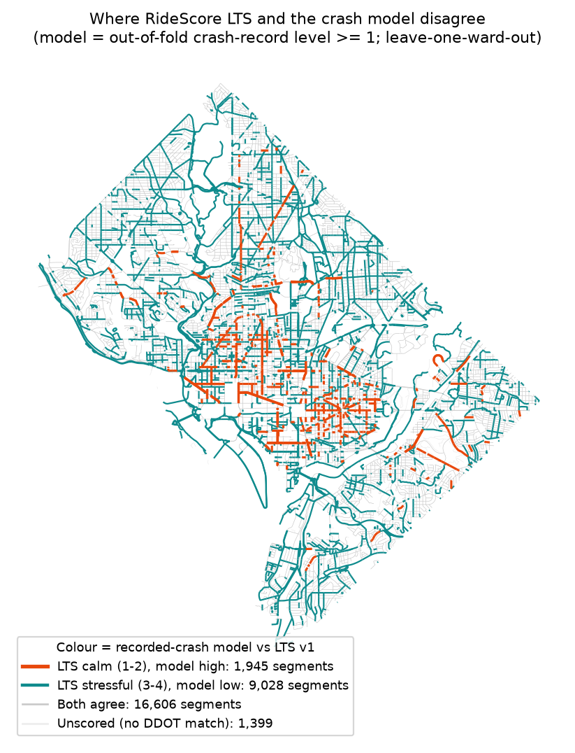
Where LTS says calm, crashes say otherwise
Evidence
Streets LTS calls calm but our model flags: 4% of the network, 15% of all bike crashes (5.3 crashes/km, same as streets both call risky).
Worst block in DC: 14th St NW at Irving St, LTS 1 with a protected lane, 18 crashes in 5 years.
Honest limits
No ridership data: this shows where crashes happen, not danger per ride (busy bike routes get more crashes). Wards 7–8 lose ~20% of crashes in the data match.
Next steps for RideScore
Add a crash layer next to LTS, not instead of it.
Add bike counts to separate busy from dangerous.
Fix Ward 7–8 crash matching.
Per-segment scores ready: crash_risk_by_segment.parquet.
Data: © OpenStreetMap contributors (ODbL); DDOT, MPD Crashes in DC (CC BY 4.0)

