Slide 1
SENTINEL-2 · COMPUTER VISION · CA-ANN
ForestWatch India
Detecting and forecasting urban forest cover change across four Indian cities, using real Sentinel-2 imagery, a custom spectral formula, and a hybrid CA-ANN prediction model.
Yuvraj Singh Hajari · 23BCE1995
Guide: Kumar K · VIT Chennai

Slide 2
Cities lose forest faster than it gets measured
MOTIVATION
Most monitoring of urban forest cover still relies on global products built for 30-metre resolution and multi-year lag. A city losing a six-hectare patch this year will not see that loss reflected for seasons. Planners need something finer-grained, faster to re-run, and verifiable against their own city, not a continental average.
Fine-grained detection
Per-city, ~11.7m resolution, not a 30m global average
A transparent method
A re-runnable spectral formula, not a black-box index
Forward-looking risk
A ranked, actionable list, not just an after-the-fact loss map

Slide 3
Ten years, four cities, real reflectance
DATA
Every image comes from Sentinel-2's surface-reflectance product via Google Earth Engine, atmospheric correction already applied. Four bands feed the pipeline: Red, Green, Blue and Near-Infrared, with the Scene Classification Layer masking cloud, shadow and cirrus before compositing.
City | Radius | Area
Delhi | 6 km | 144 km²
Kolkata | 6 km | 144 km²
Bengaluru | 6 km | 144 km²
Chennai | 6 km | 144 km²
10
4
11.7m
years, 2016–2025
cities validated
per pixel

Slide 4
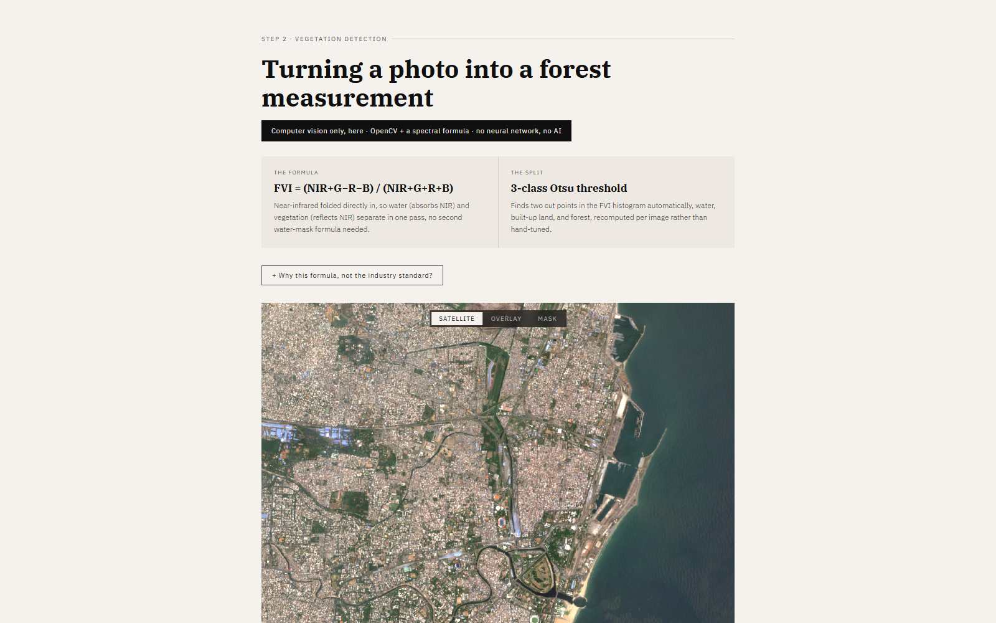
Turning a photo into a forest measurement
COMPUTER VISION STAGE
NO NEURAL NETWORK · NO AI · PURE OPENCV
THE FORMULA · FVI
(NIR+G−R−B) / (NIR+G+R+B)
Near-infrared folded directly in, so water and vegetation separate in one pass, no second water-mask formula needed.
THE SPLIT
3-class Otsu threshold
Finds water, built-up land, and forest automatically, recomputed per image rather than hand-tuned.

Slide 5
From satellite tile to live dashboard
SYSTEM ARCHITECTURE
DATA LAYER
PROCESSING
BACKEND API
FRONTEND
Sentinel-2 + GEE
OpenCV + Clay + CA-ANN
FastAPI
React + Vite
Cached GeoTIFFs on disk, SCL cloud masking, 4 cities × 10 years
FVI/Otsu masks, frozen Clay embeddings, trained MLP ensemble
In-memory response cache, static image serving, 9 live endpoints
Interactive dashboard, scroll-driven explainers, live queries
Once imagery is fetched, every analysis runs on local cached data: no internet dependency for the live demo.

Slide 6
Every layer, request to response
SYSTEM ARCHITECTURE · DETAILED
EXTERNAL DATA SOURCE
INTERNET REQUIRED ONLY HERE
Sentinel-2 Surface Reflectance via Google Earth Engine
Imagery is fetched once per city and year, then written to disk. Every later analysis call reads from that cache.
STORAGE — static/
GeoTIFFs · cached masks · Clay embeddings · trained models
OpenCV
Clay v1.5
CA-ANN
EVERYTHING BELOW RUNS OFFLINE
FVI + 3-class Otsu
frozen embeddings, offline only
8-seed MLP ensemble
Processing, the API, and the UI all run on cached local data, no internet dependency for a live demo. Repeat requests for the same city return in under a second.
BACKEND — FastAPI (main.py)
9 REST endpoints · in-memory response cache · static image serving
HTTP / JSON + PNG
FRONTEND — React + Vite
9 ENDPOINTS
Landing, guided intro, and a 5-tab dashboard
/cities /years /analyze /compare /predict /risk /conservation-priority /validate-hansen
USER — Browser
The live demo, running entirely on localhost

Slide 7
Two questions become one map
PREDICTION PIPELINE
1
2
3
Clay v1.5
Hand-built features
12-dim merge
Pretrained by someone else, never trained by us. One tile in, 1024 numbers out, reduced to 8.
4 numbers, no learning: forest density at 3 scales, distance to the nearest edge.
Clay's 8 and our 4, concatenated into one description per pixel.
4
5
6
Our network
10-year history
Combine
The only trained part: 12 in, 16, 8, 1 out, a per-pixel change probability.
No learning, just counting: how much forest changes per year, on average.
Rank every pixel by risk. Spend the historical budget on the riskiest first.

Slide 8
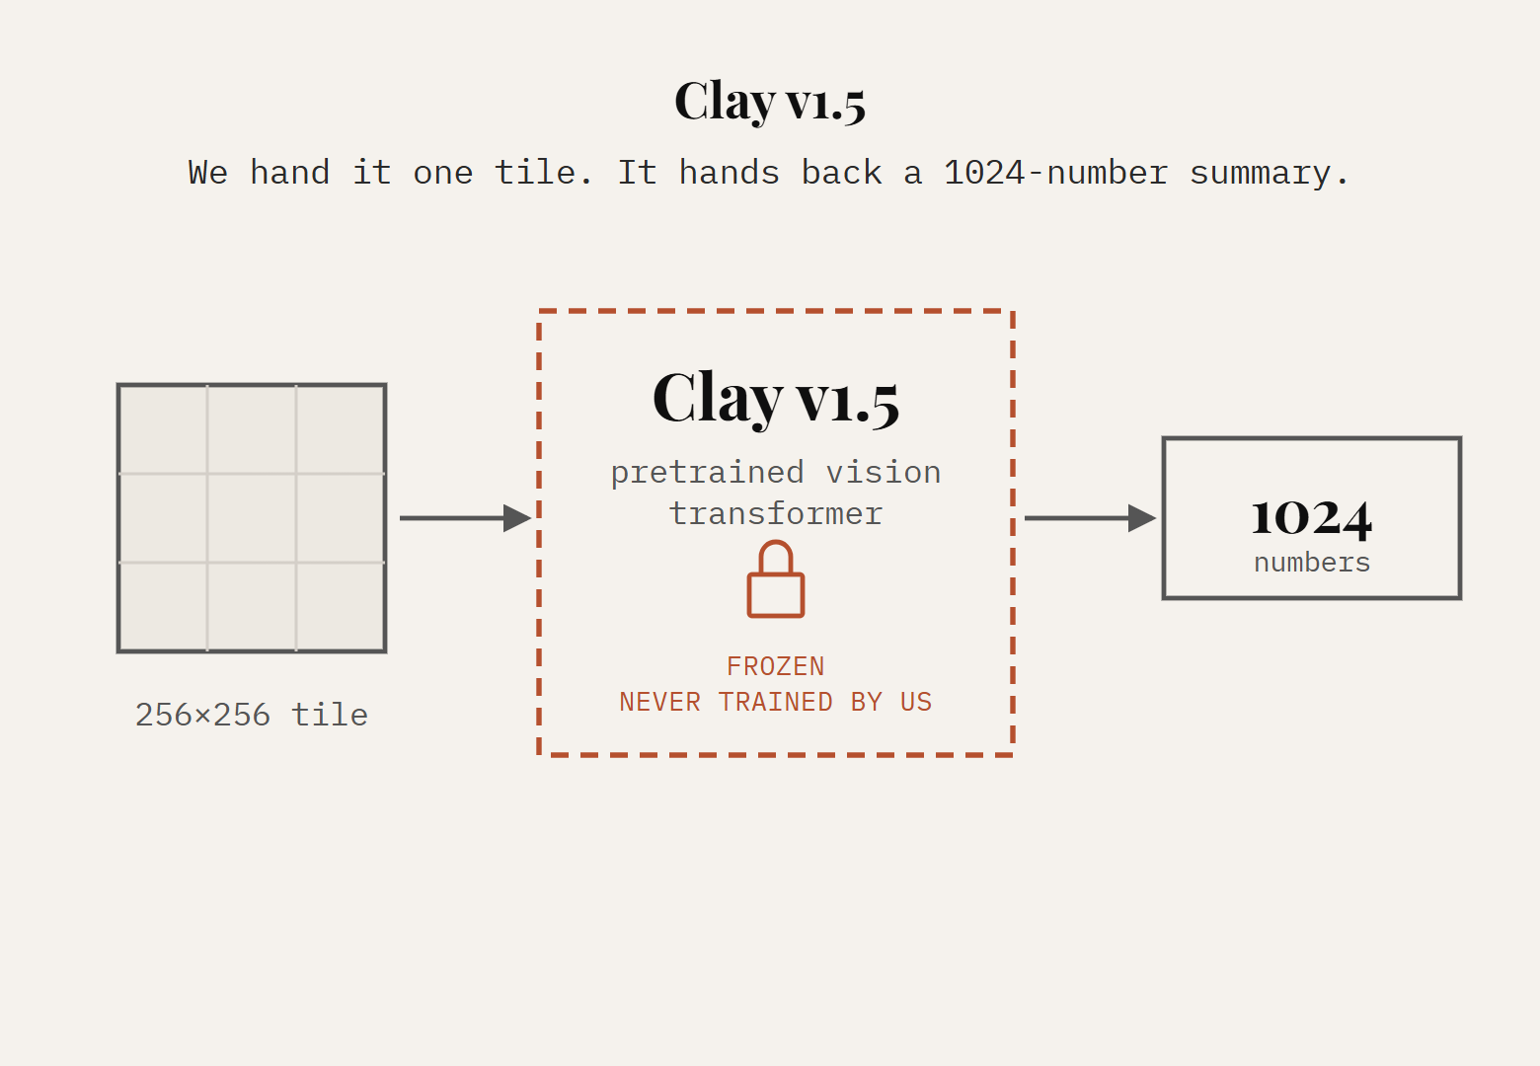
Step 1 of 6 · Clay v1.5
BEHIND THE SCENES
frozen · pretrained · 8 numbers after reduction
A foundation model, pretrained on millions of satellite images worldwide. We hand it a tile and it hands back 1024 numbers that summarise what's in that image.

Slide 9
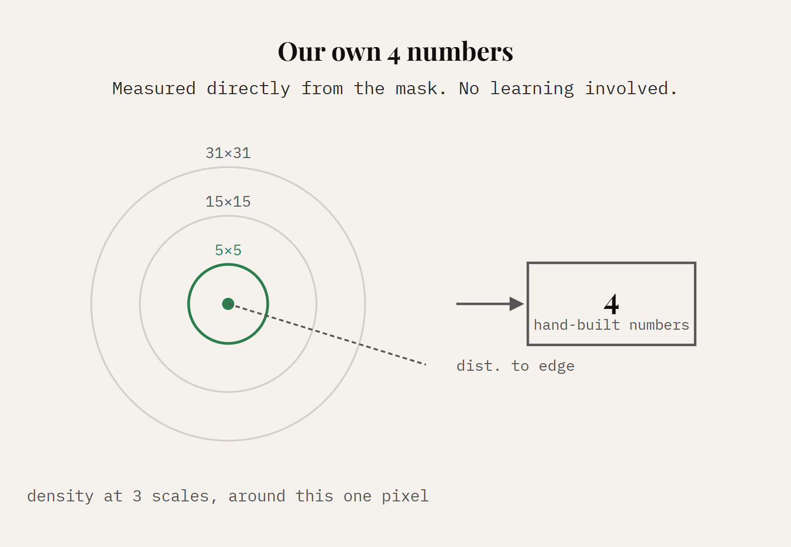
Step 2 of 6 · Our own 4 numbers
BEHIND THE SCENES
hand-built · 4 numbers
Measured directly, no learning involved: how much forest surrounds this pixel at three different distances, and how close it sits to a forest edge.

Slide 10
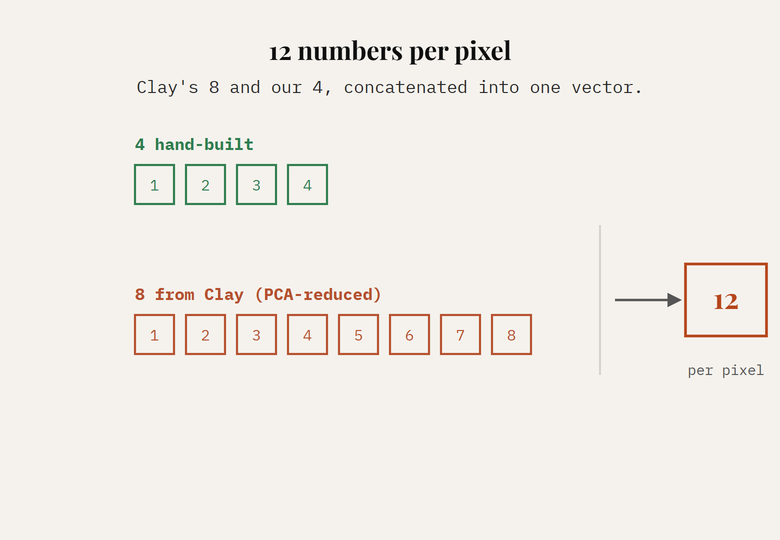
Step 3 of 6 · 12 numbers per pixel
BEHIND THE SCENES
4 + 8 = 12
Clay's 8 and our 4, concatenated. Every pixel in the image now carries this same 12-number description.

Slide 11
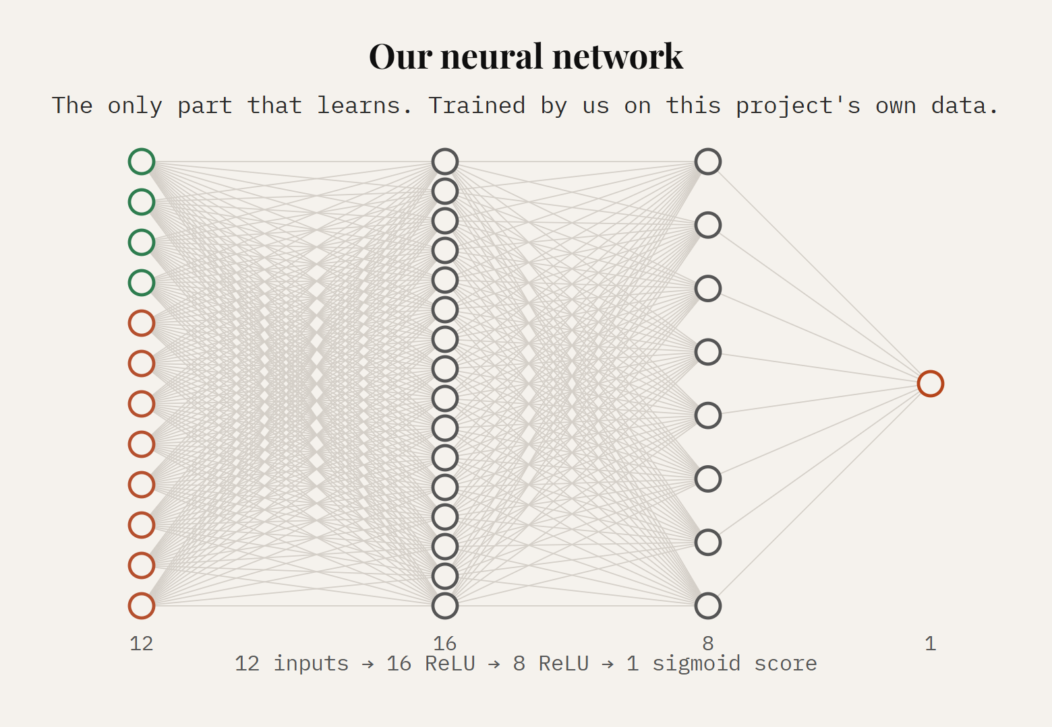
Step 4 of 6 · Our neural network
BEHIND THE SCENES
trained by us · 12 → 16 → 8 → 1
A small network we trained ourselves on this project's own data, 12 numbers in, one score out: how likely is this specific pixel to change? This is the only part that learns.

Slide 12
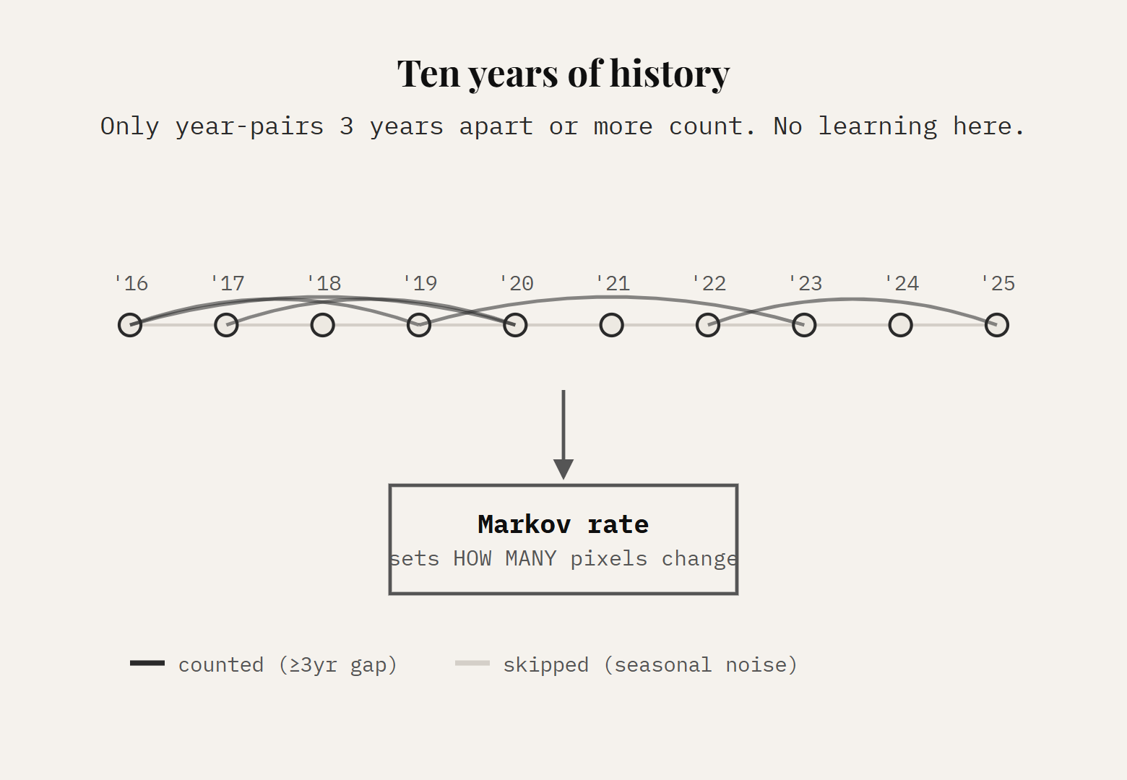
Step 5 of 6 · 10 years of history
BEHIND THE SCENES
no learning · simple counting
Separately, we look at how much forest typically changed year to year across the whole decade. This sets a budget: how many pixels should change, not which ones.

Slide 13
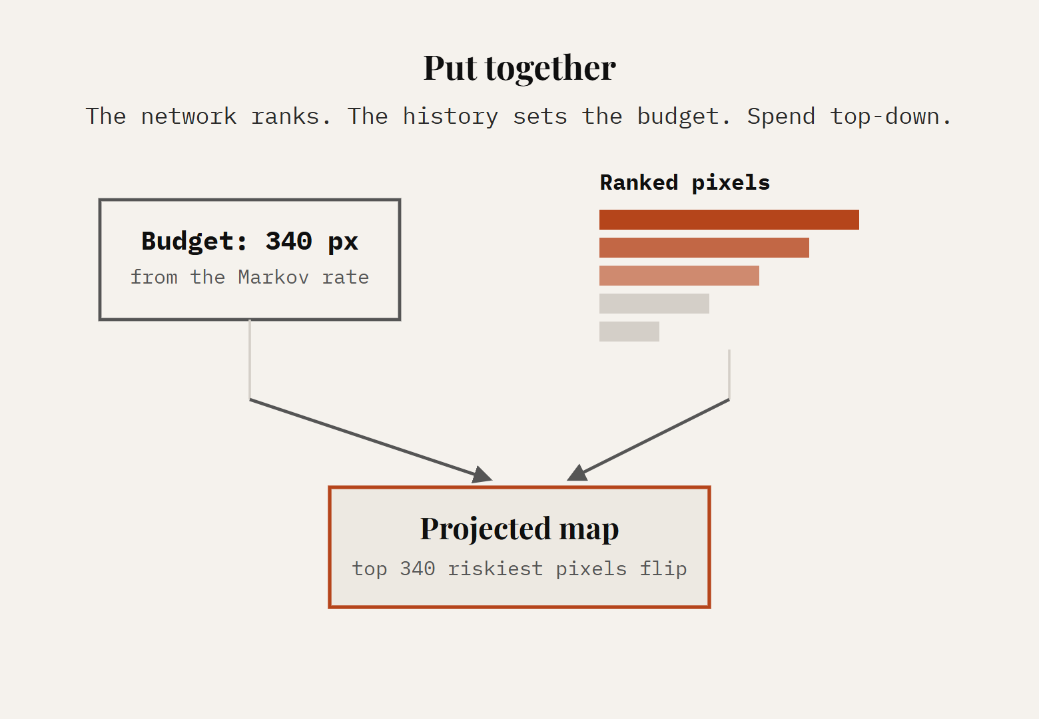
Step 6 of 6 · Put together
BEHIND THE SCENES
network says WHERE · history says HOW MUCH
The network ranks every pixel by risk. The history sets how many pixels get to change. Rank the candidates, spend the budget on the riskiest ones first: that's the projected map.

Slide 14
From raw tile to ranked decision
WORKFLOW · DETAILED
1
Fetch Sentinel-2 imagery, 2016–2025, 4 cities
2
Compute FVI per pixel: (NIR+G−R−B)/(NIR+G+R+B)
3-class Otsu → forest / water / built-up mask
CV-ONLY OUTPUT · DETECTION & COMPARE
3
Per-year stats and the two-year diff map (0.1 ha filter). Pure computer vision, no CA-ANN involved.
4
Feature engineering: 4 hand-built + Clay v1.5 (12-dim)
5
Train CA-ANN: 8-seed MLP ensemble, calibrated
6
Historical Markov rate, 3-year-gap filtered
7
Rank by score, spend the budget → projected map
OUTPUT
OUTPUT
VALIDATION
Risk Heatmap
Conservation Priority
Walk-forward testing (16 splits) + an external Hansen GFC cross-check → Kappa 0.78

Slide 15
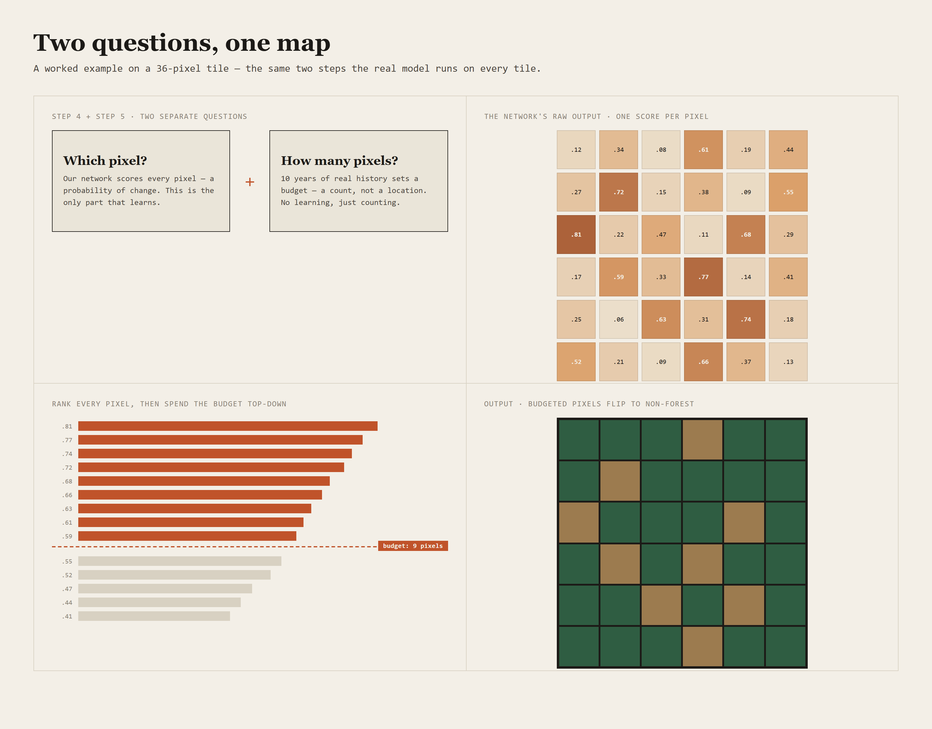
A 36-pixel tile, start to finish
WORKED EXAMPLE

Slide 16
One formula vs. the two-step standard
VALIDATION · SPECTRAL FORMULA
INDUSTRY STANDARD · TWO FORMULAS
THIS PROJECT · ONE FORMULA
NDVI = (NIR−R) / (NIR+R)
NDWI = (G−NIR) / (G+NIR)
FVI = (NIR+G−R−B) / (NIR+G+R+B)
NIR built into one ratio: no second mask that has to agree with the first at every boundary pixel.
Run separately, one for vegetation, one for water, then combined as two masks.
The advantage is real but conditional: Bengaluru and Delhi have little water in frame, so both approaches tie there. The win shows up specifically where it matters, in water-heavy scenes.
CHENNAI, ~31% OF FRAME IS WATER
3.37% NDVI alone
0.00% FVI alone
of water misclassified as forest

Slide 17
Validated Kappa, one-year horizon
RESULTS
0.78
Kappa, ahead of 4 of 6 published configurations compared
4 cities validated end to end
Checked against Hansen Global Forest Change, an independent external dataset
Deployed as a live, queryable system, not a one-off offline script

Slide 18
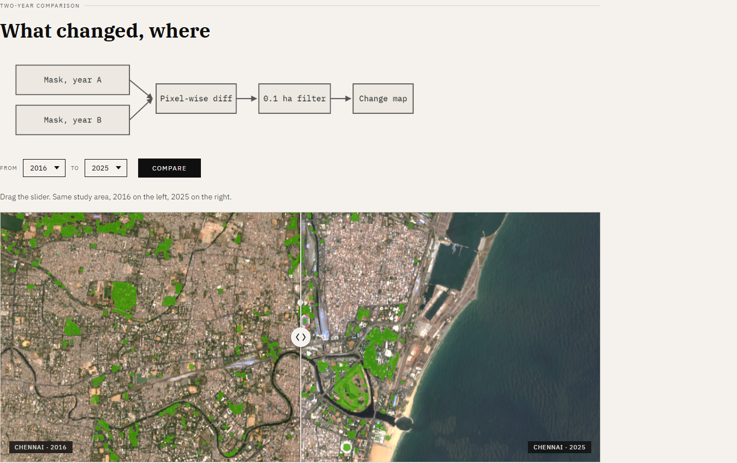
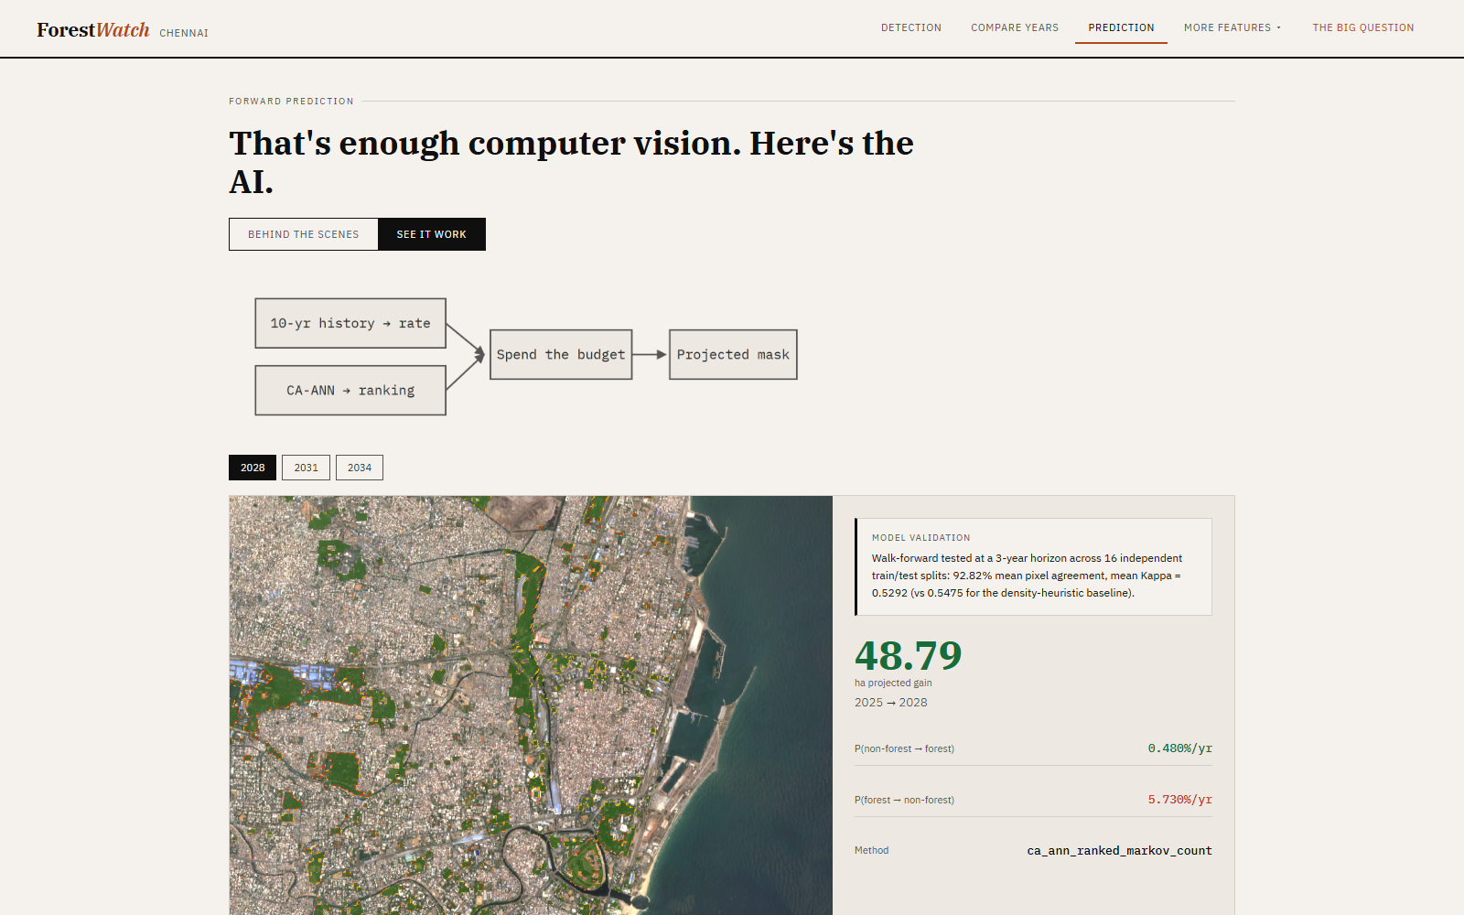
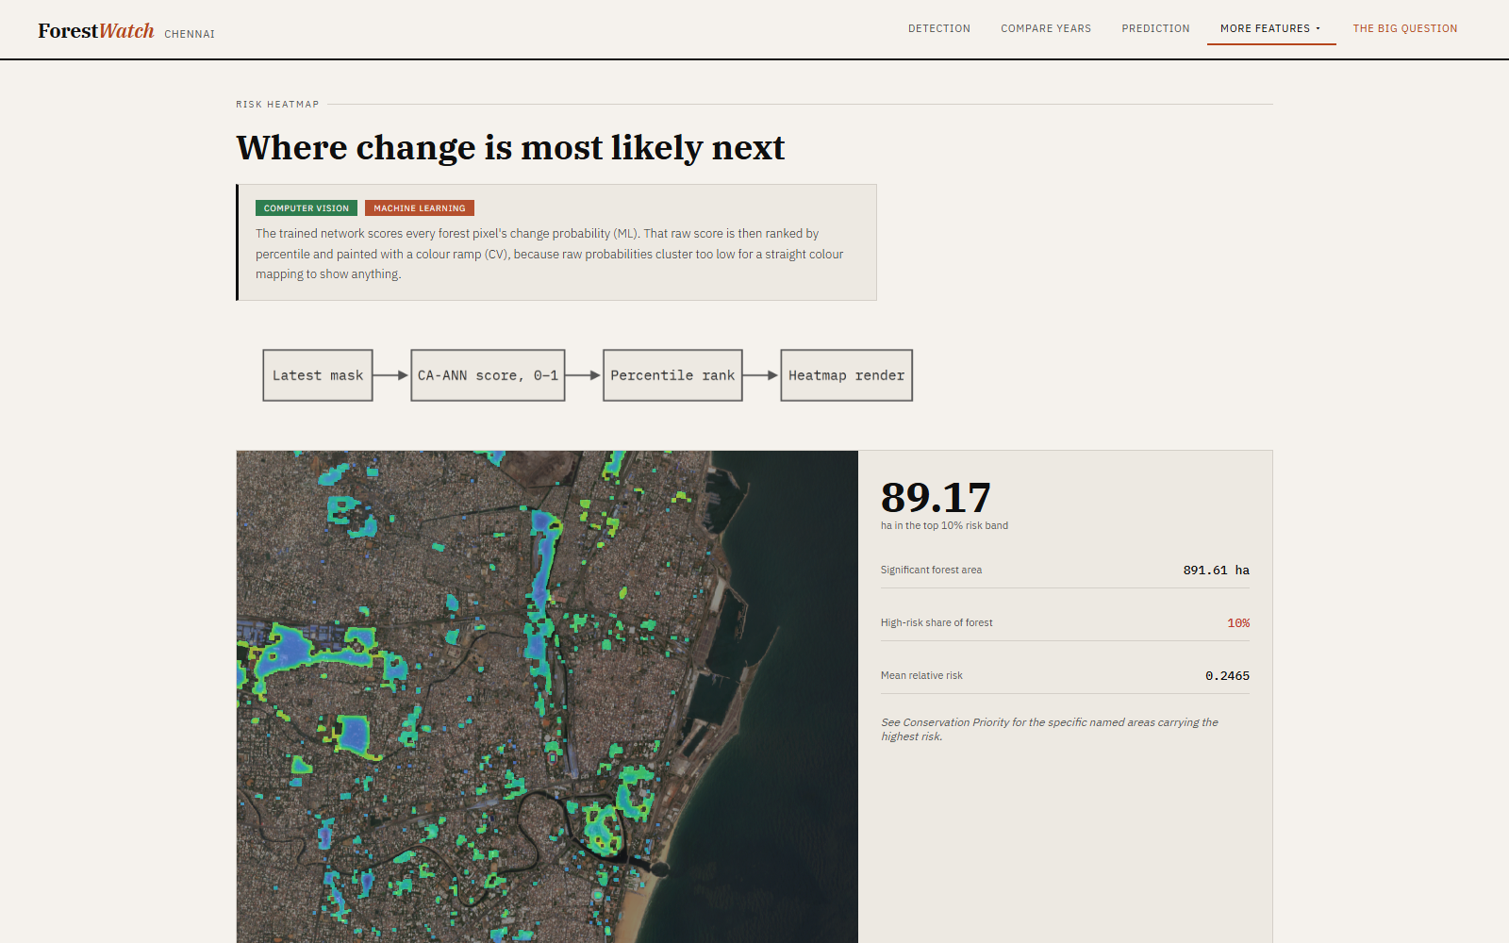
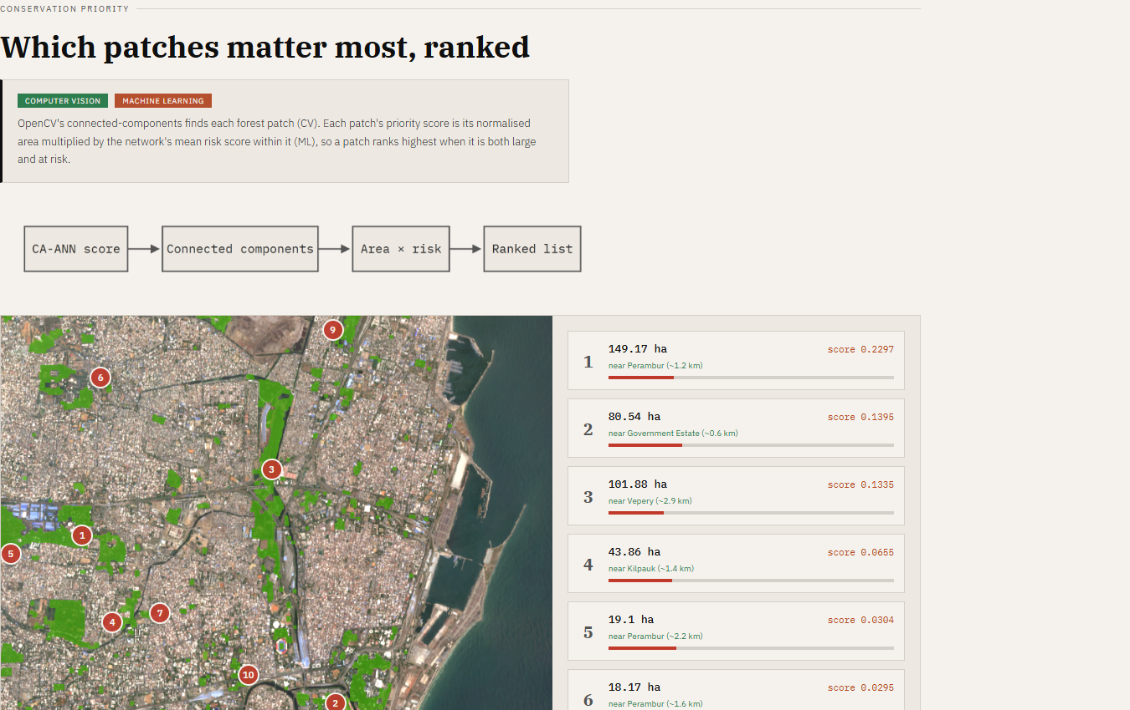
What it looks like, running
THE LIVE SYSTEM
Compare Years
Prediction
Risk Heatmap
Conservation Priority

Slide 19
CONTRIBUTIONS
What is actually new here
01
A single spectral formula, FVI, replacing a two-step industry pipeline, measurably better in water-heavy scenes
02
A geospatial foundation model, Clay v1.5, brought into a CA-ANN pipeline: none of the six comparison studies do this
03
How much will change and which pixels will change, kept as two separate questions inside the CA-ANN step
04
Four cities validated end to end, checked against an independent external dataset, deployed as a live system
Thank you.

