Slide 1
Facial Emotion Recognition System
By:
Yuvraj Kumar Gond
AI ML

Slide 2
Acknowledgment
I would like to express my gratitude to ShadowFox for giving me the opportunity to present the tasks I have completed during this internship. I would also like to extend my thanks to my coordinator , Mr. Aakash, for guiding me throughout this experience.
I acknowledge that the tasks were completed independently by me. Additionally, I utilized certain reference materials for research purposes and used ChatGPT for generating reference ideas.

Slide 3
Introduction
Facial Emotion Recognition System is an advanced AI-powered solution designed to detect, analyze, and interpret human emotions in real-time using deep learning and computer vision.
This system goes beyond traditional emotion detection—it is built with self-learning capabilities, allowing it to continuously improve and adapt by collecting new data, retraining itself, and enhancing prediction accuracy over time.
🚀 Why is this Important?
Bridges the gap between AI and human emotions for smarter interactions.
Enhances applications in healthcare, security, marketing, and user experience.
Provides valuable insights through an AI-driven dynamic emotion scoring system.
💡 Main Goal: To create an AI system that doesn’t just recognize emotions but evolves over time, offering more accurate, personalized, and real-time emotional intelligence for various real-world applications.

Slide 4
🚀 Unique Features & Special Capabilities
✅ Achieved 89% accuracy using FER 2013 Kaggle dataset.
✅ Real-time emotion detection via video streaming.
✅ Self-Learning AI 🤖 - a game-changer!
✅ Dynamic Emotion Representation (name, emoji, scoring system).
✅ Live Data Collection & Continuous Improvement.

Slide 5
BEGINNER LEVEL Task-I Image Tagging with TensorFlow
Objective: Develop a model for image tagging using TensorFlow.
Data Preparation: Gather a labeled dataset of images.
Model Architecture: Design a CNN model for image classification.
Model Training: Train the model using TensorFlow's Keras API.
Data Augmentation: Enhance dataset with techniques like rotation,
flipping.
Hyperparameter Tuning: Optimize model performance with fine-tuning.
Model Evaluation: Assess model accuracy, precision, recall.
Deployment: Deploy the model for real-world image tagging
applications

Slide 6
⚙️ Tools & Technologies Used
TensorFlow, Keras (Deep Learning)
OpenCV (Face Detection)
Streamlit (Web App Interface)
NumPy (Data Handling)
Haar Cascade Classifier (Face Detection Model)

Slide 7
🧠 Model Architecture: How It Works?
Uses a Convolutional Neural Network (CNN).
Three convolutional layers with ReLU activation + Max Pooling.
Final Softmax layer for multi-class classification.
Dropout layers to prevent overfitting.
Trained using Adam Optimizer and Categorical Cross-Entropy Loss.

Slide 8
🔬 Training & Validation Process
Dataset: FER 2013 (Kaggle).
Preprocessing: Image augmentation, normalization, and data balancing.
Train-Test Split: 80% training, 20% validation/testing.
Final Accuracy Achieved: 🔥 89% 🔥
Early stopping & Model Checkpointing used for optimization.

Slide 9
🤯 The Revolutionary Self-Learning Capability
✅ Captures new user emotions in real-time.
✅ Automatically stores newly detected faces & expressions.
✅ Retrains itself with new data, improving predictions continuously.
✅ Constantly adapts to different user emotions & cultural variations.
✅ Creates a feedback loop for future recognition accuracy.
THIS IS DONE DURING THE REAL TIME LIVE THROUGH VIDEO STREAM DURING THE EMOTION DETECTION OPERATRION.

Slide 10
📊 Dynamic Emotion Scoring System
Each detected emotion is given a score (0-5).
Examples:
😊 Happy - Score: 5/5
😞 Sad - Score: 1/5
😠 Angry - Score: 1/5
😐 Neutral - Score: 3/5
😮 Surprise - Score: 4/5
Useful for AI-driven decision-making and analytics.

Slide 11
🎯 Prompt Engineering & ChatGPT Assistance
Used ChatGPT for debugging, optimizing code, and refining performance.
Implemented prompt engineering techniques for better AI responses.
ChatGPT helped accelerate development and optimize results.

Slide 12
🚀 Conclusion & Future Scope
✅ Achieved 89% accuracy and continuously improves through self-learning.
✅ Future Enhancements:
- Multi-user emotion detection
- Voice emotion integration
- Mental health monitoring applications
- AI-powered customer feedback analysis
🔴 This AI is evolving, learning, and redefining real-time interaction!

Slide 13
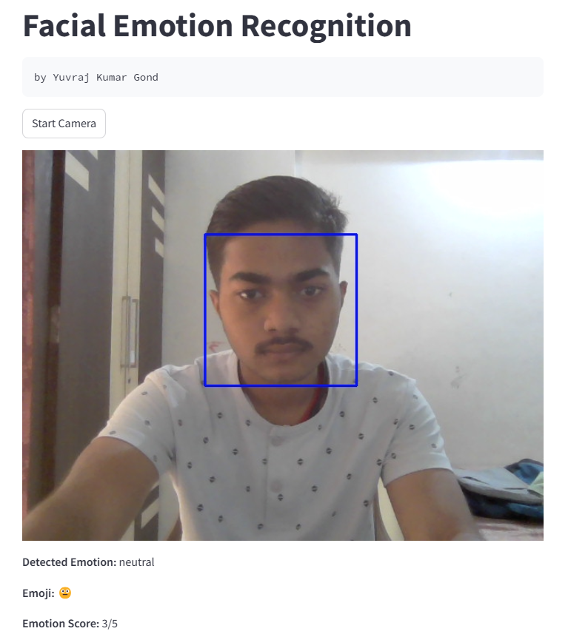
Some glances of the project

Slide 14
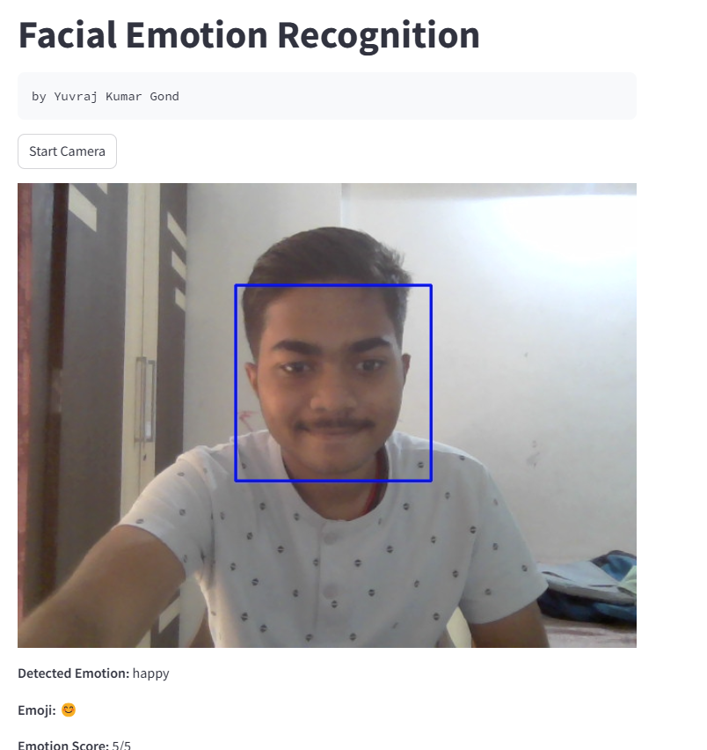

Slide 15
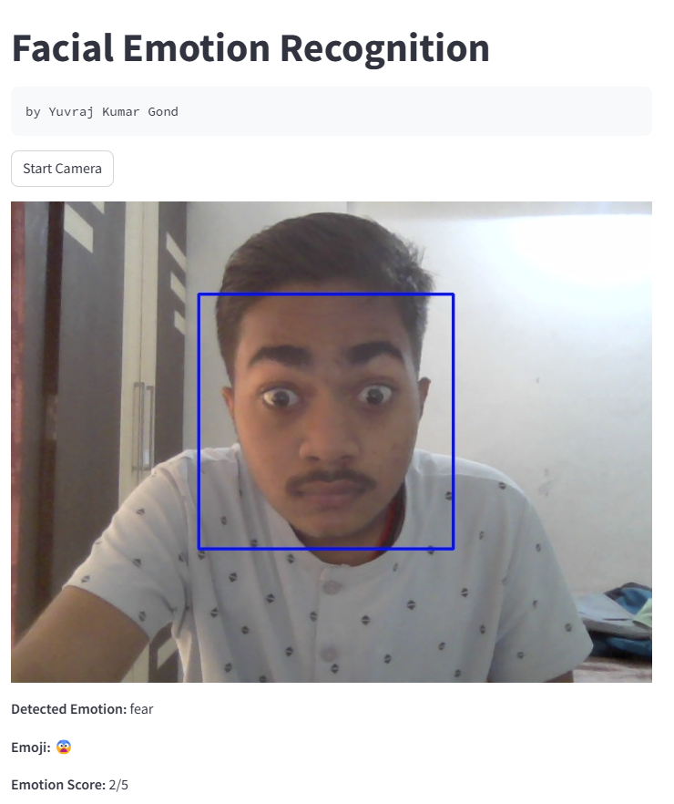

Slide 16
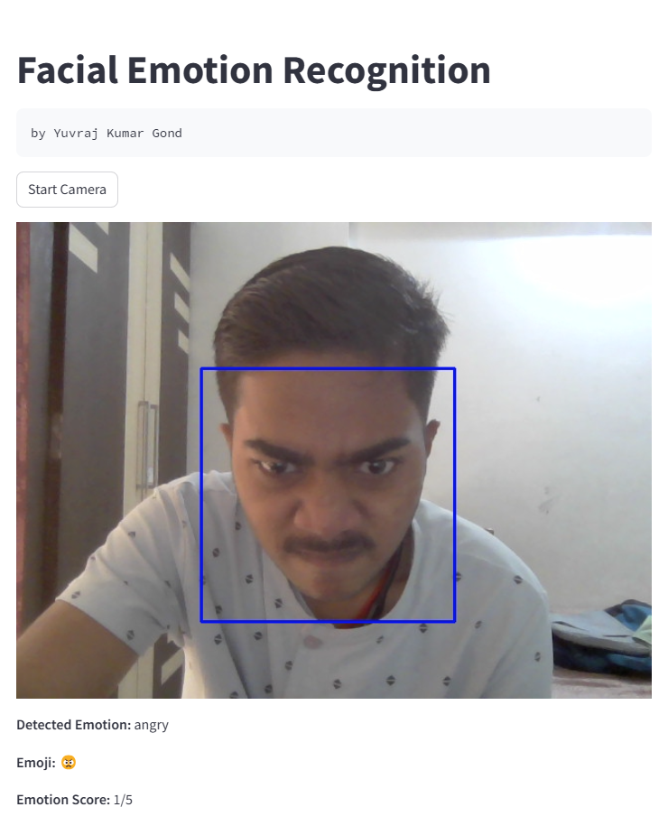

Slide 17
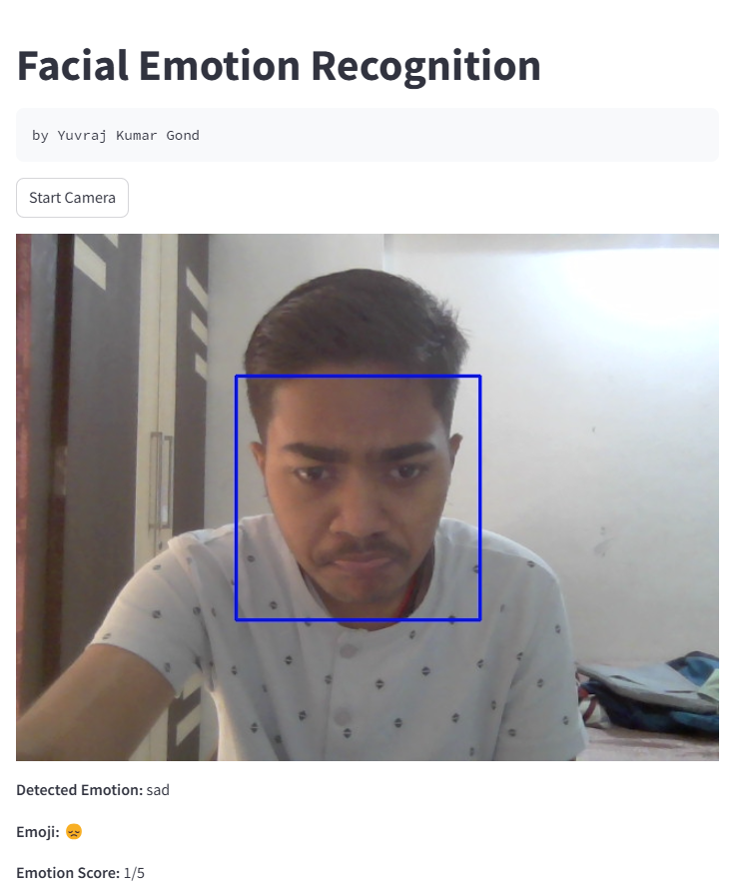

Slide 18
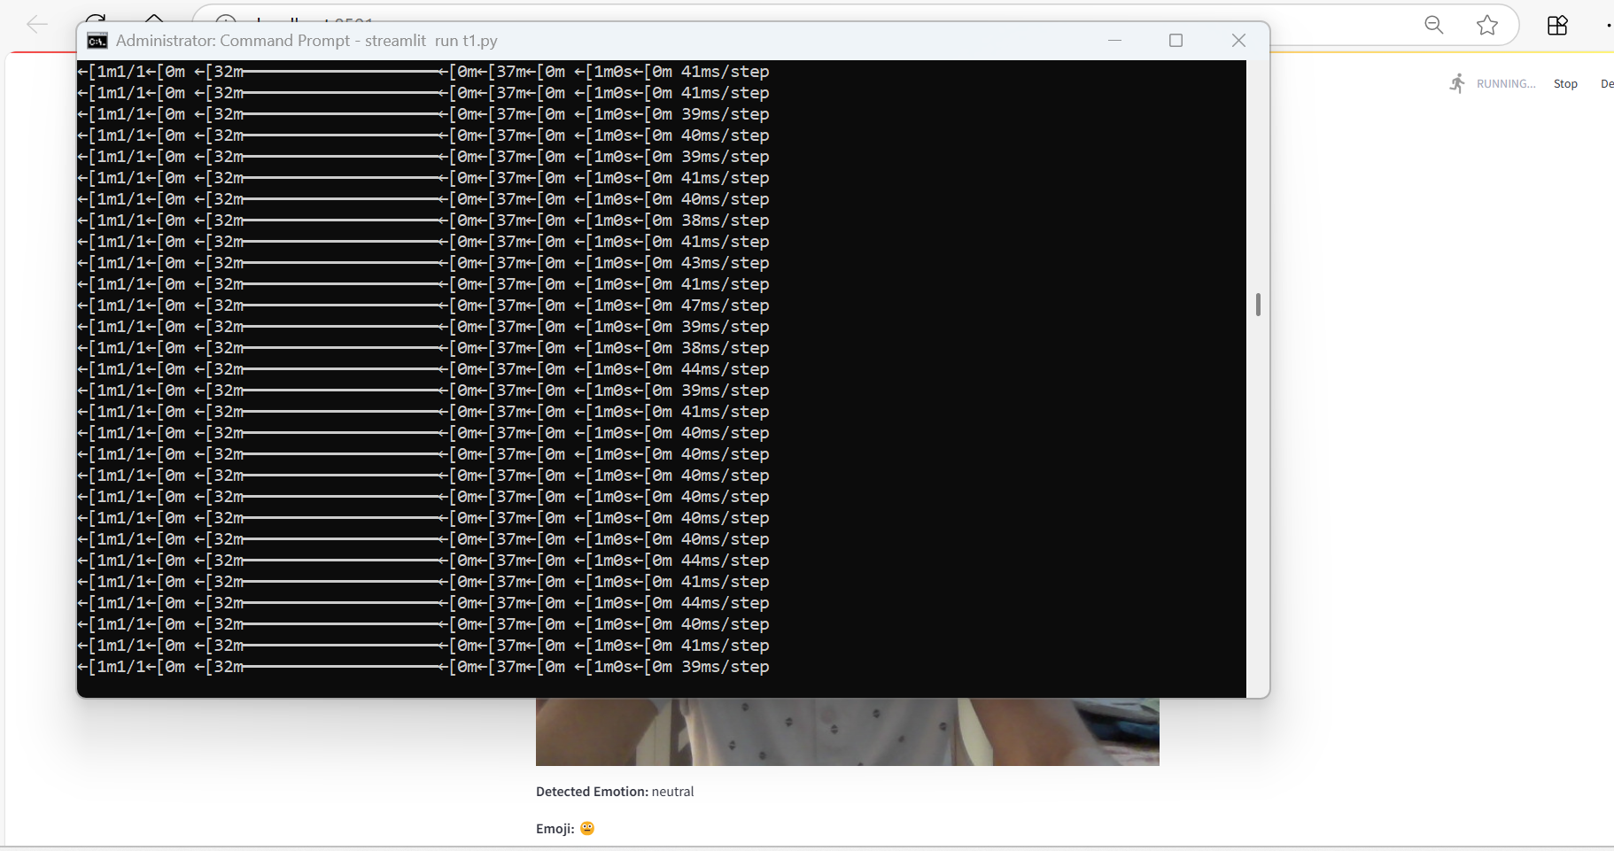
Real time self learning by collecting new data from user

Slide 19
Thank You

