Slide 1
Diwali Sales Data Analysis

Slide 2
Problem Statement
Use Tableau/Power BI to analyze and visualize data from Diwali Sales Dataset.
Create different Dashboards to visualize Customer information and product information.
Gain visual insights and draw conclusions from the dashboard.

Slide 3
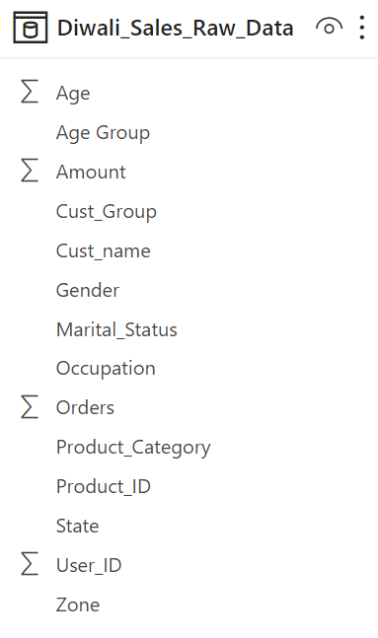
Data: 1 Table, 13 Columns, 11251 Rows.

Slide 4
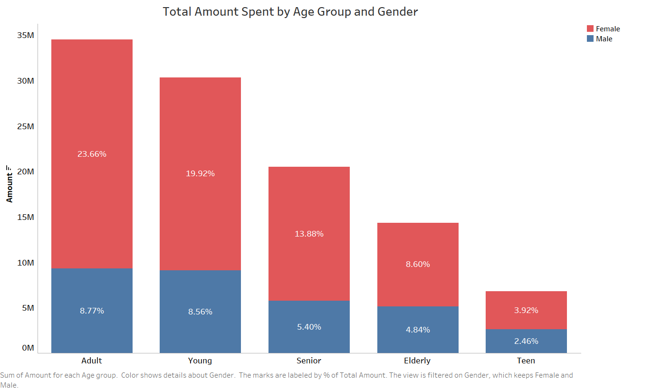
Majority (61 %) of the amount has been spent by the age groups Young (20-29) and Adult (30-39).
Teenage customers have spent very less, around 6.4% of the total amount.

Slide 5
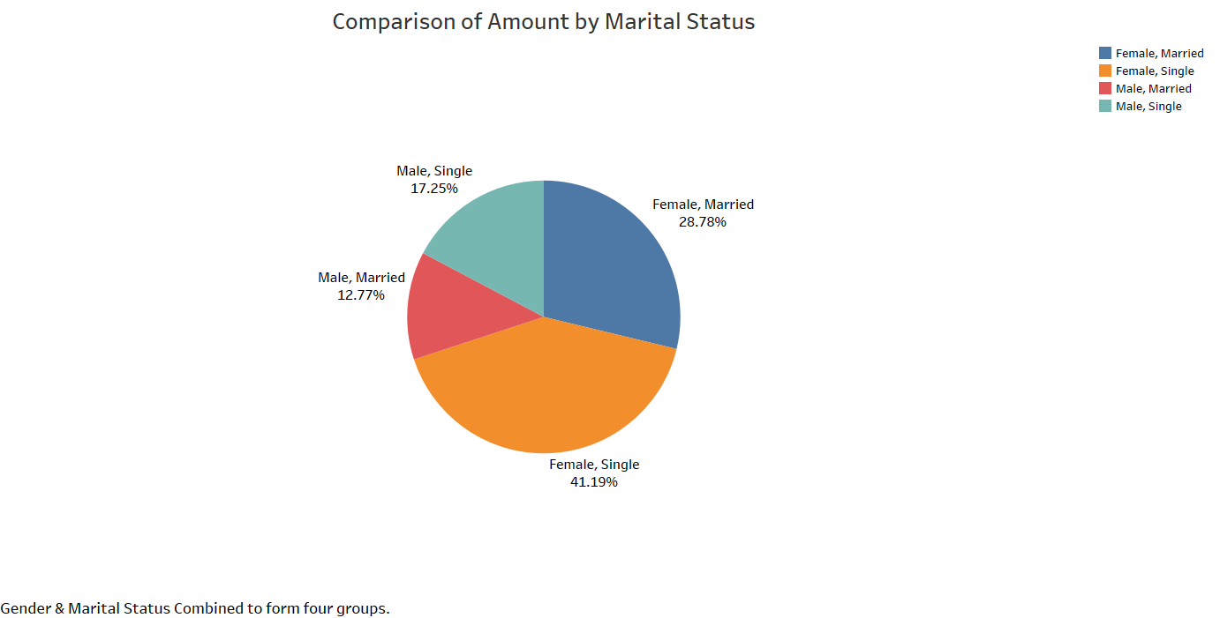
70% of the total amount spent on during Diwali shopping is from Female customers.
Customers who are unmarried have spent 59 % of the total amount, rest 41 % from married customers.

Slide 6
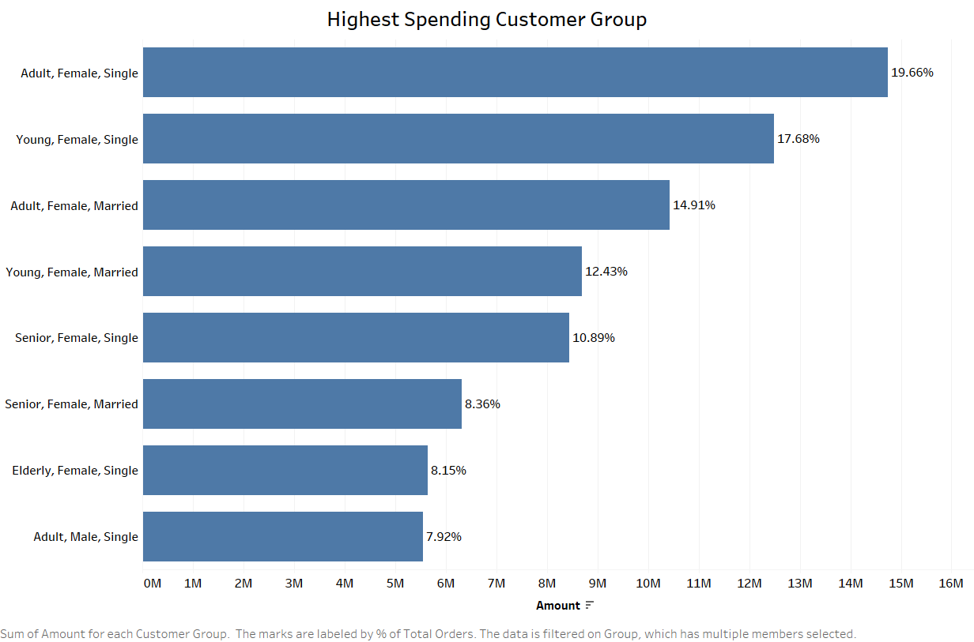
From a combination of Age Group, Gender and Marital Status, 1/5th of the sales are coming from Adult Female customers.

Slide 7
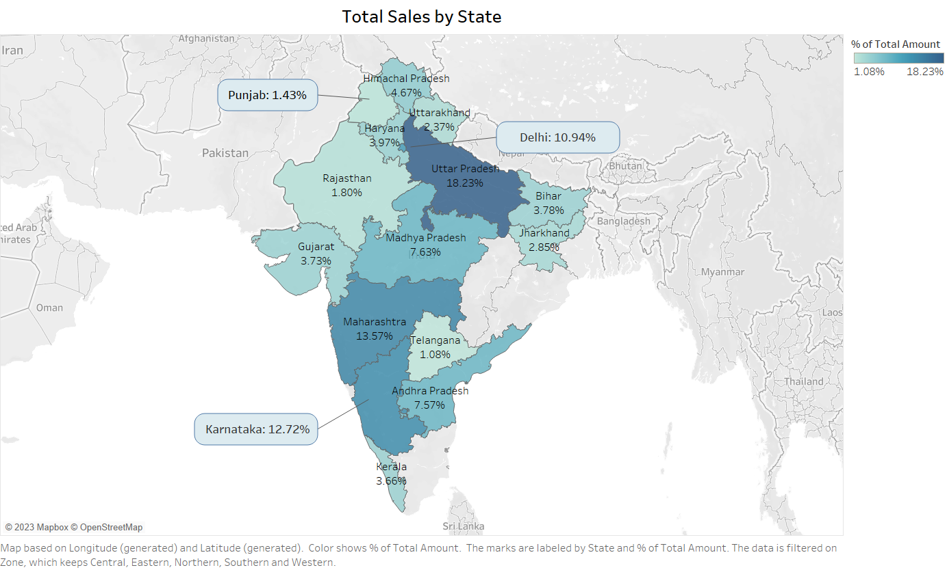
Customers from Maharashtra, UP, Karnataka and Delhi have spent 55.5% of the total amount.
Lowest spending states are Telangana, Punjab, Rajasthan, Uttarakhand and Jharkhand, each having less than 3% of total amount spent.

Slide 8
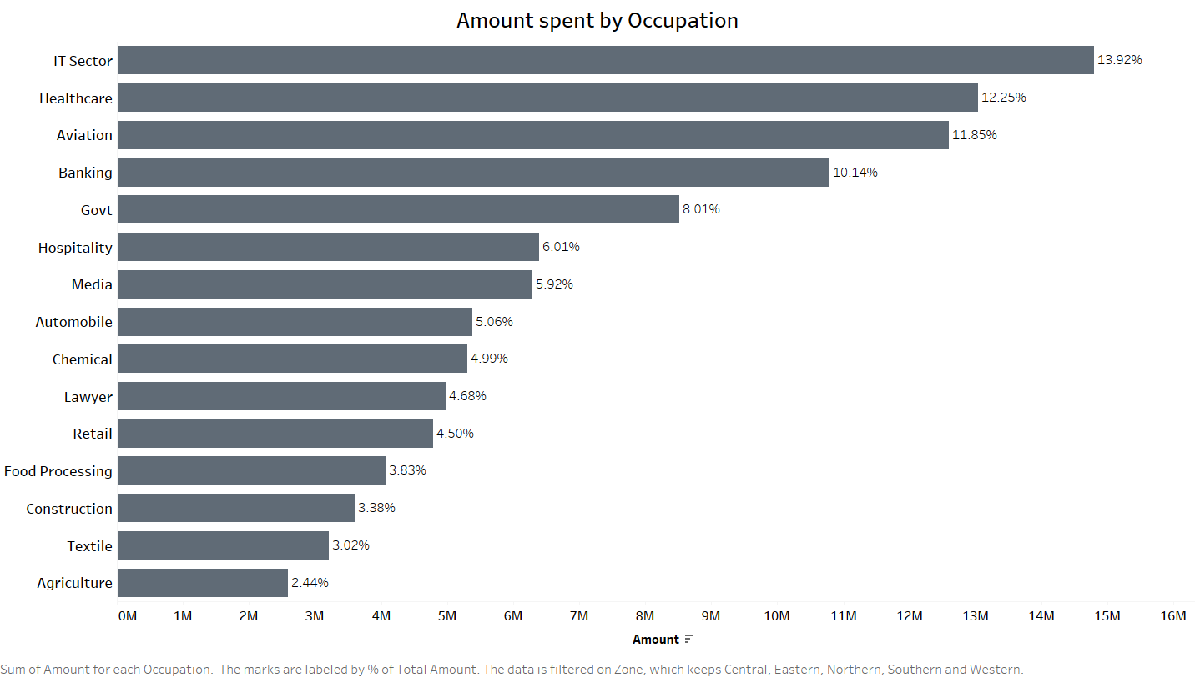
Customers working in IT, Healthcare, Aviation, Banking have spent 48.16 % of the amount.
People working in Agriculture, Textile, Construction, Food Processing are less in numbers.

Slide 9
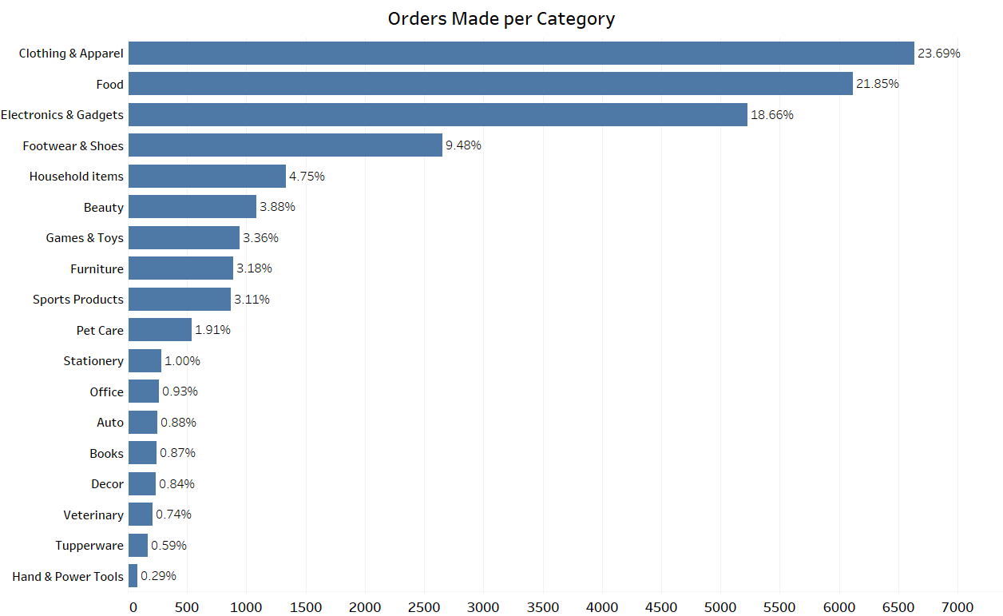
Clothing, Food and Electronics are the categories receiving highest orders during Diwali.
Tools, Tupperware, Décor, Veterinary supplies are receiving less orders.

Slide 10
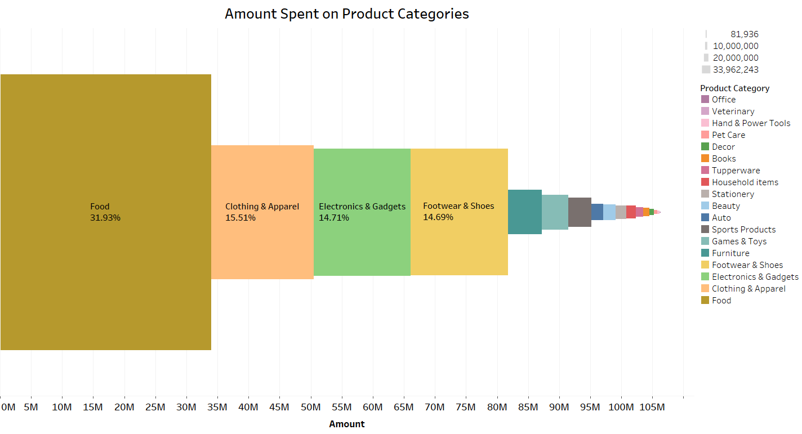
Despite receiving 8.4% more orders than Clothing and Apparel, Food is the product category with highest amount being spent on. Same case for furniture and household items.
The difference in rank of amount spent and number of orders occurs due to size of each order.

Slide 11
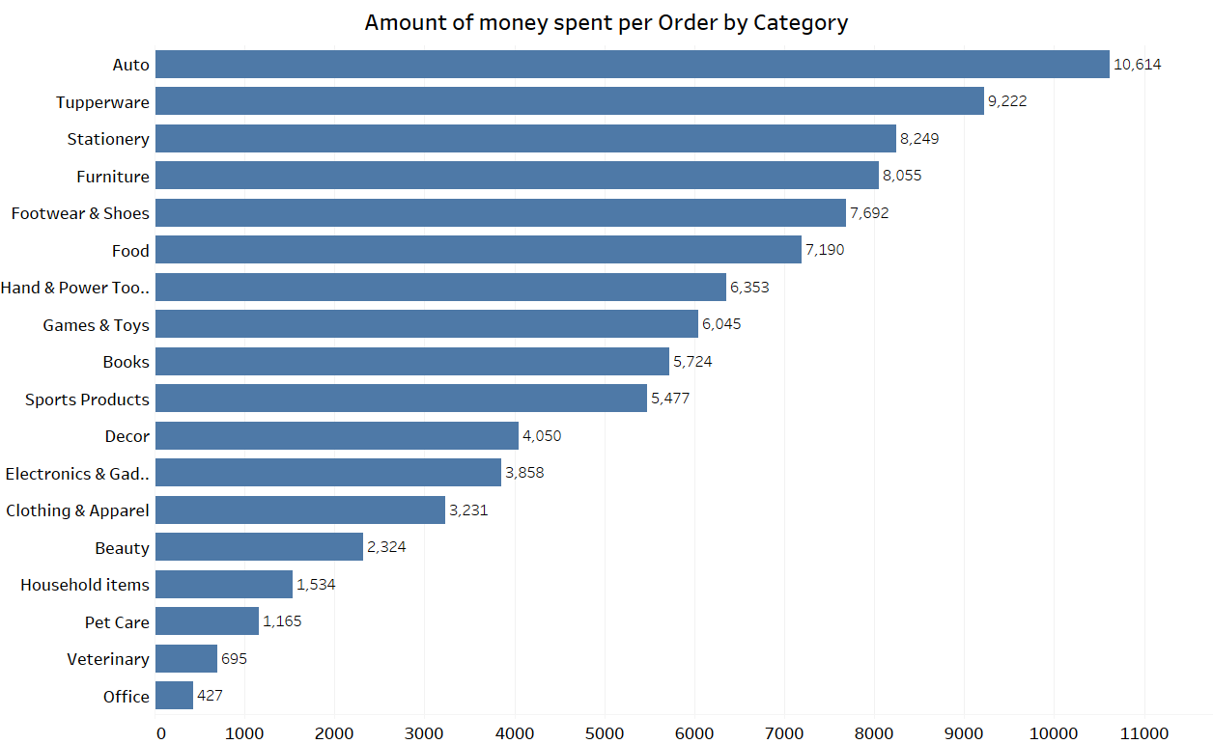
This chart shows that customers are spending more money on Auto, Tupperware, Stationary and furniture products, yet the number of order is less, as seen from previous charts.

Slide 12
Conclusion
Majority of customers across all age groups are women. Also Unmarried customers, both male and female tend to spend more money than married customers.
1/5th of the sales amount is generated from Adult Female Customers.
48% of customers work in IT, Banking, Healthcare or Aviation sector.
Telangana, Punjab, Rajasthan, Uttarakhand and Jharkhand are states with lowest amount generated, while Uttar Pradesh, Maharashtra, Karnataka and Delhi are highest spending states.
Food products sold during Diwali generate almost 32% of the total sales, but number of orders made for clothing products is more than food products.
Products from auto, Tupperware, Stationary and furniture category have high spending per order. If more orders of these products are made, it will result in significant increase in sales amount.

Slide 13
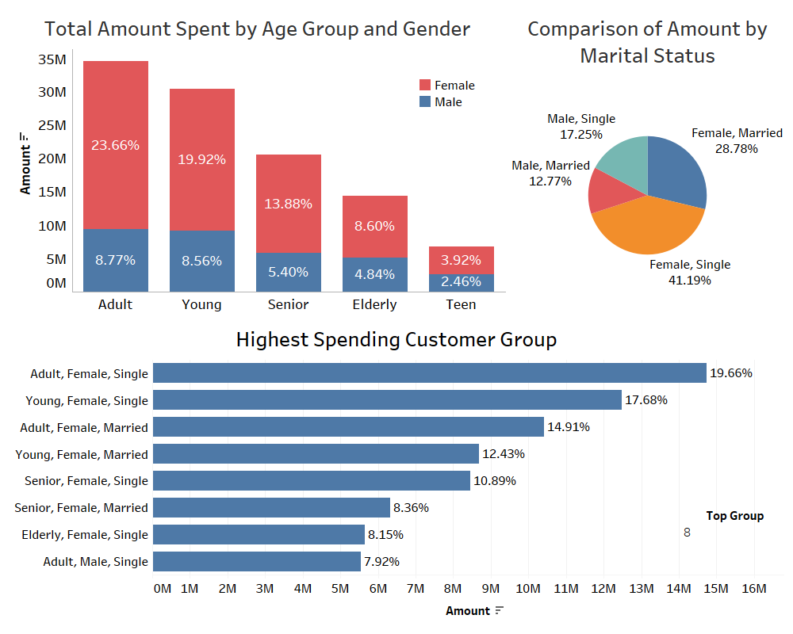
Customer Data Dashboard (Tableau)

Slide 14
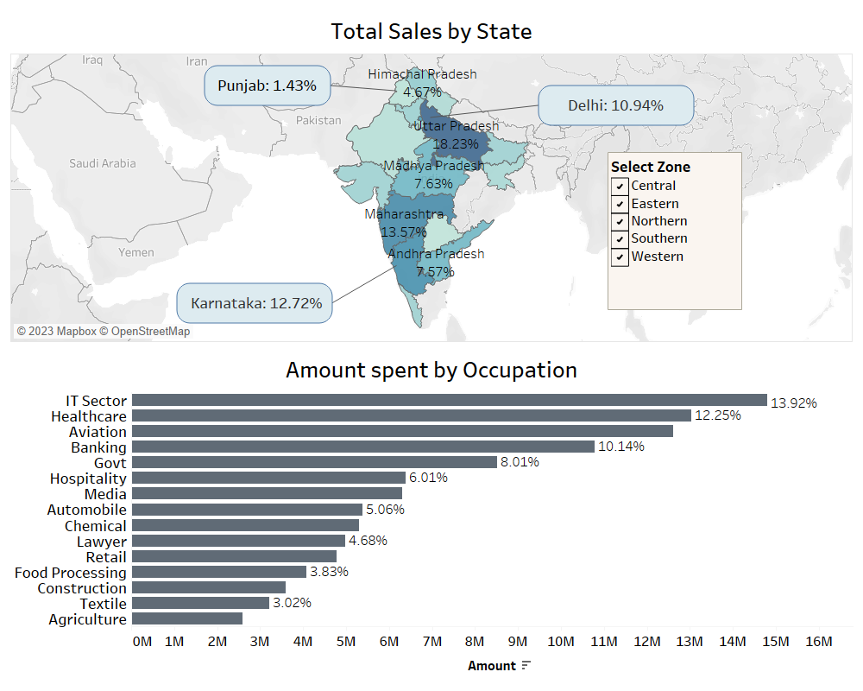
Region and Occupation Dashboard (Tableau)

Slide 15
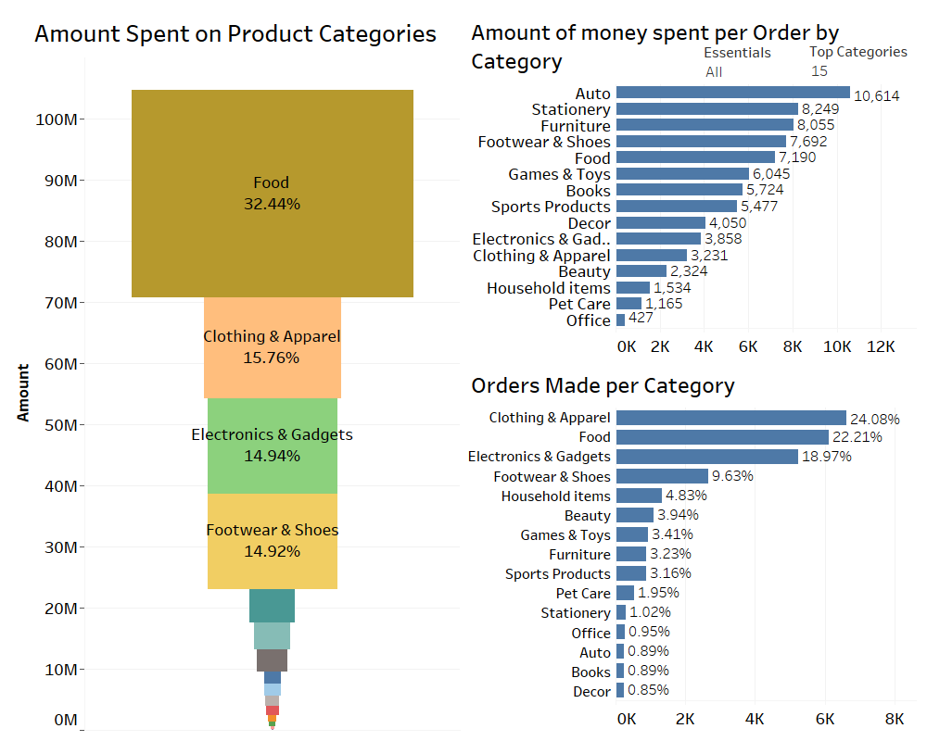
Product Data Dashboard (Tableau)

Slide 16
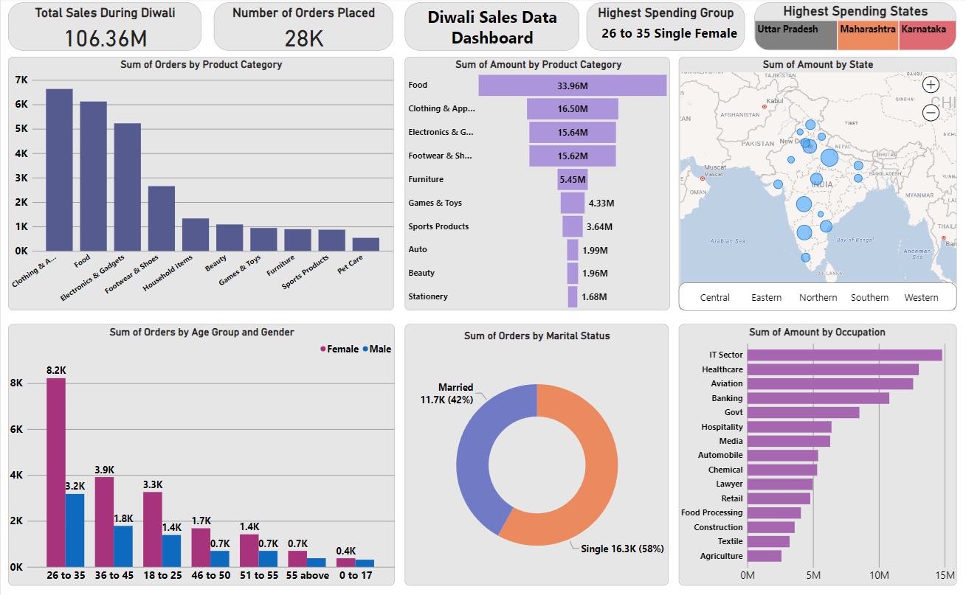
Microsoft Power BI Dashboard

Slide 17
Thank you !

