Slide 1
HR Data Analysis

Slide 2
Problem Statement
Use Power BI to analyze and visualize data from organizations HR Dataset.
Create Dashboards to visualize Employee information, department data and Employee feedback.

Slide 3
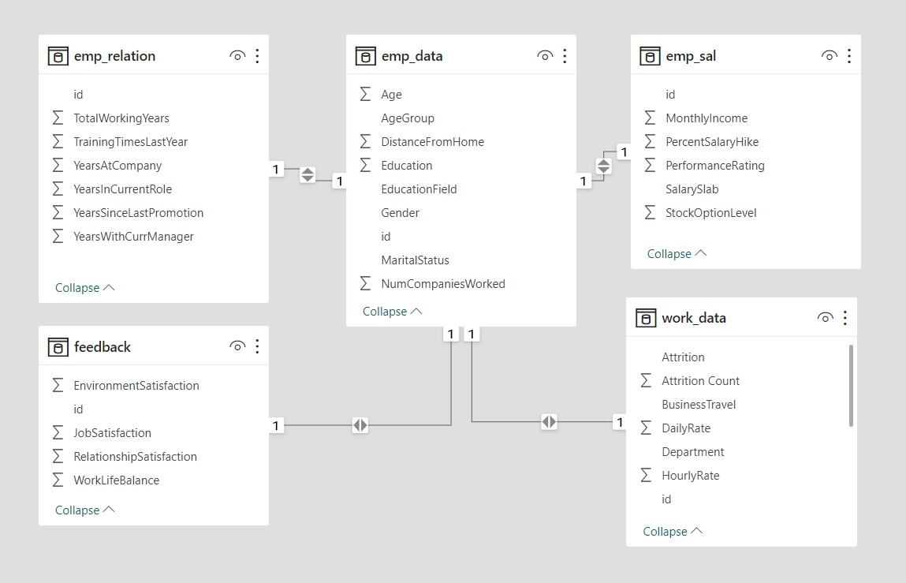
Data Model: 5 Tables, 33 Columns, 1480 Rows.

Slide 4
About Dataset
HR dataset consists of data collected from all employees that are working for or have worked previously for the organization.
The data included in this dataset is employee information such as their age, education, department, salary, feedback about the job etc.
Some data variables such as education level, performance, feedback, amount of years spent at company are useful to HR managers to understand how their organization is growing

Slide 5
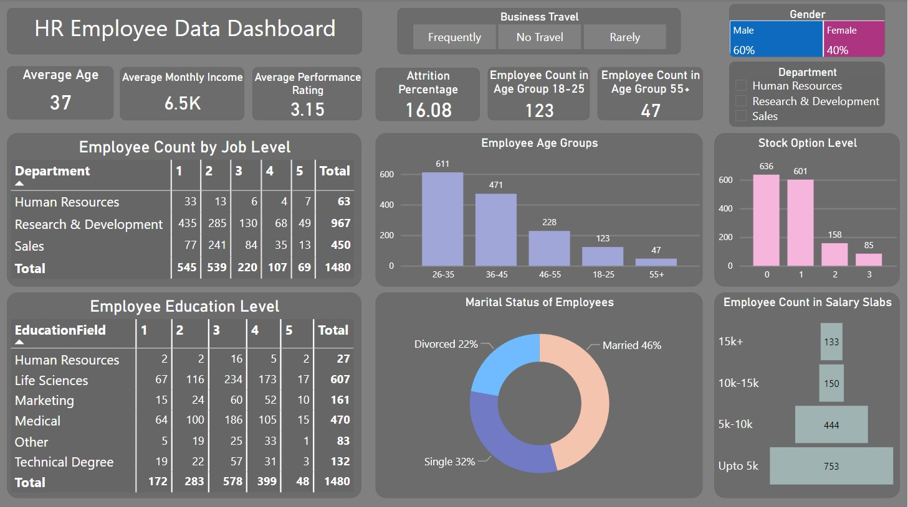

Slide 6
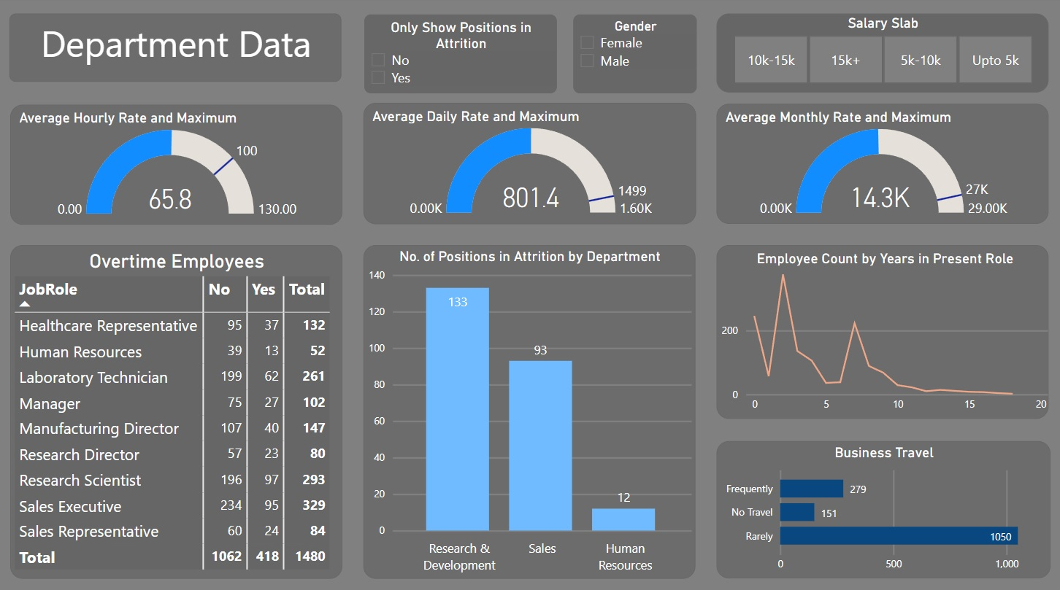

Slide 7
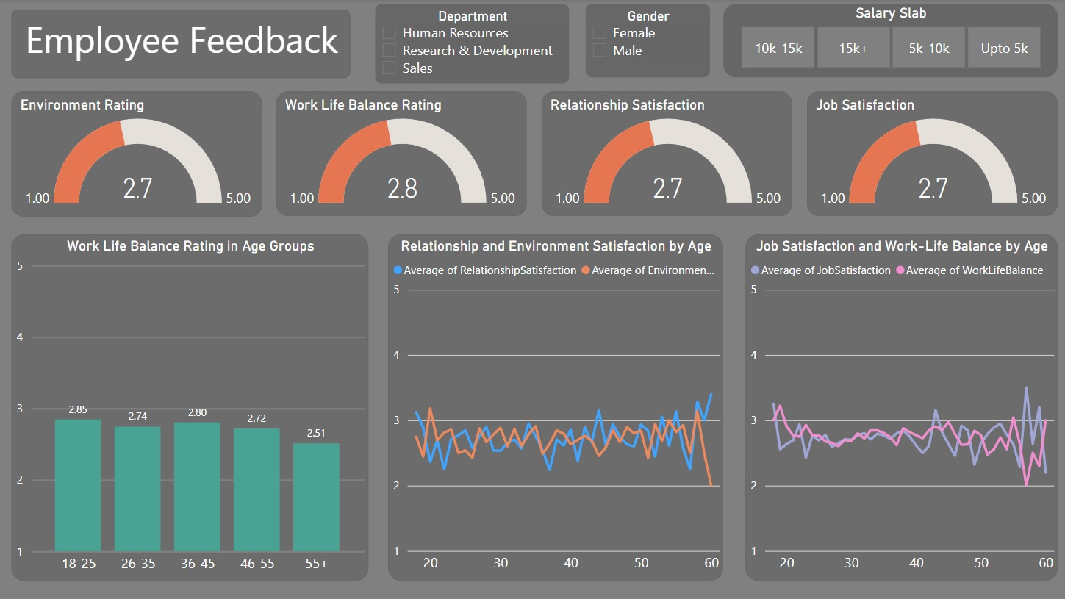

Slide 8
Thank you !

