Slide 1
Real Estate Data Analysis

Slide 2
Problem Statement
Prepare a Power BI Report consisting of important KPIs in real estate industry along with information about status of various properties.
Prepare a report on price analysis around variables that affect the price such as current status, square-feet area of property, number of rooms, etc.
Develop an interactive dashboard such that a business user can monitor expected number of rooms and other amenities available, based on price and area category.

Slide 3
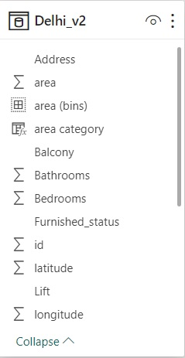
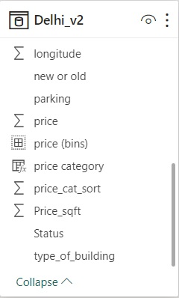
Data Model: 1 Big Table, Denormalized data, 20 columns, 7668 rows, 2 bin groups.

Slide 4
About Dataset: Kaggle Link
This dataset is uploaded by Kaggle competition expert Yash Goel and the dataset has good usability score.
Dataset consists of 18 columns, from which I have removed Locality, description and added category and bins for both price and area.
Due to unavailability of data in many records for number of parking slots, lifts and balconies, I have replaced null values by “Unknown”. This causes data to appear categorial although it is numerical.

Slide 5
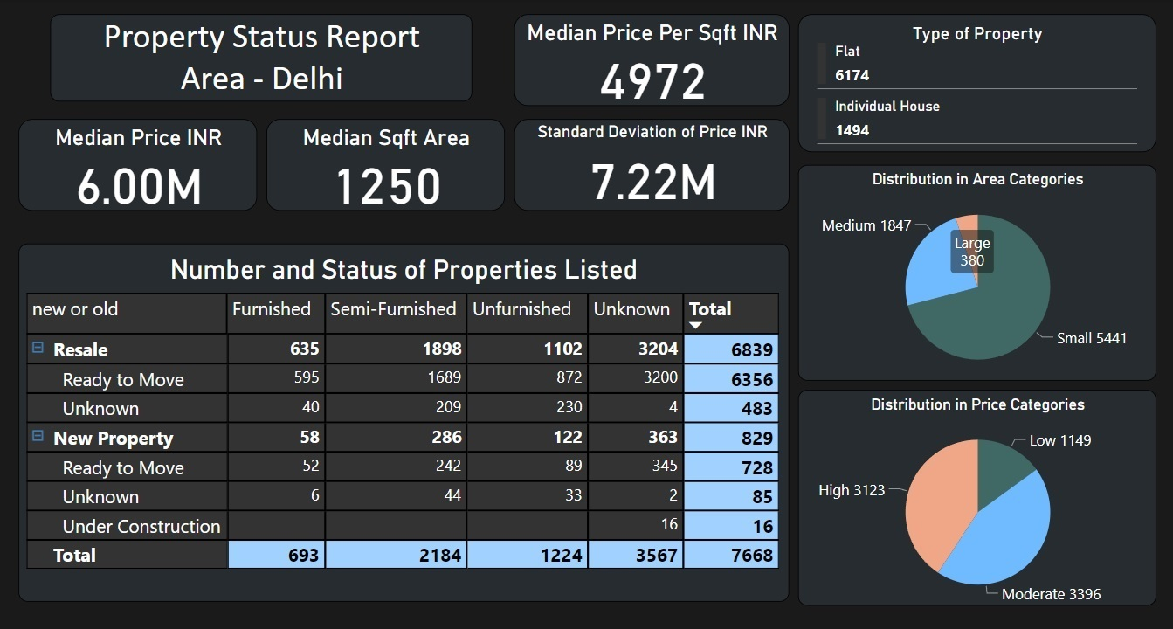

Slide 6
Property Status Report
Report consists of 4 important KPIs on top left, median is preferred over average because outliers are present in data.
A Table shows New or Resale status in rows and can be drilled down to status of possession, the column headers are the furnishment status and user can see number of listings available of desired status.
Two pie charts on right side of the report show the distribution of listings in area and price categories.
Card on top right corner shows number of flats and houses, and it can also be used as a filter.

Slide 7
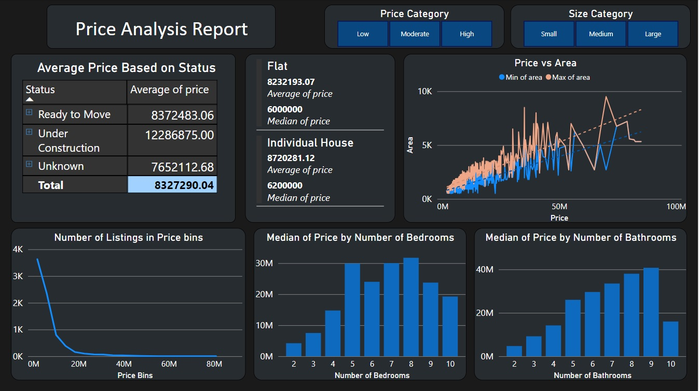

Slide 8
Price Analysis Report
Average price based on possession status is displayed and it can be drilled down to furnishment status.
To its left, the multi row card shows average and median price of flats and houses.
Price vs Area line plot shows strong positive correlation between the variables. The blue line shows minimum area and light orange line shows maximum area available at a given price.
Three charts on the bottom show distribution of price, relation with number of bedrooms and bathrooms, respectively.

Slide 9
Conclusion: Status Report
Number of flats is much higher than number of individual houses.
Number of resale properties is higher than new properties.
Status of all properties is not available, but a number of semi-furnished properties is higher than furnished and unfurnished properties.
Small number of properties, 5% can be considered large and 71% of listings are properties of small size. But that is not the case for price category as only 15% of listings are of low price.

Slide 10
Conclusion: Price Report
Average price of properties ready to move is less than that of properties under construction. As expected average price of furnished and semi furnished properties is more than that of unfurnished.
Average and median price of flats is less than that of individual houses.
The gap between trend line of maximum and minimum area increases as price increases, which means a buyer with more budget has wider range of area to choose from. As expected the area grows with price.
Number of bedrooms and bathrooms has very strong correlation with price, but some anomalies will be present, which could be due to age or purpose of property such as hostels, homestays, PG buildings.

Slide 11
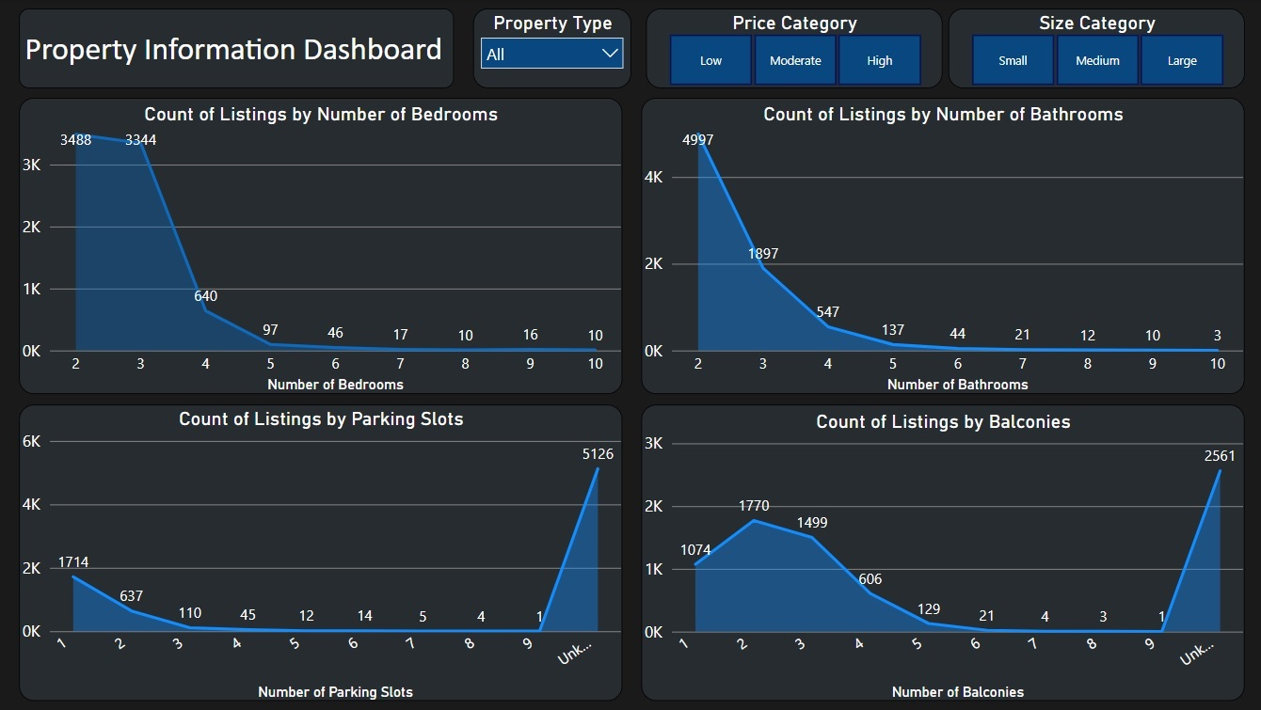

Slide 12
Property information dashboard and map
This dashboard and map can be used to filter to the desired property listings, and see the number of bedrooms, bathrooms, parking slots and balconies that will be available in that desired property.
Example: If a user wants to look at flats, of moderate price and medium area, they can select the same from the three filters in the top row and see how many listings are present and what number of rooms and amenities are available. Further if user clicks on desired number of bedrooms, dashboard will apply filter on other visuals to show the number of listings with desired bedrooms only.
The filters are synced with the map, so after applying desired filters the user can see where the properties are located. The snapshot in next slide shows medium sized properties with moderate price in Delhi.

Slide 13
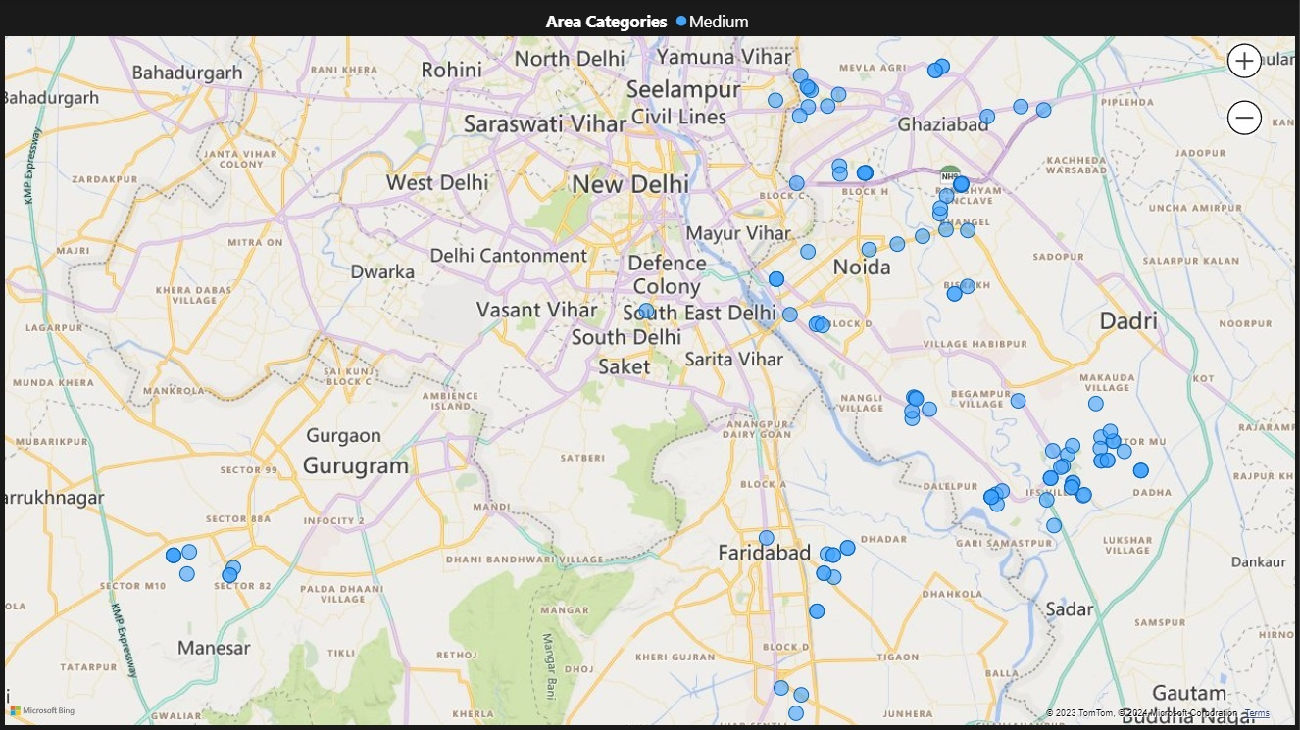

Slide 14
Thank You !

