Slide 1
DRDO · CFEES | Internship Project
Employee Data Analysis
& Visualization using Python
A data pipeline project demonstrating CSV ingestion, exploratory analysis, and age-distribution charting on real employee records.
Pukhraj Singh
Institution Manipal University
Organization DRDO – CFEES
Role Intern

Slide 2
Dataset Overview
4,653
9
Employee.csv
195 KB
Total Records
Columns
Source File
File Size
Columns in the Dataset:
Education
JoiningYear
City
PaymentTier
Age
Gender
EverBenched
ExperienceInCurrentDomain
LeaveOrNot
Focus Column: Age — used to generate the bar chart

Slide 3
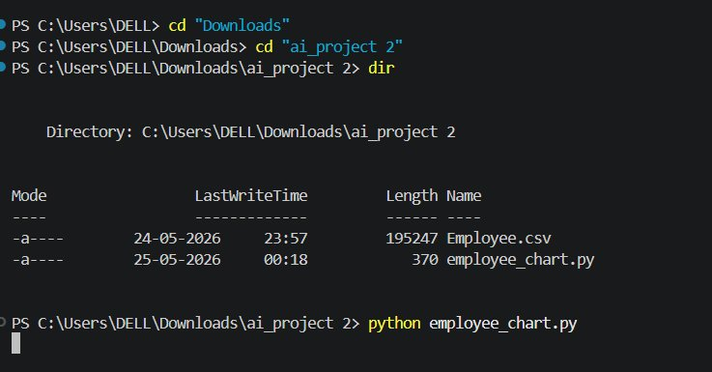
Step 1 — Terminal Setup & File Navigation
01
Navigate to folder
cd Downloads then cd 'ai_project 2' to enter the project directory.
02
List files (dir)
Confirms Employee.csv (195 KB) and employee_chart.py (370 B) are present.
03
Run the script
python employee_chart.py executes the visualization.
PowerShell terminal on Windows — ai_project 2 directory

Slide 4
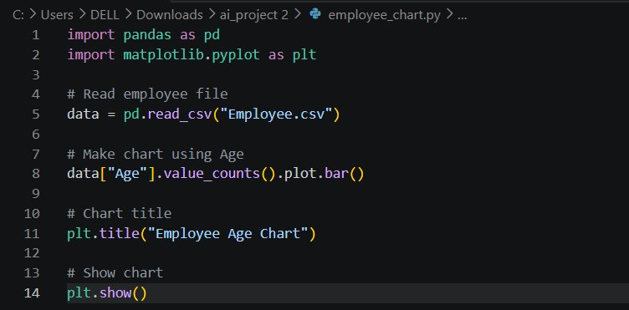
Step 2 — Python Code: employee_chart.py
Line-by-line Explanation
Line 1–2
Import pandas (data handling) and matplotlib.pyplot (charting).
Line 5
Load Employee.csv into a DataFrame with pd.read_csv().
Line 8
Count occurrences of each Age value and render as a bar chart.
Line 11
Set the chart title to 'Employee Age Chart'.
Line 14
Display the interactive chart window using plt.show().
VS Code · employee_chart.py

Slide 5
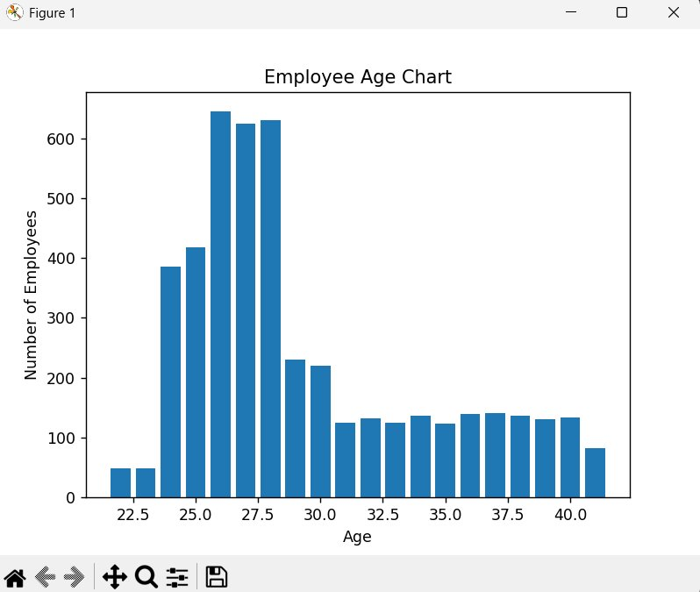
Output — Employee Age Distribution Chart
Key Observations
📈 Peak count near age 26–28 (~630–640 employees)
📉 Count drops sharply after age 30
⚖️ Ages 22–24 have the fewest employees (~50)
📊 Steady ~130–145 range for ages 31–41
👥 Majority of workforce is under 30 years old
matplotlib output window · Figure 1

Slide 6
Workflow Summary
1
Prepare Files
2
Open Terminal
3
Import Libraries
Place Employee.csv and employee_chart.py in the same project folder (ai_project 2).
Navigate to the project folder using cd commands in PowerShell.
Use pandas for data I/O and matplotlib for visualization in the Python script.
4
Load CSV Data
5
Build the Chart
6
View Result
pd.read_csv() reads all 4,653 rows into a DataFrame instantly.
value_counts().plot.bar() on the Age column counts and plots each age group.
plt.show() opens an interactive Figure window with the age distribution bar chart.

Slide 7
Conclusion
Python + Pandas + Matplotlib form a powerful, lightweight data analysis stack.
Just 5 lines of functional code are enough to load a large CSV and render a chart.
The age distribution reveals a young workforce concentrated between 25–29 years.
value_counts().plot.bar() is a quick one-liner for categorical frequency charts.
This workflow can be extended to other columns like City, Gender, or PaymentTier.
Pukhraj Singh · Manipal University · Intern @ DRDO – CFEES · Project: Employee Data Analysis & Visualization

