Slide 1
COVID-19 Prediction and Modeling using ML and NLP
Yuvraj Shivtare, Meetkumar Patel, Raghav Daga

Slide 2
Introduction
Evaluate response of each country about the previously published papers related to the virus
NLP
Extracting relevant keywords from the published papers
ML Algorithm:
To monitor and prognosticate the possible changes in the curve
Evaluate the effect of a change in the countries approach and policies on the spread of the virus
Make a prediction for the number of cases in the next few days

Slide 3
Related Work
Various models being brought up by the technology community for prediction and analysis
Worldwide competitions, universities and world organizations working on them too
Few models like SEIRD, Holt’s models being used
But why are we observing a lot of variations in results?
Lots of things to consider, for example, actions being taken by the country and the communities

Slide 4
Dataset Description
Two major datasets being used in the project --
CORD-19 Dataset: 44,000 scholarly articles related to COVID-19, SARS-CoV-2, Coronavirus (Available on Kaggle)
JHU CSSE Covid-19 Global Dataset : Real time data on number of daily cases, recoveries and deaths worldwide
Why these two datasets? One for NLP (Keyword extraction) and the other for ML prediction and analysis

Slide 5
Implementation process
Data Visualization using Pandas, Matplotlib and Tableau for 3 categories: Confirmed cases, Deaths and Recoveries
Identifying the trend of different types of cases worldwide
Implementing ML Algorithms (Polynomial Regression & SVM) to predict the future values for all categories.
Plotting ACF and PACF of the graphs to choose the best time series forecasting model (AR, MA and ARIMA) to be used to predict future values.
Comparing the models according to the Root Mean Square values.

Slide 6

Data Visualization

Slide 7
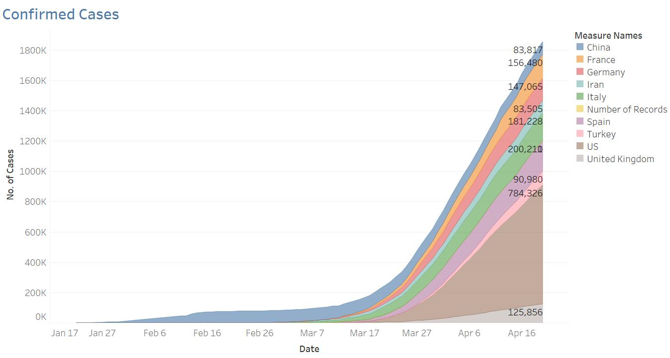

Slide 8
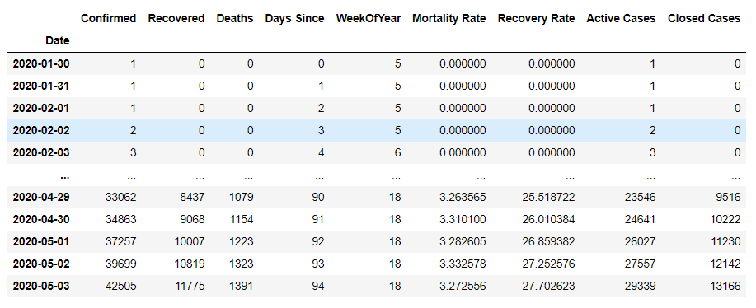
Data Analysis for India:

Slide 9

Exploring trend

Slide 10
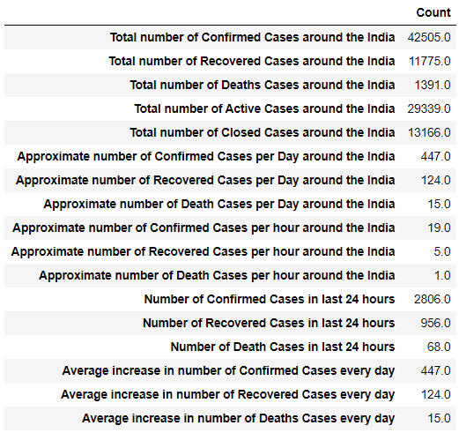
Data analysis for India

Slide 11
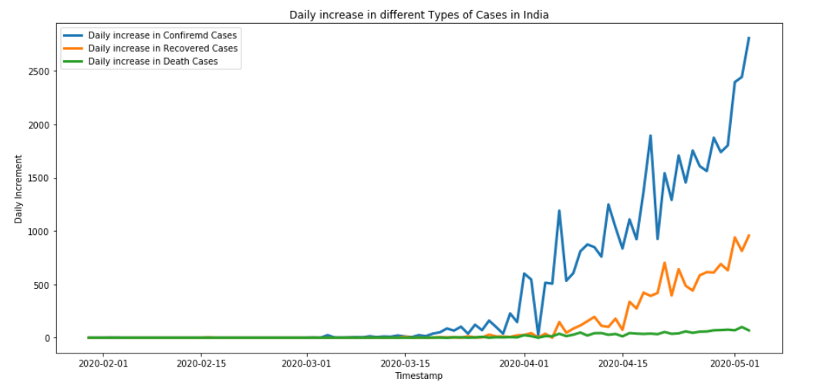

Slide 12
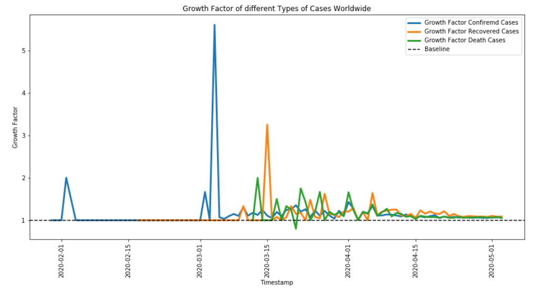

Slide 13
What is SEIRD?
Why did everyone use it but not us?
Idealistic model of how Infectious diseases behave - SEIRD - Suspected, Exposed, Infected, Recovered, Deaths
Hard to model external variables like Lockdown, second waves, change in availability of resources

Slide 14
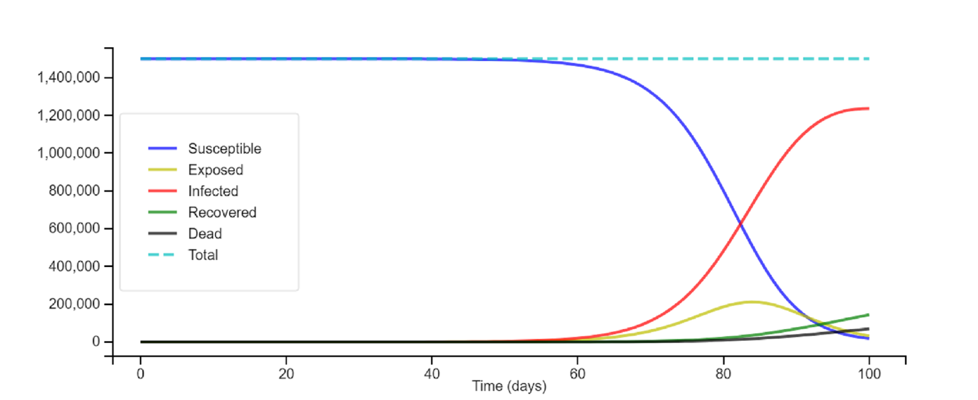

Slide 15
ML algorithms used
Natural Language Processing
Polynomial Regression
SVM
AR
MA
ARIMA

Slide 16
Natural Language Processing
Latent Dirichlet Allocation (LDA): Statistical model that uses Unsupervised learning to classify keywords into several classes based on similarity

Slide 17
Natural Language Processing
Keyword Extraction:
44,000 scholarly articles from CORD-19 Dataset
Removal of “Stop Words” and then applying LDA on the keywords extracted
Keywords give a better idea and understanding of the virus and its behaviour
Also some details on which areas it might affect the most and little details on controlling the effect
Keywords classified into 8 different topics based on Unsupervised Learning

Slide 18
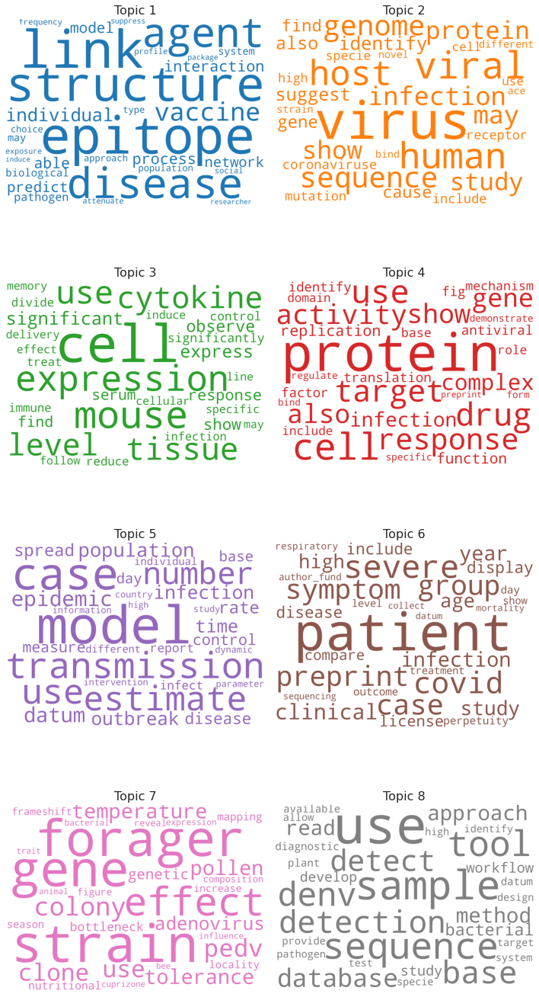

Slide 19
Polynomial Regression
Polynomial Regression is a form of linear regression in which the relationship between the independent predictor variable x and dependent outcome variable y is modeled as an nth degree polynomial

Slide 20
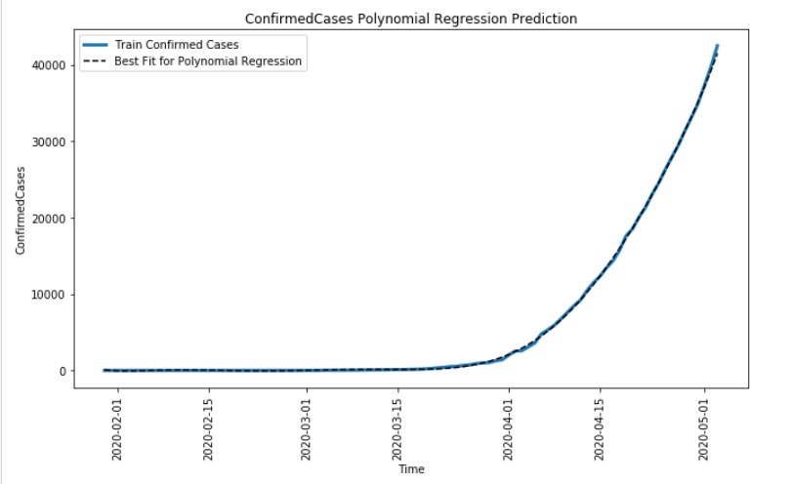
Polynomial Regression:

Slide 21
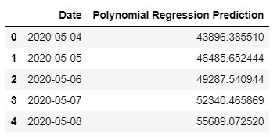
Polynomial Regression:
Root Mean Squared Error: 517.246

Slide 22
Support Vector Machine
Support vector machine algorithm is to find a hyperplane in an N-dimensional space (N — the number of features) that distinctly classifies the data points.

Slide 23
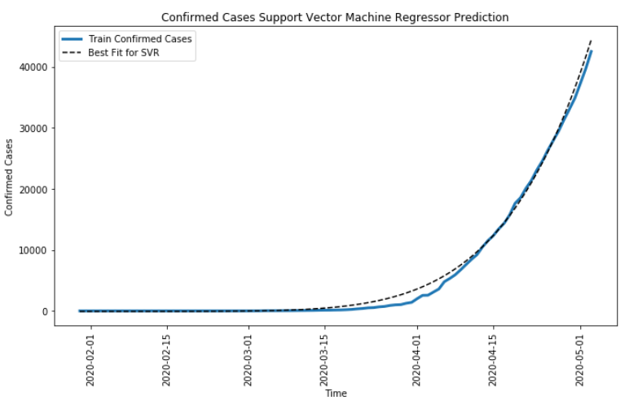
Support Vector Machine:

Slide 24
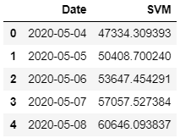
Support Vector Machine:
Root Mean Square Error: 1717.715

Slide 25

Prediction using time series forecasting models

Slide 26
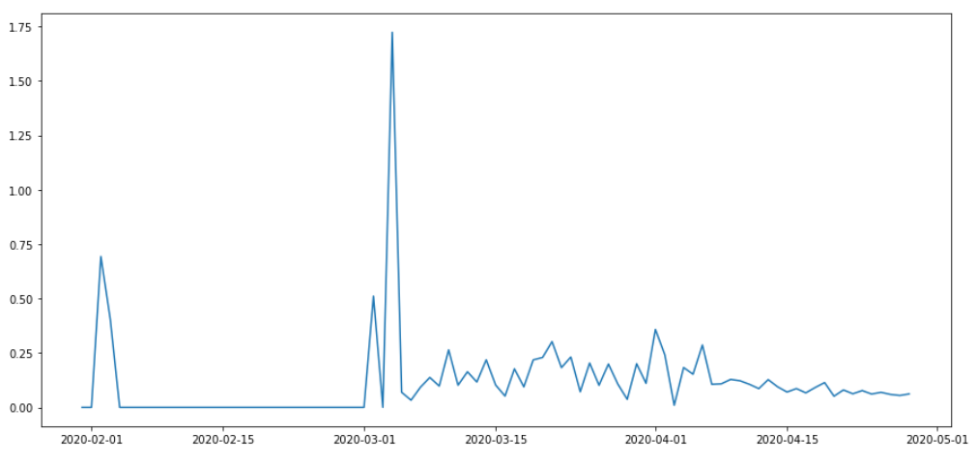
Removing Trend From Series:

Slide 27
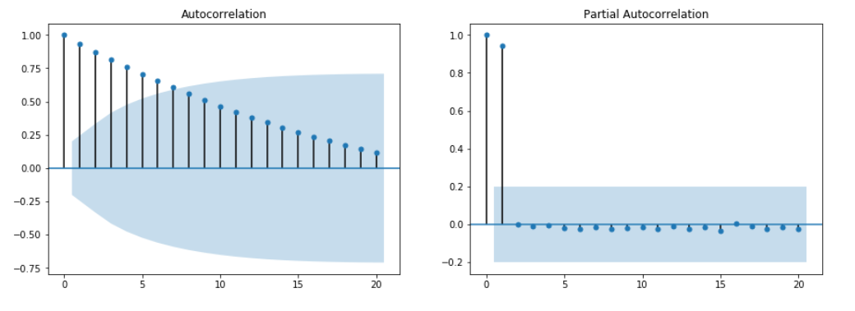
ACF and PACF:

Slide 28
Autoregressive Model
Autoregressive (AR)
The value of the outcome variable (Y) at some point t in time is — like “regular” linear regression — directly related to the predictor variable (X).
Where simple linear regression and AR models differ is that Y is dependent on X and previous values for Y.
Model predicts future behavior based on past behavior.

Slide 29
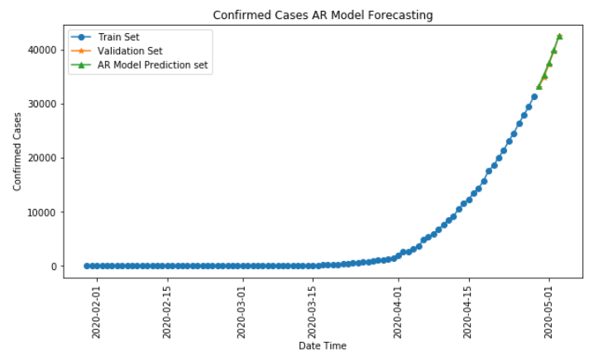
AR Model:

Slide 30
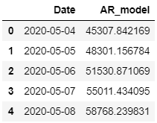
AR Model:
Root Mean Square Error: 271.878

Slide 31
moving average model
A moving average model uses past forecast errors in a regression-like model, rather than using past values of the forecast variable in a regression.

Slide 32
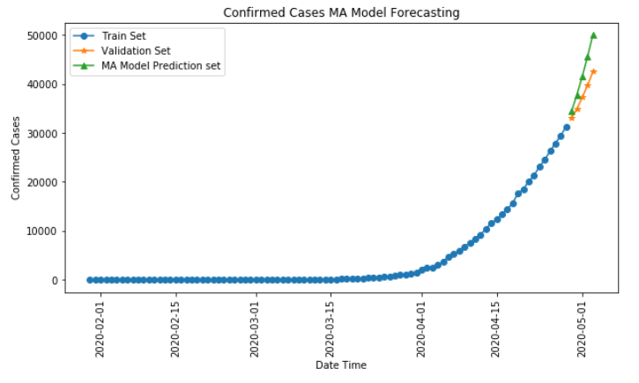
MA Model:

Slide 33
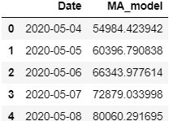
MA Model:
Root Mean Square Error: 4896.179

Slide 34
Auto Regressive Integrated Moving Average
ARIMA is actually a class of models that ‘explains’ a given time series based on its own past values, that is, its own lags and the lagged forecast errors, so that equation can be used to forecast future values.

Slide 35
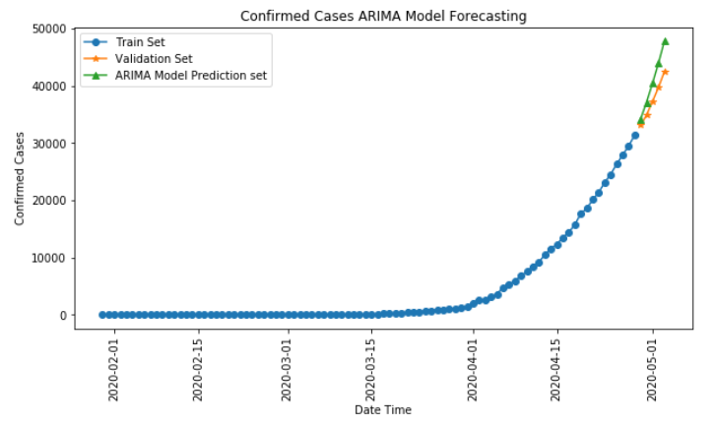
ARIMA Model:

Slide 36
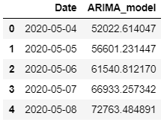
ARIMA Model:
Root Mean Square Error: 3544.864

Slide 37
Results

Slide 38
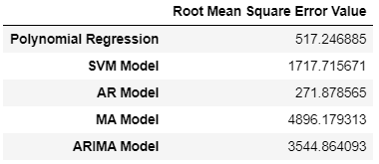
Root Mean Square Error Values:

Slide 39
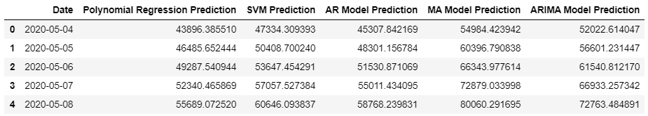
Consolidated Predictions

Slide 40
Conclusions
We were able to successfully model and optimize the ML models related to Coronavirus
The predictions for next few days were relatively accurate
In future work, one could expand the NLP to include news articles to figure out when the lockdown took place and fine tune our models accordingly
As we increase the understanding of the virus (which has been done through keyword extraction), we can successfully find ways to mitigate it and control the spread of infections

