Slide 1

B.TECH PROJECT REPORT
GlandersWatch
Risk prediction, cited explanation and owner
alerting for a neglected zoonosis
A report submitted in partial fulfilment of the requirements for the award of the Bachelor of Technology in Computer Science and Engineering
UNDER THE SUPERVISION OF
Dr. Sangita Dhara
Risk engine
a calibrated probability
Explanation layer
PRESENTED BY
Pedapatruni Shanmukh Vardhan · B123089
Shaktimayee Mohanty · B123118
Yuvraj Singh · B123153
cited, or refused
Alert service
a message still worth reading
Department of Computer Science and Engineering · November 2026

Slide 2
INTRODUCTION
A disease that still has no forecast
01
The organism
Glanders is a bacterial zoonosis of equids caused by Burkholderia mallei. Notifiable, frequently fatal, and with no environmental reservoir: it persists in animal populations rather than in soil or water.
02
The gap
Surveillance describes what has already happened. The published machine-learning work on this disease stops at laboratory identification. No population-level risk model has been reported.
Indian surveillance, 2019 to 2023, found 728 seropositive equids in 138 districts, sharply concentrated geographically. Cases cluster, and that is what makes a spatial model worth building.
What this project adds
A calibrated risk model, an explanation layer grounded in official guidance, and an alert service, each independently deployable behind a fixed contract.
Each component communicates through a versioned schema rather than shared internals, so none of the three hardcodes the disease and each degrades without failing the others.
GlandersWatch · B.Tech Project · IIIT Bhubaneswar
02

Slide 3
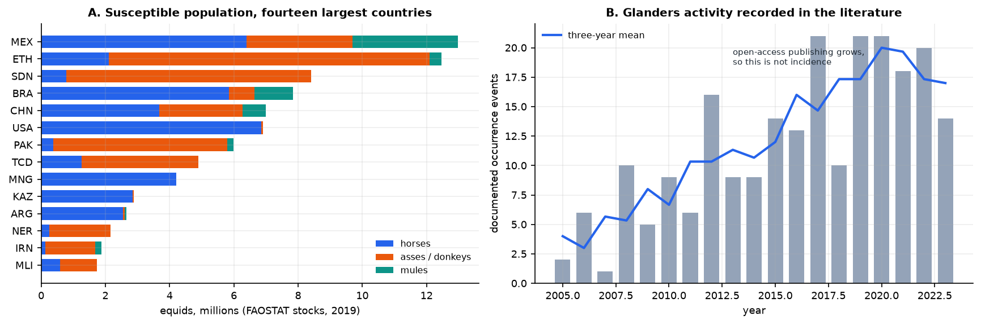
WHY IT MATTERS
Population at risk is not the same as damage
5.50 lakh
equids in India, 2019
728
seropositive, 2019–23
138
districts affected
The two figures are routinely conflated, so they are separated here at the outset.
· 5.50 lakh is the exposed population: how many animals are susceptible.
· 728 of 158,798 screened is the documented damage: under one per cent.
· Each positive is acted on rather than monitored, because the disease is notifiable and often fatal once clinical.
Panel A: the exposed population by species. Panel B: documented events per year, which tracks open-access publishing as much as disease.
Because documentation follows publishing capacity, the target is a documented event rather than raw incidence. That choice is stated once and held throughout.
GlandersWatch · B.Tech Project · IIIT Bhubaneswar
03

Slide 4
DEFINITION
Problem statement
Given a country's features in year t, predict whether glanders is documented in that country in year t + 1.
01
The label
One country-year is positive if a glanders occurrence is reported from that country in that year. Features come only from the year before, so the model never reads the outcome it is predicting.
02
The difficulty
169 positives in 2,880 rows. A model that always says “no” is 94 per cent accurate and worthless, which is why accuracy and ROC-AUC are not used to rank models here.
Base rate 5.87 per cent. Precision-recall AUC is the primary metric because it moves when a model starts finding the 169 positives; ROC-AUC does not.
Every later result is reported on this target and this metric. The country-level model in the next section asks an easier question and is labelled as such.
GlandersWatch · B.Tech Project · IIIT Bhubaneswar
04

Slide 5
SCOPE
Project objectives
01
Assemble the panel
Four public sources, none previously applied to this disease, into a country-year panel.
02
Build the risk engine
Select features by attribution, compare six model families under two splits, calibrate.
03
Specify the explanation layer
Retrieval grounded in official guidance, with citations and a refusal protocol.
04
Specify the alert service
Levels from the calibration curve, hysteresis, deduplication, delivery logging.
Objectives 01 and 02 carry measured results. 03 and 04 are contracts with an evaluation protocol, and are never presented as measured.
GlandersWatch · B.Tech Project · IIIT Bhubaneswar
05

Slide 6
USE
Who the system is for
01
District veterinary officer
Where to pre-position testing and movement checks, before the report arrives.
02
Equine owner
Whether this is the month to restrict movement, in a language they read.
03
State planner
A single scale on which districts can be compared for resources.
The failure mode to design against
A warning system that fires for every area every month is ignored by month twelve. Alert budget is therefore a design constraint, not a tuning parameter.
None of the three users operates a dashboard. The output has to arrive as a message, and the reasoning has to arrive with it.
GlandersWatch · B.Tech Project · IIIT Bhubaneswar
06

Slide 7
01
The risk engine
Can a country's next year be forecast from its last?
— Four public sources assembled into a country-year panel
— Eight features chosen by attribution rather than correlation
— Six model families, two validation splits, and a calibration check
GlandersWatch · section 01

Slide 8
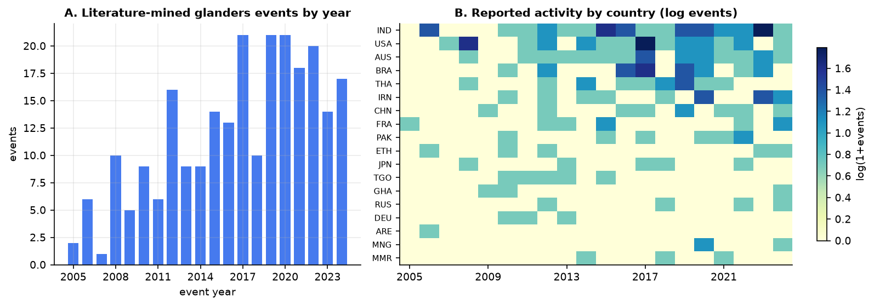
DATA
Four public sources, none used for this disease
01
Europe PMC
Occurrence events extracted from abstracts. This is the label.
02
FAOSTAT
Horse, ass and mule head counts. This is exposure.
03
World Bank
Development and connectivity indicators. This is context.
04
NASA POWER
Temperature, humidity and rainfall. This is environment.
2,880
modelling rows
160
countries
169
positives
5.87%
prevalence
6,700 raw country-year rows over 268 reporting entities reduce to 2,880 observations. Rows with no climate baseline are dropped rather than imputed, so no anomaly is invented.
Coverage of the assembled panel: which countries contribute which years.
GlandersWatch · B.Tech Project · IIIT Bhubaneswar
08

Slide 9
METHOD
From raw sources to a calibrated probability
01
Sources
Four APIs, one panel
02
Panel
Country-year rows
03
Attribution
42 ranked, 8 kept
04
Training
Six families, two splits
05
Output
Calibrated probability
The temporal split trains on 2006–2017 and tests on 2018–2023: forward in time, which is the only honest test of a forecast.
The country split holds out whole countries, so no row from a test country appears in training. This is the split that matches deployment.
Feature ranking uses training years only. Fitting on the full panel would let the held-out years choose the features and make the temporal score optimistic.
Model family | Character
Logistic Regression | additive, interpretable
Decision Tree | single split tree
Random Forest | bagged trees
Extra Trees | randomised splits
XGBoost | gradient boosted
LightGBM | leaf-wise boosted
Eight numeric features, no categorical columns, no identifiers. Country codes and calendar years are identifiers and never enter the model.
GlandersWatch · B.Tech Project · IIIT Bhubaneswar
09

Slide 10
FEATURES
Eight features, chosen by attribution
# | Feature | Unit as measured | Mean |SHAP|
1 | pop_total | persons | 1.035
2 | years_since_last | years (99 = never) | 0.648
3 | temp_mean_anom | °C from baseline | 0.505
4 | internet_pct | % of population | 0.449
5 | humidity_anom | % RH from baseline | 0.382
6 | precip_cv | ratio, sd / mean | 0.371
7 | log_livestock | ln(1 + LSU) | 0.364
8 | goats | head | 0.362
Attributes a prediction
SHAP says how far each feature moved this model's output, so the ranking matches what the model uses.
Beyond pairs
Correlation and mutual information score features pairwise; they cannot see interactions or redundancy.
Comparable
Both are unnormalised and undirected. Attribution is additive and sums to the prediction.
8 of 42 numeric candidates, carrying 49 per cent of total attribution.
Population and years since the last report rank first: exposure, then history.
Correlation ranks longitude first and attribution ranks it near the bottom. Selecting on association keeps geography proxies instead of drivers.
GlandersWatch · B.Tech Project · IIIT Bhubaneswar
10

Slide 11
MODELS
The three models worth describing
01
Logistic Regression
A weighted sum of the eight features passed through a sigmoid. The coefficients are readable, which matters when a prediction has to be defended.
p = 1 / (1 + e^(−z))
z = β0 + β1x1 + … + β8x8
02
Random Forest
Five hundred trees, each grown on a bootstrap sample with a random feature subset at every split, then averaged. Captures interactions, and cannot extrapolate beyond the data it saw.
ŷ = (1/B) Σ Tb(x)
G = 1 − Σ pk²
03
Gradient Boosting
Trees added in sequence, each fitting the residual of the last. XGBoost and LightGBM differ mainly in how they grow the trees.
Obj = Σ L(yi, ŷi) + Σ Ω(fk)
Ω(f) = γT + ½λ||w||²
Six families are trained in total; Decision Tree and Extra Trees are reported in the results table but add nothing to the argument. Logistic Regression and Random Forest are the two that carry it: one is additive and stable, the other flexible and unstable across countries.
Random Forest wins on unseen years; Logistic Regression wins on unseen countries. The next slide is about why that inversion is the finding.
GlandersWatch · B.Tech Project · IIIT Bhubaneswar
11

Slide 12
RESULTS
One target, two validation splits
Model | PR-AUC, unseen years | PR-AUC, unseen countries
Logistic Regression | 0.461 | 0.381
Decision Tree | 0.376 | 0.243
Random Forest | 0.495 | 0.322
Extra Trees | 0.494 | 0.353
XGBoost | 0.429 | 0.268
LightGBM | 0.471 | 0.280
Base rate 5.87 per cent, so PR-AUC is the metric that moves.
ROC-AUC stays inside 0.80–0.87 for all six families on both splits. It cannot separate them, which is why it is not the headline.
Logistic Regression is the champion because it wins on unseen countries, which is what deployment means.
0.495
random forest, unseen years
0.381
logistic, unseen countries
0.322
random forest, unseen countries
The ranking inverts between the two splits. A model that generalises across countries has to be simpler than one that generalises across years, because country-level structure is what the flexible models memorise.
GlandersWatch · B.Tech Project · IIIT Bhubaneswar
12

Slide 13
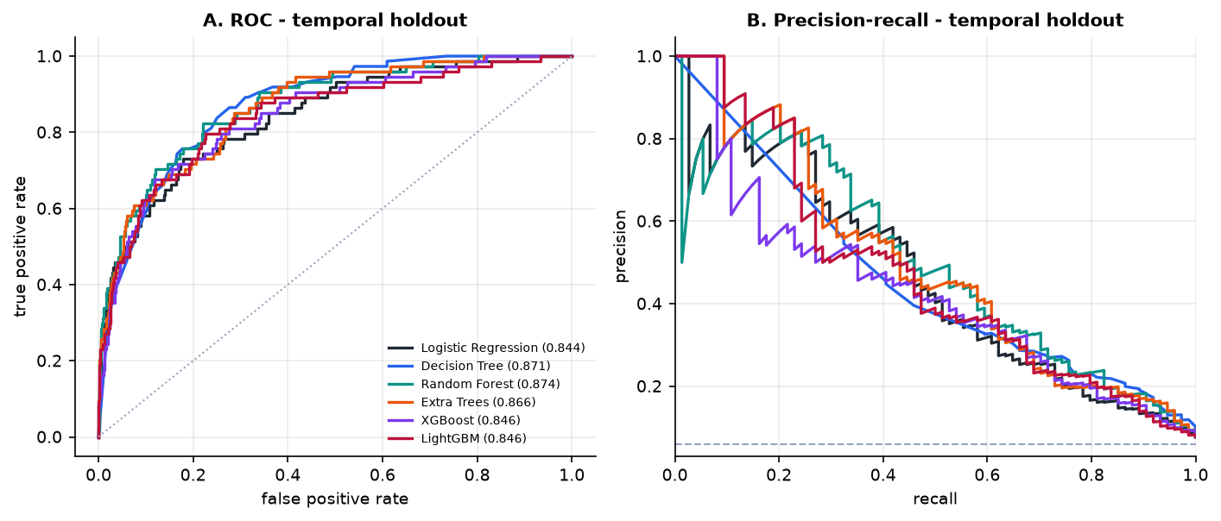
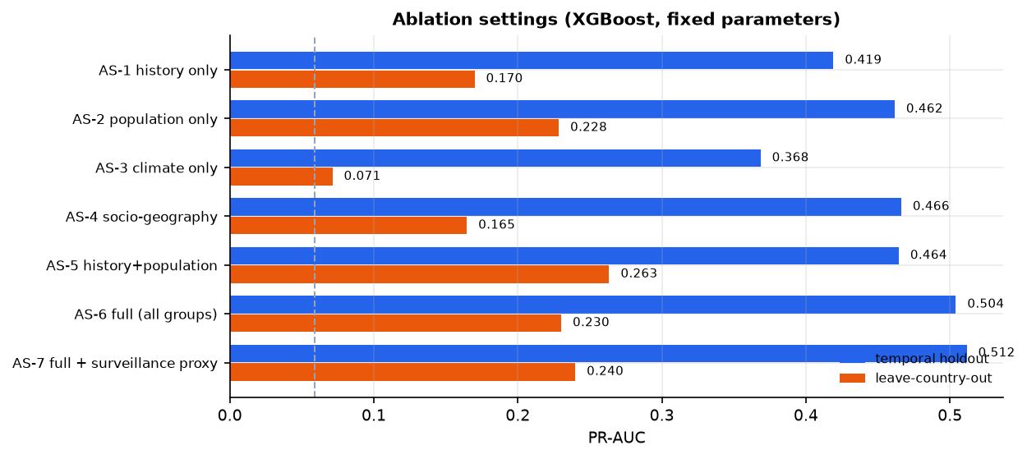
RESULTS
What the two metrics actually measure
Left: ROC curves, which stay high because the negatives vastly outnumber the positives. Right: precision-recall, which falls as recall rises.
Attribution-based selection against correlation-based, on the same split.
The ROC panel is why the deck does not lead with ROC-AUC. Every family sits near 0.85 there, including models that find almost none of the positives. The PR panel separates them, and the ablation shows what the feature choice is worth.
Two metrics, two different questions, and only one of them tells you whether the model finds events.
GlandersWatch · B.Tech Project · IIIT Bhubaneswar
13

Slide 14
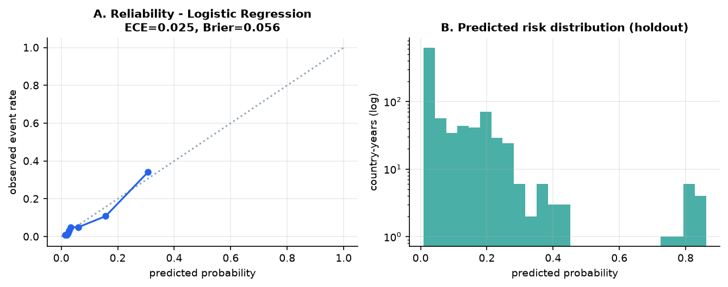
CALIBRATION
The number has to be worth quoting
0.025
expected calibration error
0.056
Brier score
43%
events caught at a 6% budget
A ranking can sort countries. A message needs a number somebody can act on, and that requires the probabilities to mean what they say.
An error of 0.025 means a predicted 0.20 corresponds to roughly one event in five. The reliability curve below is the evidence.
The alert levels are read off this curve rather than set to a default 0.5.
Predicted probability against observed frequency. A well calibrated model follows the diagonal.
Calibration is what lets one number serve two consumers: the alert service thresholds it, and the explanation layer quotes it back to a user.
GlandersWatch · B.Tech Project · IIIT Bhubaneswar
14

Slide 15
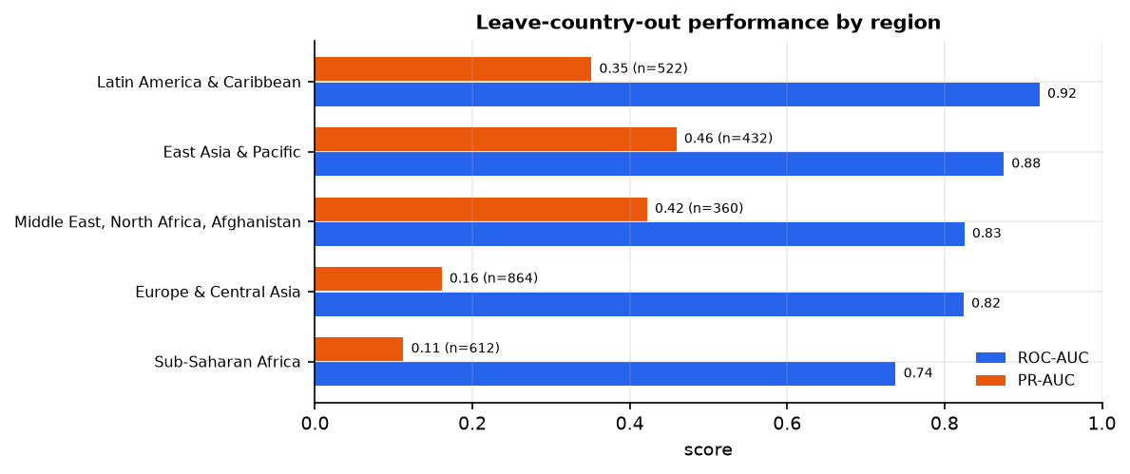
SUPPLEMENTARY
An easier question, answered better
Model | ROC-AUC | PR-AUC
Logistic regression | 0.951 | 0.914
Random forest | 0.968 | 0.963
Asking for the year instead
Predicting the calendar year of a report scores R² = -0.103 under a linear model.
Target | Model | R²
Year of report | Linear | -0.103
Year of report | Random forest | -0.095
Year of report | Predict the mean | 0.000
161 countries, 56 ever positive, prevalence 34.8 per cent.
Discrimination rises to about 0.97, and that is not a better model. It is a simpler question: whether a country reports the disease at all is a stable national property.
Why it fails
Negative R² means worse than predicting the average. The year tracks when reporting began, not biology.
The negative result is kept in the report because deleting it would hide how much of the signal is reporting practice rather than disease.
GlandersWatch · B.Tech Project · IIIT Bhubaneswar
15

Slide 16
02
The explanation layer
Why did the model flag this country, and what should an owner actually do?
— Grounded retrieval with citations, and refusal when nothing supports an answer
— Guardrails that stop advisory text from inventing guidance
— The evaluation protocol, and what has not yet been measured
GlandersWatch · section 02

Slide 17
EXPLANATION
An answer is retrieved, then written
01
Question
“Why is this district high risk?”
02
Retrieve
Dense plus lexical search over the guidance corpus
03
Fuse
Reciprocal rank fusion, then a cross-encoder rerank
04
Answer
Every claim tied to a retrieved passage, or refused
Guardrails, not suggestions
Refuses to answer outside the retrieved sources. Refuses to diagnose an individual animal. Always shows the passages it used.
Why retrieval rather than a fine-tune
Guidance changes and weights would have to be retrained to follow it. A cited passage can be checked by a veterinarian; a generated sentence cannot.
“Risk is elevated mainly because of recent reported activity in neighbouring districts and high equine density. Restrict equid movement and contact the local veterinary authority if an animal is suspected.”
GlandersWatch · B.Tech Project · IIIT Bhubaneswar
17

Slide 18
EXPLANATION
How this layer will be judged
Metric | What it asks | How it is measured
Recall@k | Is the right passage in the top k? | Hand-built question set
Faithfulness | Does the answer follow from those passages? | RAGAS, plus manual review
Answer relevance | Does it answer the question asked? | RAGAS
Citation precision | Does every claim trace to a passage? | Automated check
These four cover the ways an explanation fails: retrieving the wrong passage, drifting from the passages it retrieved, or faithfully answering a question nobody asked.
None of these are measured yet. Targets are fixed before measurement, so the layer cannot be scored by choosing a threshold after seeing the results.
Why this is stated rather than shown
The layer is specified to the level of its interface and rules. Reporting a metric without a deployment would be a stronger claim than the evidence supports.
GlandersWatch · B.Tech Project · IIIT Bhubaneswar
18

Slide 19
03
The alert service
How does a probability become a message that is still read in month twelve?
— Levels read from the calibration curve, not a default cutoff
— Hysteresis, deduplication and a stale-data guard
— Delivery measured against alert fatigue, not accuracy
GlandersWatch · section 03

Slide 20
ALERTING
Five stages, each preventing one failure
01
Predict
Latest calibrated score for the area
02
Assign level
Thresholds from the budget curve
03
Deduplicate
Three idempotency keys
04
Deliver
SMS or WhatsApp, with retries
05
Log
Status per recipient
Hysteresis
Enter at a threshold, leave only 0.05 below it, so a country on the line does not oscillate.
Freshness
If the data check fails, no alert goes out and the admin is told instead.
Quiet hours
Hold overnight except for escalation, so a real rise still gets through.
9%
budget for half the events
37%
budget for 80 per cent
43%
caught at a 6 per cent budget
Levels carry a measured meaning because they come from the curve, and deduplication is what stops a re-run or a retrain from sending the same warning twice.
GlandersWatch · B.Tech Project · IIIT Bhubaneswar
20

Slide 21
ALERTING
What an owner receives, and how it is judged
Metric | What it asks
Precision | Of the alerts sent, how many were real events?
Recall | Of the real events, how many did we alert on?
Missed events | The failure a user actually feels
False alerts per subscriber | The alert-fatigue budget
GLANDERS RISK ALERT
Risk
HIGH
Reason
recent reported activity in neighbouring districts; high equine density
Action
avoid unnecessary movement or mixing of equids; contact the local veterinary authority if an animal is suspected of illness
Caveat
a population-level forecast, not a diagnosis
Defined but not yet measured. A pilot with a district office is how these acquire numbers, and until then the service is not claimed to work.
The message names its reason and its action, and says plainly that it is a forecast. A warning without those three parts is not actionable, and an owner who cannot act on it will stop reading.
GlandersWatch · B.Tech Project · IIIT Bhubaneswar
21

Slide 22
CONCLUSION
What is built, and what a pilot would settle
Conclusion
The risk engine is built and measured: six families, two splits, calibrated, with every number reproducible from committed scripts. The explanation and alert layers are specified to the level of their interfaces and rules.
Future scope
Model reporting capacity as a quantity rather than a covariate. Measure the explanation layer on a hand-built question set. Pilot the alert service with a district office and report precision, recall and fatigue.
The dominant limitation is the label: a negative may mean no disease or no report. With 169 positives the uncertainty on every headline metric is wide, and the honest reading is that this is a moderate model on a hard, noisy target.
The model is the part that is finished. Evidence that the explanation and alert layers behave in use is the part that is not, and a pilot is how it arrives.
GlandersWatch · B.Tech Project · IIIT Bhubaneswar
22

Slide 23
References
[1] Lundberg, S. M. and Lee, S.-I. (2017). A unified approach to interpreting model predictions. NeurIPS 30.
[2] Breiman, L. (2001). Random forests. Machine Learning, 45(1), 5–32.
[3] Chen, T. and Guestrin, C. (2016). XGBoost: a scalable tree boosting system. KDD ’16.
[4] Ke, G. et al. (2017). LightGBM: a highly efficient gradient boosting decision tree. NeurIPS 30.
[5] Lewis, P. et al. (2020). Retrieval-augmented generation for knowledge-intensive NLP tasks. NeurIPS 33.
[6] Es, S. et al. (2023). RAGAS: automated evaluation of retrieval augmented generation. arXiv:2309.15217.
[7] Robertson, S. and Zaragoza, H. (2009). The probabilistic relevance framework: BM25 and beyond. Foundations and Trends in IR, 3(4), 333–389.
[8] Food and Agriculture Organization (2024). FAOSTAT livestock stocks. Rome.
[9] World Bank (2024). World Development Indicators. Washington, DC.
[10] NASA Langley Research Center (2024). POWER project: prediction of worldwide energy resources.
[11] Europe PMC (2024). Literature database, EMBL-EBI.
[12] Department of Animal Husbandry and Dairying (2025). National Action Plan on Glanders. Government of India.
[13] ICAR-NIVEDI (2023). NADRES v2: national animal disease referential and forewarning system.
GlandersWatch · B.Tech Project · IIIT Bhubaneswar
23

