Slide 1

B.TECH PROJECT REPORT
GlandersWatch
Next-year risk prediction, grounded Q&A and owner alerting for a neglected zoonosis
Supervisor: Dr. Sangita Dhara
Presented by: P. Shanmukh Vardhan (B123089) · Shaktimayee Mohanty (B123118) · Yuvraj Singh (B123153)
Department: Computer Science and Engineering · IIIT Bhubaneswar · Nov 2026

Slide 2
RUNNING ORDER
Presentation outline
# | Segment | Presenter | Owns Q&A on
1 | Problem, objectives, platform | Yuvraj Singh | Scope, label, contracts
2 | Data, features, models, results | Yuvraj Singh | Splits, metrics, champion
3 | RAG question answering | Shaktimayee Mohanty | Retrieval, citations, refusal
4 | Alerting system | P. Shanmukh Vardhan | Rules, delivery, audit
5 | Limits, future work, close | All three | Open questions together
Aligned to Final_v2 (~35 pages). Charts on later slides are taken from the report PDF itself. Measured results are only for next-year (t+1) prediction.
GlandersWatch · B.Tech Project · IIIT Bhubaneswar
1

Slide 3
INTRODUCTION
A disease that still has no forecast
01 The organism
Glanders is a bacterial zoonosis of equids caused by Burkholderia mallei. Notifiable, frequently fatal, with no environmental reservoir.
02 The gap
Surveillance describes what already happened. Published ML work on this disease stops at laboratory identification. No population-level risk model has been reported.
Indian surveillance, 2019–2023, found 728 seropositive equids in 138 districts.
This project adds three independently deployable pieces behind fixed contracts:
• a calibrated next-year risk model,
• a RAG layer that answers from official guidance (or refuses),
• an alert service that sends few enough messages to stay readable.
Components talk through versioned schemas, so none hardcodes the disease and each can degrade without failing the others.
GlandersWatch · B.Tech Project · IIIT Bhubaneswar
2

Slide 4
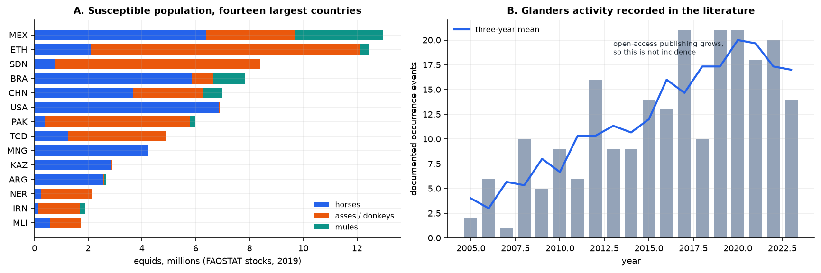
WHY IT MATTERS
Population at risk is not the same as damage
5.50 lakh
equids in India, 2019
728
seropositive, 2019–23
138
districts affected
Report Figure 1.1 — Panel A: exposed population by species. Panel B: documented events per year (tracks publishing as much as disease).
The target is a documented event rather than raw incidence, because documentation follows publishing capacity.
GlandersWatch · B.Tech Project · IIIT Bhubaneswar
3

Slide 5
DEFINITION
Problem statement
Given a country's features in year t, predict whether glanders is documented in that country in year t + 1.
01 The label
One country-year is positive if a glanders occurrence is reported from that country in that year. Features come only from the year before.
02 The difficulty
169 positives in 2,880 rows. A model that always says “no” is 94% accurate and worthless — accuracy and ROC-AUC are not used to rank models.
Base rate 5.87%. Precision-recall AUC is the primary metric because it moves when a model finds the 169 positives.
GlandersWatch · B.Tech Project · IIIT Bhubaneswar
4

Slide 6
SCOPE
Project objectives
01 Prediction as a service
Package a calibrated next-year risk model as a versioned artefact behind a REST interface.
02 Grounded Q&A
Build a retrieval-augmented layer that answers from official guidance, cites every claim, and refuses rather than guesses.
03 Owner alerts
Convert a calibrated probability into few enough messages that they are read.
Objective 01 has measured results. 02 and 03 are specified contracts with evaluation protocols — not presented as measured field performance.
GlandersWatch · B.Tech Project · IIIT Bhubaneswar
5

Slide 7
USE
Who the system is for
01 District veterinary officer
Where to pre-position testing and movement checks, before the report arrives.
02 Equine owner
Whether this is the month to restrict movement, in a language they read.
03 State planner
A single scale on which districts can be compared for resources.
A warning system that fires for every area every month is ignored by month twelve. Alert budget is a design constraint, not a tuning parameter.
GlandersWatch · B.Tech Project · IIIT Bhubaneswar
6

Slide 8
01
The risk engine
Can a country's next year be forecast from its last?
— Four public sources assembled into a country-year panel
— Eight features chosen by attribution rather than correlation
— Six model families, two validation splits, calibration check

Slide 9
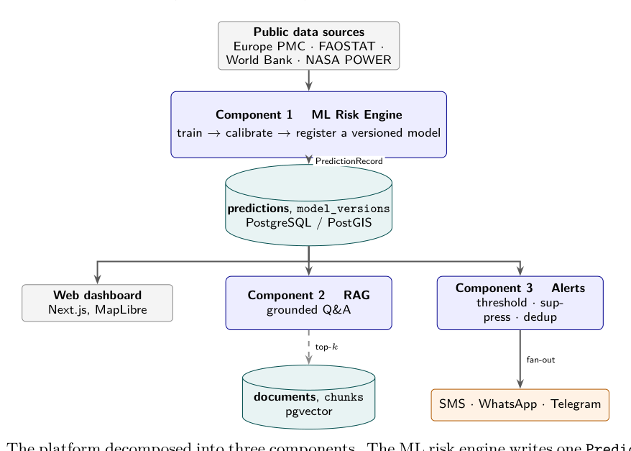
ARCHITECTURE
Three components behind fixed contracts
Report Figure 3.1 — ML risk engine, RAG Q&A layer, and alert service; each independently deployable.
Coupling alert delivery to LLM latency would make the risk model hard to test on its own — so the three jobs stay separate.
GlandersWatch · B.Tech Project · IIIT Bhubaneswar
8

Slide 10
DATA
Four public sources, none built for this disease
01 Europe PMC
Occurrence events from abstracts: the label.
02 FAOSTAT
Horse, ass and mule head counts: exposure.
03 World Bank
Development and connectivity: context.
04 NASA POWER
Temperature, humidity, rainfall: environment.
2,880
modelling rows
160
countries
169
positives
5.87%
prevalence
The next slide shows the three label charts from the report (Figures 8 to 10), stacked for readability.
GlandersWatch · B.Tech Project · IIIT Bhubaneswar
9

Slide 11
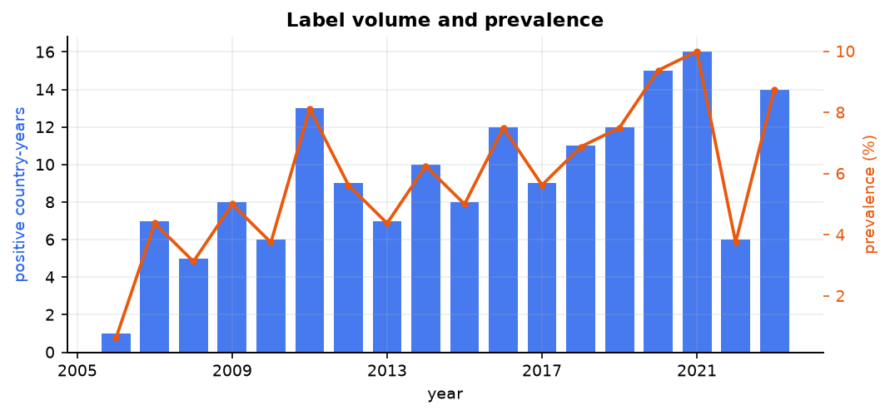
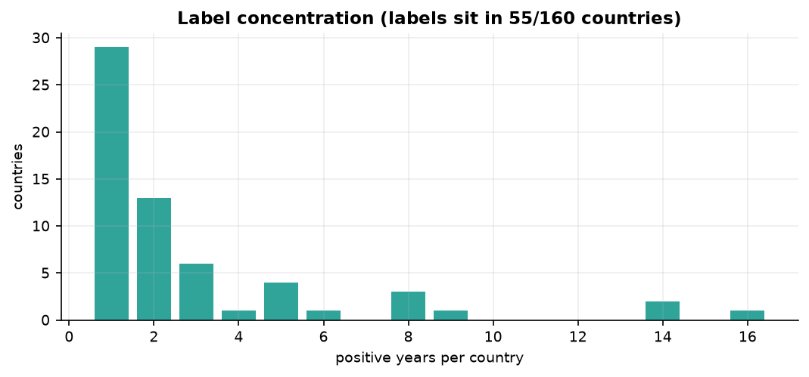
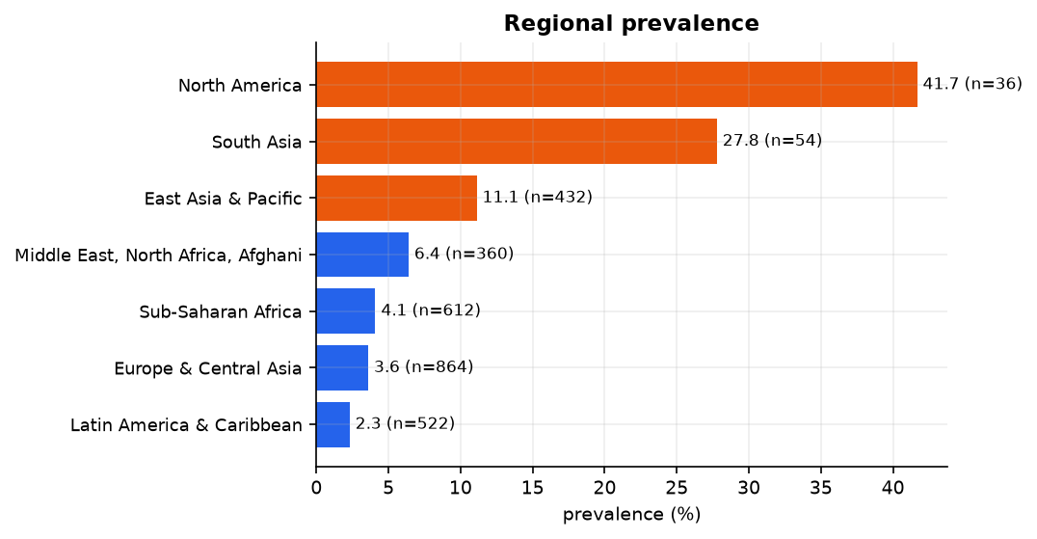
DATA
How the label looks
Fig 8 Annual positives and prevalence
Fig 9 Positive years per country
Fig 10 Prevalence by World Bank region
GlandersWatch · B.Tech Project · IIIT Bhubaneswar
10

Slide 12
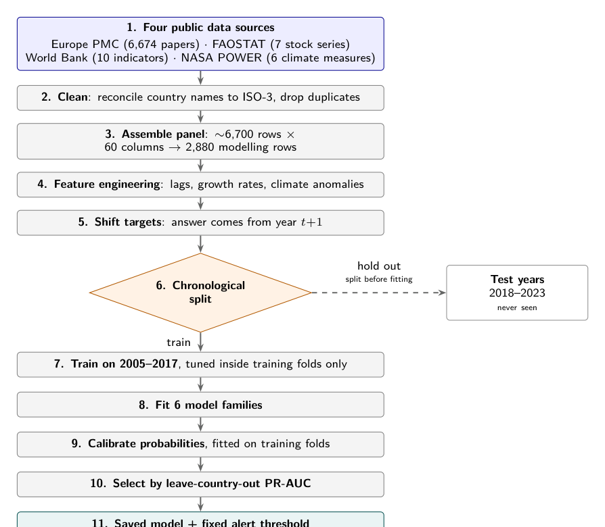
METHOD
From sources to a calibrated probability
Temporal split: train 2005–2017 (~68%), test 2018–2023 (~32%).
Country split: whole countries held out — the deployment-like test.
Feature ranking uses training years only.
Six families trained; Logistic Regression is the champion on unseen countries.
Eight of 42 candidates kept (49% of total SHAP attribution).
Report Figure 4.1 — Training pipeline (chronological split before any model sees data).
Country codes and calendar years are identifiers and never enter the model.
GlandersWatch · B.Tech Project · IIIT Bhubaneswar
11

Slide 13
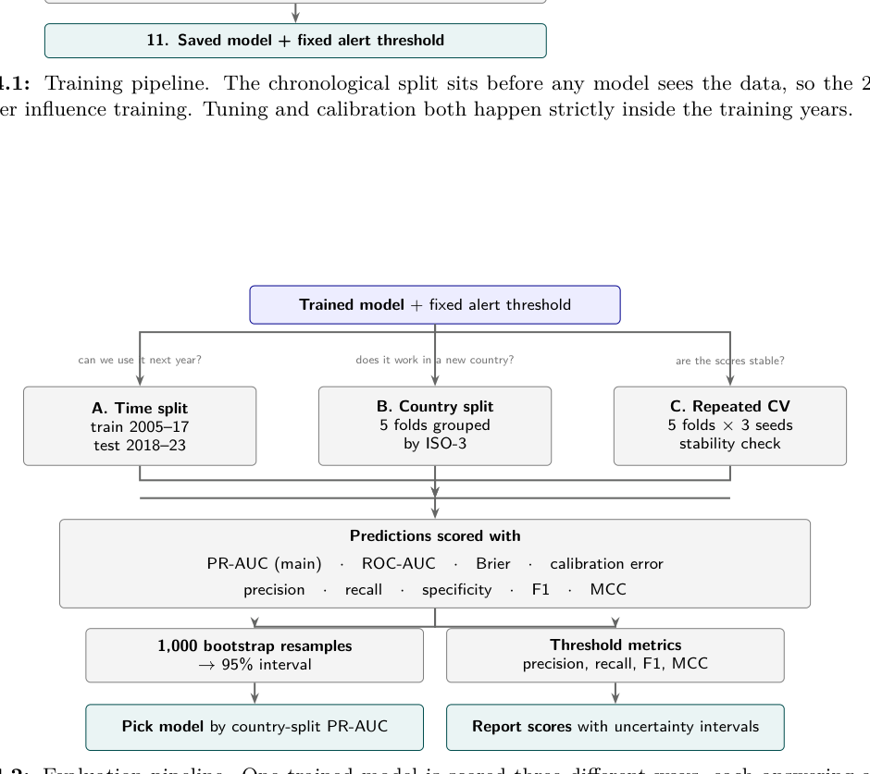
EVALUATION
How one trained model is scored
Report Figure 4.2 — Evaluation pipeline: three scoring paths for one fitted model.
PR-AUC is the headline metric. ROC-AUC stays high for all families and cannot separate them on this imbalance.
GlandersWatch · B.Tech Project · IIIT Bhubaneswar
12

Slide 14
FEATURES
Eight features, chosen by attribution
# | Feature | Unit | Mean |SHAP|
1 | pop_total | persons | 1.035
2 | years_since_last | years (99 = never) | 0.648
3 | temp_mean_anom | °C from baseline | 0.505
4 | internet_pct | % of population | 0.449
5 | humidity_anom | % RH from baseline | 0.382
6 | precip_cv | ratio, sd / mean | 0.371
7 | log_livestock | ln(1 + LSU) | 0.364
8 | goats | head | 0.362
SHAP ranks what the model actually uses.
Correlation / MI score features pairwise and miss interactions.
Population and years since last report rank first: exposure, then history.
Correlation ranks longitude high; attribution ranks it near the bottom.
Selecting on association keeps geography proxies instead of drivers.
GlandersWatch · B.Tech Project · IIIT Bhubaneswar
13

Slide 15
RESULTS
One target, two validation splits
Model | PR-AUC (unseen years) | PR-AUC (unseen countries)
Logistic Regression | 0.461 | 0.381
Decision Tree | 0.376 | 0.243
Random Forest | 0.495 | 0.322
Extra Trees | 0.494 | 0.353
XGBoost | 0.429 | 0.268
LightGBM | 0.471 | 0.280
Base rate 5.87%.
Random Forest on years: 0.495
Logistic on countries: 0.381
Calibration ECE: 0.025
Brier: 0.056
Events at 6% budget: 43%
Ranking inverts between splits. Logistic Regression is champion because deployment means unseen countries.
GlandersWatch · B.Tech Project · IIIT Bhubaneswar
14

Slide 16
02
The RAG question-answering layer
How do officers and owners get answers that cite official guidance?
— Grounded retrieval with citations, refusal when unsupported
— Guardrails against invented control instructions
— Evaluation protocol fixed before measurement

Slide 17
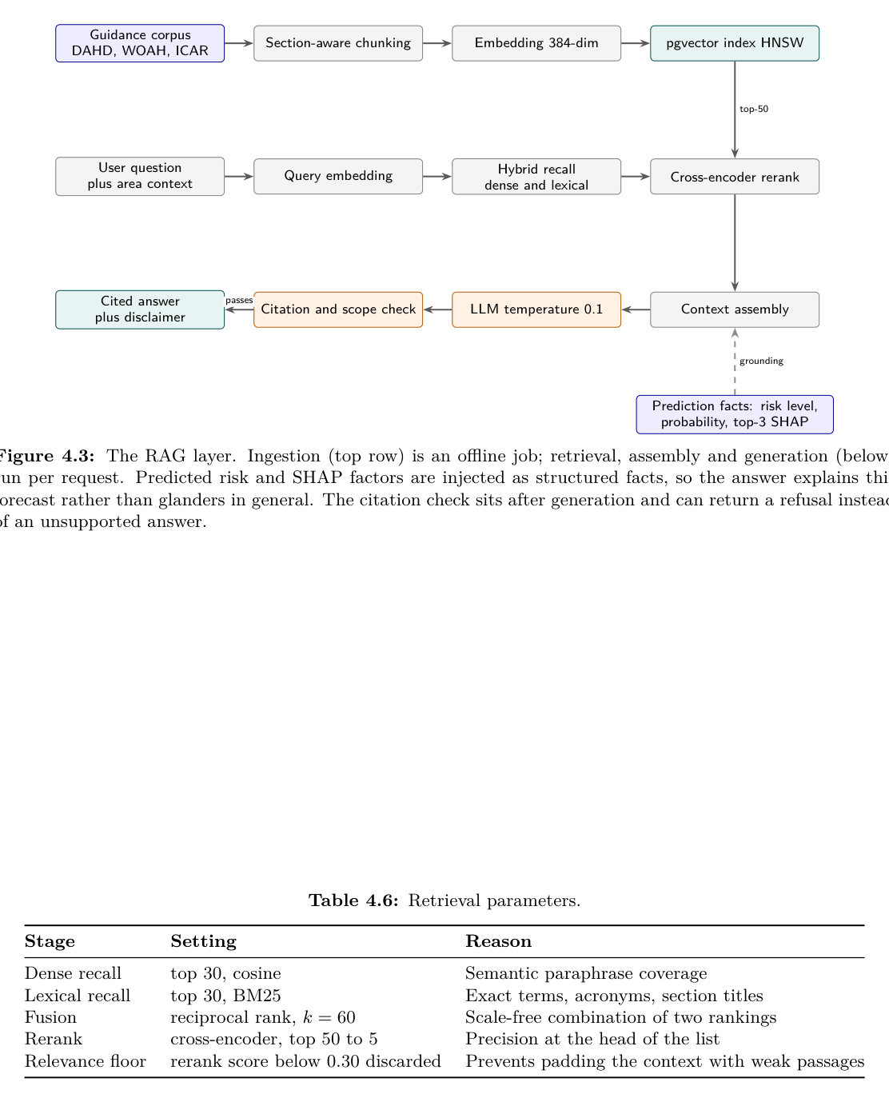
RAG Q&A
A question is answered from retrieved passages
Report Figure 4.3 — Offline ingestion (top); retrieval, assembly, generation (below).
If fewer than two passages clear the relevance floor, the layer refuses rather than inventing an answer.
GlandersWatch · B.Tech Project · IIIT Bhubaneswar
16

Slide 18
RAG Q&A
How this layer will be judged
Metric | What it asks | How it is measured
Recall@k | Is the right passage in the top k? | Hand-built question set
Faithfulness | Does the answer follow those passages? | RAGAS + manual review
Answer relevance | Does it answer the question asked? | RAGAS
Citation precision | Does every claim trace to a passage? | Automated check
None of these are measured yet. Targets are fixed before measurement so the layer cannot be scored by choosing a threshold after the fact.
GlandersWatch · B.Tech Project · IIIT Bhubaneswar
17

Slide 19
03
The alert service
How does a probability become a message that is still read in month twelve?
— Levels from the calibration / budget curve
— Hysteresis, deduplication, stale-data guard
— Delivery judged on fatigue, not only accuracy

Slide 20
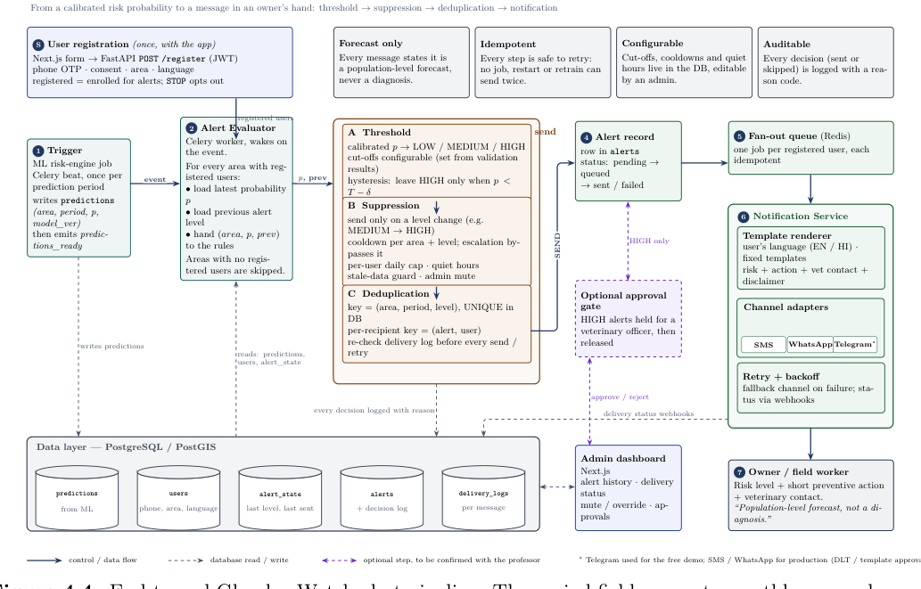
ALERTING
End-to-end alert pipeline
Report Figure 4.4 — Prediction → level → dedupe → deliver → log.
Budget for half the events: 9% of ranked areas. Budget for 80%: 37%. Caught at a 6% budget: 43%.
Levels carry measured meaning because they come from the curve; deduplication stops a re-run from sending the same warning twice.
GlandersWatch · B.Tech Project · IIIT Bhubaneswar
19

Slide 21
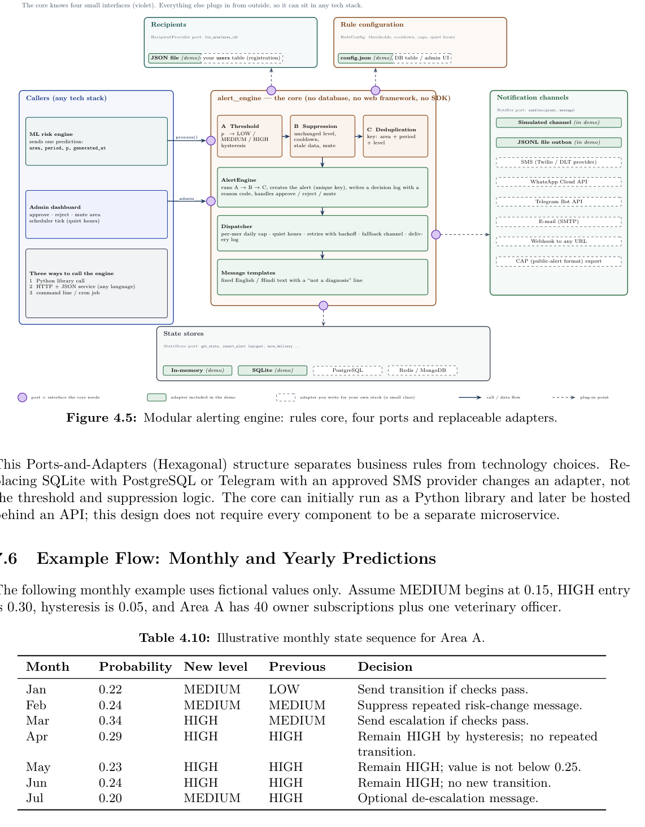
ALERTING
Rules core, ports and adapters
Report Figure 4.5 — Modular alerting engine: core rules, four ports, replaceable adapters.
The core does not know SMS vendors or databases — adapters plug in from outside.
GlandersWatch · B.Tech Project · IIIT Bhubaneswar
20

Slide 22
CONCLUSION
What is built, and what a pilot would settle
Conclusion
The risk engine is built and measured: six families, two splits, calibrated, reproducible from committed scripts. RAG and alert layers are specified to their interfaces and rules.
Future scope
Model reporting capacity explicitly. Measure RAG on a hand-built question set. Pilot alerts with a district office and report precision, recall and fatigue.
Dominant limitation: a negative may mean no disease or no report. With 169 positives, uncertainty on every headline metric is wide.
The model is finished. Evidence that RAG and alerts behave in use is not — a pilot is how it arrives.
GlandersWatch · B.Tech Project · IIIT Bhubaneswar
21

Slide 23
Q&A OWNERSHIP
Questions
Topic | Who answers
Data panel, features, splits, ML results | Yuvraj Singh
RAG retrieval, citations, refusal | Shaktimayee Mohanty
Alert rules, delivery, audit trail | P. Shanmukh Vardhan
Scope, limits, future work | Any of us
Thank you. We will take questions now.
GlandersWatch · B.Tech Project · IIIT Bhubaneswar
22

Slide 24
References
[1] Lundberg & Lee (2017). A unified approach to interpreting model predictions. NeurIPS.
[2] Breiman (2001). Random forests. Machine Learning, 45(1).
[3] Chen & Guestrin (2016). XGBoost. KDD ’16.
[4] Ke et al. (2017). LightGBM. NeurIPS.
[5] Lewis et al. (2020). Retrieval-augmented generation. NeurIPS.
[6] Es et al. (2023). RAGAS. arXiv:2309.15217.
[7] Robertson & Zaragoza (2009). BM25 and beyond. FnT IR.
[8] FAO (2024). FAOSTAT livestock stocks.
[9] World Bank (2024). World Development Indicators.
[10] NASA POWER (2024). Prediction of Worldwide Energy Resources.
[11] Europe PMC (2024). EMBL-EBI literature database.
[12] DAHD (2025). National Action Plan on Glanders. Government of India.
[13] ICAR-NIVEDI (2023). NADRES v2.
GlandersWatch · B.Tech Project · IIIT Bhubaneswar
23

