Slide 1
SECURE DATA HIDING IN IMAGES USING STEGNOGRAPHY
CAPSTONE PROJECT
Presented By :
Student Name : Parmar Yuvrajsinh Premjibhai
College Name & Department : Shree Swaminarayan Institute of Technology
Information Technology Department

Slide 2
OUTLINE
Problem Statement
Technology used
Wow factor
End users
Result
Conclusion
Git-hub Link
Future scope

Slide 3
Problem Statement
Traditional data transmission methods are vulnerable to hacking, eavesdropping, and unauthorized access. Encryption alone may attract attention, making hidden communication crucial. This project implements steganography, which hides secret data inside images, ensuring secure and undetectable communication.

Slide 4
Technology used
Programming Language: Python
Libraries: OpenCV, Tkinter (for GUI),PIL
Platform : VS Code

Slide 5
Wow factors
Dual-layer Security: Uses both steganography and encryption.
Custom GUI: User-friendly interface for encoding and decoding images.
High Capacity: Can hide text or small files without noticeable image distortion.
Undetectable Data Storage: The image looks the same to human eyes

Slide 6
End users
Government & Defense: Secure military and intelligence communication
Corporate & Business: Protect confidential data from cyber threats
Individuals: Personal data security in private messaging
Journalists & Activists: Safe transmission of sensitive information

Slide 7


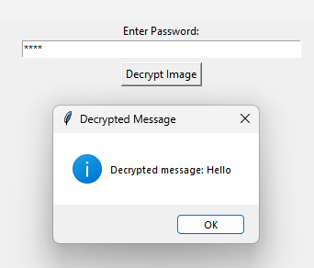
Results
Successfully implemented LSB steganography to hide and extract data.
Created an interactive GUI for encoding and decoding messages.
Ensured minimal impact on image quality while securely embedding data.

Slide 8
Conclusion
This project demonstrates an efficient and secure method for hiding sensitive data in images using steganography.
It enhances data security and privacy for various applications, reducing the risk of cyber threats and unauthorized access.

Slide 9
GitHub Link
Github Repository : https://github.com/YuvrajSinh345/aicte_project.git

Slide 10
Future scope(optional)
we can encrypt the message in various forms like pictures, audios, videos,text. So by using this technologies one can share any secret message to receiver without knowing the attacker and as this technology is already applied by the various social media developers so might be possible that this technology might apply on various platforms as well

Slide 11
THANK YOU

