Slide 1

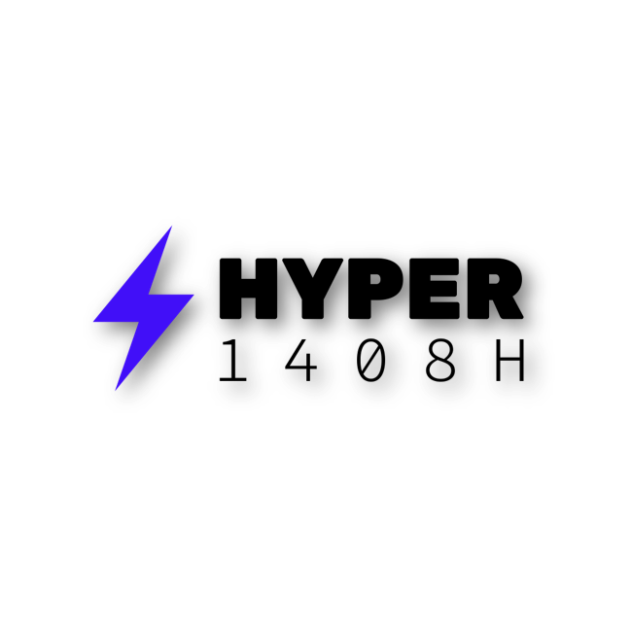
ENGINEERING NOTEBOOK
Mechanical development & Hyper Robot Manager
Team Hyper • 1408H
Notes:
Team Hyper engineering notebook. Software evidence covers July–October 2026. Mechanical image dates were not supplied.

Slide 2
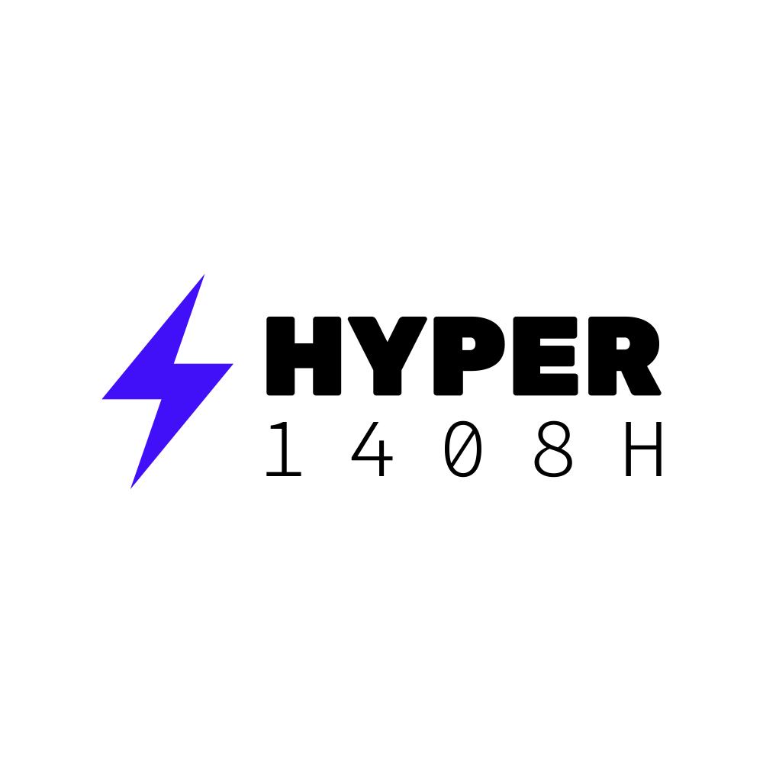
Development record
Team Hyper • Notebook scope
Mechanical development
The photographs document wheel gearing, the lift structure and the mechanism around the game object. Video frames record a lift cycle and the front roller assembly.
Software development
Dated screenshots follow Hyper Robot Manager from July build errors through the August demonstration to visualizer and control-code updates on 5 October 2026.
Evidence and next steps
Each entry identifies visible features and explains their engineering significance. Suggested checks remain separate from observed outcomes.
TEAM HYPER 1408H
2
Notes:
Sources:
Annotations describe visible features. Proposed checks are not recorded test results. Mechanical dates and performance figures are not inferred.

Slide 3
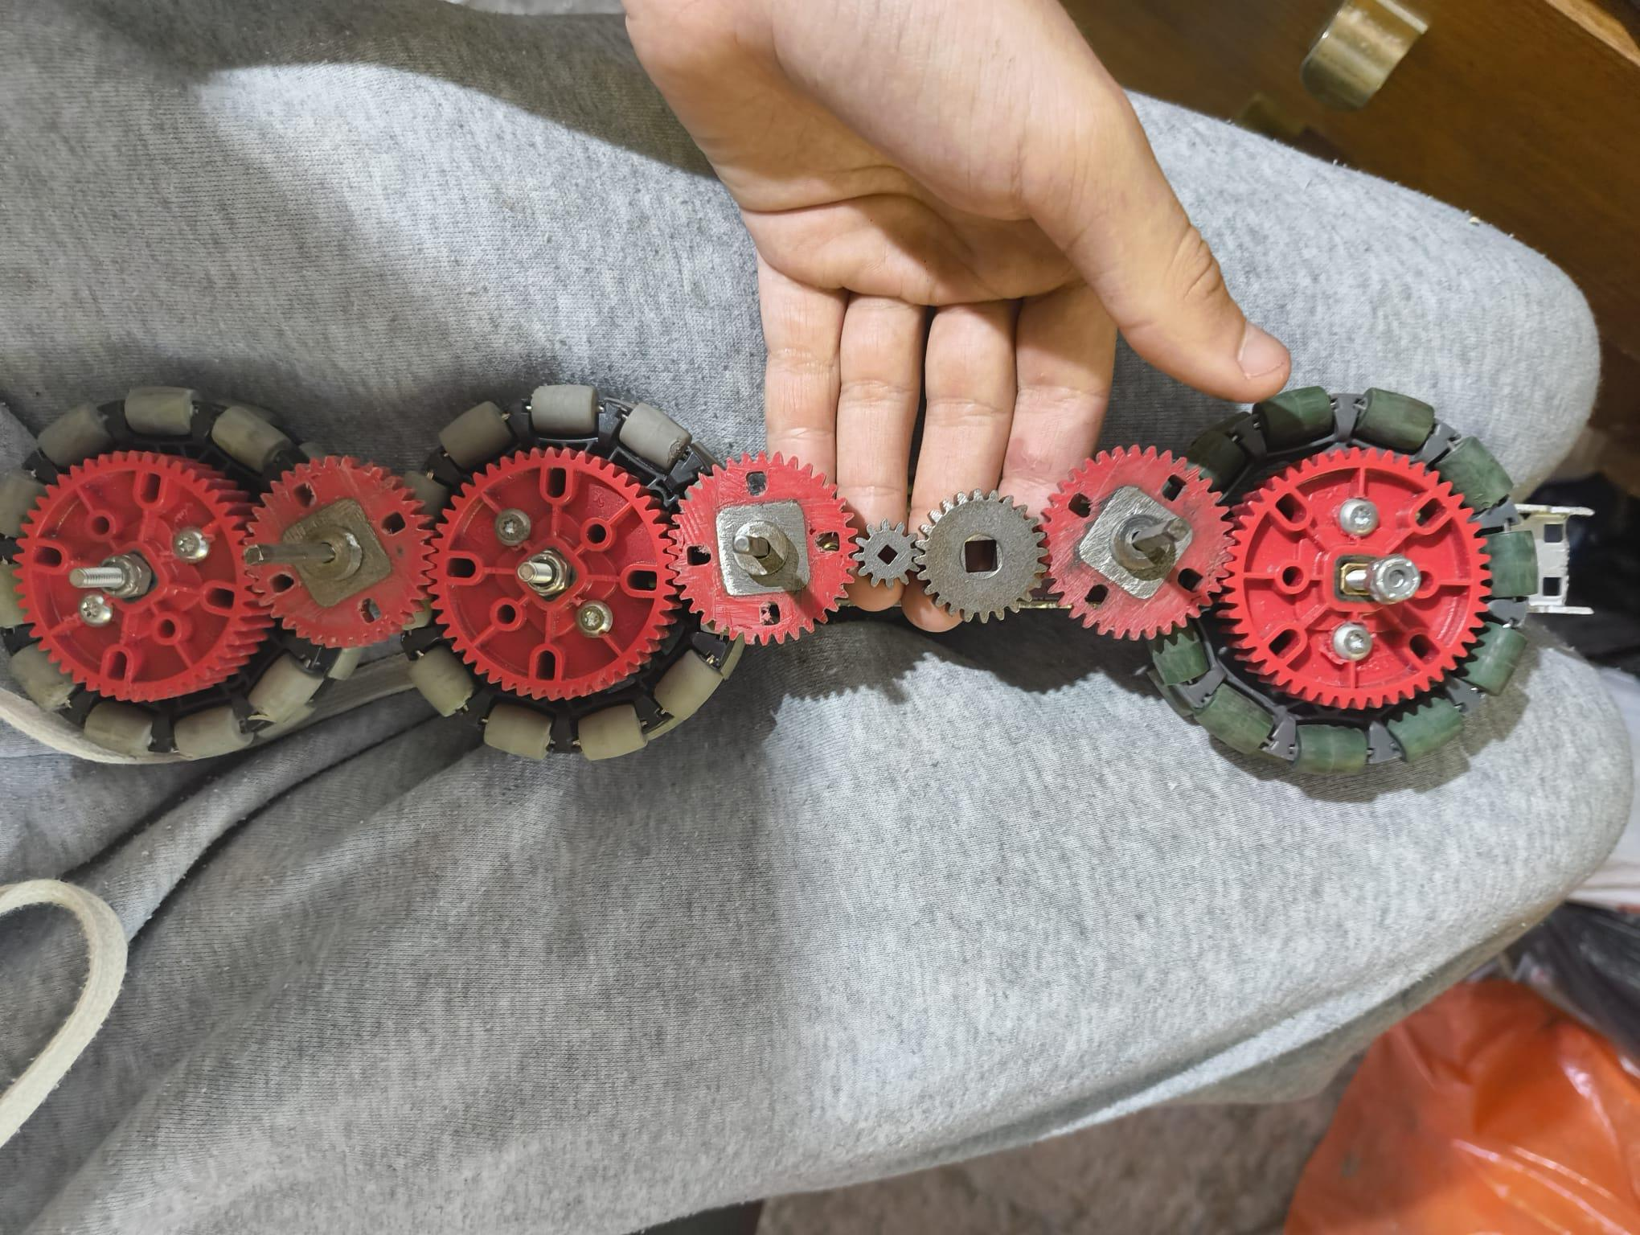
Drivetrain gear arrangement
Mechanical development • Date not recorded
1 Wheel-mounted gears
Large red gears sit beside the omni wheels. This arrangement transfers rotation directly to the wheel axles.
1
2
2 Intermediate gears
The smaller gears connect the wheel positions. Tooth counts and motor input are not established by this photograph.
3
3 Shaft alignment
The exposed shafts make spacing and support important checks. Rotate the assembly by hand to locate tight spots before powered testing.
TEAM HYPER 1408H
3
Notes:
Sources: 01-9e08dde5-6155-447d-a6d4-9e33cc6720d6.jpg
Annotations describe visible features. Proposed checks are not recorded test results. Mechanical dates and performance figures are not inferred.

Slide 4
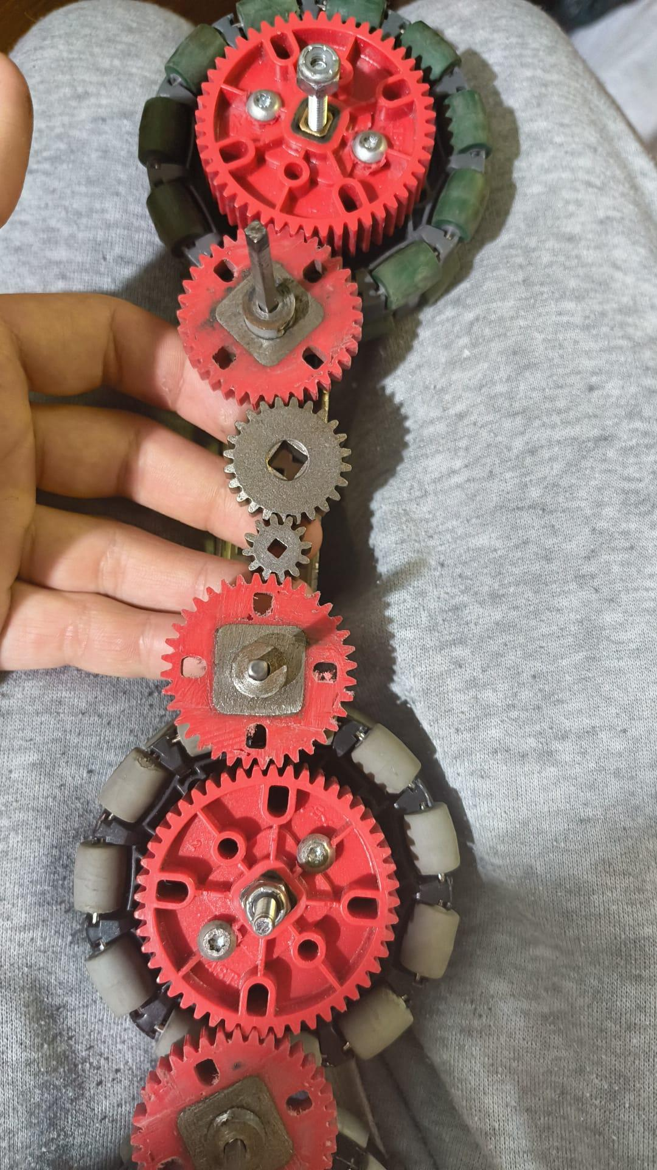
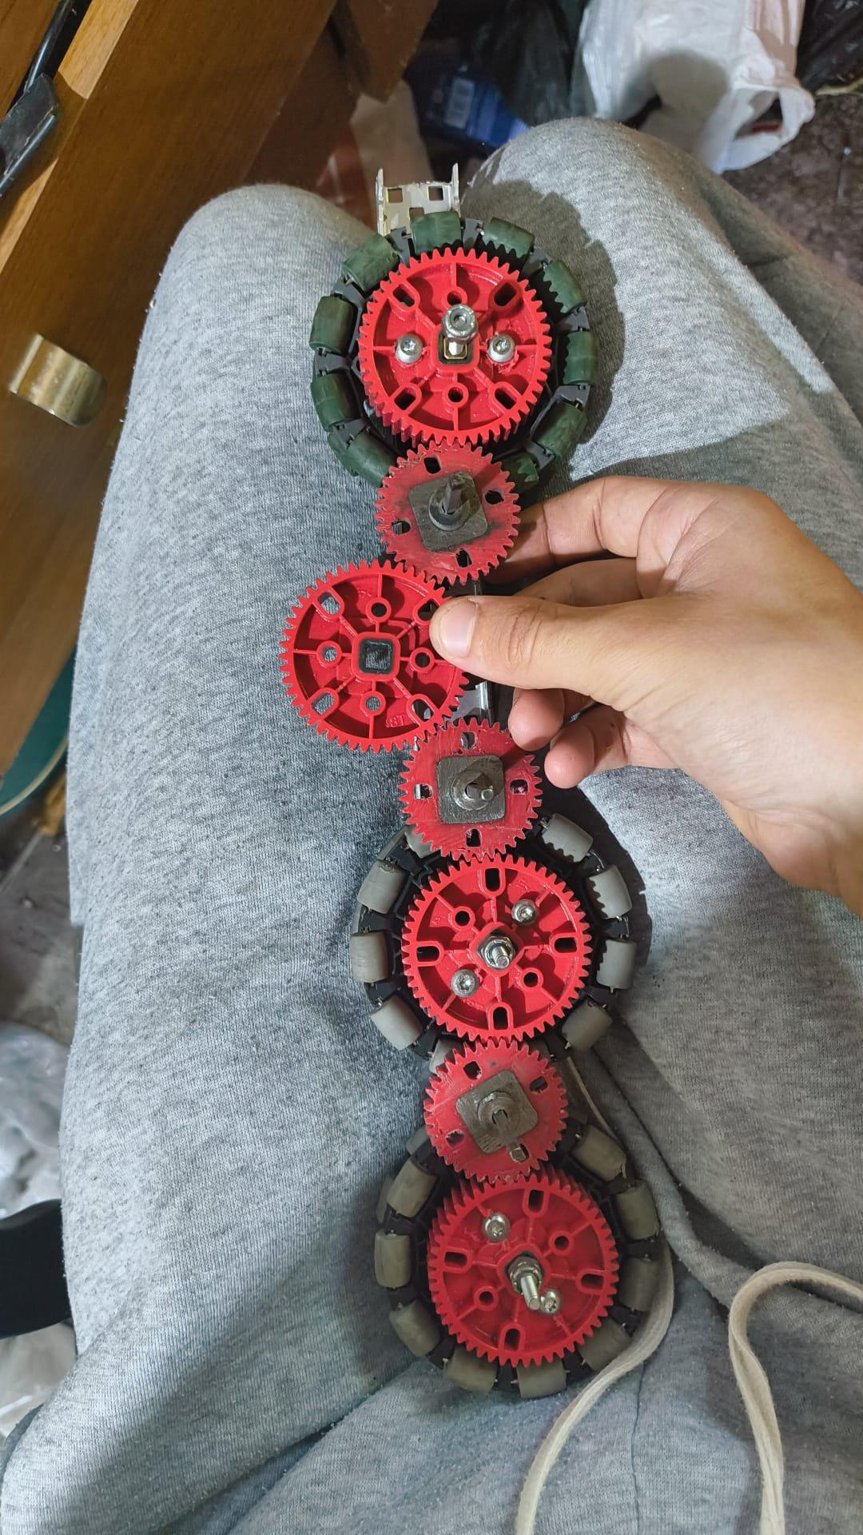
Gear spacing and assembly access
Mechanical development • Date not recorded
1 Gear mesh
1
The close views show the gear train from two positions. Check that each gear engages without being forced sideways.
2 Axle support
Check spacers and bearing support once the second side plate is fitted. A free-running open assembly may bind after tightening.
2
Proposed comparison
Record wheel rotation, friction and any tight spot before and after final assembly. These photographs alone do not establish a gear ratio.
TEAM HYPER 1408H
4
Notes:
Sources: 04-473e32d6-ce86-40a9-a3a4-a9a60467210a.jpg; 05-589b3426-c0b8-46c9-9a13-1acccb4f691b.jpg
Annotations describe visible features. Proposed checks are not recorded test results. Mechanical dates and performance figures are not inferred.

Slide 5
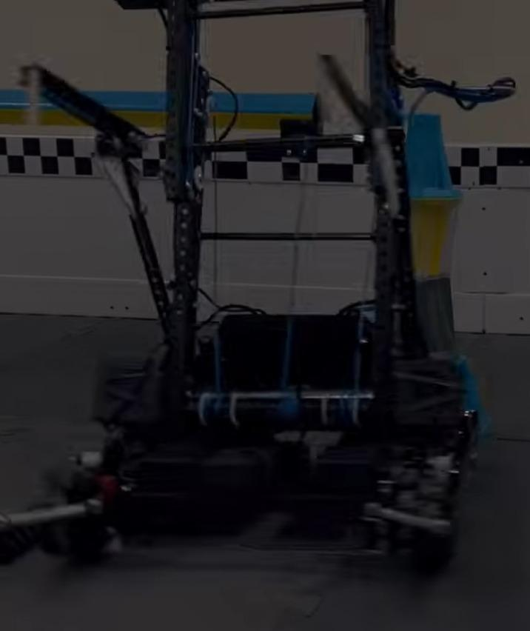
Lift structure and packaging
Mechanical development • Date not recorded
1 Vertical guides
1
Two tall side structures guide the moving assembly. Parallel alignment is a key check over the full travel.
2 Moving mechanism
The carriage sits between the guides. Its weight and offset affect the load carried by each side.
2
3 Base clearance
3
The lift shares space with the drivetrain and wiring. Check clearance at the lowest position and at full extension.
TEAM HYPER 1408H
5
Notes:
Sources: 02-64d15d4a-c310-4194-a93c-7f5bc7c08f86.jpg
Annotations describe visible features. Proposed checks are not recorded test results. Mechanical dates and performance figures are not inferred.

Slide 6
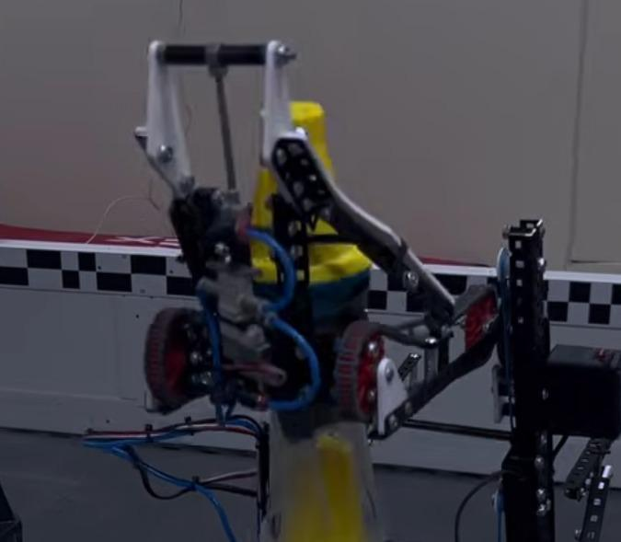
Object handling mechanism
Mechanical development • Date not recorded
1 Upper linkage
1
Pivoting links surround the upper part of the object. The photograph records the geometry in one position.
2 Contact region
Wheels sit beside the object. Check whether contact remains centred as the mechanism moves.
2
3
3 Pneumatic routing
Blue tubing runs through the moving assembly. Leave enough slack for motion while keeping it clear of pinch points.
TEAM HYPER 1408H
6
Notes:
Sources: 03-96fc02c6-599b-43dc-9c98-5f77eadaf287.jpg
Annotations describe visible features. Proposed checks are not recorded test results. Mechanical dates and performance figures are not inferred.

Slide 7
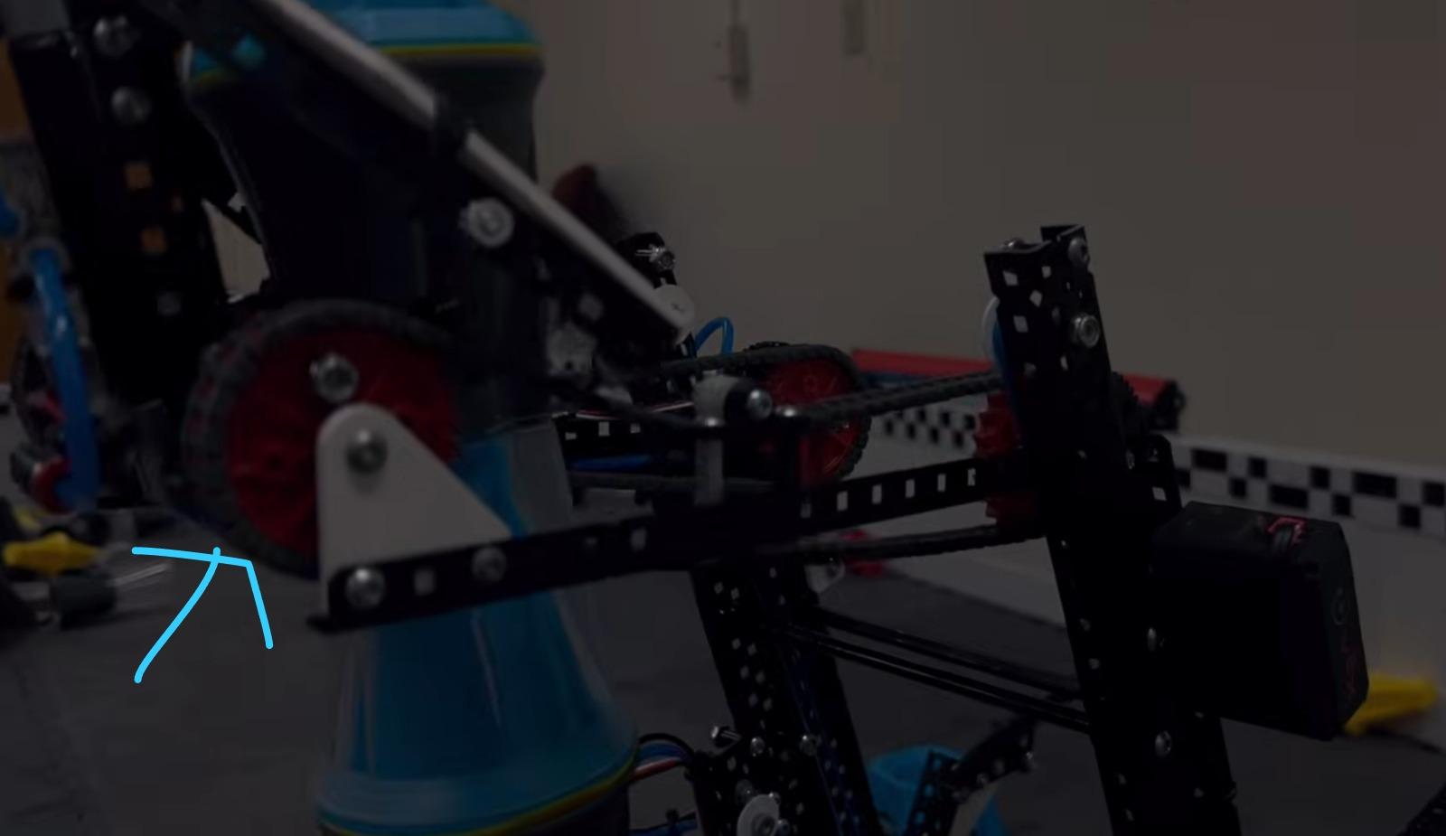
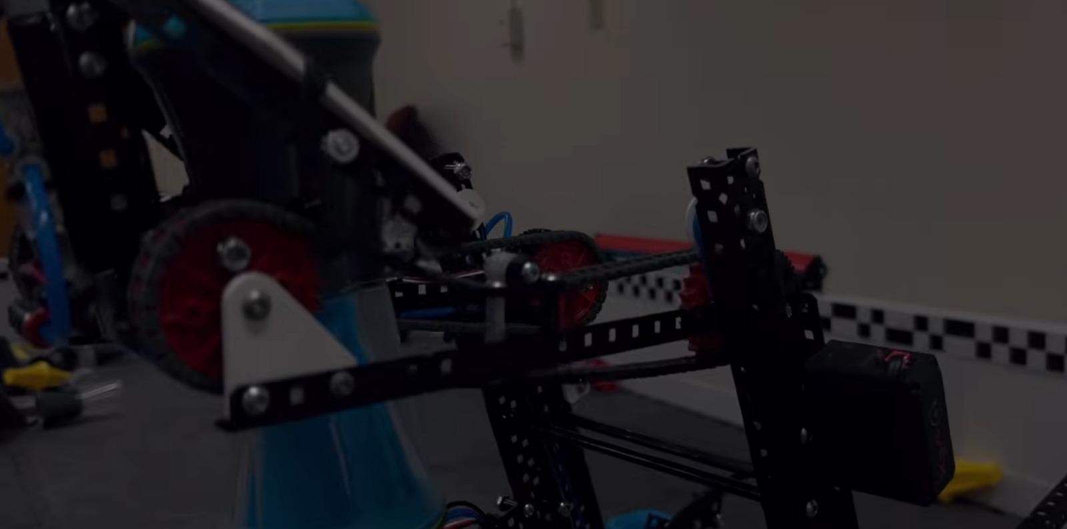
Carriage support and side alignment
Mechanical development • Date not recorded
1 Side support
1
The side views show the horizontal member and the triangular mounting plate near the wheel.
2 Rear mounting
The mechanism extends towards the rear support. Inspect both ends for loose fasteners or movement under load.
2
Proposed stiffness check
Apply the same light load on each side and compare deflection. Record any change after bracing or fastener adjustments.
TEAM HYPER 1408H
7
Notes:
Sources: 08-777189d1-2fbc-4808-b487-f018b9631d31.jpg; 10-e7a85bc9-518d-4e6b-904e-6fd77d21e95b.jpg
Annotations describe visible features. Proposed checks are not recorded test results. Mechanical dates and performance figures are not inferred.

Slide 8
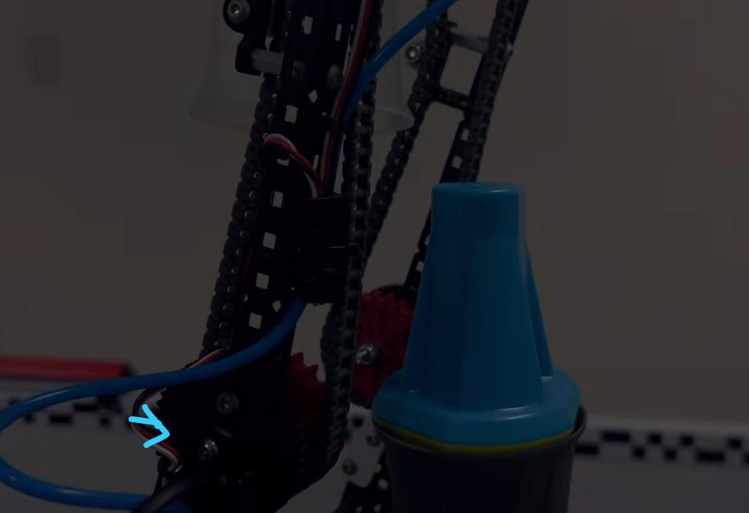
Chain path and moving services
Mechanical development • Date not recorded
1 Vertical chain
The chain runs beside the upright. Check alignment with its sprockets and look for rubbing during travel.
1
2 Lower attachment
The original blue arrow highlights the lower mechanism area. Inspect this region while the lift approaches its bottom position.
3
3 Tube clearance
2
The blue tube crosses near the structure. Check clearance through the entire stroke, not just the photographed position.
TEAM HYPER 1408H
8
Notes:
Sources: 09-90492645-9b0b-42d9-86c6-6a4c582a30d7.jpg
Annotations describe visible features. Proposed checks are not recorded test results. Mechanical dates and performance figures are not inferred.

Slide 9
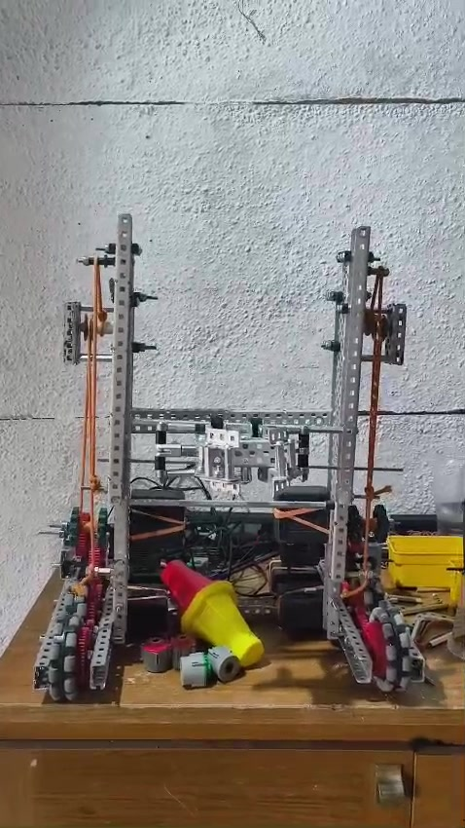
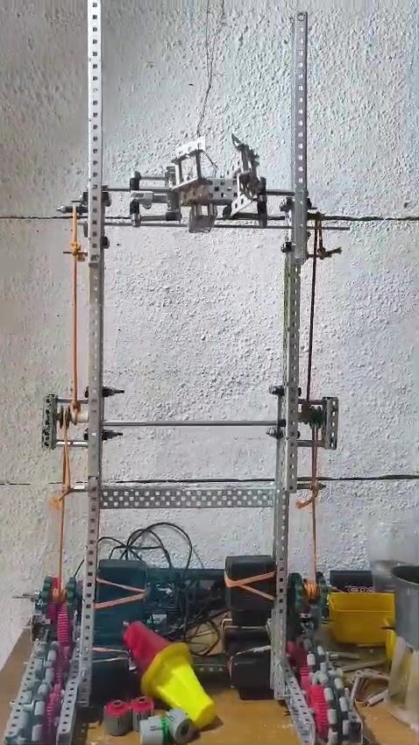
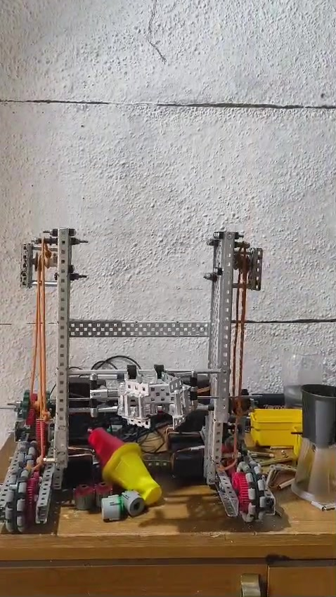
Lift movement captured on video
Mechanical development • Date not recorded
0.6 s • Lower position
2.1 s • Raised position
5.4 s • Returned lower
The sampled frames show the carriage rising and returning during the 5.95-second clip. They demonstrate movement, but do not establish a measured lift time or repeatability. Next test: repeat the cycle under a consistent load and record stalls, tilt and stopping position.
TEAM HYPER 1408H
9
Notes:
Sources: 06-frame-0 (frame from supplied video); 06-frame-1 (frame from supplied video); 06-frame-3 (frame from supplied video)
Annotations describe visible features. Proposed checks are not recorded test results. Mechanical dates and performance figures are not inferred.

Slide 10
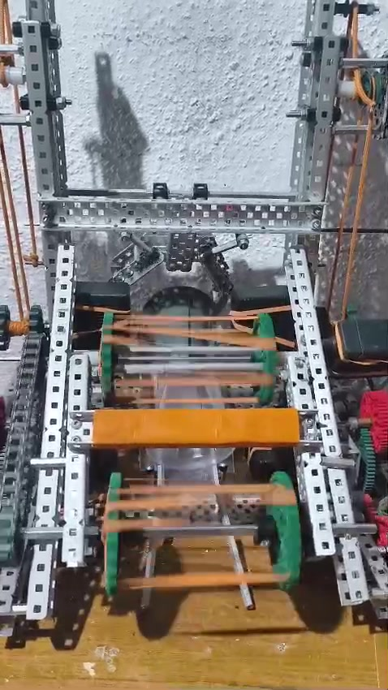
Front roller assembly in motion
Mechanical development • Date not recorded
1 Flexible roller elements
Bands span the front roller assembly. Their visible motion shows that the mechanism is being driven.
2 Side supports
1
The rollers sit between two side structures. Check shaft spacing and band clearance before adding an object.
Test limitation
2
This short clip does not show a complete object transfer. The next test should record pickup, handoff and release with the same object each time.
TEAM HYPER 1408H
10
Notes:
Sources: 07-frame-1 (frame from supplied video)
Annotations describe visible features. Proposed checks are not recorded test results. Mechanical dates and performance figures are not inferred.

Slide 11
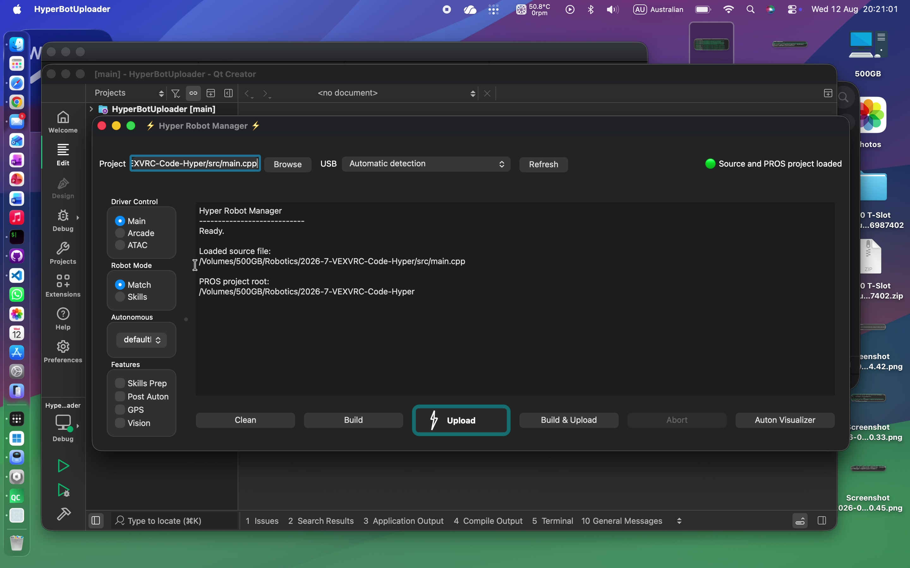
Hyper Robot Manager interface
12 August 2026 • Screen recording
1 Configuration controls
Driver mode, match/skills mode and feature options are grouped on the left of the window.
1
2 Build and upload tools
3
The lower row brings Clean, Build, Upload and Build & Upload into one interface.
2
3 Status and feedback
The terminal and status indicator show the current operation. A visible control does not by itself confirm the robot applies that setting.
TEAM HYPER 1408H
11
Notes:
Sources: 11-frame-2 (frame from supplied video)
Annotations describe visible features. Proposed checks are not recorded test results. Mechanical dates and performance figures are not inferred.

Slide 12
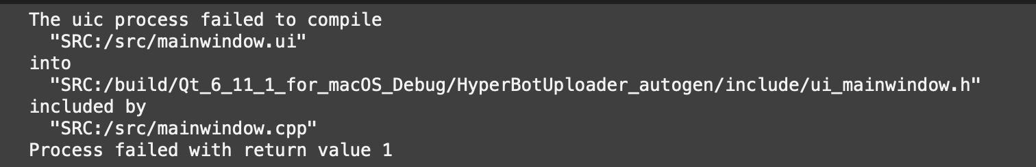
UI compilation failure
17 July 2026 • 18:54
1
Observed error
Proposed correction
Verification
Qt reports that the uic process failed while generating ui_mainwindow.h from mainwindow.ui.
Inspect the UI file and the full uic diagnostic. Check that the build points to the intended file before rebuilding.
A passing check would generate the header and then compile the window. This screenshot records the failure only.
TEAM HYPER 1408H
12
Notes:
Sources: 12-Screenshot-2026-07-17-at-18.54.42.png
Annotations describe visible features. Proposed checks are not recorded test results. Mechanical dates and performance figures are not inferred.

Slide 13
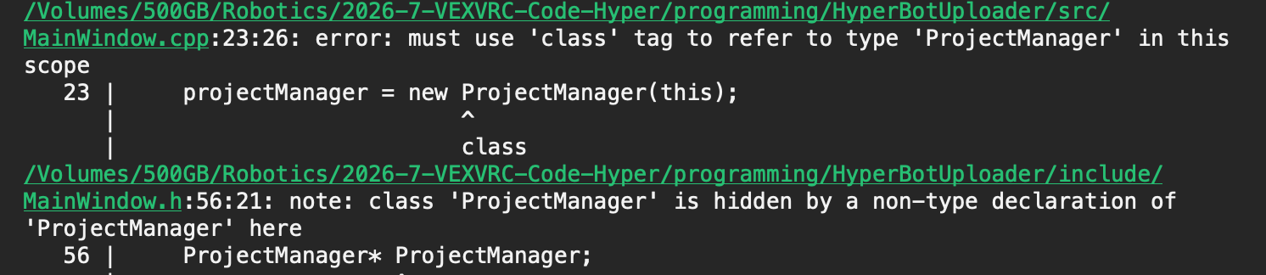
ProjectManager naming errors
17 July 2026 • 20:20
1 Hidden class name
The first diagnostic identifies a member named ProjectManager that hides the class name in the same scope.
1
2 Inconsistent identifier
The next diagnostic reports projectManager as undeclared. Keep one member name consistent in the header and source.
Proposed correction
2
Use ProjectManager for the type and projectManager for the instance. Rebuild after checking both declaration and usage.
TEAM HYPER 1408H
13
Notes:
Sources: 13-Screenshot-2026-07-17-at-20.20.33.png; 14-Screenshot-2026-07-17-at-20.20.45.png
Annotations describe visible features. Proposed checks are not recorded test results. Mechanical dates and performance figures are not inferred.

Slide 14
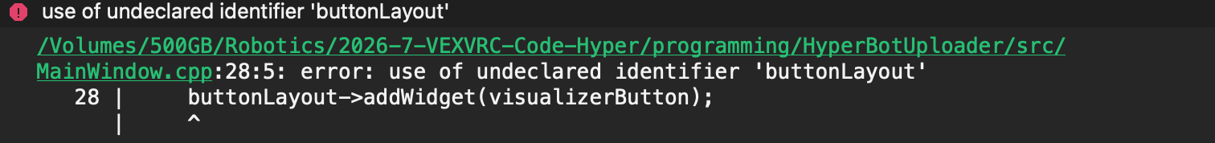
Visualizer button layout error
17 July 2026 • 20:50
1
Observed error
Proposed correction
Verification
The compiler reports buttonLayout as undeclared where visualizerButton is added to it.
Create the intended layout in the correct scope, or add the button to an existing layout using its actual variable name.
After compiling, open the window and check that the button is visible and opens the visualizer once.
TEAM HYPER 1408H
14
Notes:
Sources: 15-Screenshot-2026-07-17-at-20.50.36.png
Annotations describe visible features. Proposed checks are not recorded test results. Mechanical dates and performance figures are not inferred.

Slide 15

First visualizer output
18 July 2026 • 16:12
1 Robot marker
The red square and heading line render against a dark background. This is visible evidence of the marker drawing.
2
2 Missing field image
The field artwork is absent in this screenshot. The marker rendering and background loading need separate checks.
1
Next check
Verify the resource path and field image loading, then check marker position and heading against known coordinates.
TEAM HYPER 1408H
15
Notes:
Sources: 16-Screenshot-2026-07-18-at-16.12.21.png
Annotations describe visible features. Proposed checks are not recorded test results. Mechanical dates and performance figures are not inferred.

Slide 16
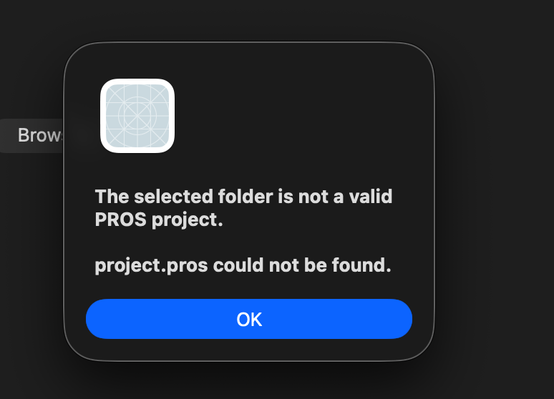
Source selection and project validation
18 July 2026 • 16:24
1 Rejected selection
The dialog says the selected folder is not a valid PROS project because project.pros could not be found.
Design requirement
1
Source selection and project discovery are separate concerns. A C++ source file still needs its build context.
Proposed behaviour
Show the selected source and resolved project root clearly. If discovery fails, explain what is missing and allow the user to correct it.
TEAM HYPER 1408H
16
Notes:
Sources: 17-Screenshot-2026-07-18-at-16.24.03.png
Annotations describe visible features. Proposed checks are not recorded test results. Mechanical dates and performance figures are not inferred.

Slide 17
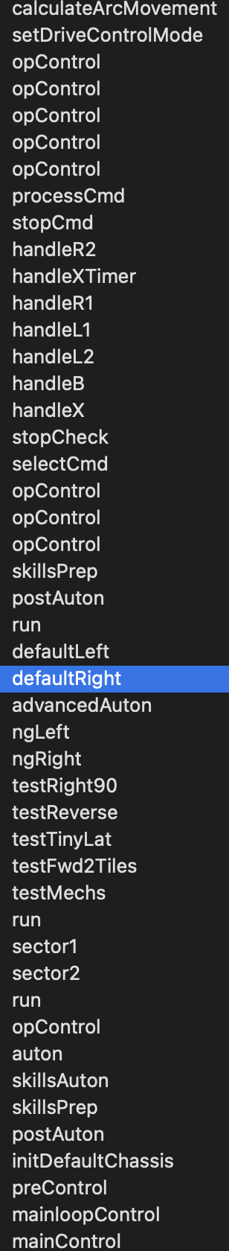
Autonomous detection is too broad
19 July 2026 • 01:14
1 Unrelated functions
The list includes opControl, controller handlers and setup functions alongside autonomous routines.
1
2 Candidate routines
defaultLeft, defaultRight and advancedAuton appear among the entries. Their presence alone does not validate the whole list.
2
Proposed refinement
Filter candidates using the project’s autonomous entry points and remove duplicates. Compare the result against a manually checked routine list.
TEAM HYPER 1408H
17
Notes:
Sources: 18-Screenshot-2026-07-19-at-01.14.13.png
Annotations describe visible features. Proposed checks are not recorded test results. Mechanical dates and performance figures are not inferred.

Slide 18
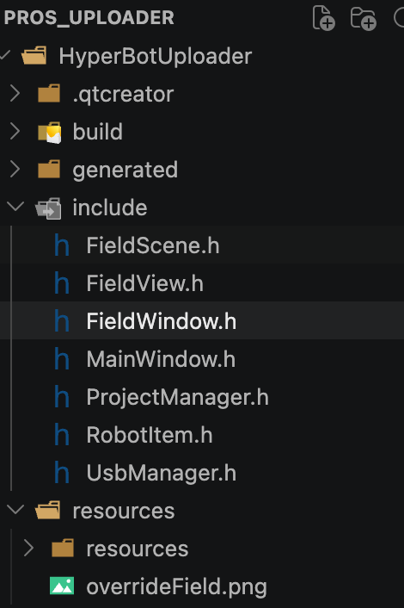
Visualizer source organisation
22 July 2026 • 16:52
1 Separate classes
FieldScene, FieldView, FieldWindow and RobotItem appear in the include directory, alongside the main window and project manager.
1
2 Field asset
overrideField.png appears under resources. File presence does not prove it has been embedded in the application.
Integration check
2
Confirm the required source files and resource declaration are included in the build. Test loading the asset through its compiled resource path.
TEAM HYPER 1408H
18
Notes:
Sources: 19-Screenshot-2026-07-22-at-16.52.24.png
Annotations describe visible features. Proposed checks are not recorded test results. Mechanical dates and performance figures are not inferred.

Slide 19
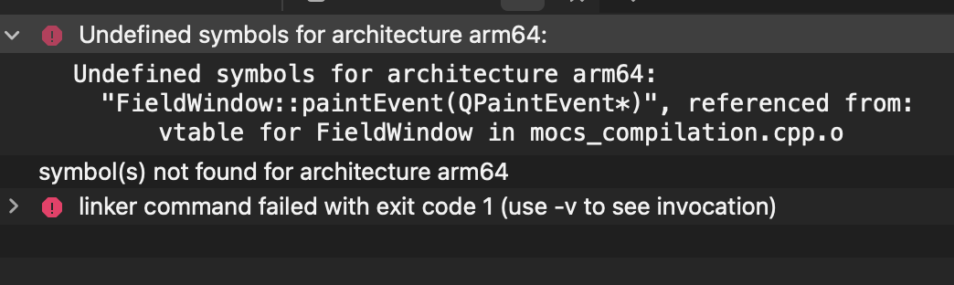
FieldWindow linker failure
27 July 2026 • 22:03
1
Observed error
Proposed correction
Verification
The arm64 linker cannot resolve FieldWindow::paintEvent(QPaintEvent*). Compilation has reached the linking stage.
Check that the definition matches the declaration and that its implementation file belongs to the executable target.
Rebuild and open FieldWindow. Confirm that the paint handler runs and displays both field and robot marker.
TEAM HYPER 1408H
19
Notes:
Sources: 20-Screenshot-2026-07-27-at-22.03.05.png
Annotations describe visible features. Proposed checks are not recorded test results. Mechanical dates and performance figures are not inferred.

Slide 20
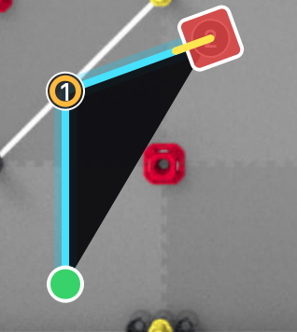
Field route and turn display
27 July 2026 • 23:54
1 Route segments
The cyan route links the green lower marker, waypoint 1 and the red robot marker. The field image is visible behind the route.
2 Robot pose
A yellow heading line extends from the robot marker. This image records the displayed pose, without confirming real robot motion.
3 Rendering check
A dark triangular area spans the bend. Check whether this fill is intentional and compare the route with the source commands.
TEAM HYPER 1408H
20
Notes:
Source: Photos/Screenshot 2026-07-27 at 23.54.02.png. Date and time follow the source filename. Annotations describe the supplied screenshot. Proposed checks are not completed test results.

Slide 21
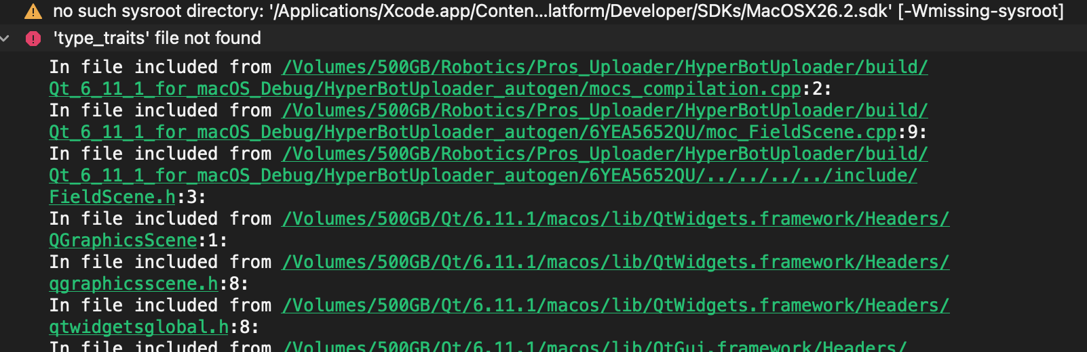
Missing SDK and standard-library header
12 August 2026 • 20:09
1 SDK path warning
The warning says the configured MacOSX26.2.sdk directory does not exist. The build points to an unavailable SDK location.
2 Compilation stops
The compiler reports “type_traits” file not found while processing Qt headers through FieldScene.h. This screenshot records a failed build.
3 Proposed correction
Select an installed SDK in the build configuration, regenerate the build and compile again. Record the result before marking the issue resolved.
TEAM HYPER 1408H
21
Notes:
Source: Photos/Screenshot 2026-08-12 at 20.09.55.png. Date and time follow the source filename. Annotations describe the supplied screenshot. Proposed checks are not completed test results.

Slide 22
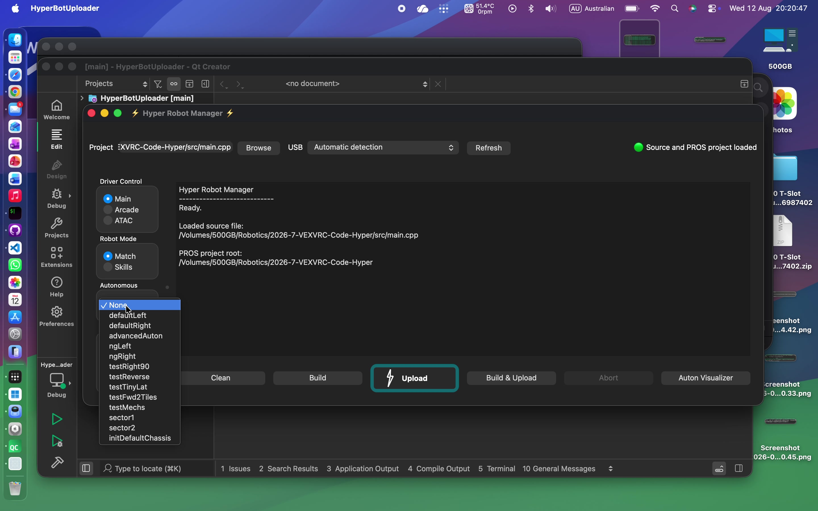
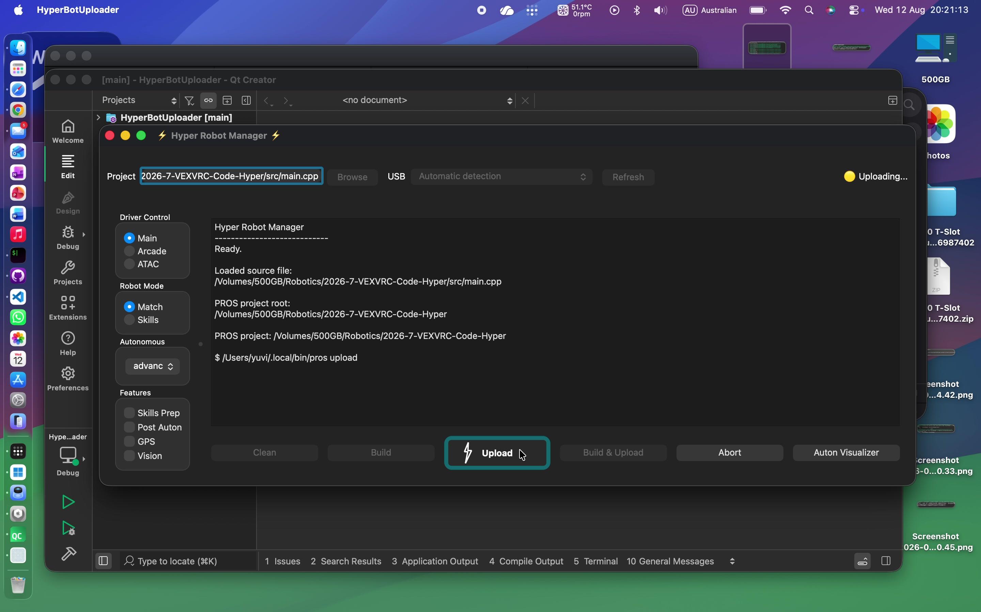
Selection and upload workflow
12 August 2026 • Screen recording
1 Routine selection
The recording shows a populated autonomous dropdown after source and project loading. Selection is visible in the interface.
1
2 Upload started
A later frame shows “Uploading…” and a PROS upload command in the terminal.
Recorded outcome
2
The upload attempt ends with a port-detection failure. The following entry records the terminal message and the next check.
TEAM HYPER 1408H
22
Notes:
Sources: 11-frame-1 (frame from supplied video); 11-frame-3 (frame from supplied video)
Annotations describe visible features. Proposed checks are not recorded test results. Mechanical dates and performance figures are not inferred.

Slide 23
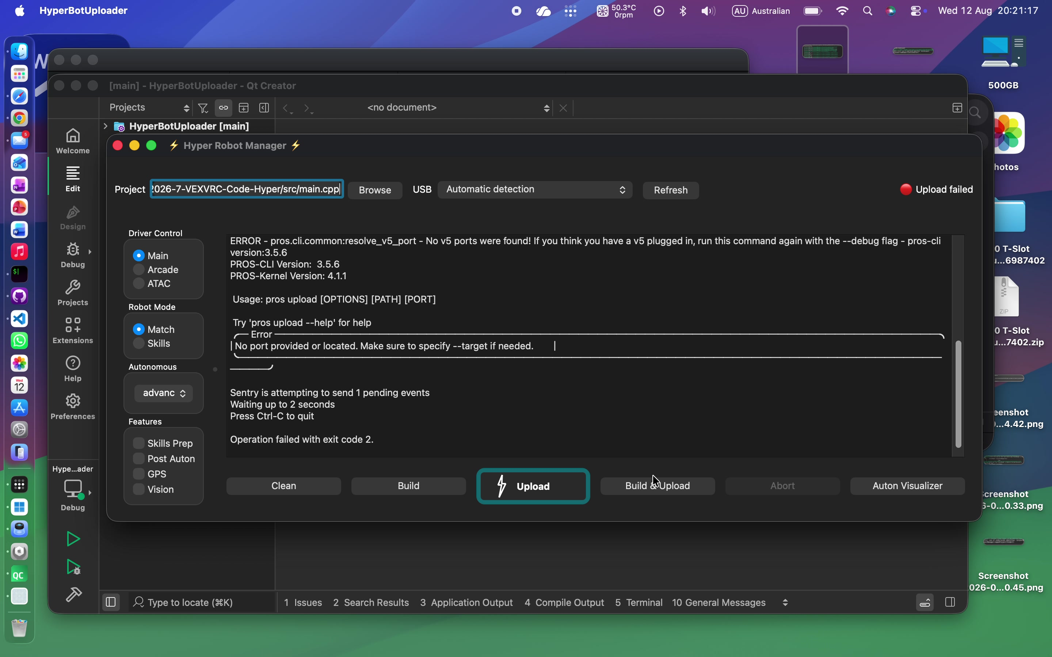
Upload failure and connection feedback
12 August 2026 • Final recording frame, 47.0 s
1 Failure status
The status indicator changes to “Upload failed”. The terminal reports that no V5 ports were found.
1
2 Process result
The operation finishes with exit code 2. This demonstrates error reporting, rather than a successful transfer to the robot.
2
Next connection test
Connect the intended V5 brain, check that a port is detected, then retry. Record the final terminal output and verify the program on the brain.
TEAM HYPER 1408H
23
Notes:
Sources: Screen Recording 2026-08-12 at 20.20.30.mov, 47.0 seconds
Annotations describe visible features. Proposed checks are not recorded test results. Mechanical dates and performance figures are not inferred.

Slide 24
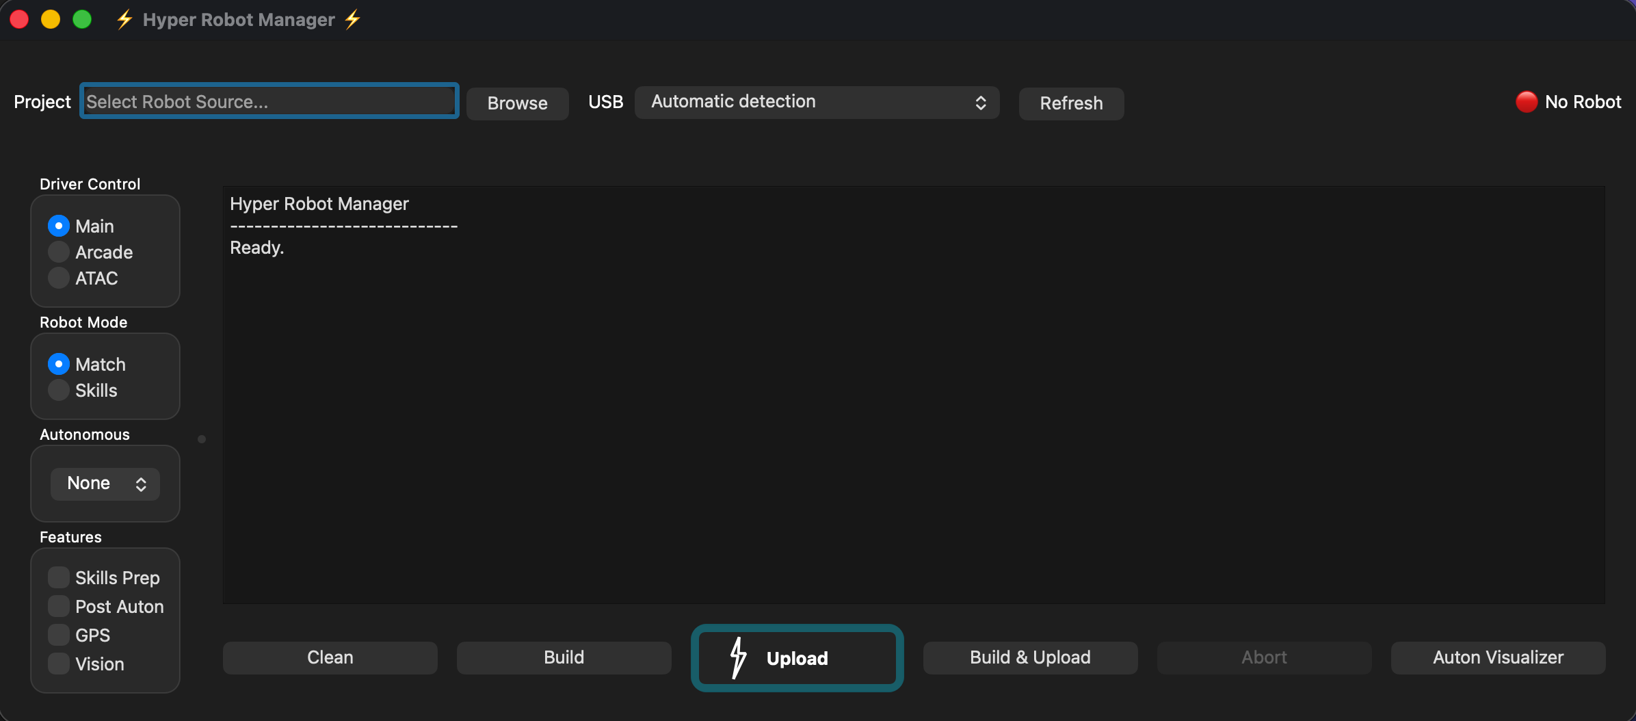
Application start-up and operator controls
5 October 2026 • 10:26
1 Source and USB selection
The start screen places source selection and USB controls together. The terminal reports “Ready” before a source is loaded.
1
3
2 Driver configuration
2
Main and Match are selected. Autonomous shows None, with feature switches and build/upload actions available.
3 Connection state
The red “No Robot” indicator makes the disconnected state visible. Check that it updates when the intended brain connects.
TEAM HYPER 1408H
24
Notes:
Source: 01-Screenshot-2026-10-05-at-10.26.26.png
Date and time come from the supplied filename. The entry analyses visible interface state or code. Suggested tests are not claims of completed testing.

Slide 25
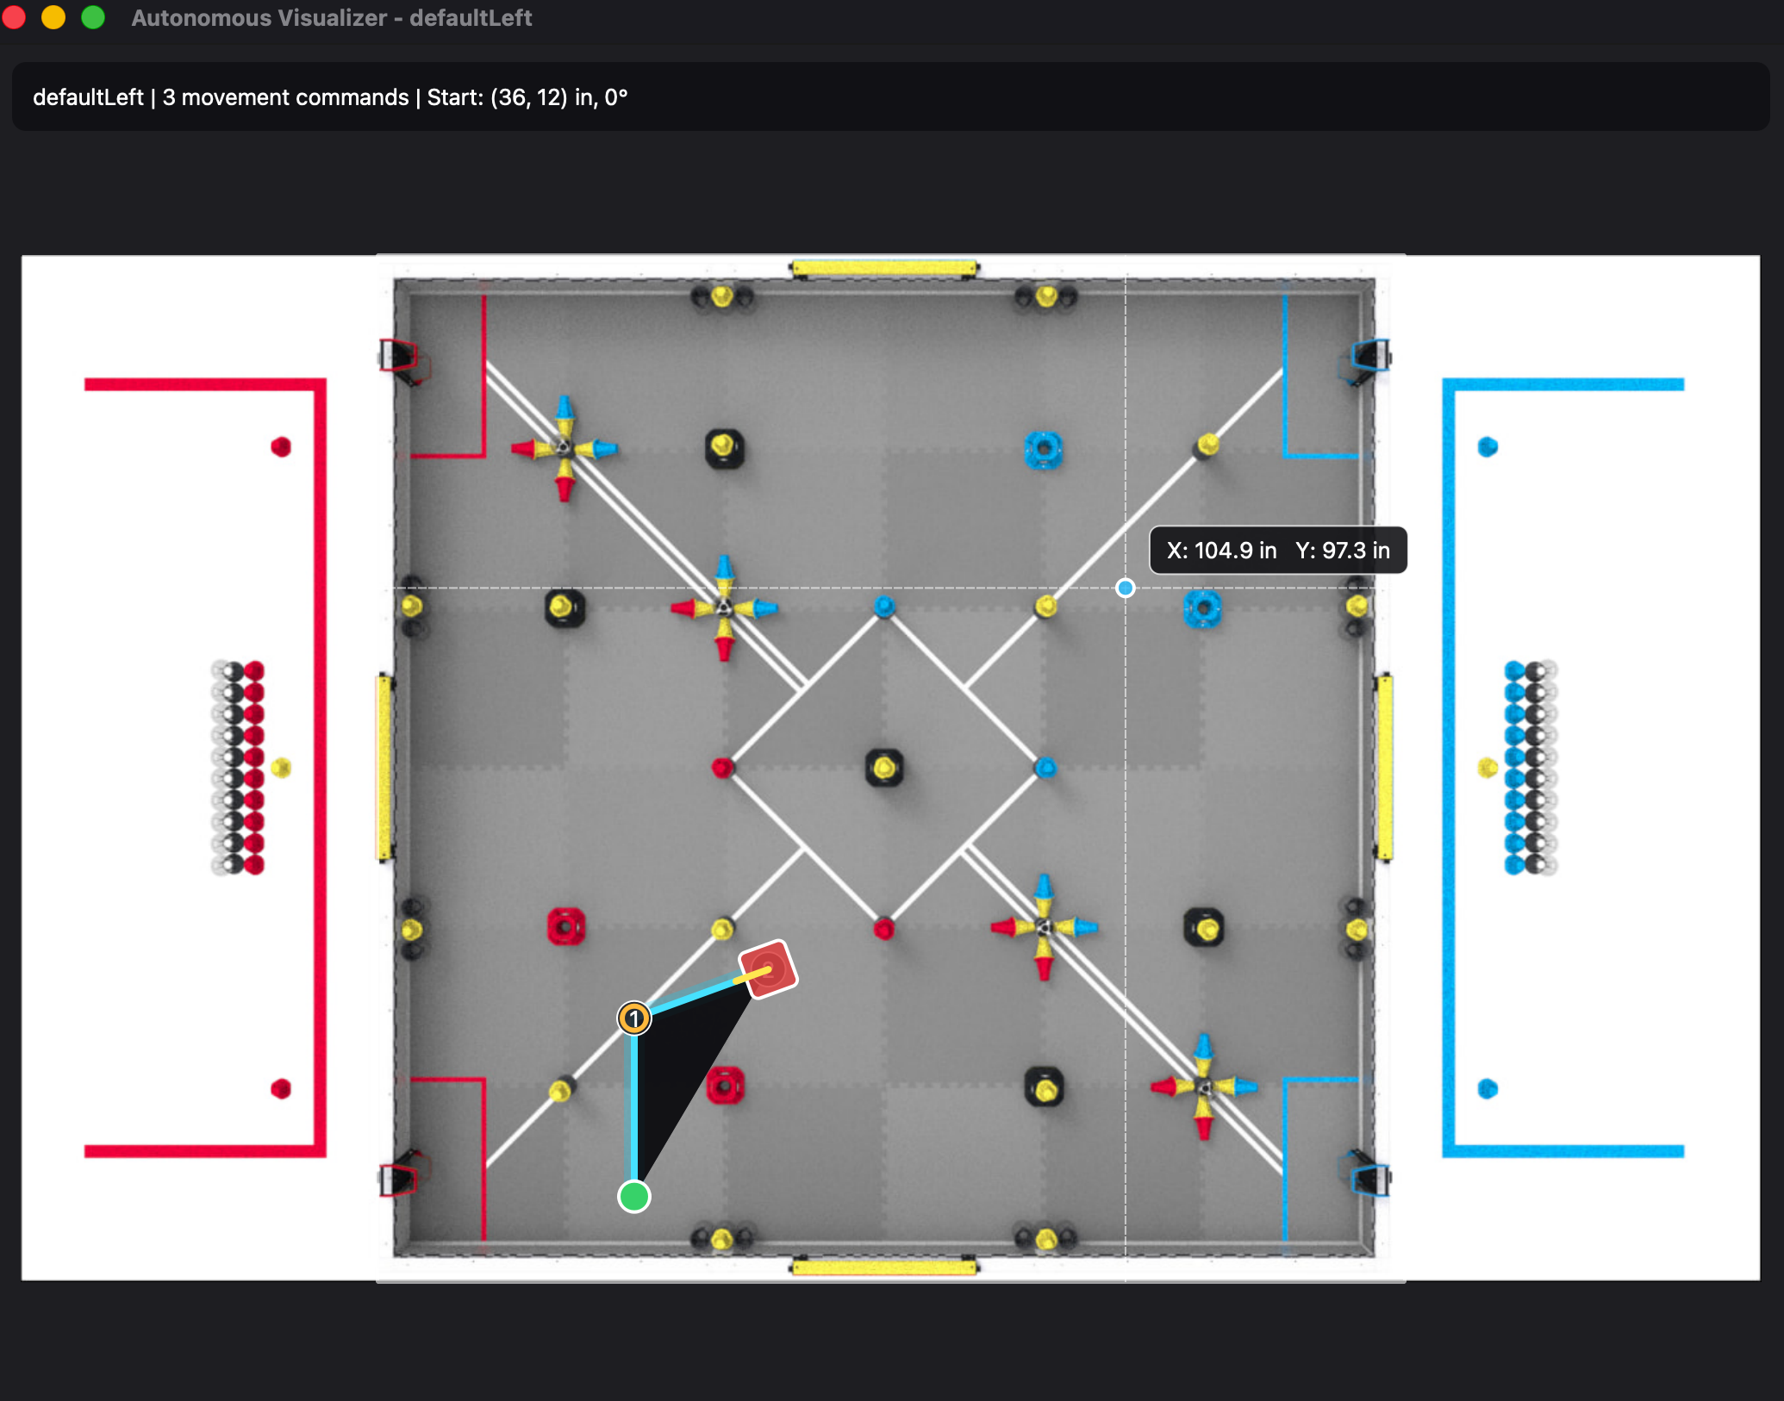
Field image and autonomous path rendering
5 October 2026 • 10:35
1 Routine information
defaultLeft reports 3 movement commands, starting at (36, 12) inches with heading 0°.
1
3
2 Visible route
The field now renders with a start marker, path and robot pose. This advances the blank-field output recorded on page 15.
3 Coordinate readout
2
The crosshair displays X: 104.9 in and Y: 97.3 in. Next, compare known field points and the route with a real robot run.
TEAM HYPER 1408H
25
Notes:
Source: 02-Screenshot-2026-10-05-at-10.35.14.png
Date and time come from the supplied filename. The entry analyses visible interface state or code. Suggested tests are not claims of completed testing.

Slide 26
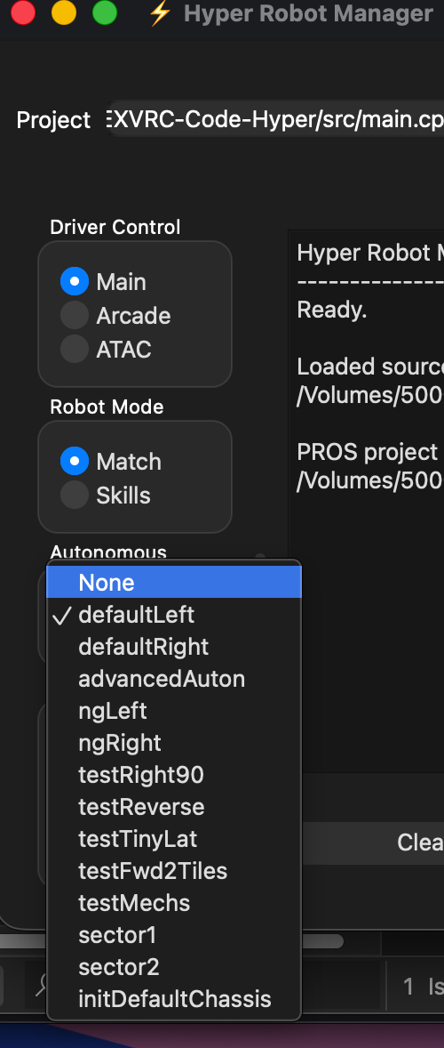
Autonomous routine selection review
5 October 2026 • 10:36
1 Selected routine
The check mark identifies defaultLeft as the active selection. defaultRight and advancedAuton are also visible.
2 Shorter candidate list
1
The menu is shorter than the July list on page 17. The visible entries include driving tests and mechanism tests.
2
3 Filtering still needs review
initDefaultChassis remains in the menu. Check whether every entry is intentionally selectable before treating detection as complete.
3
TEAM HYPER 1408H
26
Notes:
Source: 03-Screenshot-2026-10-05-at-10.36.33.png
Date and time come from the supplied filename. The entry analyses visible interface state or code. Suggested tests are not claims of completed testing.

Slide 27
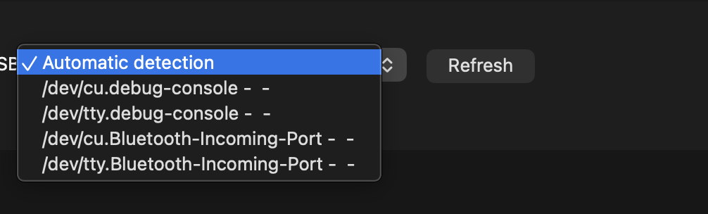
USB port discovery and manual selection
5 October 2026 • 10:36
1 Automatic mode
Automatic detection remains selected. The dropdown also allows a manual choice from the enumerated ports.
2 Ports shown
1
The visible choices are debug-console and Bluetooth ports. This screenshot does not identify a connected V5 brain.
3
2
3 Refresh control
Refresh sits beside the selector. Test the list before and after connecting the brain, then confirm the selected port uploads successfully.
TEAM HYPER 1408H
27
Notes:
Source: 04-Screenshot-2026-10-05-at-10.36.40.png
Date and time come from the supplied filename. The entry analyses visible interface state or code. Suggested tests are not claims of completed testing.

Slide 28
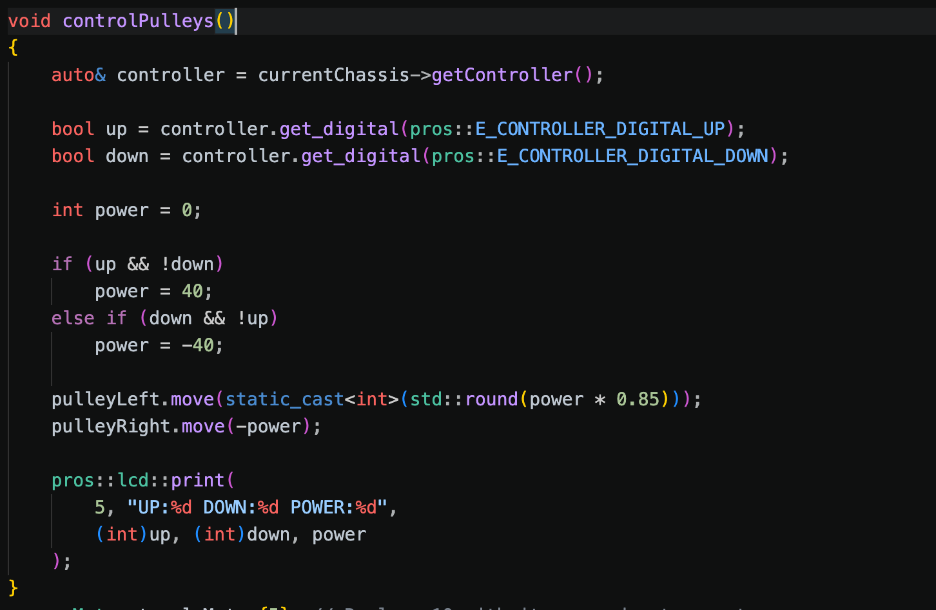
Pulley control and asymmetric motor commands
5 October 2026 • 10:38
1 Direction inputs
1
Up alone sets power to 40. Down alone sets it to −40. Both pressed, or neither pressed, leaves power at zero.
2 Left-side scaling
The left command is rounded from power × 0.85: +34 upward and −34 downward in this logic.
2
3 Opposite right command
3
The right motor receives −power. This fixed offset is not feedback control. Compare lift level and binding under a consistent load.
TEAM HYPER 1408H
28
Notes:
Source: 05-Screenshot-2026-10-05-at-10.38.59.png
Date and time come from the supplied filename. The entry analyses visible interface state or code. Suggested tests are not claims of completed testing.

Slide 29
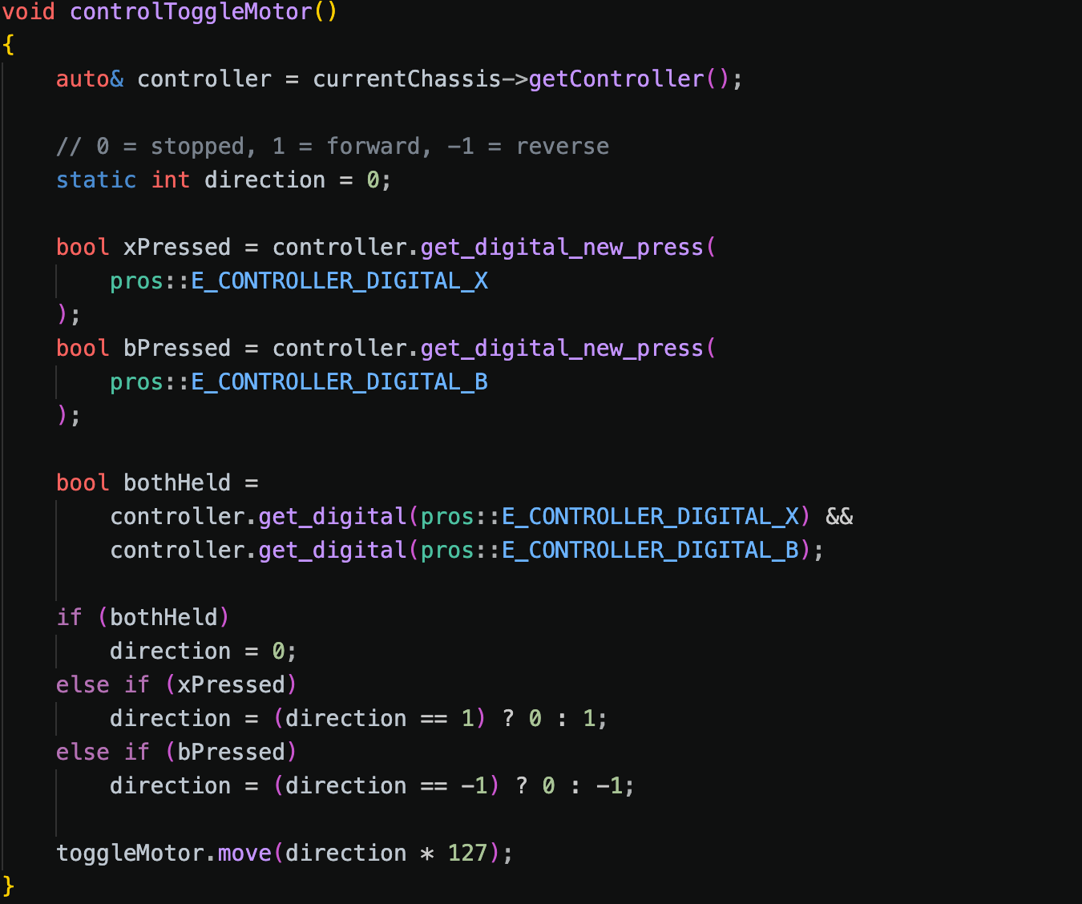
Latched forward and reverse motor control
5 October 2026 • 10:39
1 Persistent direction
The static direction value retains stopped, forward or reverse state between calls. X toggles forward; B toggles reverse.
1
2 Combined-button stop
Holding X and B together sets direction to zero before either individual toggle branch runs.
2
3 Motor output
The final command is direction × 127. Test tap, hold, reversal and both-button behaviour, including entry into driver control.
3
TEAM HYPER 1408H
29
Notes:
Source: 06-Screenshot-2026-10-05-at-10.39.04.png
Date and time come from the supplied filename. The entry analyses visible interface state or code. Suggested tests are not claims of completed testing.

Slide 30
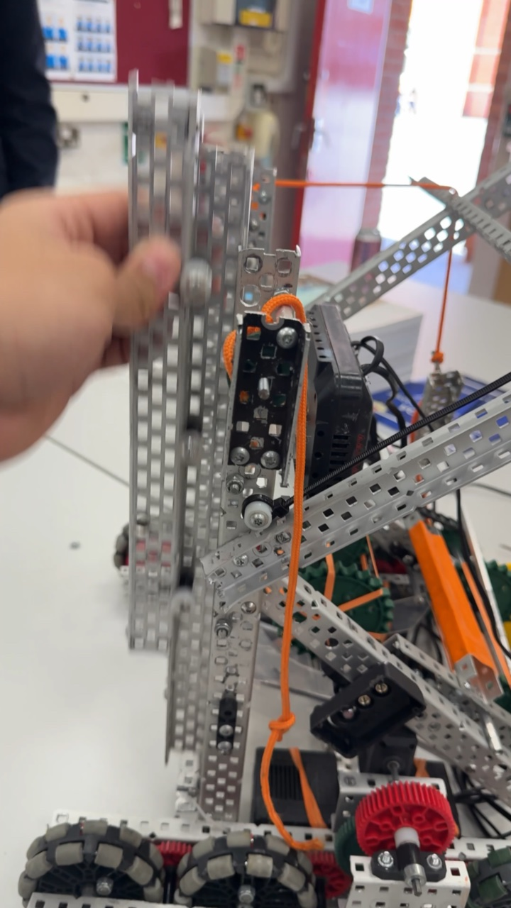
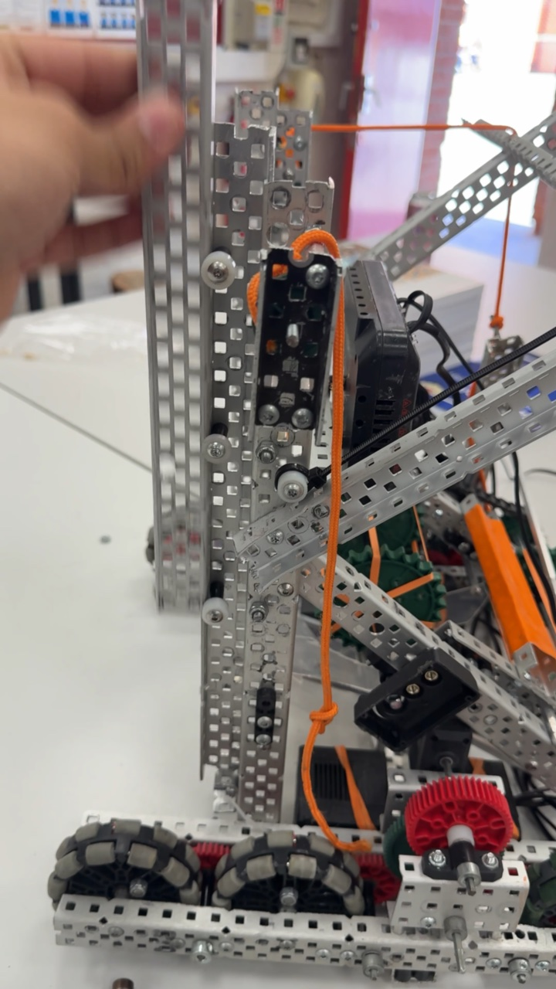
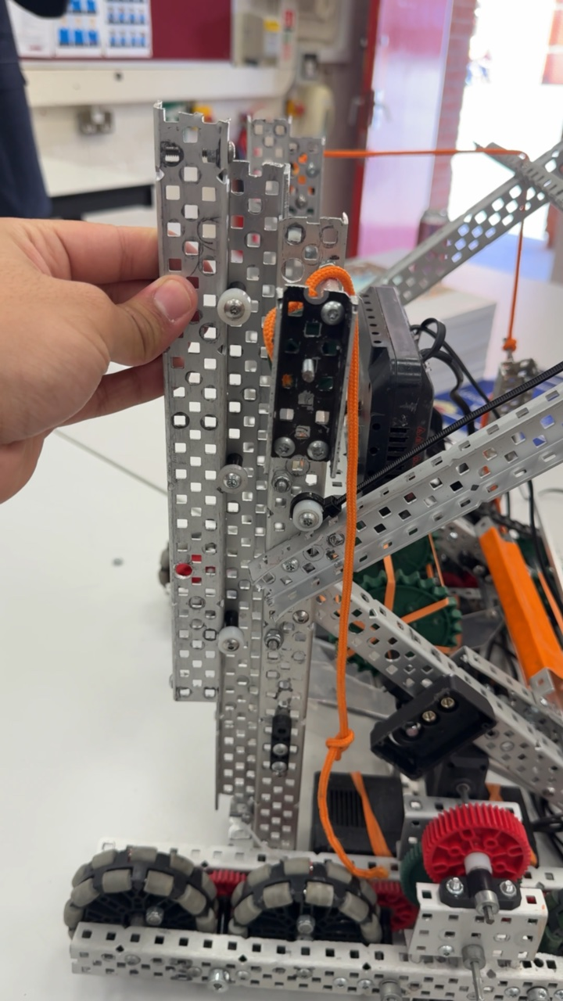
Manual movement of the lift guide
6 October 2026 • 13:17 • Video
1 Sliding channel
A hand moves the outer metal channel vertically beside the fixed upright. The sampled frames record different channel positions.
2 Guide and cord
Small rollers sit between the channels. Orange cord runs beside the upright, with a loop and knot visible near the base.
3 Next measurement
Check full travel for rubbing and side play. This manual demonstration does not establish powered lift speed or load capacity.
Early position
Raised channel
Lowered channel
TEAM HYPER 1408H
30
Notes:
Source: Photos/IMG_5216.MOV. Capture date comes from embedded media metadata. Video duration: 12.47 seconds. Representative frames sampled near 3.09, 9.28 and 12.37 seconds. These are sample positions, not measured actuation times. Annotations describe visible features. Proposed checks are not completed test results.

Slide 31
Robot assembly and component placement
6 October 2026 • 16:23 • Photograph
1 Lift frame
Tall side channels and diagonal members surround the central assembly. The V5 brain sits across the front of the frame.
2 Roller mechanism
Green wheels and orange bands form the lower roller assembly. Orange surfaces sit between the sides above the lower rollers.
3 Wiring clearance
Loose cables run across the frame and bench. Check routing through the lift travel and secure leads clear of rollers and gears.
TEAM HYPER 1408H
31
Notes:
Source: Photos/IMG_5219.jpeg. Capture date comes from embedded media metadata. Photo EXIF DateTimeOriginal: 2026:10:06 16:23:30. Annotations describe visible features. Proposed checks are not completed test results.

Slide 32
Next test record
Team Hyper • Proposed checks
Mechanical checks
Record the date, configuration and load for repeated lift and intake trials. Note stalls, object drops and any adjustment between runs.
Software checks
Check routine detection against the source code, verify field coordinates and capture the final build/upload result. Confirm behaviour on the robot.
Decision after testing
Keep a change only when the recorded comparison supports it. Add measurements, the team’s decision and the next action to the relevant notebook entry.
TEAM HYPER 1408H
32
Notes:
Sources:
Annotations describe visible features. Proposed checks are not recorded test results. Mechanical dates and performance figures are not inferred.

