Slide 1
ParkEase
1
Working Prototype Demonstration
Frontend
React-based responsive web frontend
Server
Node.js + Express REST API backend
Database
MongoDB database integration
Core flow
Authentication • Vehicles • Facilities
Booking
Search • Occupancy • Reservations
Completion
Payment integration

Slide 2
Frontend Technology Stack
2
https://parkeaselandingpageforprototypeexplai.netlify.app/
React
Component-based UI library
React Router
Client-side navigation
Local Storage
Client-side data persistence
CSS/Tailwind
Styling & responsive design

Slide 3
Backend Technology Stack — Server Layer
3
Node.js
JavaScript runtime
Express
Web framework
MongoDB
NoSQL database
JWT Auth
Secure authentication
REST API
API architecture

Slide 4
Frontend Features Implemented
5
User Registration & Login
Implemented in the prototype
Add/Manage Multiple Vehicles
Implemented in the prototype
Search Parking Facilities by Location
Implemented in the prototype
Real-time Occupancy Display
Implemented in the prototype
Make & Manage Reservations
Implemented in the prototype
Payment Integration
Implemented in the prototype
Interactive Map View
Implemented in the prototype
Booking History & Ratings
Implemented in the prototype

Slide 5
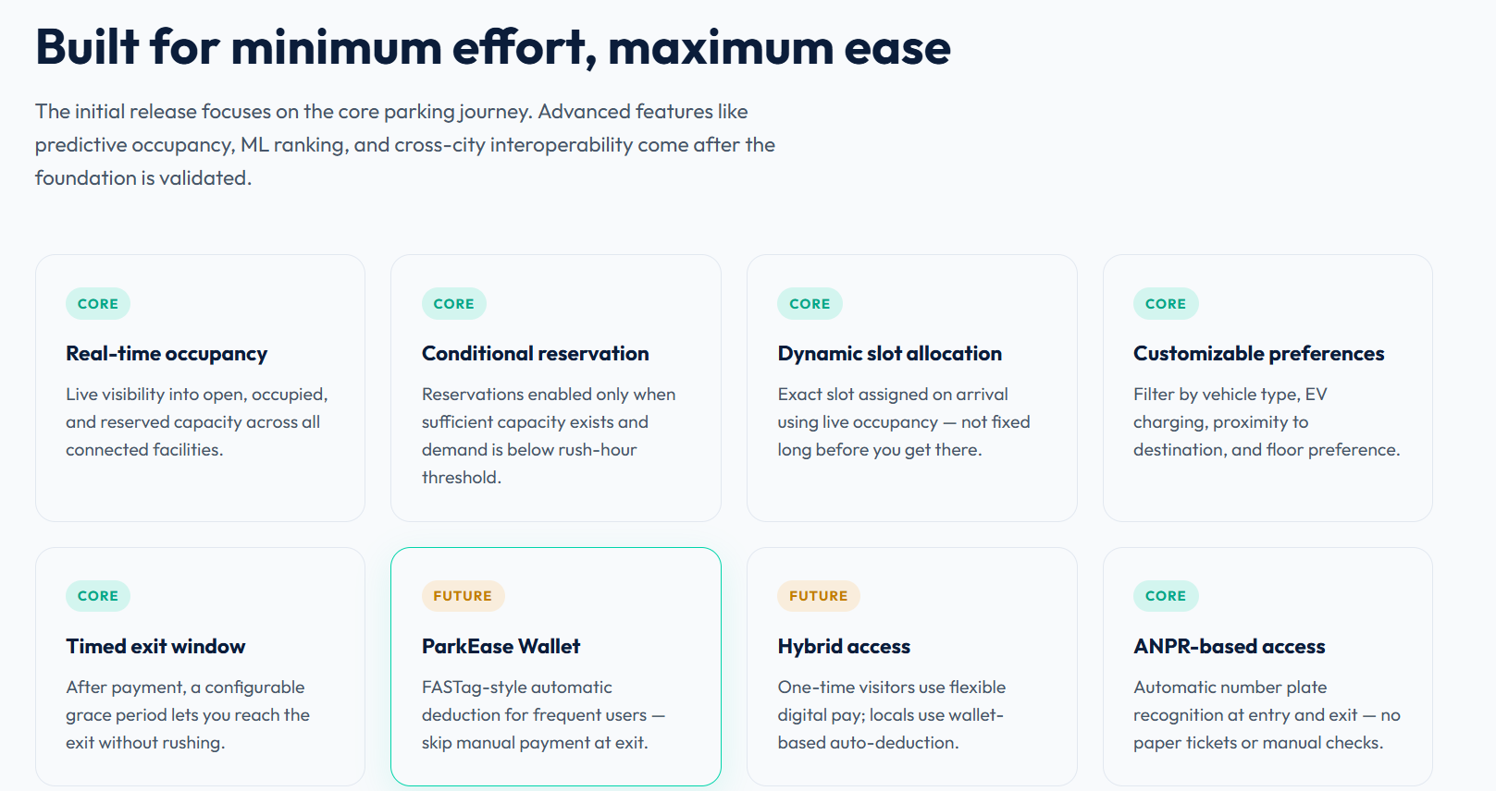
Frontend Features Implemented
5
User Registration & Login
Implemented in the prototype
Add/Manage Multiple Vehicles
Implemented in the prototype
Search Parking Facilities by Location
Implemented in the prototype
Real-time Occupancy Display
Implemented in the prototype
Make & Manage Reservations
Implemented in the prototype
Payment Integration
Implemented in the prototype
Interactive Map View
Implemented in the prototype
Booking History & Ratings
Implemented in the prototype

Slide 6
Backend API — GET & POST Calls
6
POST /auth/register
User registration
POST /auth/login
User login
GET /facilities
Get all facilities
GET /facilities/:id
Get facility details
GET /vehicles
Get user vehicles
POST /reservations
Create reservation
GET /reservations
Get user reservations
POST /payments
Process payment

Slide 7
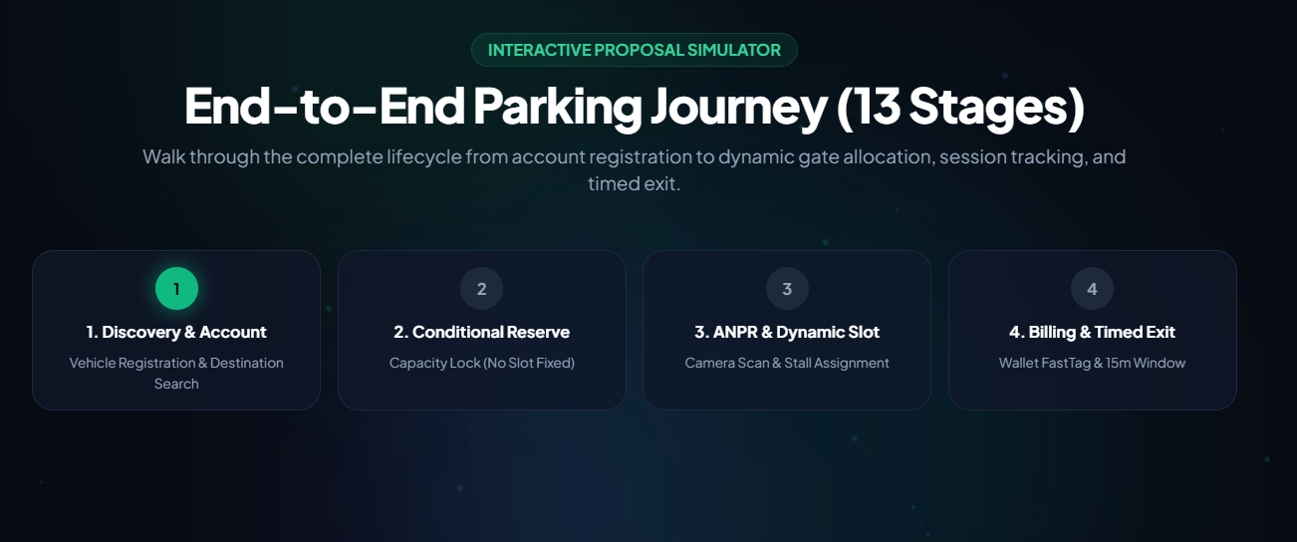
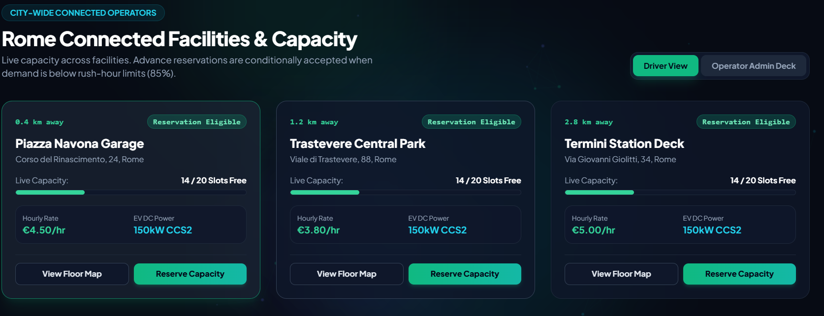
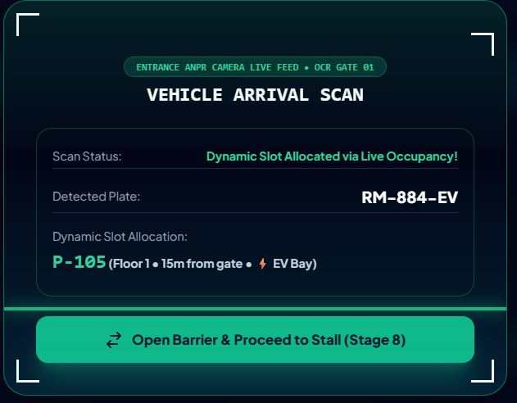
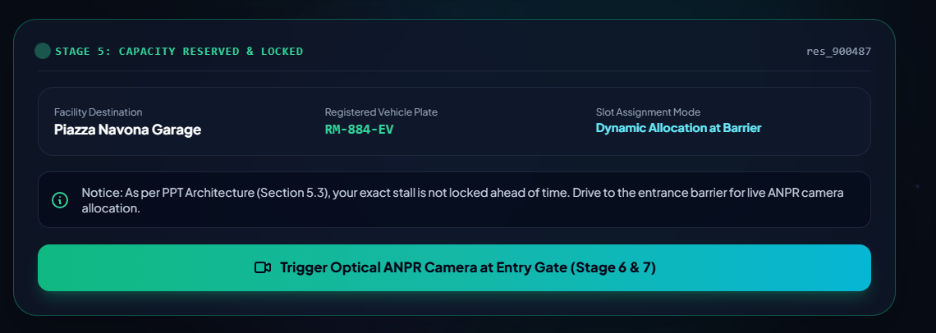

Slide 8
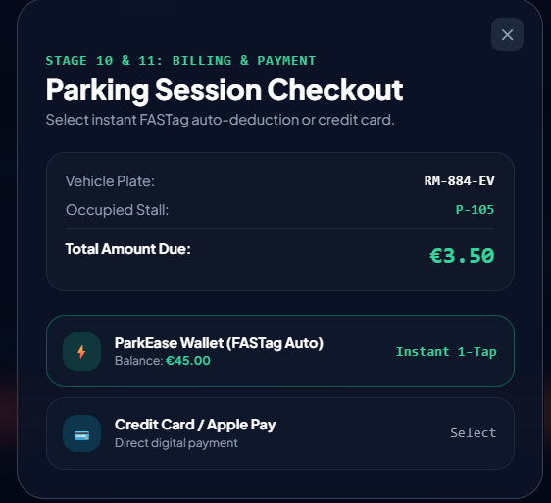
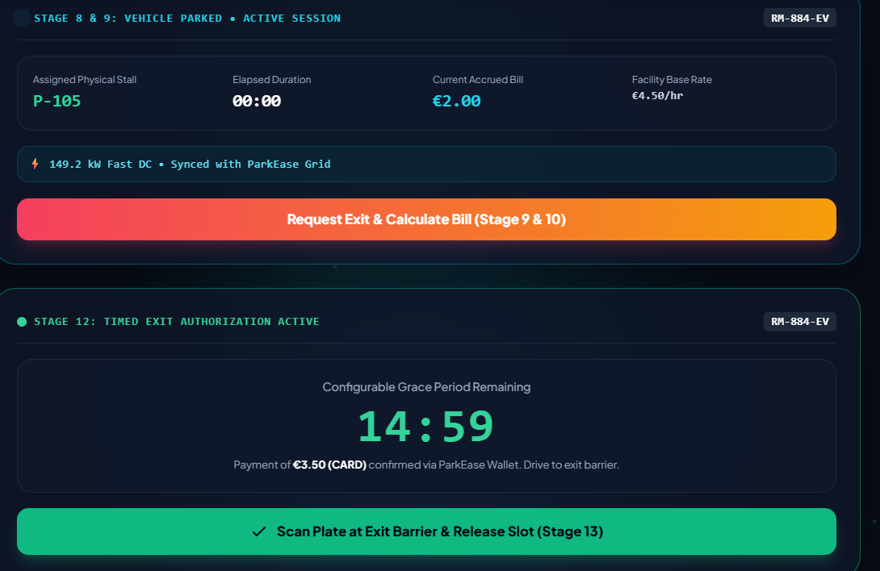

Slide 9
MongoDB Database Schema
7
Users
ID, Email, Password, Name, Phone, Created
Vehicles
ID, UserID, Plate, Type, Color, Year
Facilities
ID, Name, Location, Capacity, Rate
Slots
ID, FacilityID, FloorNo, Status, Type
Reservations
ID, UserID, SlotID, StartTime, EndTime
Payments
ID, ReservationID, Amount, Status, Date

Slide 10
User Workflow — Prototype Demo
8
01
Register / Login
02
Complete vehicle profile
03
Search parking by location or facility name
04
View real-time occupancy & available slots
05
Select floor and reserve a slot
06
Proceed to mock payment
07
Receive confirmation with QR code
08
View reservation in booking history

Slide 11
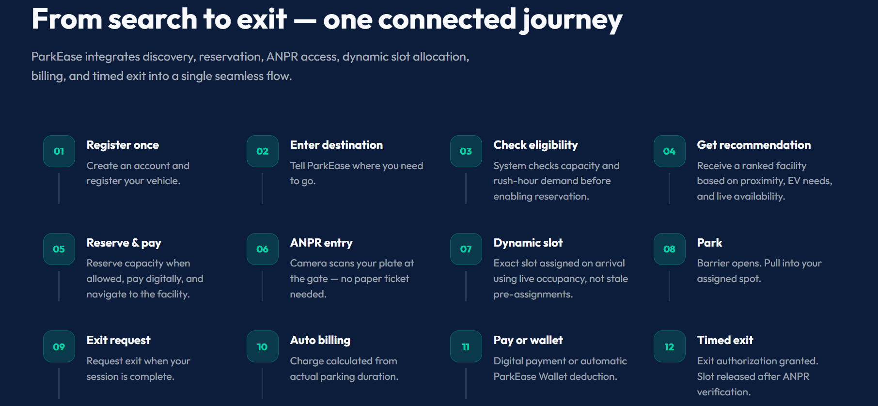
User Workflow — Prototype Demo
8
01
Register / Login
02
Complete vehicle profile
03
Search parking by location or facility name
04
View real-time occupancy & available slots
05
Select floor and reserve a slot
06
Proceed to mock payment
07
Receive confirmation with QR code
08
View reservation in booking history

Slide 12
What's Working in the Prototype
9
Complete Authentication
JWT-based secure login & registration
CRUD Operations
Create, read, update, delete for all entities
API Integration
Frontend seamlessly communicates with backend
Data Persistence
MongoDB storing and retrieving real data
Responsive Design
Works on desktop and mobile browsers
Search Functionality
Filter facilities by location & availability

Slide 13
Next Phase — Roadmap
10
Phase 2
ANPR Camera Integration • Real-time slot allocation • Mobile App (React Native)
Phase 3
Dynamic Pricing Algorithm • Wallet system for locals • Advanced Analytics Dashboard
Phase 4
Multi-city expansion • IoT sensor integration • ML-based occupancy prediction

Slide 14
Code Repository
11
GitHub Repository
Yuvrajbhardwaj11/software_engineeringProject
Folders
/client → React frontend
/server → Node.js + Express backend
VERCEL DEPLOYED LINK:-
https://parkease-bbnr-ma9oqdzsn-yuvrajbhardwajs-projects.vercel.app/

Slide 15
How to Test the Prototype
12
Step 1
Clone repository
Step 2
Install dependencies in /client and /server
Step 3
Start MongoDB locally or use cloud database
Step 4
Run backend: cd server && npm start (port 5000)
Step 5
Run frontend: cd client && npm start (localhost:3000)
Step 6
Register a new account and start booking parking

