Slide 1
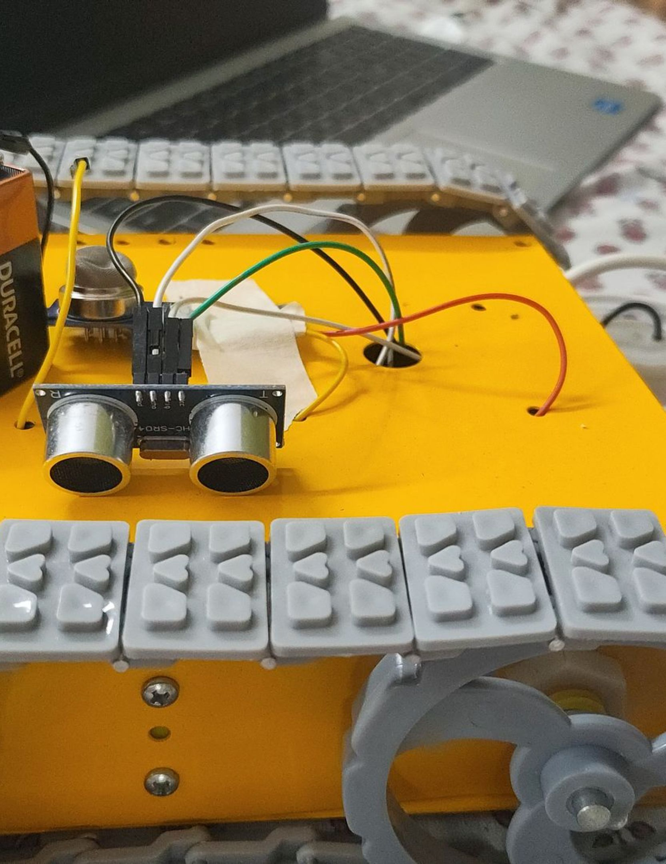

ARDUINO-BASED AUTOMATION & MULTI-SENSOR MONITORING
SMART SEWAGE INSPECTION AND CLEANING ROBOT
SENSE. MOVE. CLEAN.
An autonomous compact crawler engineered for hazardous pipe inspection, obstacle detection, and active rotary surface scrubbing.

Slide 2




OPERATIONAL SEQUENCE
MAKING CLEANING SMARTER
An integrated prototype exploring automated, water-assisted sewage inspection and cleaning.
01
02
03
04
MOVEMENT
DISTANCE SENSING
WATER DELIVERY
ROTATING MOP
Tracked chassis navigates uneven pipe terrain.
Front-mounted head scrubs internal pipe walls.
Ultrasonic pings detect forward obstacles continuously.
Submersible pump directs pressurized flow to deposits.

Slide 3
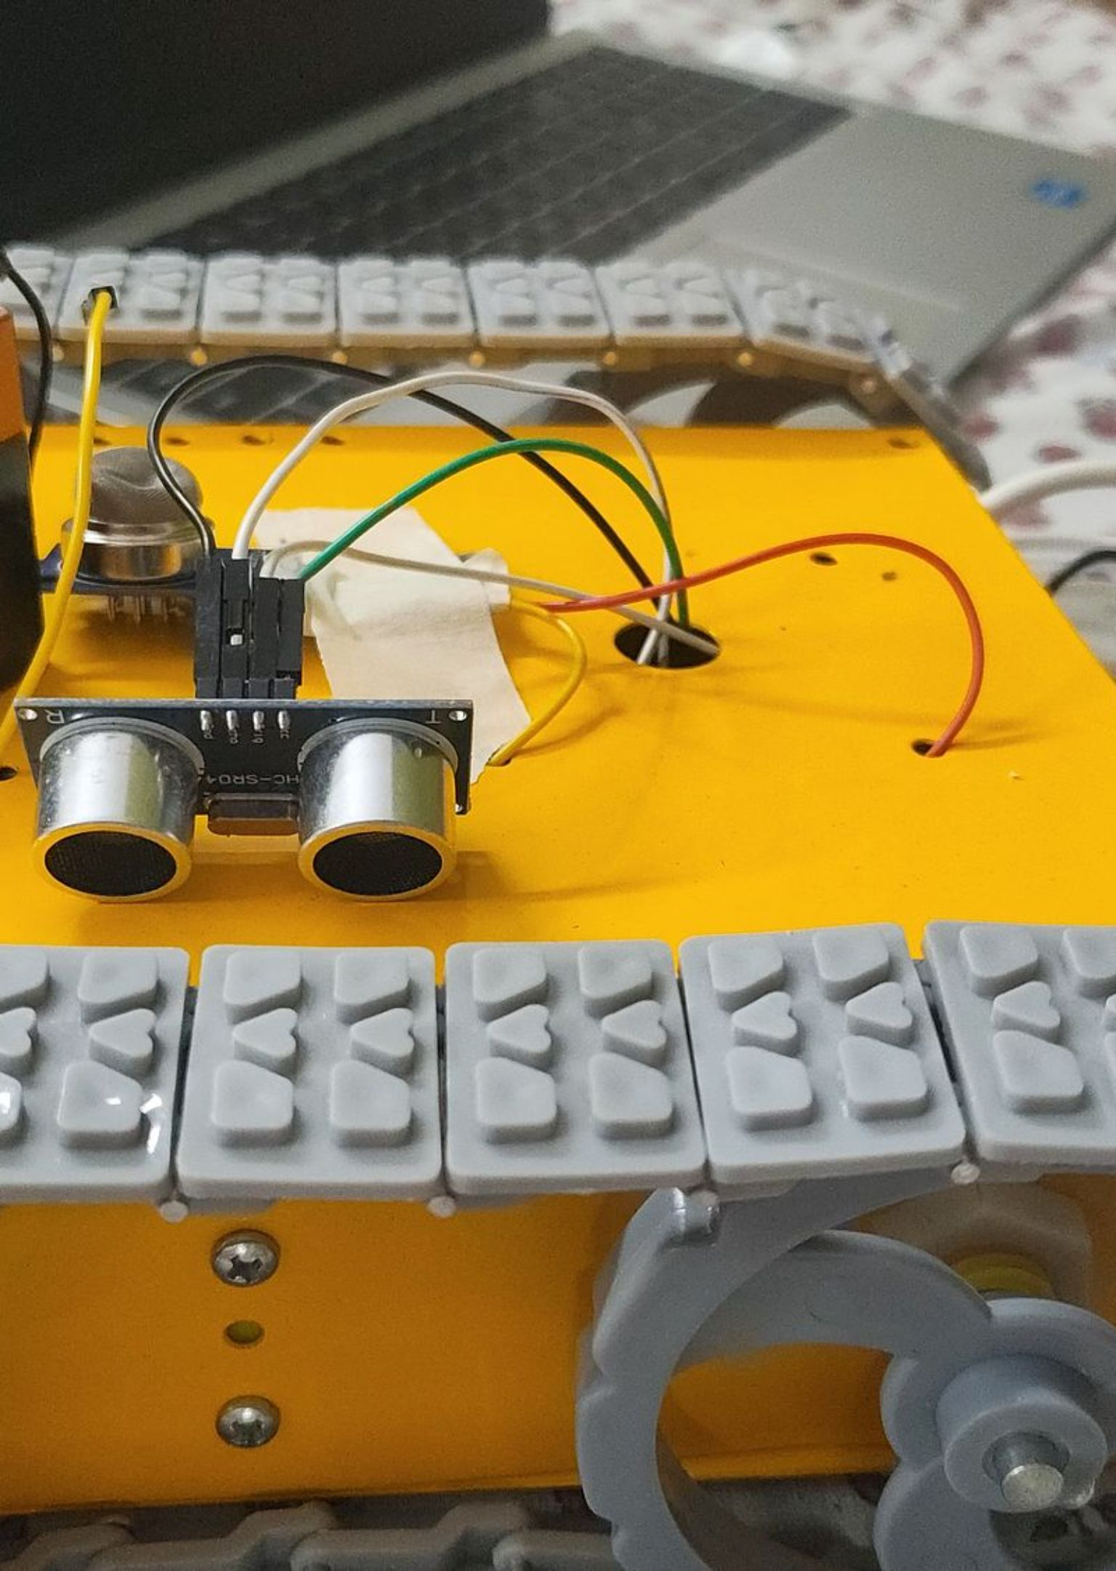
HARDWARE ARCHITECTURE
SIX KEY COMPONENTS
Arduino Uno
L298N Motor Driver
Central microcontroller running logic loops and threshold arbitration.
High-current dual H-bridge driving tracked gear motors.
HC-SR04 Ultrasonic
YF-S201 Flow Sensor
Front sonar measuring target proximity and blockage distance.
Hall-effect rotor detecting line pressure and water-flow pulses.
MQ-135 Gas Sensor
Relay & Water Pump
Air-quality sensing element providing raw analog conduit readings.
Switched high-load relay actuating 12V water delivery on demand.

Slide 4
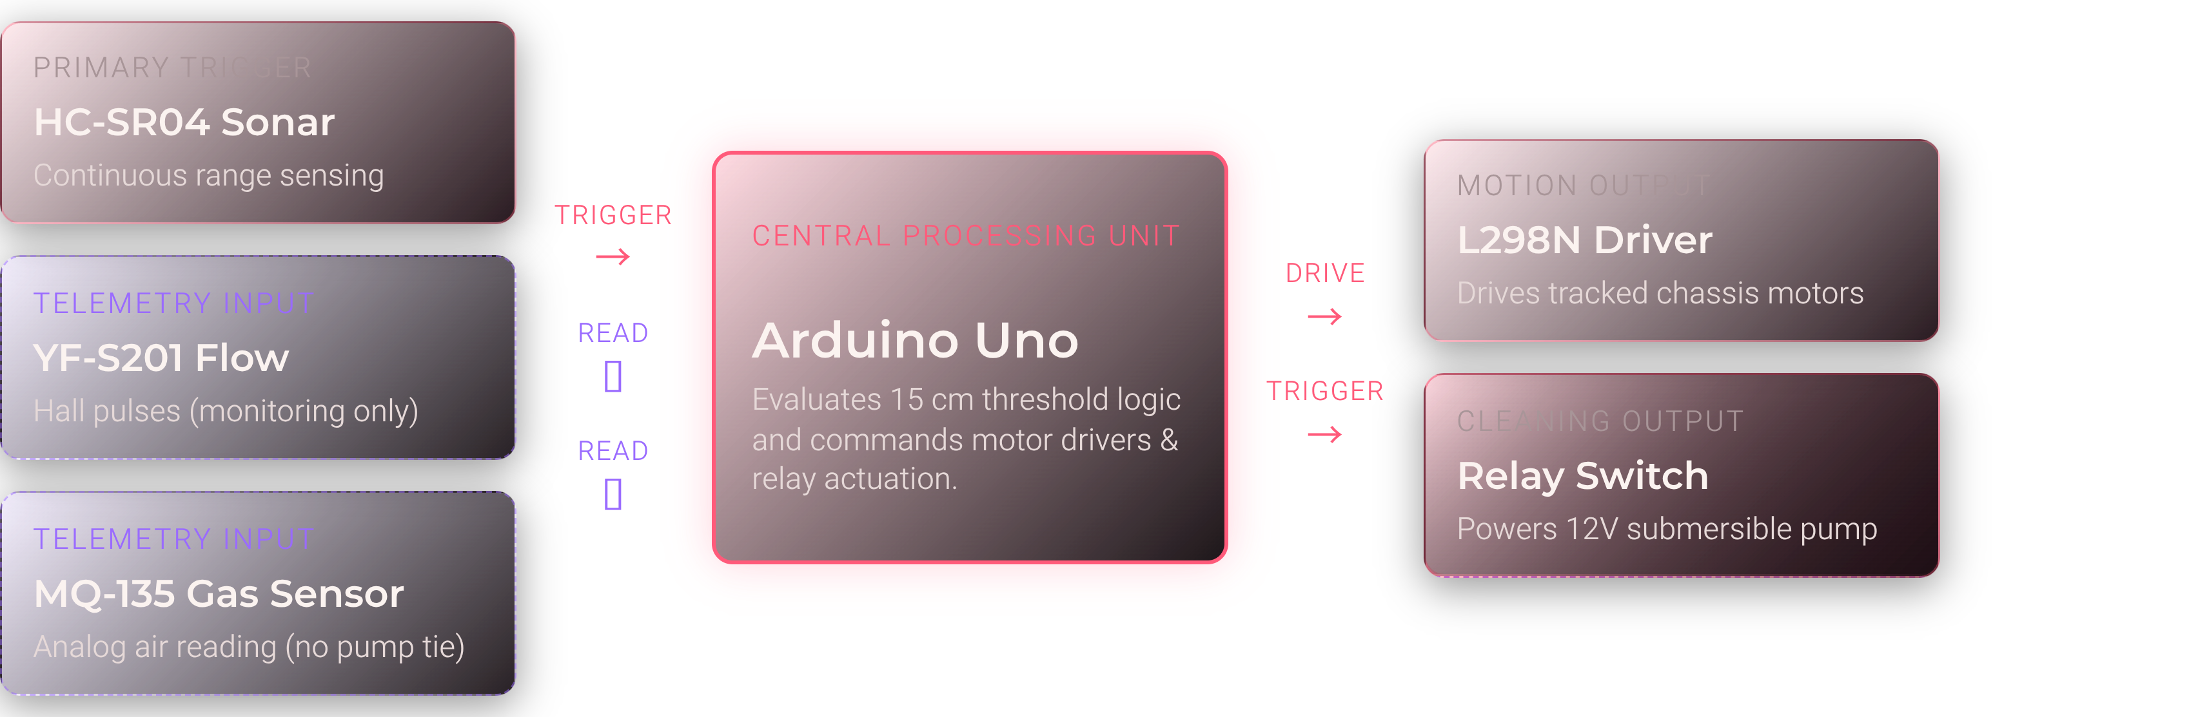
SYSTEM ARCHITECTURE
HOW THE SYSTEM THINKS
Distinct control channels separate autonomous obstacle triggers from passive environmental telemetry.

Slide 5


DECISION BOUNDARY
THE 15 CM THRESHOLD
Ultrasonic distance dictates system actuation. Any ambiguous reading immediately triggers an automated safety stop.
TARGET IN RANGE
TARGET CLEARED / OUT OF RANGE
≤ 15 cm
> 15 cm
STATE A: ACTIVE CLEANING
STATE B: SAFE STANDBY
Forward Movement: Commanded
Water Pump: Switched ON
Mop Head: Active rotary scrub
Chassis Motors: Commanded STOP
Water Pump: Switched OFF
Fail-Safe: Invalid distance readings default directly to OFF

Slide 6
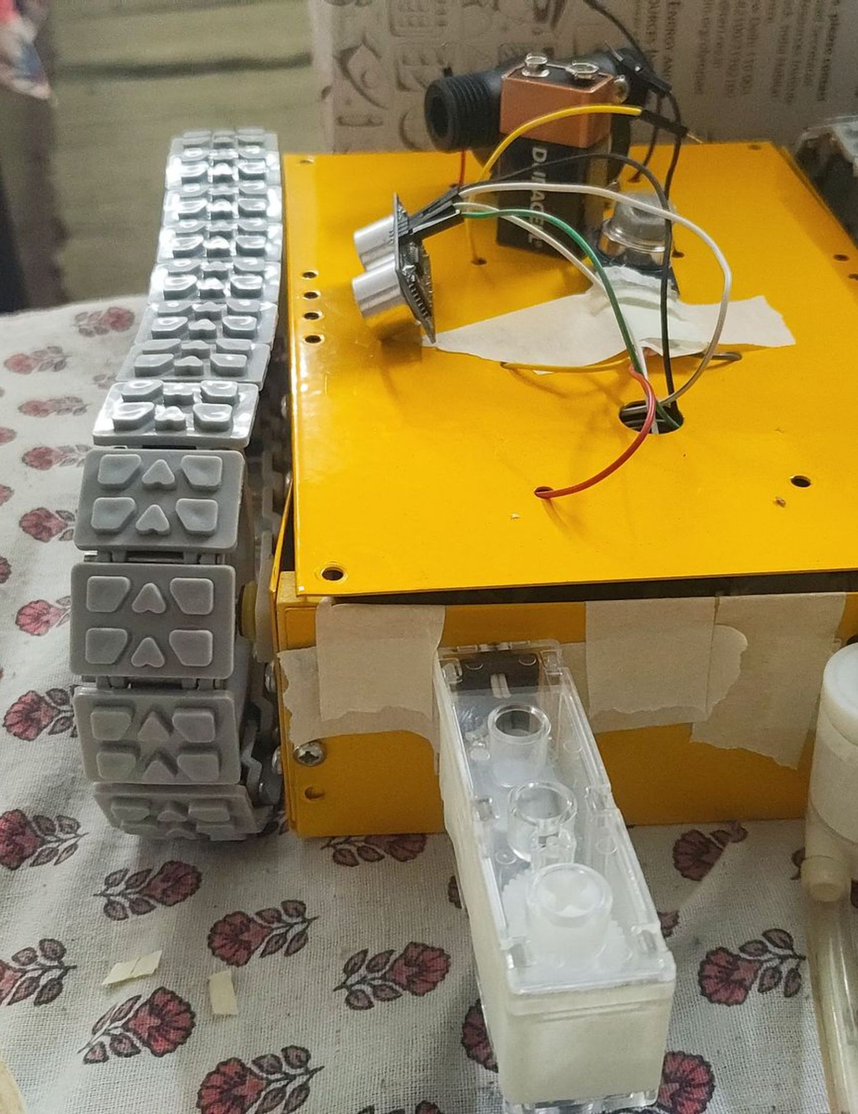

SCRUBBING MECHANISM
WATER + ROTATING MOP
The pump supplies water while the rotating front mop helps wipe and clean.
Pump
Water tubing
Water delivery →
Front rotating mop
Mop rotation ↻

Slide 7
DIAGNOSTICS & TELEMETRY
REAL-TIME OBSERVATION
SERIAL MONITOR
Distance (cm)
Flow rate (L/min)
MQ-135 raw reading
Mode / relay status
COMMAND FLAGS
F = Forward
B = Backward
S = Stop
A = Automatic mode
Illustrative interface

Slide 8
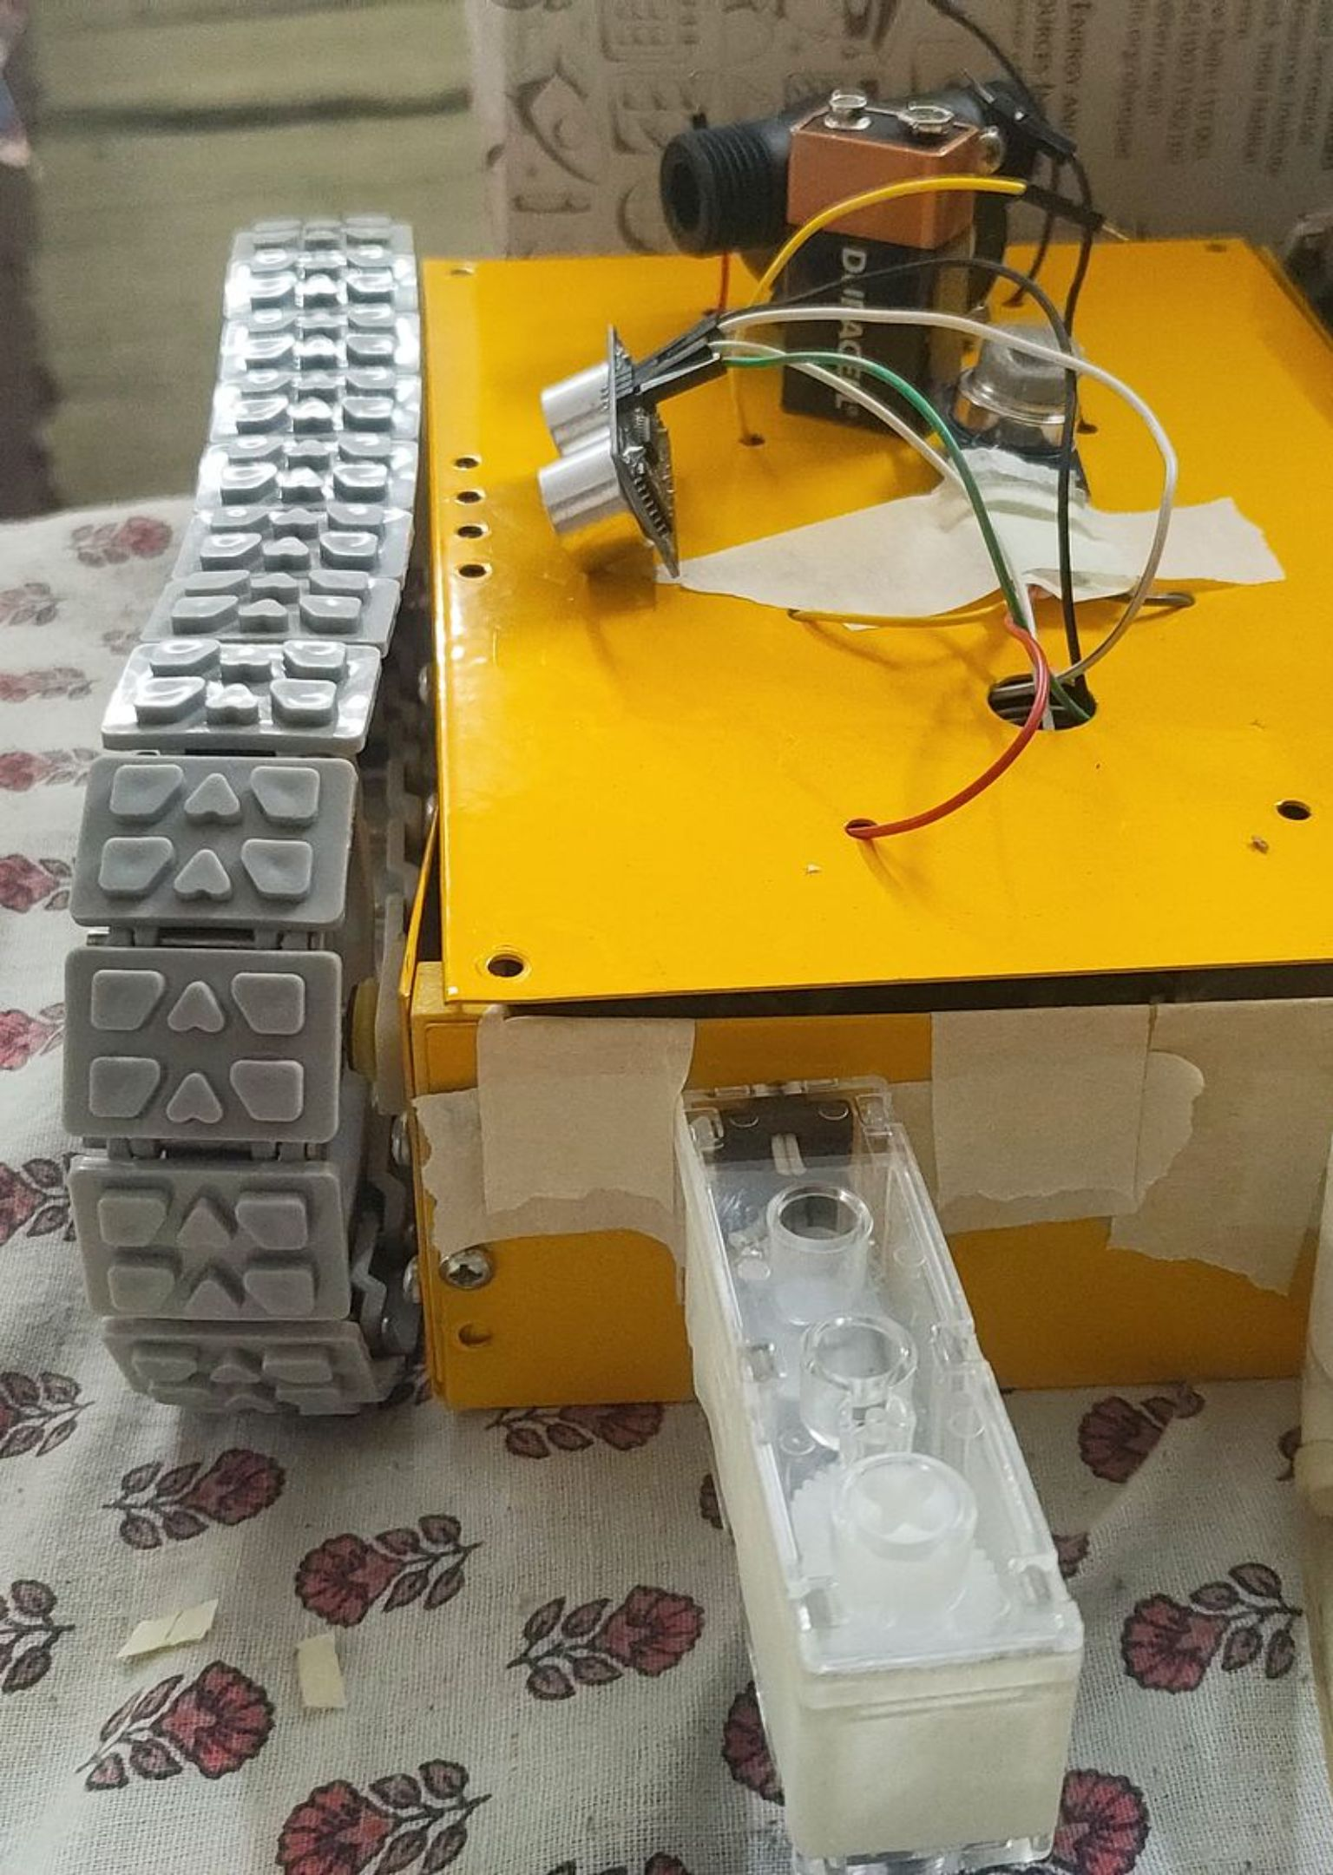
PROJECT CONCLUSION
FROM IDEA TO WORKING PROTOTYPE
SENSE. MOVE. CLEAN.
Combining electronics, programming, and mechanical design to explore smarter sewage inspection and cleaning through automation.

