Slide 1
How do Industrials and Energy Sectors fluctuate in terms of Total Revenue ?

Slide 2
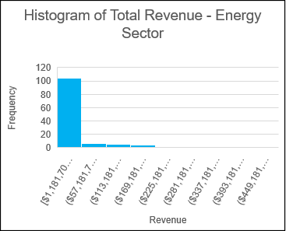
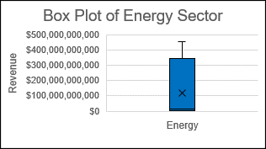
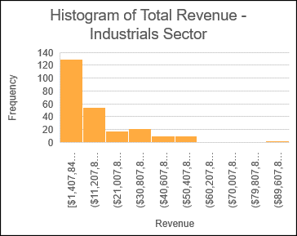
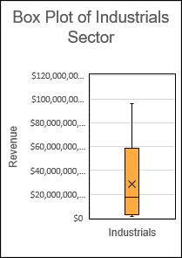
Descriptive Statistics for Industrials and Energy Sectors
Descriptive statistics | Industrials | Energy
Mean | $16,547,665,399 | $38,984,796,516
Median | $9,969,168,500 | $11,777,257,500
MAX | $96,114,000,000 | $451,509,000,000
MIN | $1,407,848,000 | $1,181,704,000
Range | $94,706,152,000 | $450,327,296,000
Standard Deviation | 17,597,038,778 | 79,864,818,250
Q1 | $4,245,912,250 | $3,375,153,500
Q3 | $21,925,500,000 | $21,239,500,000
IQR | $17,679,587,750 | $17,864,346,500
Project NYSE.xlsx

Slide 3
Findings
According to the statistics, the range of revenues in the Energy sector is higher than the Industrials which $450,327,296,000 vs. $94,706,152,000. This means, there are huge revenue difference among companies in the Energy sector than those in the industrials. The standard deviation for Energy is also higher than the Industrials(79,864,818,250 for Energy & 17,597,038,778 for Industrials). Since the standard deviation is also a measurement of spread, we can observed that the variability in Total Revenues in each years for Energy industry is higher than Industrials.
The Histograms for the annual total revenues for both sector’s are right skewed(positive skewed), which is the mean is higher than the median. The most of the companies are under the first column of the Histogram.
When considering the central tendency of figures, the Energy sector has higher mean of $38,984,796,516, as Industrials has $16,547,665,399. Similarly, $11,777,257,500 of higher median has the Energy sector when compare to the Industrials as of $9,969,168,500. Which is 50% of the total revenue amounts reported are higher than $11,777,257,500 in Energy sector, likewise, 50% of the total revenue amounts reported are higher than $9,969,168,500 in Industrials sector. There are few extreme points(outliners) can be seen in the both Histograms, that would be impacted the mean of the data.
The two box plots are also displayed the spread of data, and show that 75% & 25% of the total revenue amounts are higher than $21,239,500,000 and $3,375,153,500 in Energy Sector. Furthermore, 75% & 25% of the reported total revenue amounts are higher than $21,925,500,000 and $4,245,912,250 in Industrial Sector.

