Slide 1
SOP
Download Octave
https://www.gnu.org/software/octave/download.html
Install the software
Remember the installation directory
Ex: C:\Octave\
Unzip SFR.7Z
Modify the following line in SFR-Windows.bat
set OCTAVE_CLI="C:\Octave\Octave-5.1.0.0\mingw64\bin\octave-cli.exe“
Run the batch file in command Line
SFR-Windows.bat .\\200-1.jpg 630 510 70 25

Slide 2
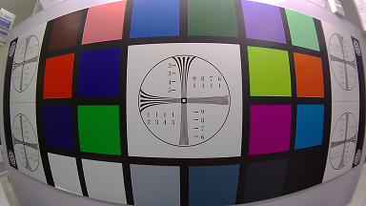
Arguments to SFR-Windows.bat
Use double backslashes for the directories in the path of the picture, for example, D:\\test\\200-1.jpg
Four numbers are required to specify the ROI’s coordinate, width, and height.
510
630
25
70

