Slide 1
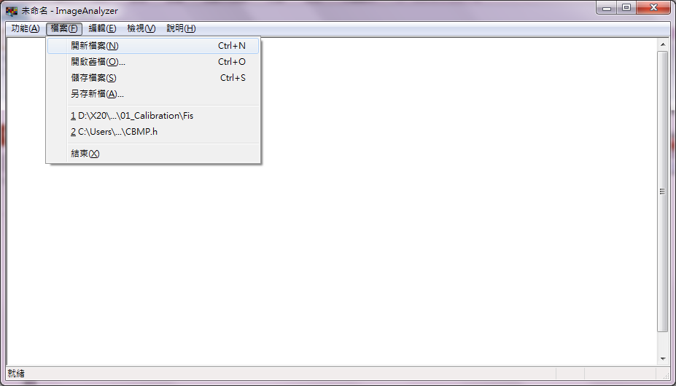
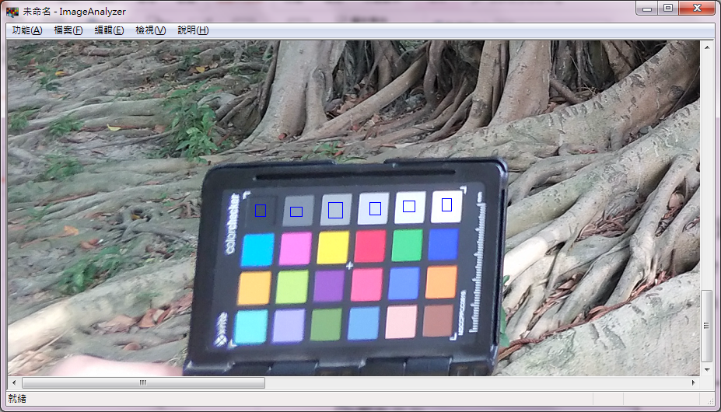
Usage
File (檔案) -> Open Existing File (開啟舊檔)
Use mouse to select the regions to be measured (at most 6 regions)
Press ‘S’ when all the interested regions are selected
The result is saved in measure_result_1.2.csv

