Slide 1



INTRODUCTION
TO AGILE METHODOLOGY
Software Development Approach
01

Slide 2

GROUP MEMBERS
Hesara Liyanage - D/ICT /25 /0130
Yuwani Anuththara - D/ICT /25 /0121
Umesha Jayalath - D/ICT /25 /0129
Sanduni Nayanathara - D/ICT /25 /0122
Yasath Amasara - D/ICT /25 /0073
Bimsara Amarathunga - D/ICT /25 /0047
Sanduni Lakshani - D/ICT /25 /0002
02

Slide 3
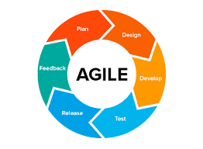
WHAT IS AGILE?
Agile is a flexible software development approach.
Focuses on :
Flexibility
Collaboration
Customer feedback
Work is done in small, iterative cycles (sprints).
Continuous delivery of working software.
03
Hesara Liyanage - D/ICT /25 /0130

Slide 4
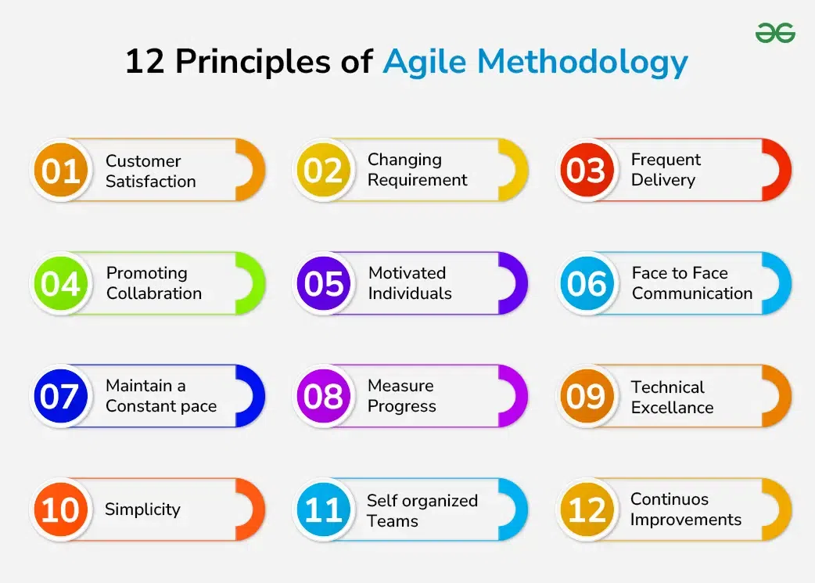
AGILE MANIFESTO & PRINCIPLES
Individuals & interactions over processes & tools
Working software over comprehensive documentation
Customer collaboration over contract negotiation
Responding to change over following a plan
04
Yuwani Anuththara - D/ICT /25 /0121

Slide 5
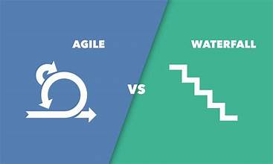
Agile VS Waterfall
Agile
Waterfall
Flexible approach
Fixed step-by-step process
Work in small sprints
Linear development
Changes allowed anytime
Changes are difficult
Continuous feedback
Testing at the end
05
Umesha Jayalath - D/ICT /25 /0129

Slide 6
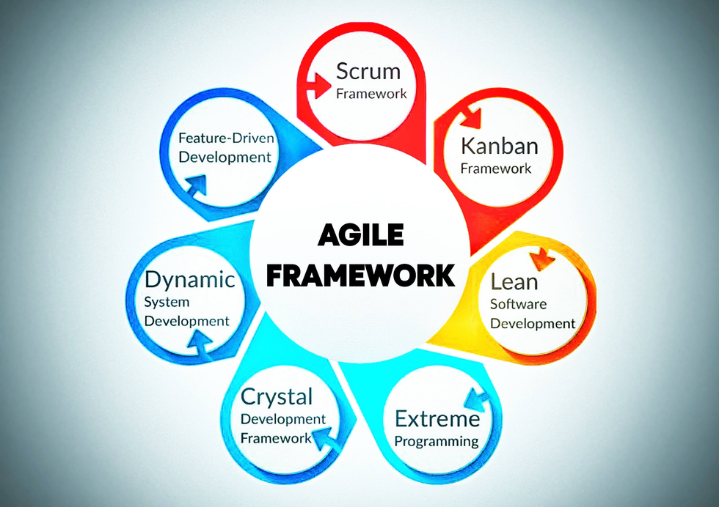
Agile Frameworks
Agile frameworks are ways to manage and complete work step by step, with flexibility and teamwork.
popular frameworks:
Scrum
Kanban
Extreme Programming (XP)
Lean
Crystal
Dynamic
06
Sanduni Nayanathara - D/ICT /25 /0122

Slide 7

&
Advantages
Disadvantages
Advantages
Faster delivery
Better customer satisfaction
Flexibility
Disadvantages
Requires experienced team
Hard to predict cost/time
Less documentation
07
Yasath Amasara - D/ICT /25 /0073

Slide 8

Real World Example
Spotify
• Spotify uses Agile to develop its app.
• Teams work in small groups (Squads)
• They release new updates quickly.
• They improve the app using user feedback.
Result: Faster development and better user experience
08
Bimsara Amarathunga - D/ICT /25 /0047

Slide 9
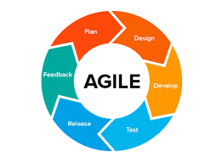
Conclusion
Agile is a modern software development method.
• It focuses on flexibility and teamwork.
• It helps teams deliver software faster.
• Many companies like Google and Microsoft use Agile.
09
Sanduni Lakshani - D/ICT /25 /0002

Slide 10

THANK YOU
10

