Slide 1
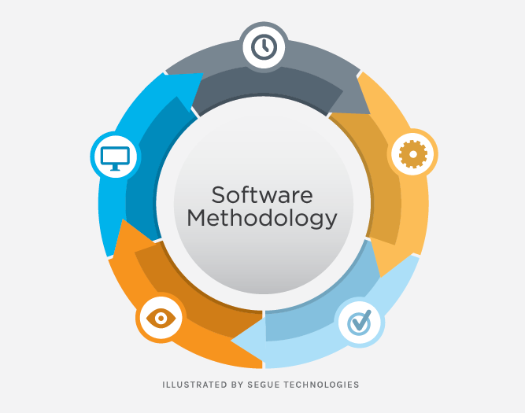

v Model
GROUP NUMBER - 7

Slide 2
Group members
Sanduni Amarasingha - D/ICT/25/0002
Hansaja Damneth - D/ICT/25/0011
Aruna Praboda - D/ICT/25/0043
Yasath Amasara -D/ICT/25/0074
Yuwani Anuththara -D/ICT/25/0121
Sanduni Handagama -D/ICT/25/0122
Umesha Nethmini -D/ICT/25/0129
Hesara Liyanage -D/ICT/25/0130

Slide 3

Introduction
Salford & Co.
The V-Model is a software development methodology where development and testing are planned together.
It is called the V-Model because its process looks like the letter “V”.
In this model, each development phase has a matching testing phase.
The main goal of the V-Model is to detect errors early and deliver high-quality software.

Slide 4
Key Features of V-Model
Verification & Validation: Each development phase has a matching testing phase.
Sequential Process: Clear step-by-step flow from requirements to deployment.
Early Testing: Errors are detected and fixed early.
Clear Structure: Shaped like a “V”, showing development ↔ testing relationship.
High-Quality Software: Ensures software meets requirements and works correctly.
Easy to Understand: Each stage has defined tasks and outputs.
Documentation Focused: Every phase produces documents guiding the next step.

Slide 5
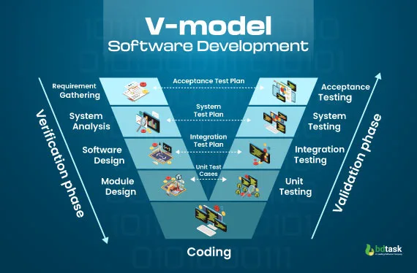

Slide 6
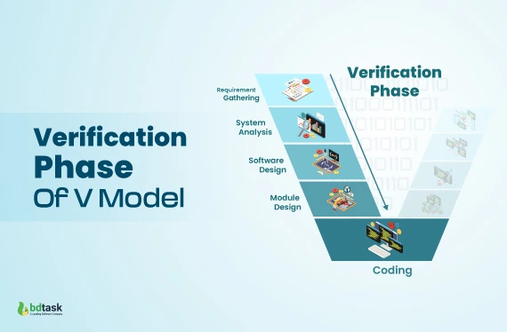
Development Phases -(Left Side of V-Model)
Requirement Analysis – Understand what the user needs.
System Design – Plan the overall system structure.
High-Level Design (HLD) – Break system into modules and define relationships.
Low-Level Design (LLD) – Detailed design of each module before coding.

Slide 7
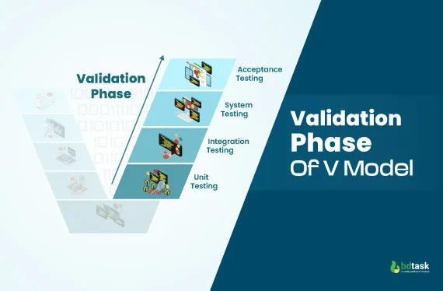
Testing Phases (Right Side of V-Model)
Unit Testing – Test individual modules for correctness.
Integration Testing – Test how modules work together.
System Testing – Test the complete system against requirements.
Acceptance Testing – Confirm software meets user needs and expectations.

Slide 8
Library Management System – V-Model Example
Development Phases (Left Side)
Requirement Analysis – Understand library needs (add, issue, return books)
System Design – Plan modules (Books, Members, Issue/Return, Reports)
High-Level Design – Define module interactions
Low-Level Design – Detailed design of each module and database
Coding
Implement all modules in code (Java, Python, etc.)
Testing Phases (Right Side)
Unit Testing – Test each module individually
Integration Testing – Test how modules work together
System Testing – Test the complete system
Acceptance Testing – Confirm system meets library staff needs

Slide 9
Advantages & Disadvantages of V-Model
Advantages
Disadvantages
Easy to understand and use
Early detection of errors
Ensures high-quality software
Each phase has clear deliverables
Simple to manage
Not flexible for changing requirements
High risk for large projects
Not suitable for complex/long projects
Requires very clear requirements

Slide 10
When to Use V-Model
Small to medium projects with clear requirements
Well-defined and fixed requirements that are unlikely to change
Safety-critical systems like banking, healthcare, or defense
Projects where early testing is important to ensure quality
When a structured and disciplined approach is needed

Slide 11
Conclusion
V-Model is a structured software development methodology.
Focuses on verification and validation at every stage.
Helps detect errors early and ensures high-quality software.
Best suited for projects with clear, fixed requirements.
Easy to understand, manage, and document, making it reliable for small to medium projects.

Slide 12
thank you

