Slide 1
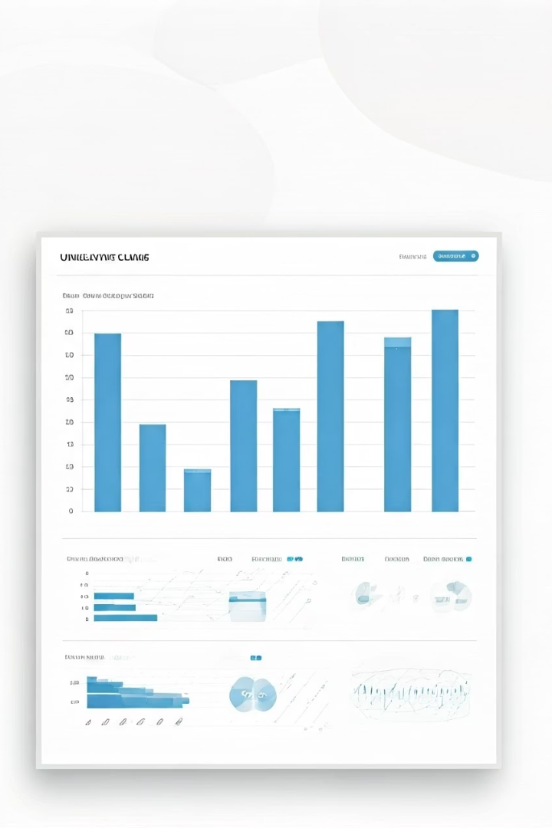
Unemployment Claims Prediction
A comparative analysis of various models for predicting Initial Claims (IC) and Continuing Claims (CC) for Unemployment Insurance.

Slide 2




Project Overview
Prediction Targets
Predictors
Initial Claims (IC) and Continuing Claims (CC) for Unemployment Insurance
Economic indicators and time features
Methodology
OLS Regression, Regularization, Boosting, PCA, GLM,
Time Series Models, KNN, and Random Forest

Slide 3
KNN Model Optimization
Initial Claims (IC)
Continuing Claims (CC)
Best k value: 3 neighbors
Best k value: 1 neighbor
Test MSE: 2.35e+12
Test MSE: 5.30e+09
Pseudo R²: 0.1379
Pseudo R²: 0.2464

Slide 4
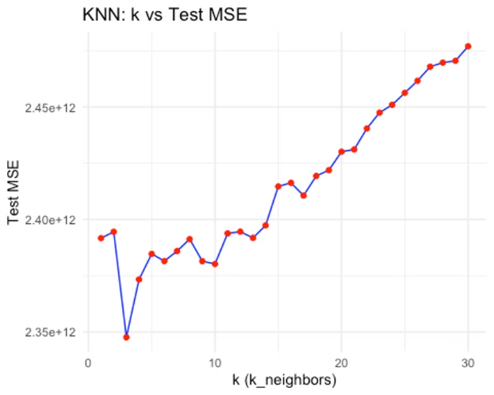
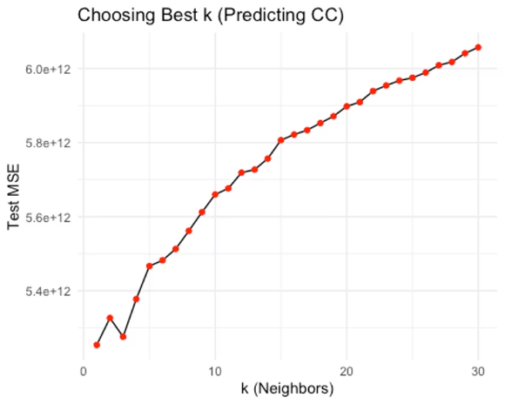
Best K selection
k=1
k=3

Slide 5
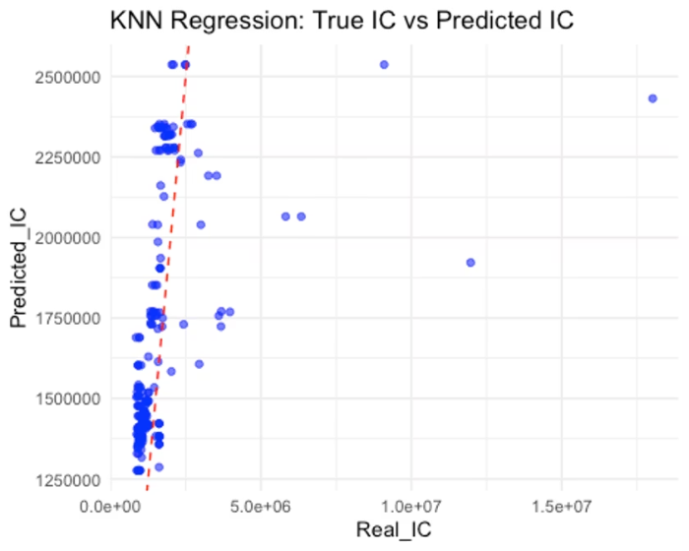
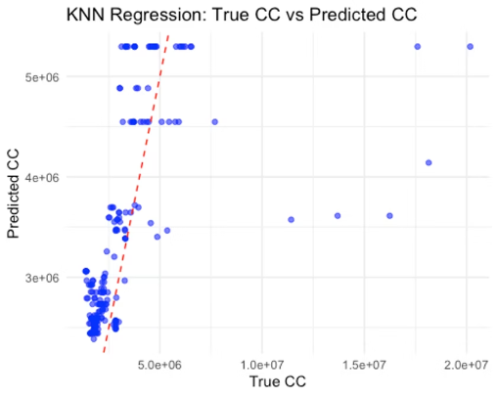
KNN Model Performance
Interpretation:
Interpretation:
The model struggles more with CC than IC.
Underestimation
The model performs decently for small to medium IC values but struggles for extreme large IC values.
Predictions are less sensitive to changes in actual CC values.
Severe underestimation happens for extremely large CC values.
Variability increases with higher IC.

Slide 6
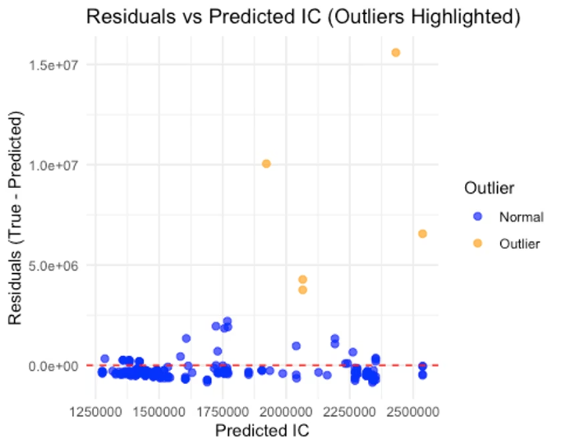
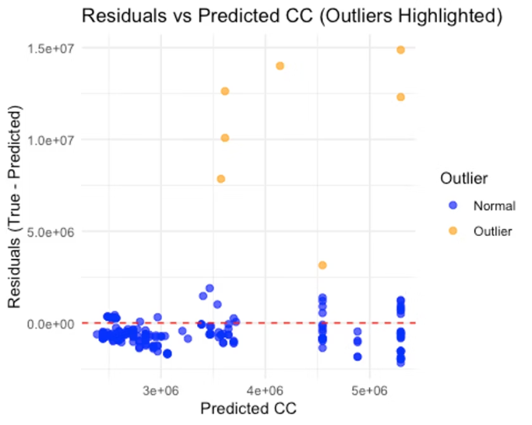
Residuals
Outlier threshold: 3000000

Slide 7




Random Forest Implementation
Model Configuration
500 trees per forest
Square root of predictors at each split
Evaluation Metrics
Test MSE and Pseudo R²
Residual analysis
Visualization
True vs Predicted plots
Residual plots and histograms

Slide 8
Random Forest Performance
Metric
CC Random Forest
IC Random Forest
Test MSE
5.32e+09
2.42e+12
Pseudo R²
0.2545
0.1183
CC model shows more stable residuals and consistent errors across prediction values compared to IC model.

Slide 9
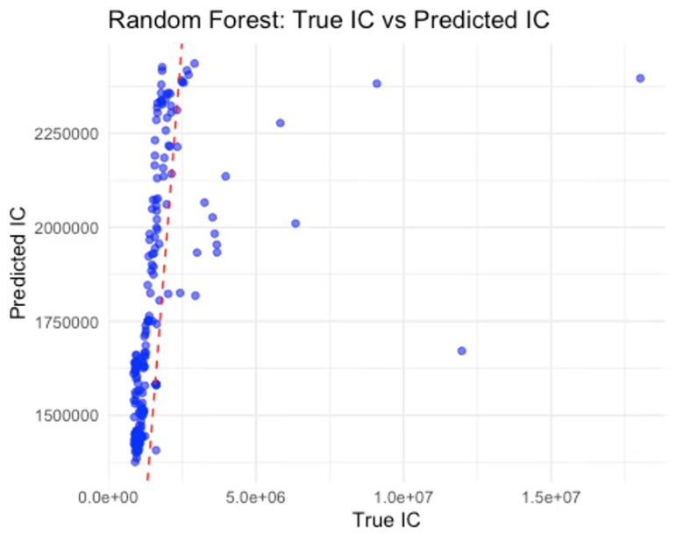
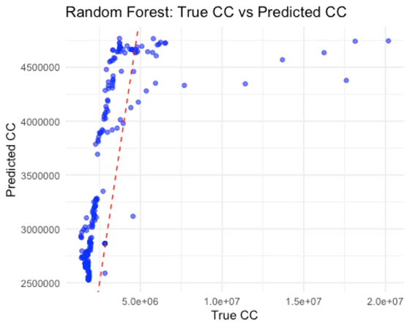
Random Forest Performance
Interpretation:
Interpretation:
Clustered along the left side of the 45-degree line.
The predictions generally follow the trend but show deviation at higher CC values (flattening effect).
More spread, especially at larger IC values.

Slide 10
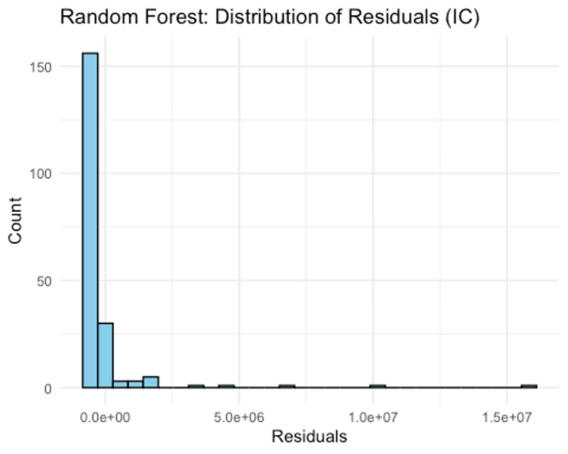
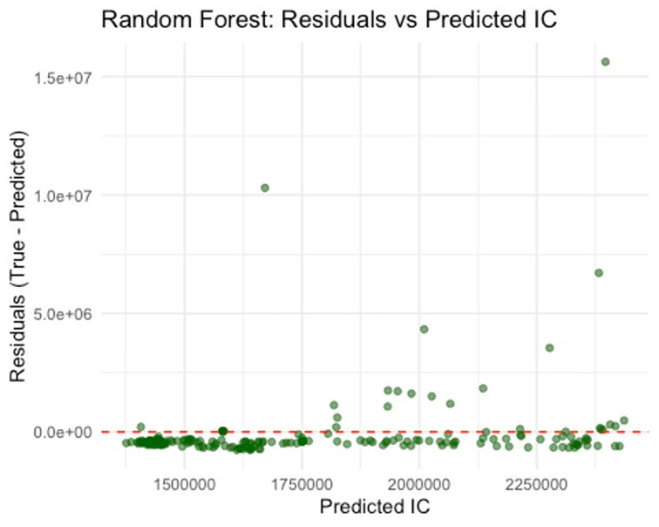
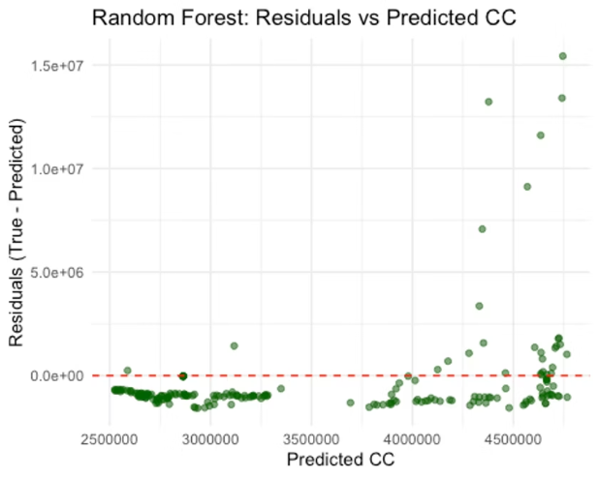
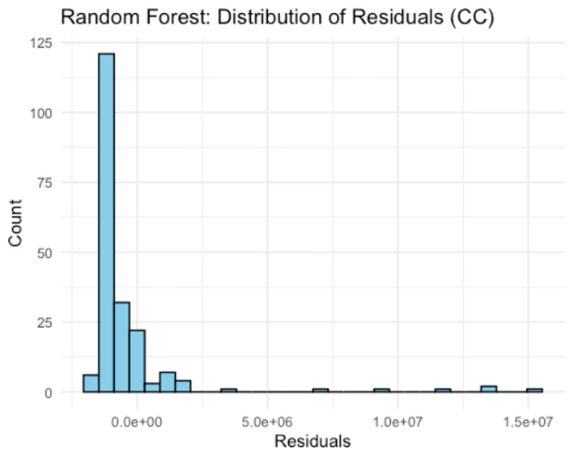
Residuals
Residuals are more dispersed compared to CC.
Here, most residuals are centered around 0, but outliers appear for high CC predictions.
Heteroskedasticity observed — errors tend to grow with larger IC predictions.

Slide 11
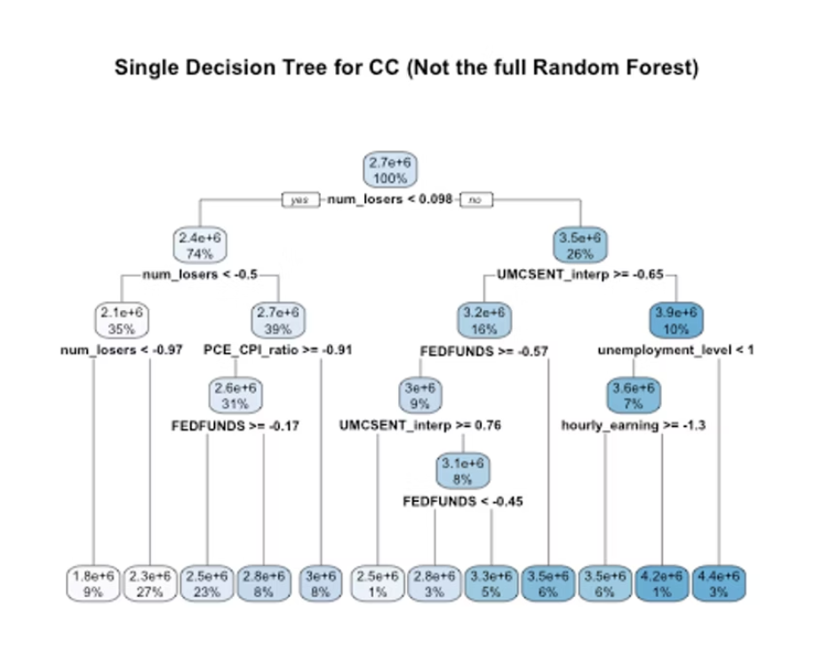
An example tree

Slide 12




Final Recommendations (comparing the two models)
Optimal Solution
Use both models for their strengths
Model Selection
KNN for IC, Random Forest for CC

