Slide 1
DESIGNED BY
YEFENGCHUICHUI
The Enhancement
of Apollo Architecture
A3 byWannaRun
Group Leader: Hairuo Li
Slides: Jialing Gong
Presentation: Muyun Sai
Report:
Yuxuan Yang / Jialing Gong / Muyun Sai
Yuxin Huang / Hairuo Li / Songyu Yang

Slide 2

Abstract
DIscussion
Enhancement
based on the existing architecture &
component interactions

Slide 3
Benefits of the Proposed Enhancement
1
Styles & Concrete Architecture
2
CONTENTS
Monitor (Alternative) Implementation
3
CANBus (Actual) Implementation
4

Slide 4
5
SAAM Analysis
6
Use Cases
Impact on Existing Subsystems&Directories
7
CONTENTS
Interactions with Pre-Existing Features
8
9
Potential Risks to NFRs
10
Testing Plans

Slide 5
PART 01
Benefits of the Proposed Enhancement
Traffic safety is always a challenge to autonomous vehicles.

Slide 6
Two major benefits
from the implementation of it:
Traffic safety - Auto vehicles
Thus, add a functionality that：
1. the decrease of traffic risk
Be able to check if there is a vehicle overload in a particular car
not Gets thrown off balance
not Misjudging the stopping distance
Can be implemented in the autonomous vehicles
2. reduces regulation violation
Check the weight
Calculate the number of passengers

Slide 7
PART 02
Styles & Concrete Architecture
The used architechture style and current concrete architechture.

Slide 8
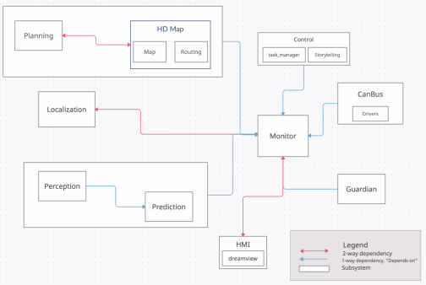
Register
View whether face overloading or overcrowding
if so, Prohibited from starting
Pub-Sub Style

Slide 9
Current Concrete Architecture
Monitor
responsible for system level software
Gardian
making sure modules work properly
monitoring detects a module crash
CANBus
interface for passing control commands to the vehicle hardware

Slide 10
PART 03
Monitor (Alternative) Implementation
As an alternative to implementing the overcrowding_overloading function, we have decided to add this module to the Monitor.

Slide 11
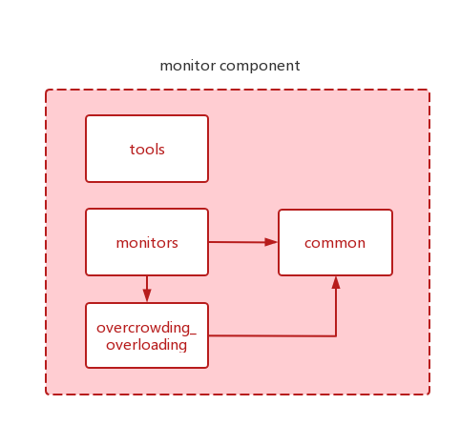
Alternative to implementing overcrowding_overloading
Add in module Monitor
add
new data
get the current data
compared to identify
the upper limit criteria for vehicle weight and
people
from the sonsor by the function
if so gets the exception
information and passes it to the HMI for display
However, slows down the overall process of the program
additional dependencies and more system operations
a waste of system resources
Thus, abandon...

Slide 12
PART 04
CANBus (Actual) Implementation
The actual implementation of Overcrowding/overloading is to add this functionality to the CANBus.

Slide 13
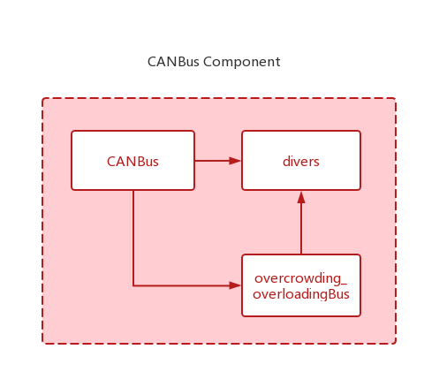
Actual to implementing overcrowding_overloading
Add in module CANBus
drive sensing system
compare the standard
output to other modules
provide real-time information and the load in the car
compare, then returns the information to the control as status
exception information to Guardian, Monitor, and the user from the HMI.
no additional dependencies
detection can be done completely before the car is started
periodically returns the vehicle status to control
safer and does not consume so many system resources

Slide 14
PART 05
SAAM Analysis
how the new enhanced component should interact with other components within the system, what interfaces it should be connected to and what kind of changes it will make to the system interaction at different interfaces

Slide 15
How
What
What
the new component interact with
other components
interfaces it
should be
connected to
it will make to the system interaction at different interfaces
to put it in the
monitor to implement the feature
to put it
in the CANBus to monitor the in-vehicle situation
01
02

Slide 16
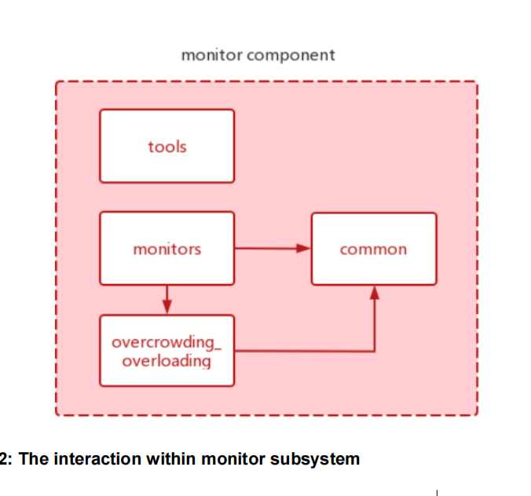
Approach1(Monitor)
add to
Monitor
directly monitor the interior environment
confirm whether there is overcrowding and overloading

Slide 17
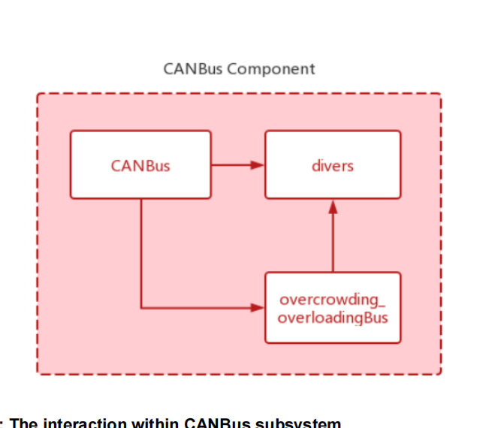
Approach2(CANBus)
add to
CANBus
directly monitor the interior environment
CANBus can directly get the command
and then interact with
control

Slide 18
NFR’s Impacted
Performance
Maintainability
Performance
Maintainability
Plan the journey only after checking whether the car is overcrowding and overloading
This can lead to longer times between identifying the system overcrowding and the car's response, and this can lead to a waste of system resources
Determination of overcrowding or overloading is made after planning a single path of travel
No new dependencies appear between higher-level subsystems
Approach 1
Approach 2

Slide 19
PART 06
Use Cases
two use cases of the different approach

Slide 20
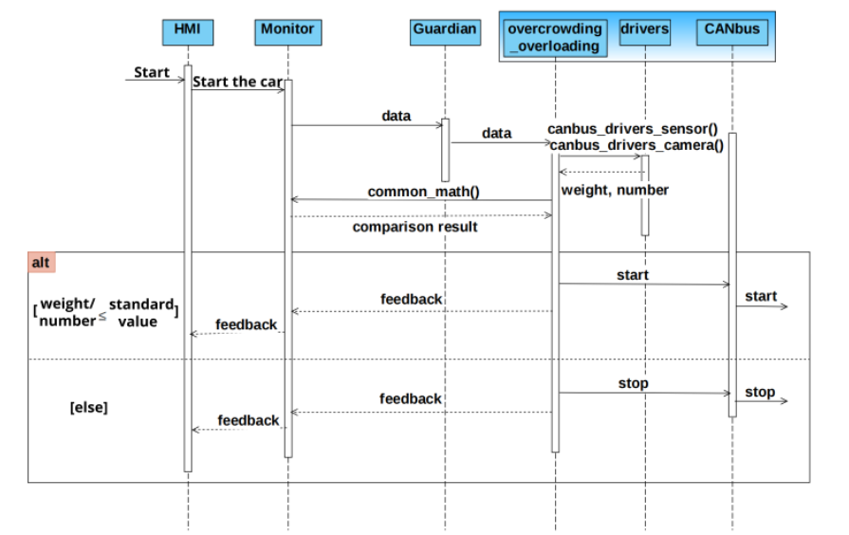
The sequence diagram of use case #1

Slide 21
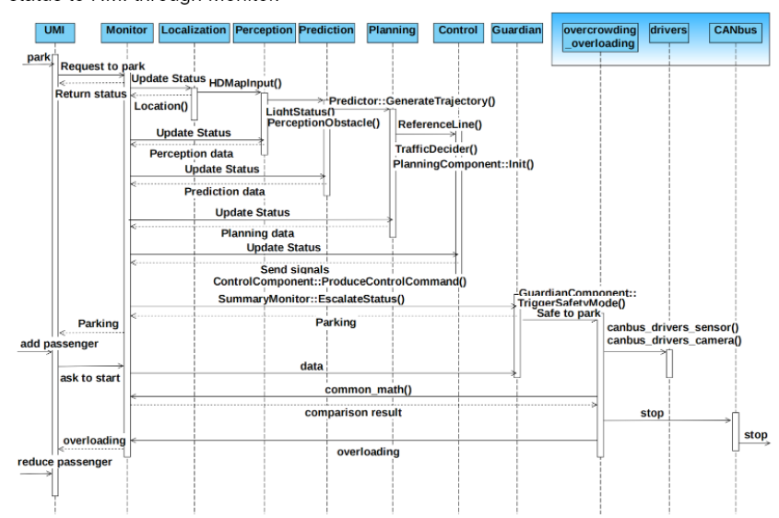
The sequence diagram of use case #2

Slide 22
PART 07
Impact on Existing Subsystems&Directories
it is important to consider the invariability which means even if there are changes made for improving the system, there should as best as small impact made on the existing subsystems.

Slide 23
Impact
consider the
invariability
should as best as small impact
two major impacts on subsystem
and one on Directories
CANBus
Control
Directories
two more functionalities:
facial recognition
weight measurement
more essential
one more process:
where Control module receive the message from Canbus, it needs to judge and decide
most obvious one is the modules directory
has updates

Slide 24
PART 08
Interactions with Pre-Existing Features

Slide 25
interactions
CANBus_drivers
provide real-time information
notify from CANBus
return the message
in CANBus
add the function
Complete!
Control
add new code to determine
add an agent to output

Slide 26
PART 09
Potential Risks to NFRs
it is important to consider the invariability which means even if there are changes made for improving the system, there should as best as small impact made on the existing subsystems.

Slide 27
Risks
Maintability (No)
consistent with the past
and will not decrease
Performance (Risk)
still a waste of the process of the system
01
02
03
Security (No)
not add any new security risks

Slide 28
PART 10
Testing Plans
The test plan focuses on the impact of communication between enhancements and other features.

Slide 29
Testing Plans
Ongoing from
pre-development to
post-development
Runnability
interaction between components during testing does not give the expected results
Completeness
refer to all situations where problems occur
Focuses on runnability, completeness, and importance
Importance
helps set out how the software will be checked, what specifically will be tested, and who will be performing the test.
What should be considered?

Slide 30
Testing Plans
Difficult to Achieve
Test after "stop"
because of system
components & subsystems’ own complexity, detecting all cases is
difficult to achieve
Because method required
re-qualifying the number of people and occupants on board once after each stop
TEST
in practice
Test the Functionality
monitored by the developer
prefer to test according to its
importance and focus on the cases that occur more often
to ensure that other components are working properly as enhancements
are added

Slide 31
Conclusion

Slide 32
Overcrowding/overloading
Enhancement
add a subsystem
performed a SAAM analysis
Limit in CANBus
NFR
high maintainability and also low risk
planning and analysis
believe best way

Slide 33
DESIGNED BY
YEFENGCHUICHUI
The Enhancement of Apollo Architecture
Thanks for Watching
A3 byWannaRun

