Slide 1
Short Story -- A Survey on Deep Neural Network Compression
Yuxing Wang

Slide 2
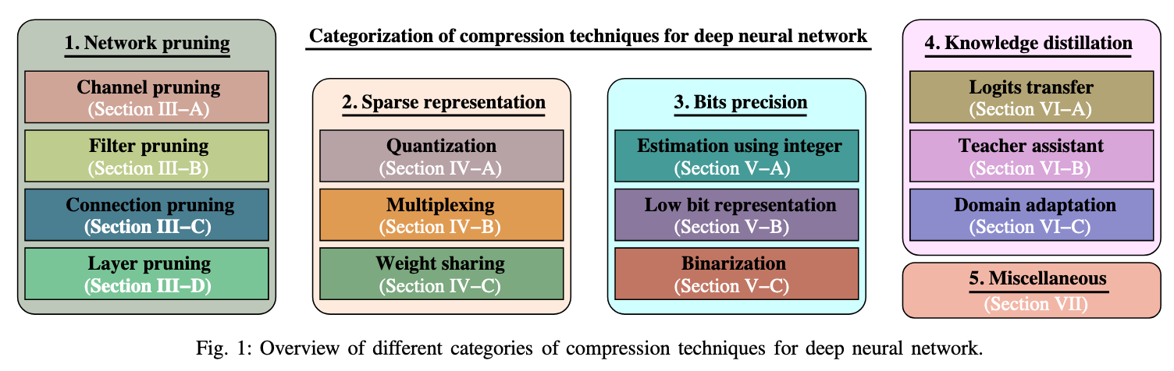
Compression techniques for DNN

Slide 3
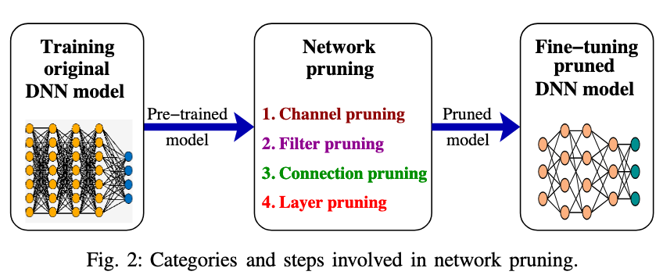
Network pruning

Slide 4
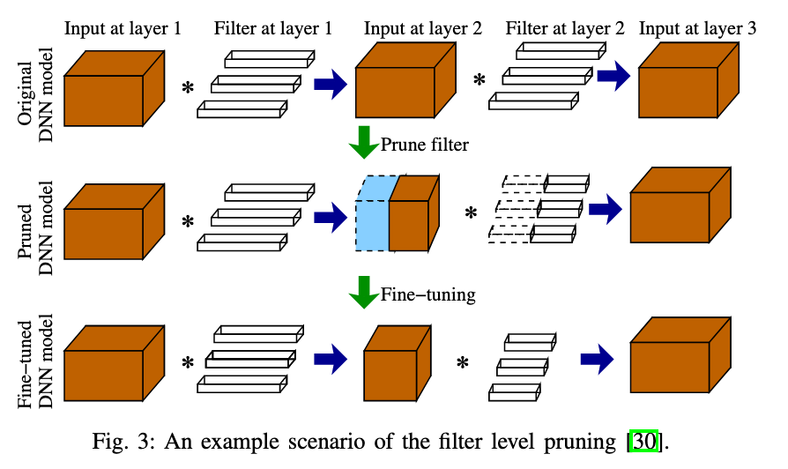
Filter pruning

Slide 5
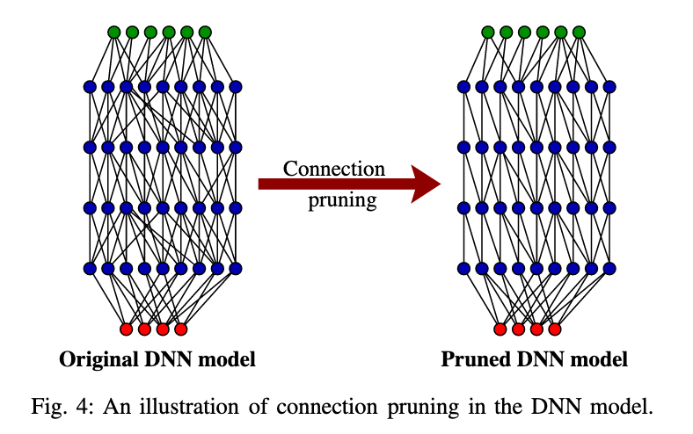
Connection pruning

Slide 6
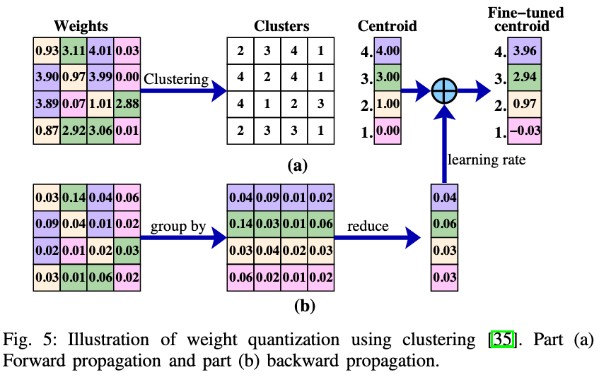
Weight quantization using clustering

Slide 7
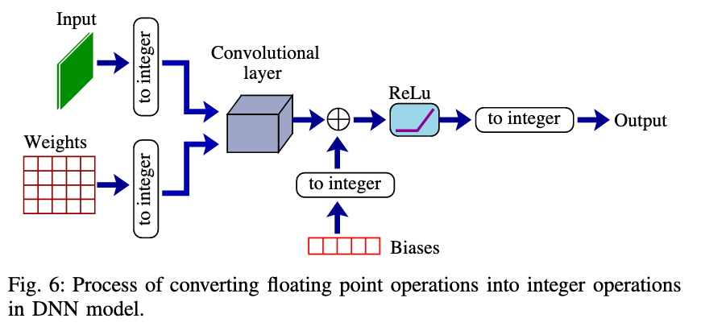
Bits precision

Slide 8
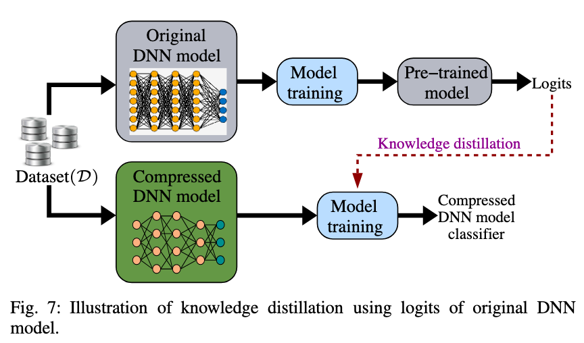
Knowledge Distillation -- Logits transfer

Slide 9
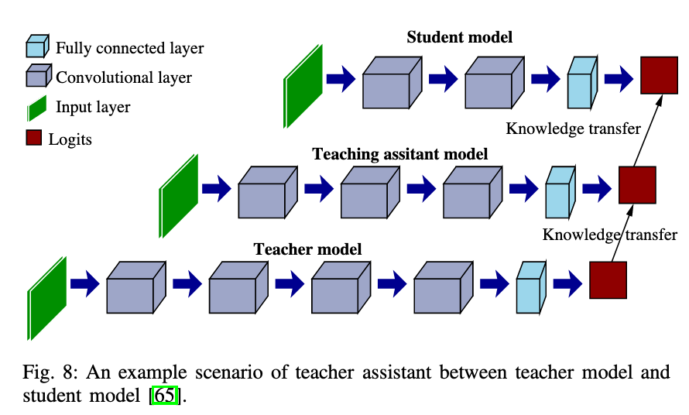
Teacher Assistant

Slide 10
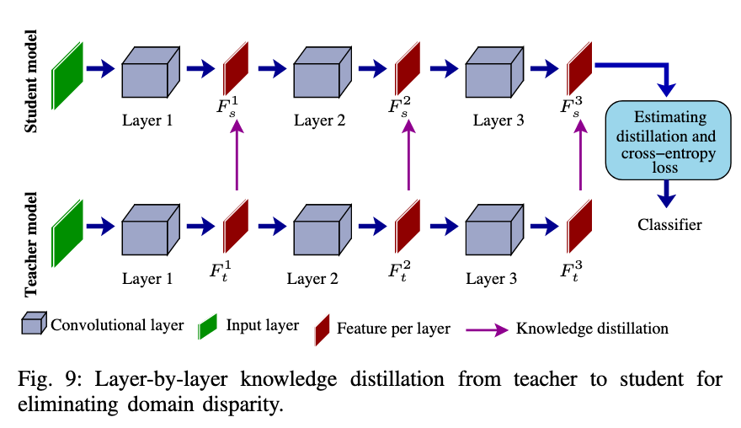
Domain Adaptation

Slide 11
Thanks for watching

