Slide 1
PM Review
IS203 Software Engineering
G3T2
Aayush Garg
Eva Tan Guan Hua
Max Chua
Wu Di
Yuan Yuxuan

Slide 2
Scope
Functionalities
Schedule
Metrics
Roles & responsibilities

Slide 3
Functionalities
NO additional functionalities
N0T dropping any functionality
Using Model View Controller

Slide 4
Schedule
Iteration 1: 10th sept – 13th sept
Iteration 2: 15th sept – 27th sept
Iteration 3: 29th sept – 12th oct
Iteration 4: 13th oct – 26th oct
Iteration 5: 27th oct – 9th nov
Iteration 6: 10th nov - 23nd nov

Slide 5
Schedule
Overall Timeline
Planning Schedule
Domain Diagram
System Diagrams
HeatMap
Basic Location Report
Group Aware Location Report
Iteration 1
Iteration 3
Iteration 5
Iteration 2
Iteration 4
Iteration 6
Login/ Logout
Bootstrap
Automatic Group Identification
Web Service UI + JSON
Buffer

Slide 6
Schedule
Iteration 1 (week 4)
Domain Diagram
Use Case Diagram
Logical Diagram
Overall Design Layout for System (Wireframe)
System Sequence Diagram

Slide 7
Schedule
Iteration 2 (week 5-6)
Login/Logout
Buffer
4 days
Sequence Diagrams for Login/Logout and Bootstrap
Integrate + System Test + Debug
Deploy on OpenShift
2 days
3 days
1 days
Bootstrap
8 days

Slide 8
Schedule
Iteration 2 (week 5-6)
Login/Logout
Buffer
4 days
Sequence Diagrams for Login/Logout and Bootstrap
Integrate + System Test + Debug
Deploy on OpenShift
2 days
3 days
1 days
Bootstrap
8 days

Slide 9
Schedule
Iteration 3 (week 7-8)
HeatMap
Buffer
6 days
Sequence Diagrams for HeatMap and Basic Location Report
Integrate + System Test + Debug
Deploy on OpenShift
2 days
3 days
1 days
Basic Location Report
8 days

Slide 10
Schedule
Iteration 3 (week 7-8)
HeatMap
Buffer
6 days
Sequence Diagrams for HeatMap and Basic Location Report
Integrate + System Test + Debug
Deploy on OpenShift
2 days
3 days
1 days
Basic Location Report
8 days

Slide 11
Schedule
Iteration 4 (week 9-10)
Web Service UI + JSON
Buffer
4 days
Sequence Diagram for Automatic Group Identification
Integrate + System Test + Debug
Deploy on OpenShift
2 days
3 days
1 days
Group Identification System
8 days

Slide 12
Schedule
Iteration 4 (week 9-10)
Web Service UI + JSON
Buffer
4 days
Sequence Diagram for Automatic Group Identification
Integrate + System Test + Debug
Deploy on OpenShift
2 days
3 days
1 days
Group Identification System
8 days

Slide 13
Schedule
Iteration 5 (week 11-12)
UI/ Catchup
Buffer
4 days
Sequence Diagram for Group Aware Location Report
Integrate + System Test + Debug
Deploy on OpenShift
2 days
3 days
1 days
Group Aware Location Report
8 days

Slide 14
Schedule
Iteration 5 (week 11-12)
UI/ Catchup
Buffer
4 days
Sequence Diagram for Group Aware Location Report
Integrate + System Test + Debug
Deploy on OpenShift
2 days
3 days
1 days
Group Aware Location Report
8 days

Slide 15
Schedule
Iteration 6 (week 13-14)
Buffer….

Slide 16
Schedule
Milestones
Iteration 1
Iteration 3
Iteration 5
Iteration 2
Iteration 4
Iteration 6
Milestone | PM in-charge
PM Review | Aayush
Heuristic Evaluation | Yuxuan
UAT Testing | Wu Di & Eva
Final Presentation | Max

Slide 17
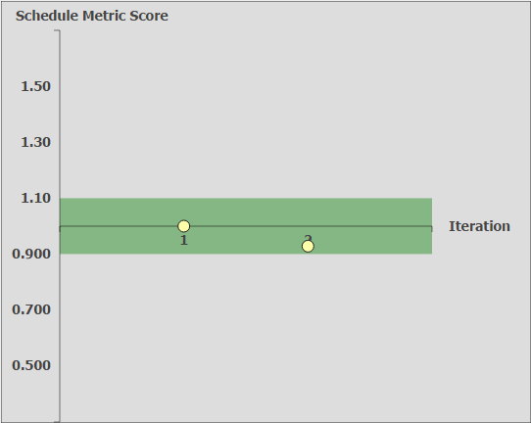
Schedule Metrics

Slide 18
Schedule Metrics
Iteration | Estimated Days | Actual Days | Schedule Metric Index | What can be improved
1 | 4 | 4 | 1.00 | -
2 | 13 | 14 | 0.93 | Allocate debugging time after deployment

Slide 19
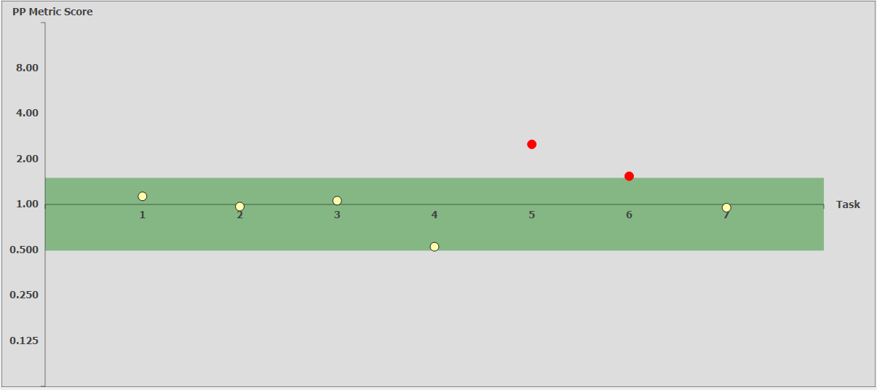
Pair Programming Metrics

Slide 20
Pair Programming Metrics
Functionality | Coders | Estimated Hours | Actual Hours | PP Index | What we can Improve
UI for Login/Logout and Bootstrap | Eva & Yuxuan | 2.0 | 1.8 | 1.13
Login/Logout | Eva & Yuxuan | 5.0 | 5.2 | 0.97
Code Bootstrap (Unzip, Read data files and create SQL tables) | Wu Di & Max | 6.0 | 5.7 | 1.06
Code Bootstrap (Validate data files, connect to database, insert into tables, drop tables) | Wu Di & Max | 6.0 | 11.4 | 0.52
Integrate functionalities | Wu Di & Max | 2.0 | 0.8 | 2.50
Debugging Bootstrap | Wu Di & Max | 6.0 | 6.3 | 0.95
Debugging Login/Logout | Eva & Yuxuan | 3.0 | 2.0 | 1.54

Slide 21
Pair Programming Metrics
Functionality | Coders | Estimated Hours | Actual Hours | PP Index | What we can Improve
UI for Login/Logout and Bootstrap | Eva & Yuxuan | 2.0 | 1.8 | 1.13
Login/Logout | Eva & Yuxuan | 5.0 | 5.2 | 0.97
Code Bootstrap (Unzip, Read data files and create SQL tables) | Wu Di & Max | 6.0 | 5.7 | 1.06
Code Bootstrap (Validate data files, connect to database, insert into tables, drop tables) | Wu Di & Max | 6.0 | 11.4 | 0.52
Integrate functionalities | Wu Di & Max | 2.0 | 0.8 | 2.50 | Estimate Integration time better. (Lower)
Debugging Bootstrap | Wu Di & Max | 6.0 | 6.3 | 0.95
Debugging Login/Logout | Eva & Yuxuan | 3.0 | 2.0 | 1.54 | Allocate debugging time better according to difficulty of functionality

Slide 22
Bug Metrics
Functionality | Bug Details | Category
Login/Logout | Separate User and Admin Login pages. Need to Integrate them. | Low Impact (1 point)
Bootstrap | Takes longer than 15 minutes to upload and validate data | High Impact (5 points)
Overall Score < 10
Therefore, Errors should be debugged in planned debugging time

Slide 23
Roles & Responsibilities
Project Manager Rotation
Iteration | Project Manager
Iteration 1 (week 4) | Aayush
Iteration 2 (week 5-6) | Aayush
Iteration 3 (week 7-8) | Yuxuan
Iteration 4 (week 9-10) | Wu Di
Iteration 5 (week 11-12) | Eva
Iteration 6 (week 13-14) | Max

Slide 24
Roles & Responsibilities
Pair Programming Schedule
Functionality | Coding Pair Assigned
Login/ Logout | Yuxuan and Eva
Bootstrap | Max and Wu Di
Basic Location Report | Aayush and Wu Di
HeatMap | Max and Eva
Automatic Group Identification | Eva and Yuxuan
Web Service + JSON | Max and Aayush
Group Aware Location Reports | Yuxuan and Aayush
UI/ Catch-up | Max and Wu Di

Slide 25
Thank You! Any Questions?

