Slide 1





SCRIBE: Learning Reusable
Skill Rubrics for Process Reward Models
Yuxuan Jiang Francis Ferraro
University of Maryland, Baltimore County
Project & Slides
Supported by:
EMNLP 2026

Slide 2
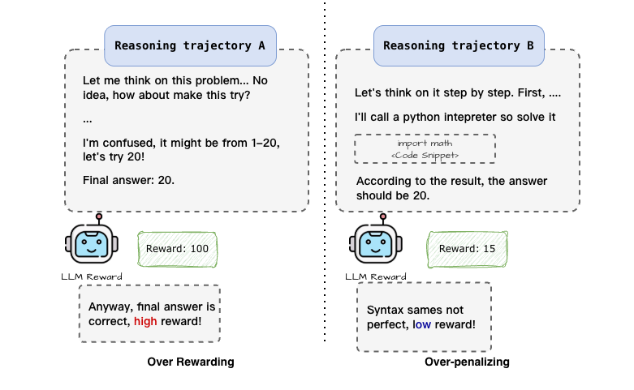
Motivation: Unreliable Reward Leads to Unreliable RL Training
Over-rewarding: Correct Answer + Flawed Logic
Over-penalizing: Sound Strategy + Minor Syntax Error

Slide 3
Motivation: Unreliable Reward Leads to Unreliable RL Training
Over-rewarding:
Correct Answer but Flawed Logic
Over-penalizing:
Sound Strategy + Minor Syntax Error

Slide 4
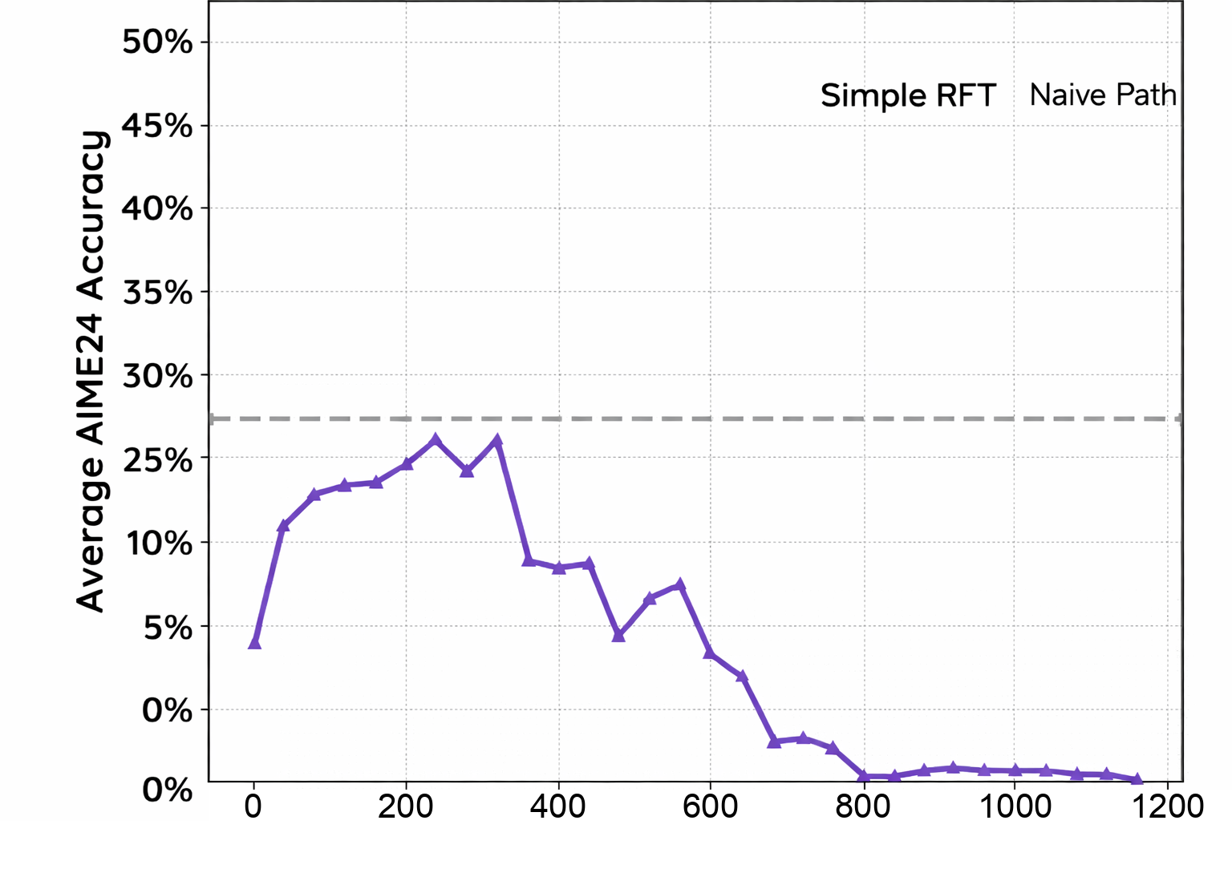
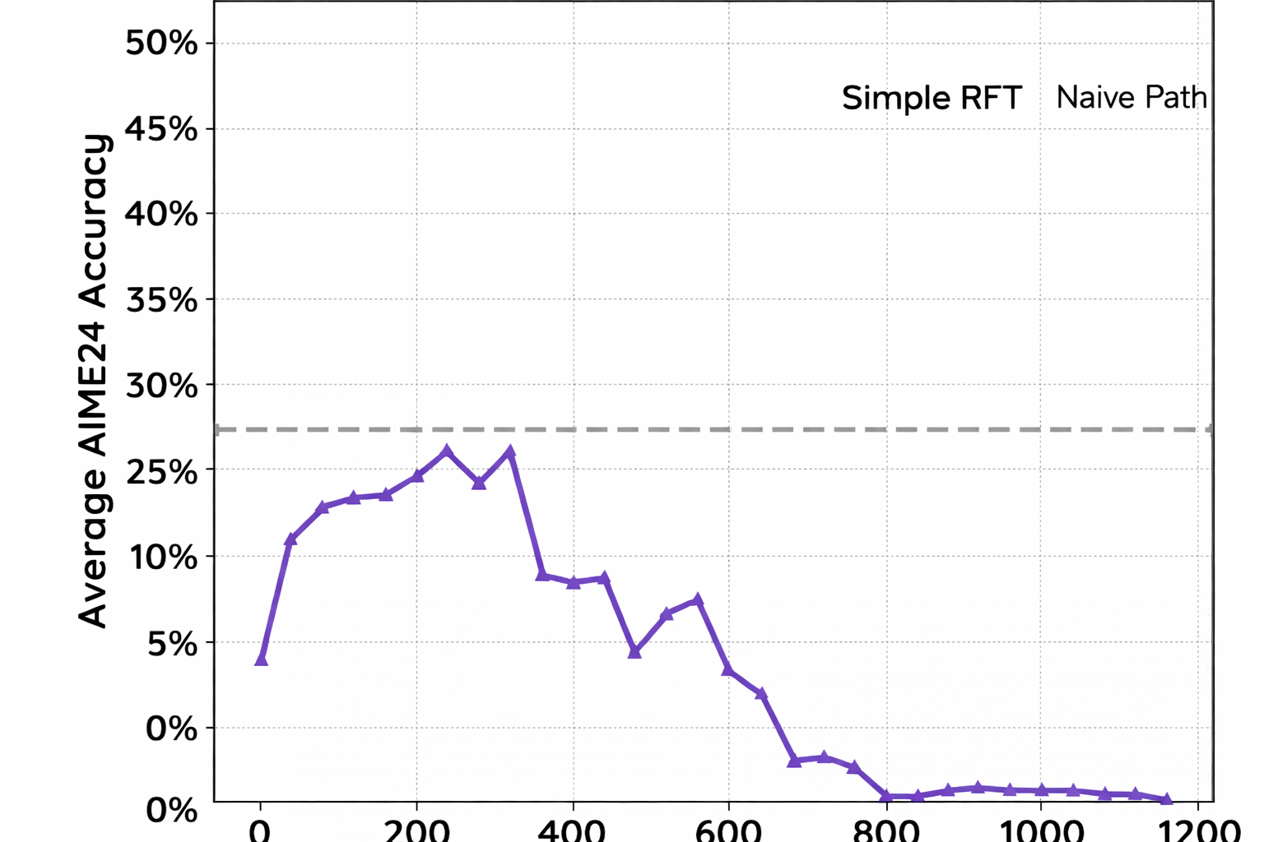
Motivation: Unreliable Reward Leads to Unreliable RL Training
Over-rewarding: Correct Answer + Flawed Logic
Over-penalizing: Sound Strategy + Minor Syntax Error
Training Crash!
Notes:
Restored clipped x-axis tick labels (0–1200) on the original image. Curve pixels and vertical axis are unchanged. No new experimental values were generated.

Slide 5
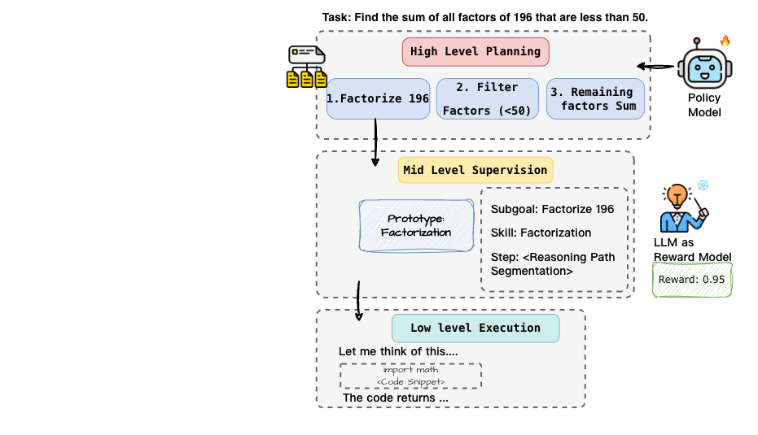
SCRIBE: Process Reward Is Not About ‘Correct’ but ‘Done’

Slide 6
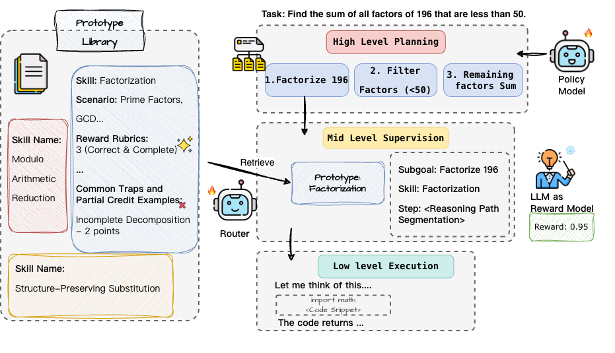
Skill Prototype: A Reliable Rewarding Rubric

Slide 7
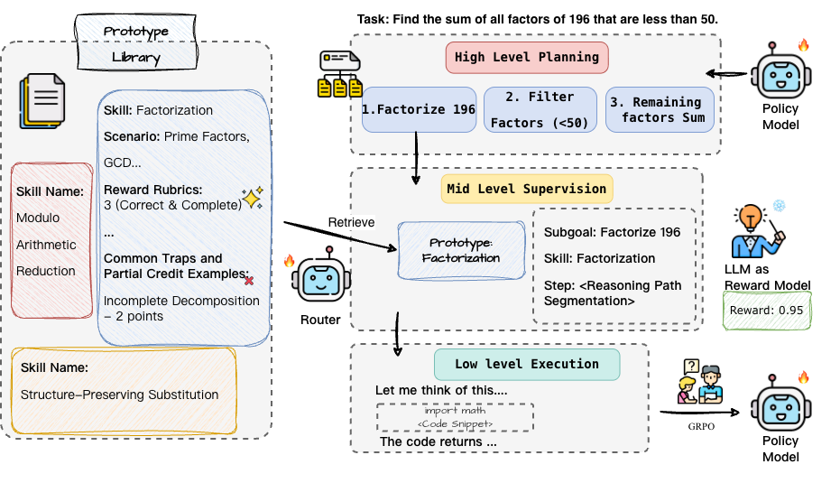
Reliable Training

Slide 8
A Skill Prototype Becomes a Reusable Reward Standard
SKILL PROTOTYPE · MATHEMATICAL REASONING
Bound-Based Conclusion and Synthesis
TAKEAWAY
SCOPE & APPLICABLE SCENARIO
Bounds, extrema, tightness, case coverage, and domain constraints. Conclude from prior constraints; justify attainability or feasibility.
Structured
A prototype specifies the skill, expected reasoning pattern, and concrete failure modes.
CANONICAL REASONING PATTERN
1. Identify the relevant intermediate results.
2. Distinguish implication from a tightness claim.
3. Prove attainability when claiming an extremum.
4. Check domains and cover all cases.
5. State the final conclusion.
Reusable
The same rubric evaluates comparable subgoals across different problems.
JUDGING RUBRIC · 0–3
3 Correct & complete: rigorous and feasible.
2 Minor flaw: sound strategy, small slips.
Actionable
Reward reflects whether an intermediate behavior is complete—not merely whether it resembles a reference.
1 Major logical gap: unsupported conclusion.
0 Wrong skill: incompatible or premature.
COMMON TRAPS
Boundary leak → 2 Unproved tightness → 1
Reusable criteria reduce reward drift across instances.

Slide 9
Reference Quality Matters for Instance-Level Rubrics
RaR builds a rubric from each problem’s reference answer.
SCRIBE reuses skill rubrics without requiring golden reference answers.
Method | Reference source | MATH500 | AIME25 | BFCL
RaR | GPT-5.1 labeled | 90.7 | 43.3 | 46.2
SCRIBE | Not required

Slide 10
Reference Quality Matters for Instance-Level Rubrics
RaR builds a rubric from each problem’s reference answer.
SCRIBE reuses skill rubrics without requiring golden reference answers.
Method | Reference source | MATH500 | AIME25 | BFCL
RaR | GPT-5.1 labeled | 90.7 | 43.3 | 46.2
SCRIBE | Not required | 95.8 | 63.3 | 51.3

Slide 11
Same Input, Same Rubric: Does the Score Stay Stable?
Repeat one fixed evaluation 10 times with independent judge sampling.
One Fixed Input
Same problem + trace + judge
Same rubric, when applicable
Problem: Find the maximum of x(1 − x), 0 ≤ x ≤ 1.
Trace: “x(1 − x) ≤ 1/4, so the maximum is 1/4.”
Missing step: show that x = 1/2 attains the bound.
10 evaluations → r₁, r₂, …, r₁₀
Measure exact score agreement
and reward standard deviation.
SCRIBE criterion: an upper bound alone does not establish a maximum.
Method | Agreement ↑ (%) | Reward Std. ↓
No-rubric PRM | 71.8 | 0.63
RaR | 82.4 | 0.41
SCRIBE | 93.7 | 0.18
Illustrative input; table reports the paper’s aggregate experiment, not this example’s scores.
Notes:
Protocol matches the camera-ready paper: fix problem, trajectory, rubric and judge; repeat 10 times with independent sampling. The math input is a constructed explanation of the protocol, not an actual recorded sample. No individual scores are invented.

Slide 12
Different Problems, Same Behavior: Is Scoring Consistent?
Match subgoals by reasoning pattern or failure type, then compare their scores.
Problem A: Maximize x(1 − x)
One Matched Behavior Group
“x(1 − x) ≤ 1/4, so the maximum is 1/4.”
No check that equality is attainable.
Score both spans under each method.
SCRIBE: one shared skill rubric.
RaR: the relevant dimension from each problem’s rubric.
Problem B: Maximize xy, Given x + y = 10
“xy ≤ 25 by AM–GM, so the maximum is 25.”
No check that equality is attainable.
Compare score equality and |rA − rB|.
50 groups; 2–11 subgoals per group.
Method | Agree ↑ | Gap ↓
Direct PRM | 58.6% | 0.82
RaR | 69.4% | 0.57
SCRIBE | 86.8% | 0.24
Shared behavior: unproved tightness
Compare only the relevant subgoal spans.
Illustrative matched pair; the table reports aggregate results across the paper’s 50 groups.
Notes:
Illustrative examples of the unproved-tightness failure type. Actual experiment: manually collect 50 groups of 2–11 semantically matched subgoals (mean 5.2), isolate target spans, score under Direct PRM, relevant RaR rubric dimension, and shared SCRIBE prototype. Report pairwise exact agreement and mean absolute score gap. Example-specific model scores are not available and are not shown.

Slide 13
Reusable Rubrics Make Reward Judgments More Consistent
Compare no-rubric Process Reward Modeling, instance-level rubrics (RaR), and reusable skill rubrics (SCRIBE).
Same input, repeated 10 times
Similar behavior, different problems
Fix the problem, trajectory, rubric, and judge.
50 matched behavior groups; 2–11 subgoals each.
Method | Agree ↑ (%) | Std. ↓
No-rubric PRM | 71.8 | 0.63
RaR | 82.4 | 0.41
SCRIBE | 93.7 | 0.18
Method | Agree ↑ (%) | Gap ↓
Direct PRM | 58.6 | 0.82
RaR | 69.4 | 0.57
SCRIBE | 86.8 | 0.24
One shared rubric gives similar reasoning behaviors a more consistent reward standard.

Slide 14
Improved Reasoning on Math Tasks
Model | Method | MATH500 | AIME25
Qwen3-4B Instruct-2507 | Base | 89.1 | 43.3
 | Process Reward Modeling | 92.3 | 51.7
 | SCRIBE (Ours)
LLaMA 3.2-3B-Instruct | Base | 40.8 | 1.7
 | Process Reward Modeling | 48.3 | 6.7
 | SCRIBE (Ours)

Slide 15
Improved Reasoning on Math Tasks
Model | Method | MATH500 | AIME25
Qwen3-4B Instruct-2507 | Base | 89.1 | 43.3
 | Process Reward Modeling | 92.3 | 51.7
 | SCRIBE (Ours) | 95.8 | 63.3
LLaMA 3.2-3B-Instruct | Base | 40.8 | 1.7
 | Process Reward Modeling | 48.3 | 6.7
 | SCRIBE (Ours) | 63.4 | 15.8

Slide 16
BFCL V4: Evaluating Tool-Calling Behavior
WHAT IT TESTS
ILLUSTRATIVE TASK FORMAT
Can a model select the correct function, construct valid arguments, and coordinate multiple calls?
User request + available function schemas
→ choose tool(s) → fill arguments → order calls
OUTPUT
Web Search
Retrieve information through search tools
Memory
Store and retrieve user-specific information
One or more executable function calls—not a free-form final answer.
Single
Execute one live or non-live function call
Multi
Coordinate multiple calls for one request
Berkeley Function Calling Leaderboard · V4
Why SCRIBE: reliable process rewards must recognize complete intermediate tool-use behavior.
Patil et al. Berkeley Function Calling Leaderboard (BFCL V4).

Slide 17
Improved Reasoning on General Tool-Use Tasks
Method | MATH500 | AIME25 | BFCL Overall | Search | Memory | Single Live | Single Non-Live | Multi
Qwen3-4B-Instruct-2507
Base | 89.1 | 43.3 | 33.0 | 5.0 | 12.7 | 86.7 | 74.5 | 19.4
Process Reward Modeling | 92.3 | 51.7 | 44.6 | 10.0 | 15.2 | 88.5 | 77.6 | 28.6
SCRIBE (Ours) | 95.8 | 63.3
LLaMA 3.2-3B-Instruct
Base | 40.8 | 1.7 | 21.5 | 0.5 | 5.2 | 82.0 | 58.3 | 3.9
Process Reward Modeling | 48.3 | 6.7 | 24.8 | 5.0 | 8.3 | 83.8 | 59.6 | 8.2
SCRIBE (Ours) | 63.4 | 15.8

Slide 18
Improved Reasoning on General Tool-Use Tasks
Method | MATH500 | AIME25 | BFCL Overall | Search | Memory | Single Live | Single Non-Live | Multi
Qwen3-4B-Instruct-2507
Base | 89.1 | 43.3 | 33.0 | 5.0 | 12.7 | 86.7 | 74.5 | 19.4
Process Reward Modeling | 92.3 | 51.7 | 44.6 | 10.0 | 15.2 | 88.5 | 77.6 | 28.6
SCRIBE (Ours) | 95.8 | 63.3 | 51.3 | 12.5 | 15.8 | 90.0 | 80.5 | 33.3
LLaMA 3.2-3B-Instruct
Base | 40.8 | 1.7 | 21.5 | 0.5 | 5.2 | 82.0 | 58.3 | 3.9
Process Reward Modeling | 48.3 | 6.7 | 24.8 | 5.0 | 8.3 | 83.8 | 59.6 | 8.2
SCRIBE (Ours) | 63.4 | 15.8 | 30.8 | 8.5 | 11.2 | 85.5 | 62.0 | 13.5

Slide 19
Takeaway: Reuse the Standard, Not the Reference Answer
Reward what a reasoning step accomplishes
with a shared, reusable skill rubric.
Project & Slides
01
A Stable Standard Across Problems
Skill prototypes make reasoning quality explicit, without a golden answer for each instance.
02
Less Reward Drift
Cross-instance agreement: 69.4% with RaR → 86.8% with SCRIBE.
03
A Better Signal for Learning
Math and tool-use gains across both evaluated model families.
Build reusable criteria for intermediate behavior—not a new grading standard for every answer.

