Slide 1
H.265 Report
Yuxuan Ling

Slide 2
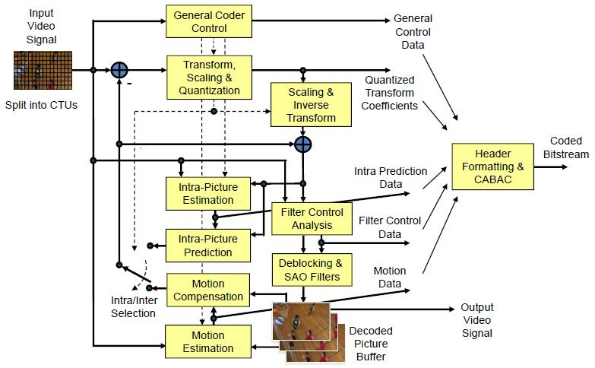
HM Encoder Flow

Slide 3
Outline
Comparison with H.264/AVC
Coding Structure of H.265
Tiles and Slices in H.265
Scaling and Transformation in H.265
Intra Prediction in H.265
Motion Compensation in H.265
In-loop Filter in H.265

Slide 4
Outline
Comparison with H.264/AVC
Coding Structure of H.265
Tiles and Slices in H.265
Scaling and Transformation in H.265
Intra Prediction in H.265
Motion Compensation in H.265
In-loop filter in H.265

Slide 5
Comparison with H.264/AVC (1/3)
New Features in H.265
  Flexible Coding Structure
    Quadtree-based block partition and maximum size of coding block is 64x64
  Residual Quadtree Transform
    Transformation matrix range from 4x4~32x32
  Sample Adaptive Offset
    Located within the coding loop and just behind the de-blocking filter
    An offset is added/subtracted from reconstruction pixel in the picture of a particular category.

Slide 6
Comparison with H.264/AVC (2/3)
New Features in H.265
  Tile
    Rectangular Shaped
    Each tile is coded independently.
  Entropy Slice
    A slice can be partition into multiple entropy slices
    CABAC decoding of each entropy slice is independent to others
  Fine-Grained Intra Prediction Modes
    Total 33 angular intra prediction modes
  Asymmetric Motion Compensation
    PART2NxnU, PART2NxnD, PARTnLx2N and PARTnRx2N

Slide 7
Comparison with H.264/AVC (3/3)
 | H.264/AVC | H.265/HEVC
Entropy coding | Exp‐Golomb,CAVLC,CABAC | Exp‐Golomb,CABAC
MB/CU Size | 4x4~16x16 | 4x4~64x64
Field Coding/MBAFF | Supported | Not Supported
QP Predictor | Left neighbor | Average of left and up neighbor
Luma Interpolation | Half-pel first, then quarter-pel 6-tap filter | Horizontal first, then vertical 7~8-tap filters
Chroma Interpolation | Bilinear Interpolation | Different 4-tap interpolation filters for different fractional positions
MV Prediction | Spatial Domain + Temporal MVP. The latter used only in B-Direct or B-Skip Mode | Combined Spatial and Temporal MVP
B_Slice WP | bipred_idc = 0,1,2 | bipred_idc=0,1
Intra Prediction | 9 prediction modes | 33 angular prediction modes + DC mode + Planar mode
Transformation | DCT4x4/8x8 | DCT4x4/8x8/16x16/32x32
In-Loop Filter | De-blocking Only. DBK process each 4x4 edge and 5 modes are used. | De-blocking + SAO. DBK process each 8x8 edge and only 3 modes are used.

Slide 8
Outline
Comparison with H.264/AVC
Coding Structure of H.265
Tiles and Slices in H.265
Scaling and Transformation in H.265
Intra Prediction in H.265
Motion Compensation in H.265
In-loop filter in H.265

Slide 9
Coding Structure of H.265 (1/4)
Four block concepts are introduced
  Coding Tree Block (CTB)
    Basic coding unit like macroblock in H.264/AVC
    Quad-tree partitioned into small blocks for prediction and transform coding
  Coding Block
    The leaf of the above quad-tree
  Prediction Block
    Specify the partition of coding block for prediction
  Transform Block
    Specify the partition of coding block for transformation

Slide 10
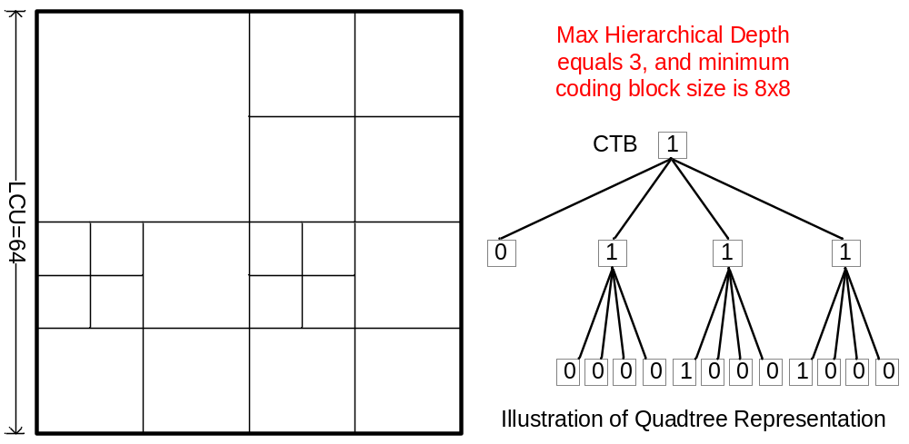
Coding Structure of H.265 (2/4)
Example of Quad-tree partition of CTB
  The CTB size is defined by the LCU and the partition is restricted by the max. recursive depth
  0-valued node refers to a leaf node, and related block is a coding block.

Slide 11
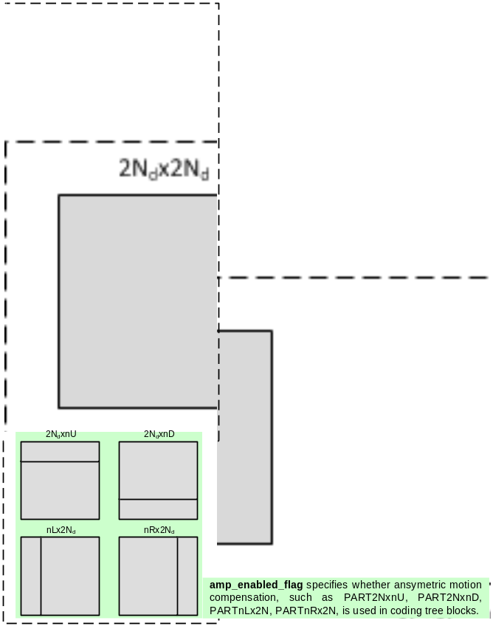
Coding Structure of H.265 (3/4)
Relationship between coding block and prediction partitions are illustrated in the right figure.
‘split_transform_flag’ is used to indicate whether the current coding block need to be split into smaller transform blocks.
  This process is restricted by the maximum and minimum transform block size.
  This partition tree is also called transform tree, which uses coding block as root node.

Slide 12
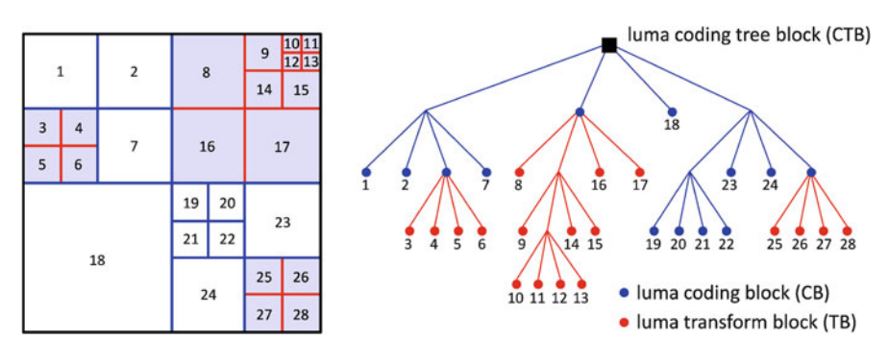
Coding Structure of H.265 (4/4)
CU as root node
SPS level, max TU size, min TU size, max TU depth, for intra prediction, PU >= TU, no limit in inter prediction

Slide 13
Outline
Comparison with H.264/AVC
Coding Structure of H.265
Tiles and Slices in H.265
Scaling and Transformation in H.265
Intra Prediction in H.265
Motion Compensation in H.265
In-loop filter in H.265

Slide 14
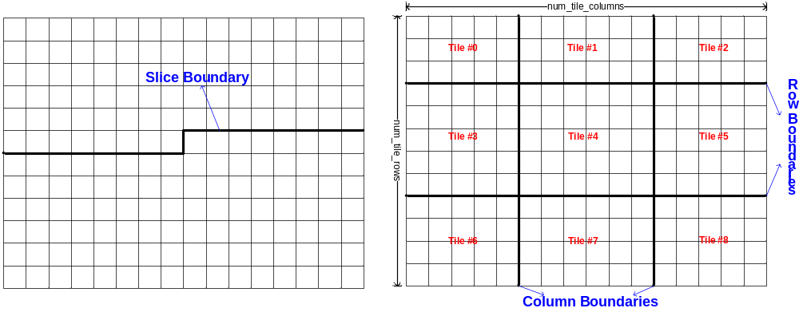
Tiles and Slices in H.265 (1/3)
A slice or a tile is a sequence of coding tree blocks. Unlike slice, tile is always rectangular shaped.
One or both of the following conditions shall be fulfilled for each slice and tile:
  All coding tree blocks in a slice belong to the same tile.
  All coding tree blocks in a tile belong to the same slice.

Slide 15
Tiles and Slices in H.265 (2/3)
Scan Orders introduced by Tile in H.265
  Tile-Scan Order
    In tile level, transverse each tile in raster scan order of the picture. And inside each tile, transverse each CTB in raster scan order of the tile.
  Z-Scan Order
    When the minimum block is of the same size with CTB, z-scan order is identical to tile-scan order
    Otherwise, the z-scan order transverse from CTB to CTB in tile scan order of the picture. For each CTB, the z-scan order traverses from sub-quadree to sub-quadree of a particular immediately higher quadree level in raster scan order of the particular-quadree-level.
1. Z-Scan Order is the encoding order used in H.265, which is distinct from the
processing orders like the raster scan order in other standards.
2. All the neighbor availability should be generated in z-scan order.

Slide 16
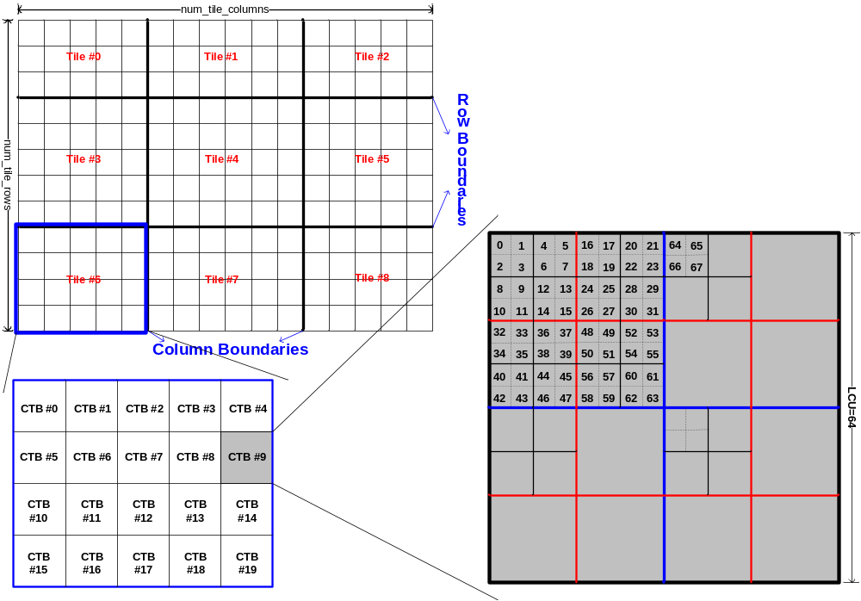
Tiles and Slices in H.265 (3/3)
Example of the Z-Scan Order

Slide 17
Outline
Comparison with H.264/AVC
Coding Structure of H.265
Tiles and Slices in H.265
Scaling and Transformation in H.265
Intra Prediction in H.265
Motion Compensation in H.265
In-loop filter in H.265

Slide 18
Scaling and Transformation in H.265
Scaling in H.265
  Identical to H.264/AVC
  d[x][y]=Clip3(-32768, 32767, TransCoeffLevel[ xT ][ yT ] *
  m[ x ][ y ] * levelScale[ qP%6 ] << (qP/6)) +
  (1 << (shift − 1 )) ) >> shift )
Transformation in H.265
  Adaptive Block-size Transform, transform block size ranges from 4x4 to 32x32.
  Unlike H.264, the column transform is performed first.
  The one-dimension transform is performed as follows:
    y[ i ] = ∑_{j}( transMatrix[ i ][ k ] * x[ j ] ) with i=0..nT − 1, j=0..nT − 1, where k = ( 1 << ( 5 – Log2( nT ) ) ) * j
    Where transMatrix is transformation matrix of 32x32
Scaling Factors

Slide 19
Outline
Comparison with H.264/AVC
Coding Structure of H.265
Tiles and Slices in H.265
Scaling and Transformation in H.265
Intra Prediction in H.265
Motion Compensation in H.265
In-loop filter in H.265

Slide 20
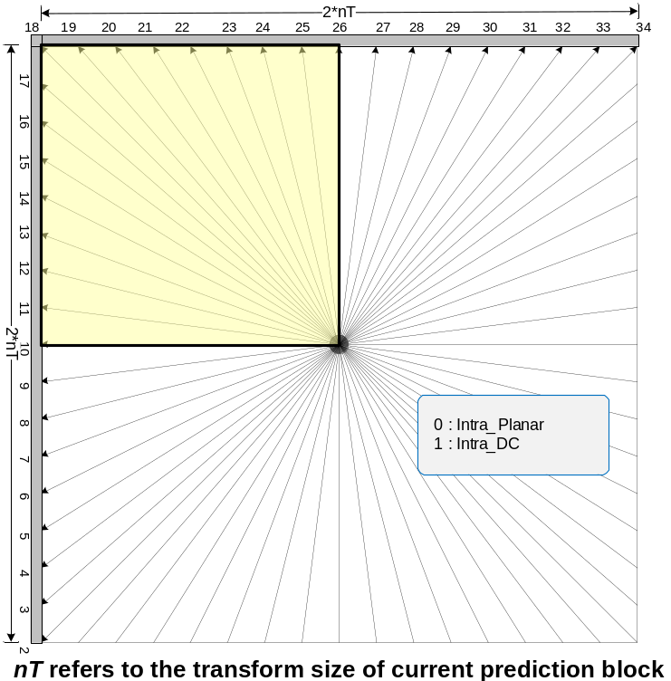
Intra Prediction in H.265 (1/5)
Total 35 prediction modes
  Intra_Planar(0), Intra_DC(1), Intra_Angular(2..34)
Neighbor availability is generated in z-scan order
Substitution for unavailable neighbors is identical to H.264
  Except when all neighbors in the left column are marked as unavailable, it’s assigned to the nearest neighbor in the upper reference row.

Slide 21
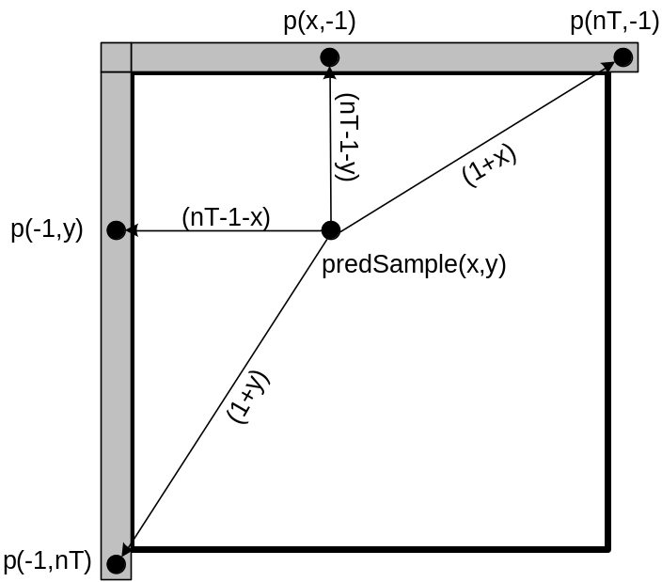
Intra Prediction in H.265 (2/5)
For Intra_Planar(0), the intra prediction samples are derived by
  p[ x ][ y ] are reference samples with x = −1, y = −1..nT*2−1 and x = 0..nT*2−1, y = −1

Slide 22
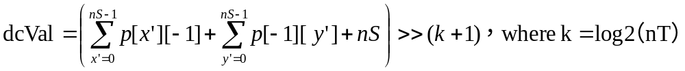
Intra Prediction in H.265 (3/5)
For Intra_DC(1), the intra prediction samples are derived in the following ordered steps:
  A variable dcVal is derived by
  Depending on the component index cIdx, the following applies:
    if cIdx equals to 0, the following applies:
      predSamples[ 0 ][ 0 ] = ( p[ −1 ][ 0 ] + 2*dcVal + p[ 0 ][ −1 ] + 2 ) >> 2
      predSamples[ x ][ 0 ] = ( p[ x ][ −1 ] + 3*dcVal + 2 ) >> 2, with x = 1..nT−1
      predSamples[ 0 ][ y ] = ( p[ −1 ][ y ] + 3*dcVal + 2 ) >> 2, with y = 1..nT−1
      predSamples[ x ][ y ] = dcVal, with x, y = 1..nT−1
    Otherwise
      predSamples[ x ][ y ] = dcVal, with x, y = 0..nT−1

Slide 23
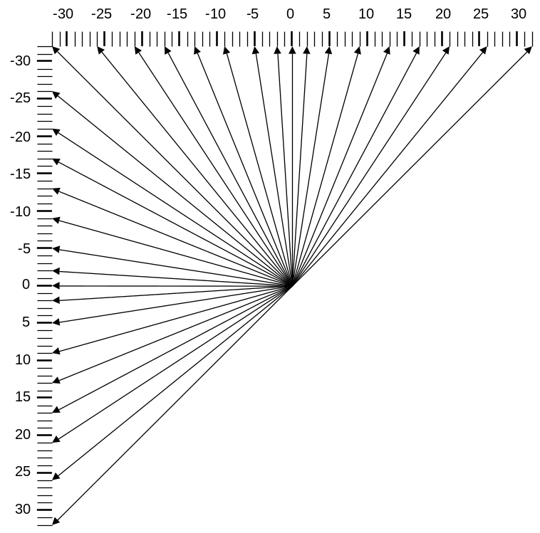
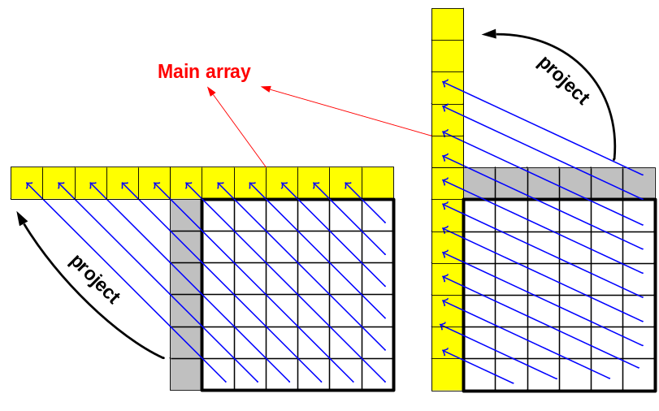
Intra Prediction in H.265 (4/5)
Intra_Angular(2..34)
  First step: Projecting the side array reference samples into the main array ref[x] based on prediction angels, where x = -nT..2*nT
Prediction Angels for different
prediction modes

Slide 24
Intra Prediction in H.265 (5/5)
Intra_Angular(2..34)
  Second Step: derive index variable iIdx and the multiplication factor iFact
    iIdx = ( ( y + 1 )*intraPredAngle ) >> 5
    iFact = ( ( y + 1 )*intraPredAngle ) && 31
  The value of the prediction samples predSamples[ x ][ y ] is derived by
    predSamples[ x ][ y ] = ( ( 32 – iFact )*ref[ x+iIdx+1 ] +
    iFact*ref[ x+iIdx+2] + 16 ) >> 5
  For Intra_Angular (26) and cIdx is equal to 0, the following filtering applies with x = 0, y = 0..nT−1.
    predSamples[ x ][ y ] = Clip1_{Y}( p[ x ][ −1 ] + ( ( p[ −1 ][ y ] – p[ −1 ][ −1 ] ) >> 1 ))
  For Intra_Angular (10) and cIdx is equal to 0, the following filtering applies with x = 0..nT−1, y = 0.
    predSamples[ x ][ y ] = Clip1_{Y}( p[ −1 ][ y ] + ( ( p[ x ][ −1 ] – p[ −1 ][ −1 ] ) >> 1 ) )
The Intra_Angular(26) mode is actually the vertical prediction mode.
The Intra_Angular(10) mode is actually the horizontal prediction mode.

Slide 25
Outline
Comparison with H.264/AVC
Coding Structure of H.265
Tiles and Slices in H.265
Scaling and Transformation in H.265
Intra Prediction in H.265
Motion Compensation in H.265
In-loop filter in H.265

Slide 26
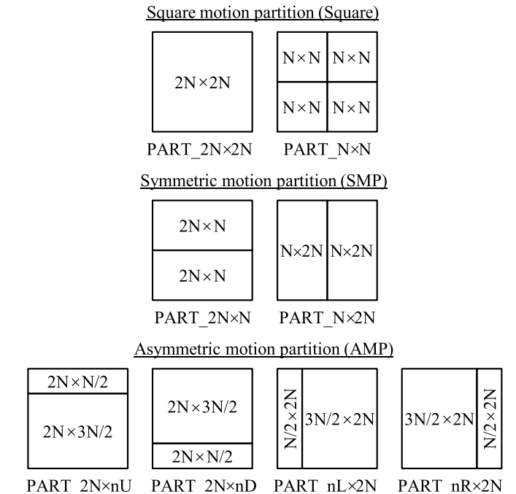
Motion Compensation in H.265 (1/4)
8 prediction modes
  Fro PART_NxN , only minimum size CU used, and 8x8 CU can’t bu used
  For Asymmetric Motion Partition, only 32x32 or 16x16 CU can be used
  If CU is skip, then PU mode
  should only be 2Nx2N

Slide 27
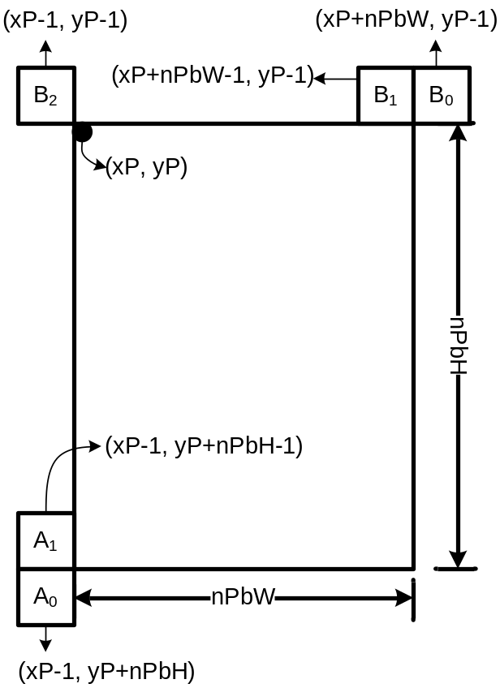
Motion Compensation in H.265 (2/4)
Generation process of MVP
  Two Modes
    Merge Mode and General Mode
  For each mode, a candidate list should be generated first. And MVP is derived from the list (The list Idx is explicitly transferred).
  Both of the candidate lists compose of both spatial and temporal predictors.
  Spatial candidates are illustrated in the right figure.
Temporal MVP is identical to H.264, except that the generation process of
collocated partition colPic is different. In H.265, the colPic depends on some syntax
elements: slice_type, collocated_from_l0_flag, and collocated_ref_idx. And P frame may also use temporal motion vector prediction process in H.265.
Temporal MVP is identical to H.264/AVC, except that the generation process of
collocated partition colPic is different. In H.265, the colPic depends on the
syntax elements: slice_type, collocated_from_l0_flag, and collocated_ref_idx. And P frame may also use temporal MVP in H.265.

Slide 28
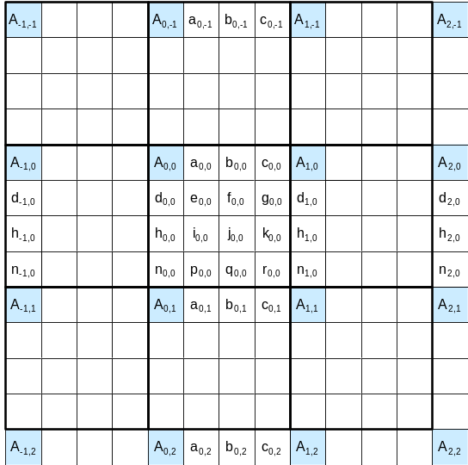

Motion Compensation in H.265 (3/4)
Fractional Sample Interpolation Process in Luma
  Fractional positions are categorized into three classes: ¼-pel, ½-pel and ¾-pel.
  Fractional samples in integer horizontal or vertical directions like a_{0,0}, b_{0,0}, c_{0,0}, d_{0,0}, h_{0,0} and n_{0,0} are calculated directly from integer samples.
  For other fractional samples, the interpolation process are performed first in horizontal direction, and then in vertical direction.

Slide 29
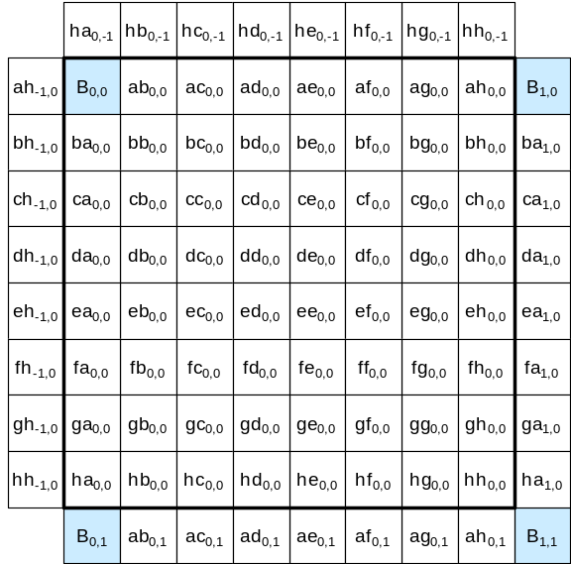
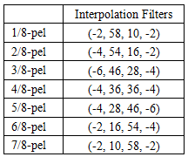
Motion Compensation in H.265 (4/4)
Fractional Sample Interpolation Process in Chroma
  Unlike the bilinear interpolation in H.264/AVC, chroma prediction of H.265 uses a 4-tap interpolation filters for each fractional pos.
  The interpolation process is performed first in horizontal direction, and then in vertical direction, as luma interpolation does.

Slide 30
Outline
Comparison with H.264/AVC
Coding Structure of H.265
Tiles and Slices in H.265
Scaling and Transformation in H.265
Intra Prediction in H.265
Motion Compensation in H.265
In-loop filter in H.265

Slide 31
In-loop Filter in H.265
The in-loop filter in H.265 refers to the de-blocking filter and sample adaptive offset
  De-blocking Filter Process
    Identical to H.264, except for the deblocking algorithm is modified.
    Less filter modes compared to H.264 (Only 3 modes)
    Applied to all prediction block edges and transform block edges.
    Maximum 4 samples in each side of the edge need to be referenced, and maximum 3 samples may be modified in each side.
  Sample Adaptive Offset (SAO)
    An offset is added/subtracted from reconstruction pixel in the picture of a particular category.
    sample_adaptive_offset_enabled_flag equal to 1 specifies the sample adaptive offset process is applied to the reconstructed picture after the de-blocking filter process.

Slide 32
Sample Adaptive Offset in H.265
sample adaptive offset modify reconstructed picture sample array after sample adaptive offset saoPicture
  Process
    3 mode , Not applied, Band Offset, Edge Offset
    Edge Offset: choose gradient pattern , calc edgeIdx, add offset
    Band Offset: split 0~255 into band, choose 4 bands, when sample value is in these bands ,add offset
  Significance
    Save average 2%~6% bit rate meanwhile encoding complex rate increase 2%

Slide 33
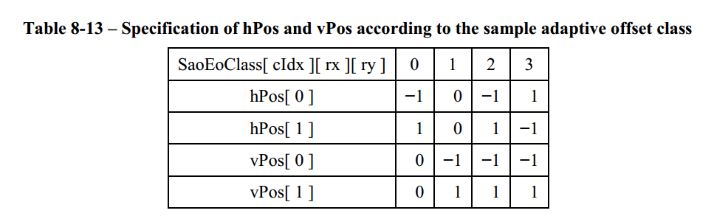
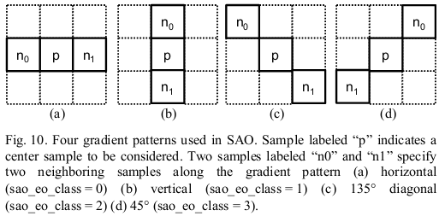
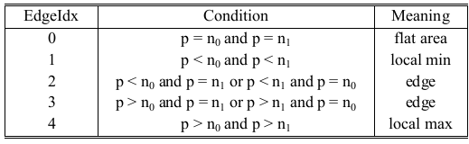

Slide 34
Thanks for your attention!

