Slide 1


Slide 2


Slide 3
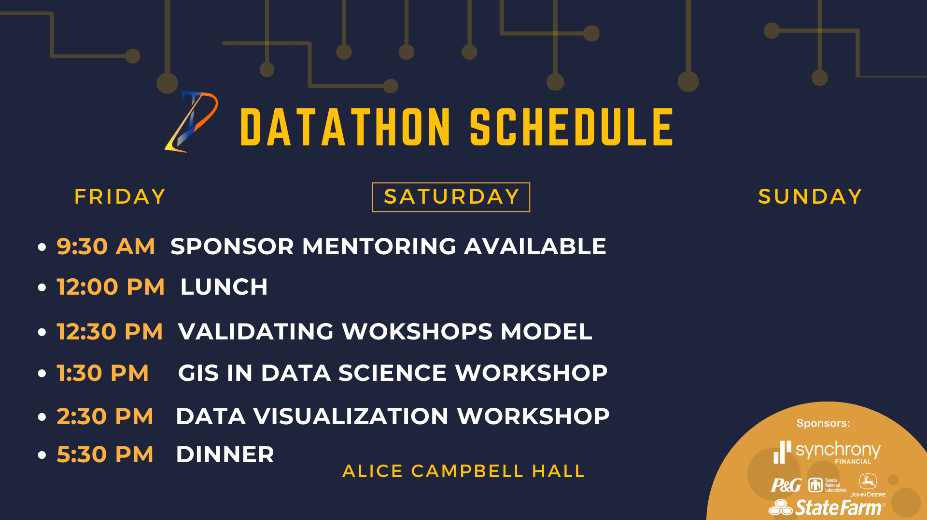

Slide 4


Slide 5


Slide 6

PROBLEM STATEMENT
You have just been promoted to a new role to bring data science to a new part of the organization. You have been assigned as the data science lead to the marketing organization and are coming at a really interesting time – the annual marketing and advertising planning process. The organization gets together during this time to figure out how to effectively spend its limited budget to support sales in the marketplace across all our products and services.
Traditionally, the marketing department has used segmentation analysis and other marketing analytics to help, but there are opportunities to add some GIS analysis into the mix to create some unique insights. Your goal is to figure out a prioritized list of zip codes to target to drive/support sales by figuring out what attributes matter most. You must identify the key attributes such as demographic, market, and sales segments (each of our businesses) to target so the marketing teams can prioritize their limited spend to make the biggest impact and can make the right ad buys. You are given sales data by zip code by each of the verticals we support (e.g. furniture, clothing). You can use any piece of external data to create the model.

Slide 7
Sandia National Labs Video

Slide 8
John Deere Video

Slide 9
Helpful Hints
You should provide the rationale and key attributes that influence sales, helping them prioritize where or who to target first and why.
Please keep a portion of this year’s data separate to validate your model because your data science colleagues don’t want to sacrifice quality output. They will want to hear what you did and how it preserved the integrity of your analysis.
The marketing team is a very visual team so create some appealing data visualizations to get buy-in from your marketing peers (it also helps to know more about marketing and advertising process).
Finally, a good pitch combines data, storytelling, and awareness of the business goals.

Slide 10
Deliverables
01
02
2-minute video pitch
Sell us your recommendations in an elevator – why should we care and what did you learn?
Presentation
You will need to give a 10 min presentation 5 min Q&A if we buy your elevator pitch. Create visualizations that move us.
03
Model
Give us your model output on a one pager, highlighting your methods and results on both training and validation datasets
04
Code
We want to be able to replicate your results to make sure it wasn’t a fluke

Slide 11
Helpful Links
Video “Pitch” Submission Criteria
A 2-minute (MAX) pitch video
Can be structured however you want to pitch your idea/findings/suggestions
Try to highlight the biggest points in your data collection and research
Try incorporating what you have learned during this process both technically and socially (team dynamics)
Only 1 person needs to be in the video
Create an unlisted YouTube video and then send us the video URL here:

Slide 12
CRITERIA
All deliverables will be taken into consideration during judging. The following criteria will be on a 5-point scale and will be weighted equally.
ACCURACY
Based on RMSE
Takes into account possibility of cheating
METHOD
Model fit and techniques
Creative, innovative approach
PRESENTATION
Engaging presentation
Clear, thoughtful explanations during Q&A
Supportive visualizations
Lessons learned
APPLICABILITY
Solution addresses given business problem
Proposed solution can be implemented in similar real life situations

Slide 13
Rules
All submissions must be in by 8:00a on Sunday. There will be no exceptions.
All submissions must have all 4 deliverables or they won’t be counted.
We are looking for clarity and ability to answer both business and data science questions not for flashiness of submissions. Work on what counts.
Teams can only leverage any publicly available data source for generating input features.
Teams can leverage any tools and/or libraries for this task but must provide the links for those tools in their code deliverable.
Teams are not allowed to ask anyone outside of mentors or their own team for help. Please do your own work because this is a learning opportunity first and foremost.
Be courteous to your peers as you work.
Have fun and get to know your fellow competitors and mentors.

Slide 14
Helpful Links
https://factfinder.census.gov/faces/tableservices/jsf/pages/productview.xhtml?src=bkmk
https://factfinder.census.gov/faces/nav/jsf/pages/index.xhtml
https://www.census.gov/econ/geo-zip.html
https://catalog.data.gov/dataset/zip-code-data
https://www.irs.gov/statistics/soi-tax-stats-individual-income-tax-statistics-zip-code-data-soi
https://www.census.gov/topics/public-sector/voting.html

Slide 15
R Resources
Useful R Libraries
Data loading – DBI, odbc, RMySQL, xlsx, haven
Data manipulation – dplyr, tidyr, stringr
Visualizations – ggplot2, rgl, htmlwidgets
Modeling – car, mgcv, lme4/nlme, randomForest, vc, glmnet, caret
Spatial data – sp, maptools, maps, ggmap, leaflet, R-ArcGIS bridge
https://support.rstudio.com/hc/en-us/articles/201057987-Quick-list-of-useful-R-packages
R Resources
https://www.r-project.org/
https://rstudio.com/
https://www.codecademy.com/learn/learn-r
https://www.coursera.org/learn/r-programming
https://www.datacamp.com/
https://www.lynda.com/R-training-tutorials/1570-0.html
https://www.reddit.com/r/Rlanguage/
https://stackoverflow.com/questions/tagged/r

Slide 16
Python Resources
Useful Python Libraries
https://pypi.org/project/googlemaps/
https://pypi.org/project/geopy/
https://pro.arcgis.com/en/pro-app/arcpy/get-started/what-is-arcpy-.htm
https://geopandas.org/
https://gdal.org/
https://numpy.org/
https://pandas.pydata.org/
https://matplotlib.org/
https://scikit-learn.org/stable/
https://www.reportlab.com/
Python Resources
https://www.learnpython.org/
https://www.codecademy.com/learn/learn-python-3
https://www.python.org/about/gettingstarted/
https://docs.python-guide.org/intro/learning/

