Slide 1
2020 Datathon
GIS Data Analysis in Marketing
Group Members:
Min Li , Yuxuan Zhang
Yutong Wang

Slide 2
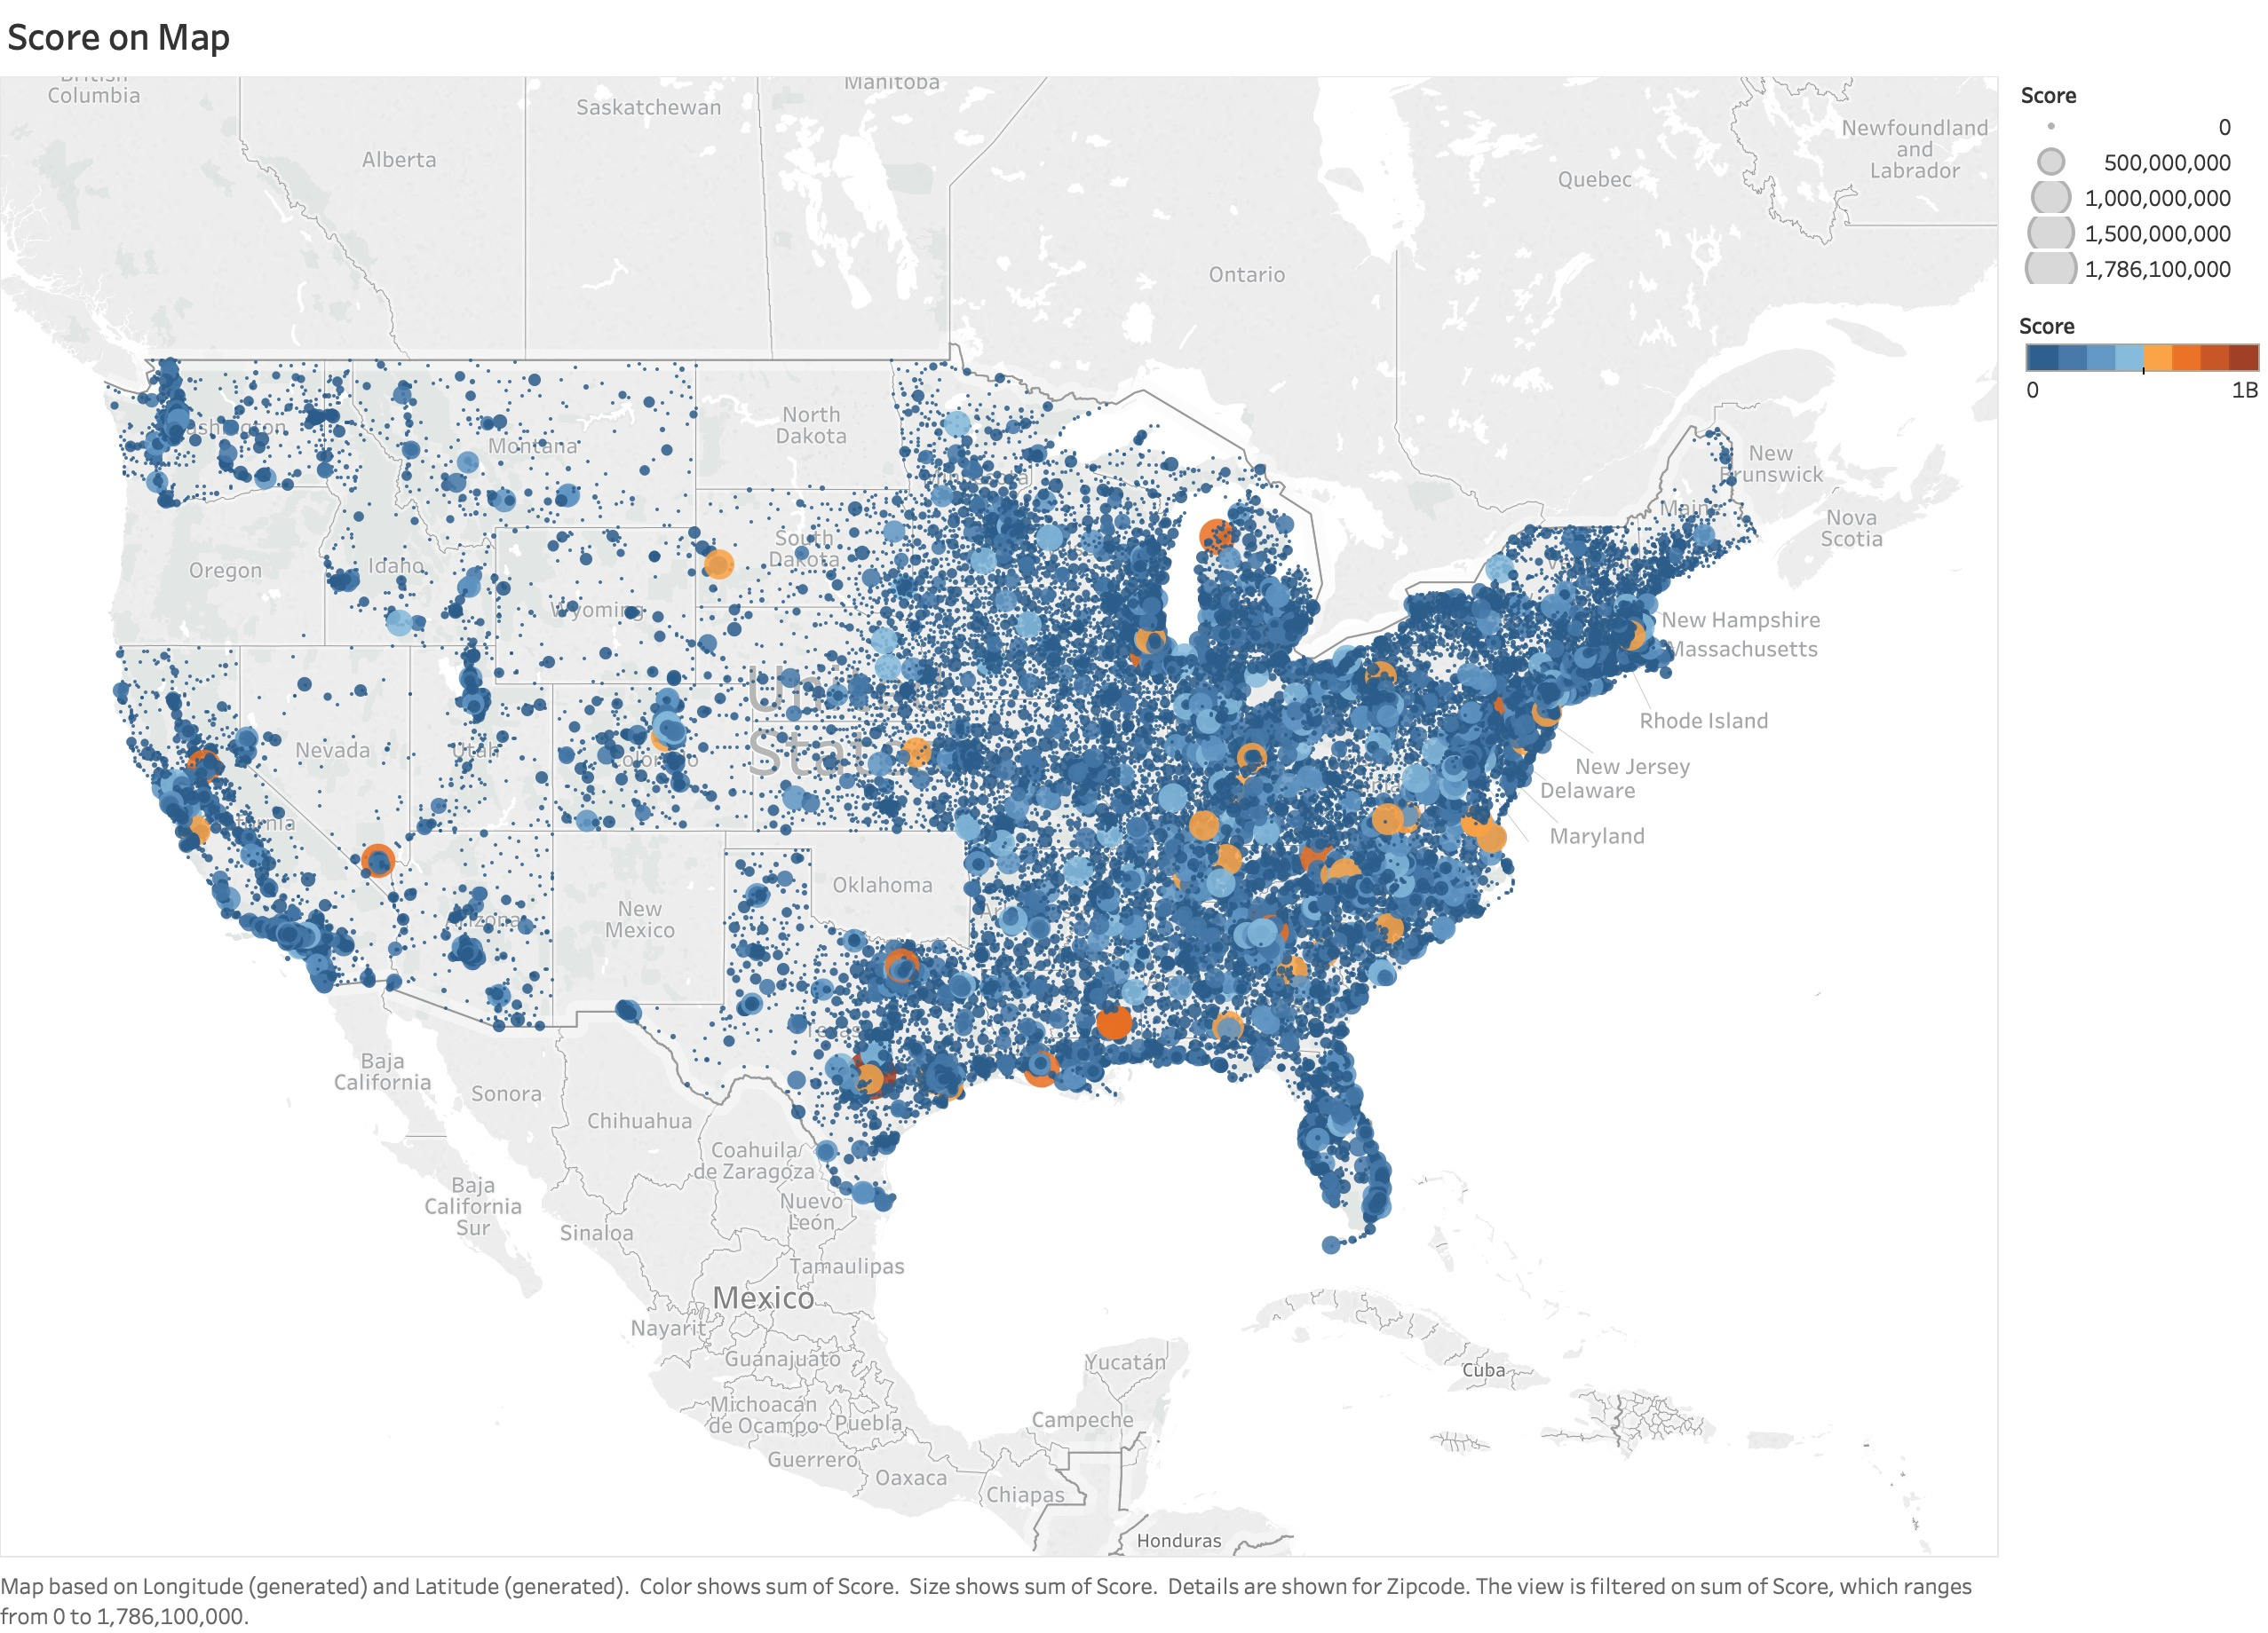

Slide 3
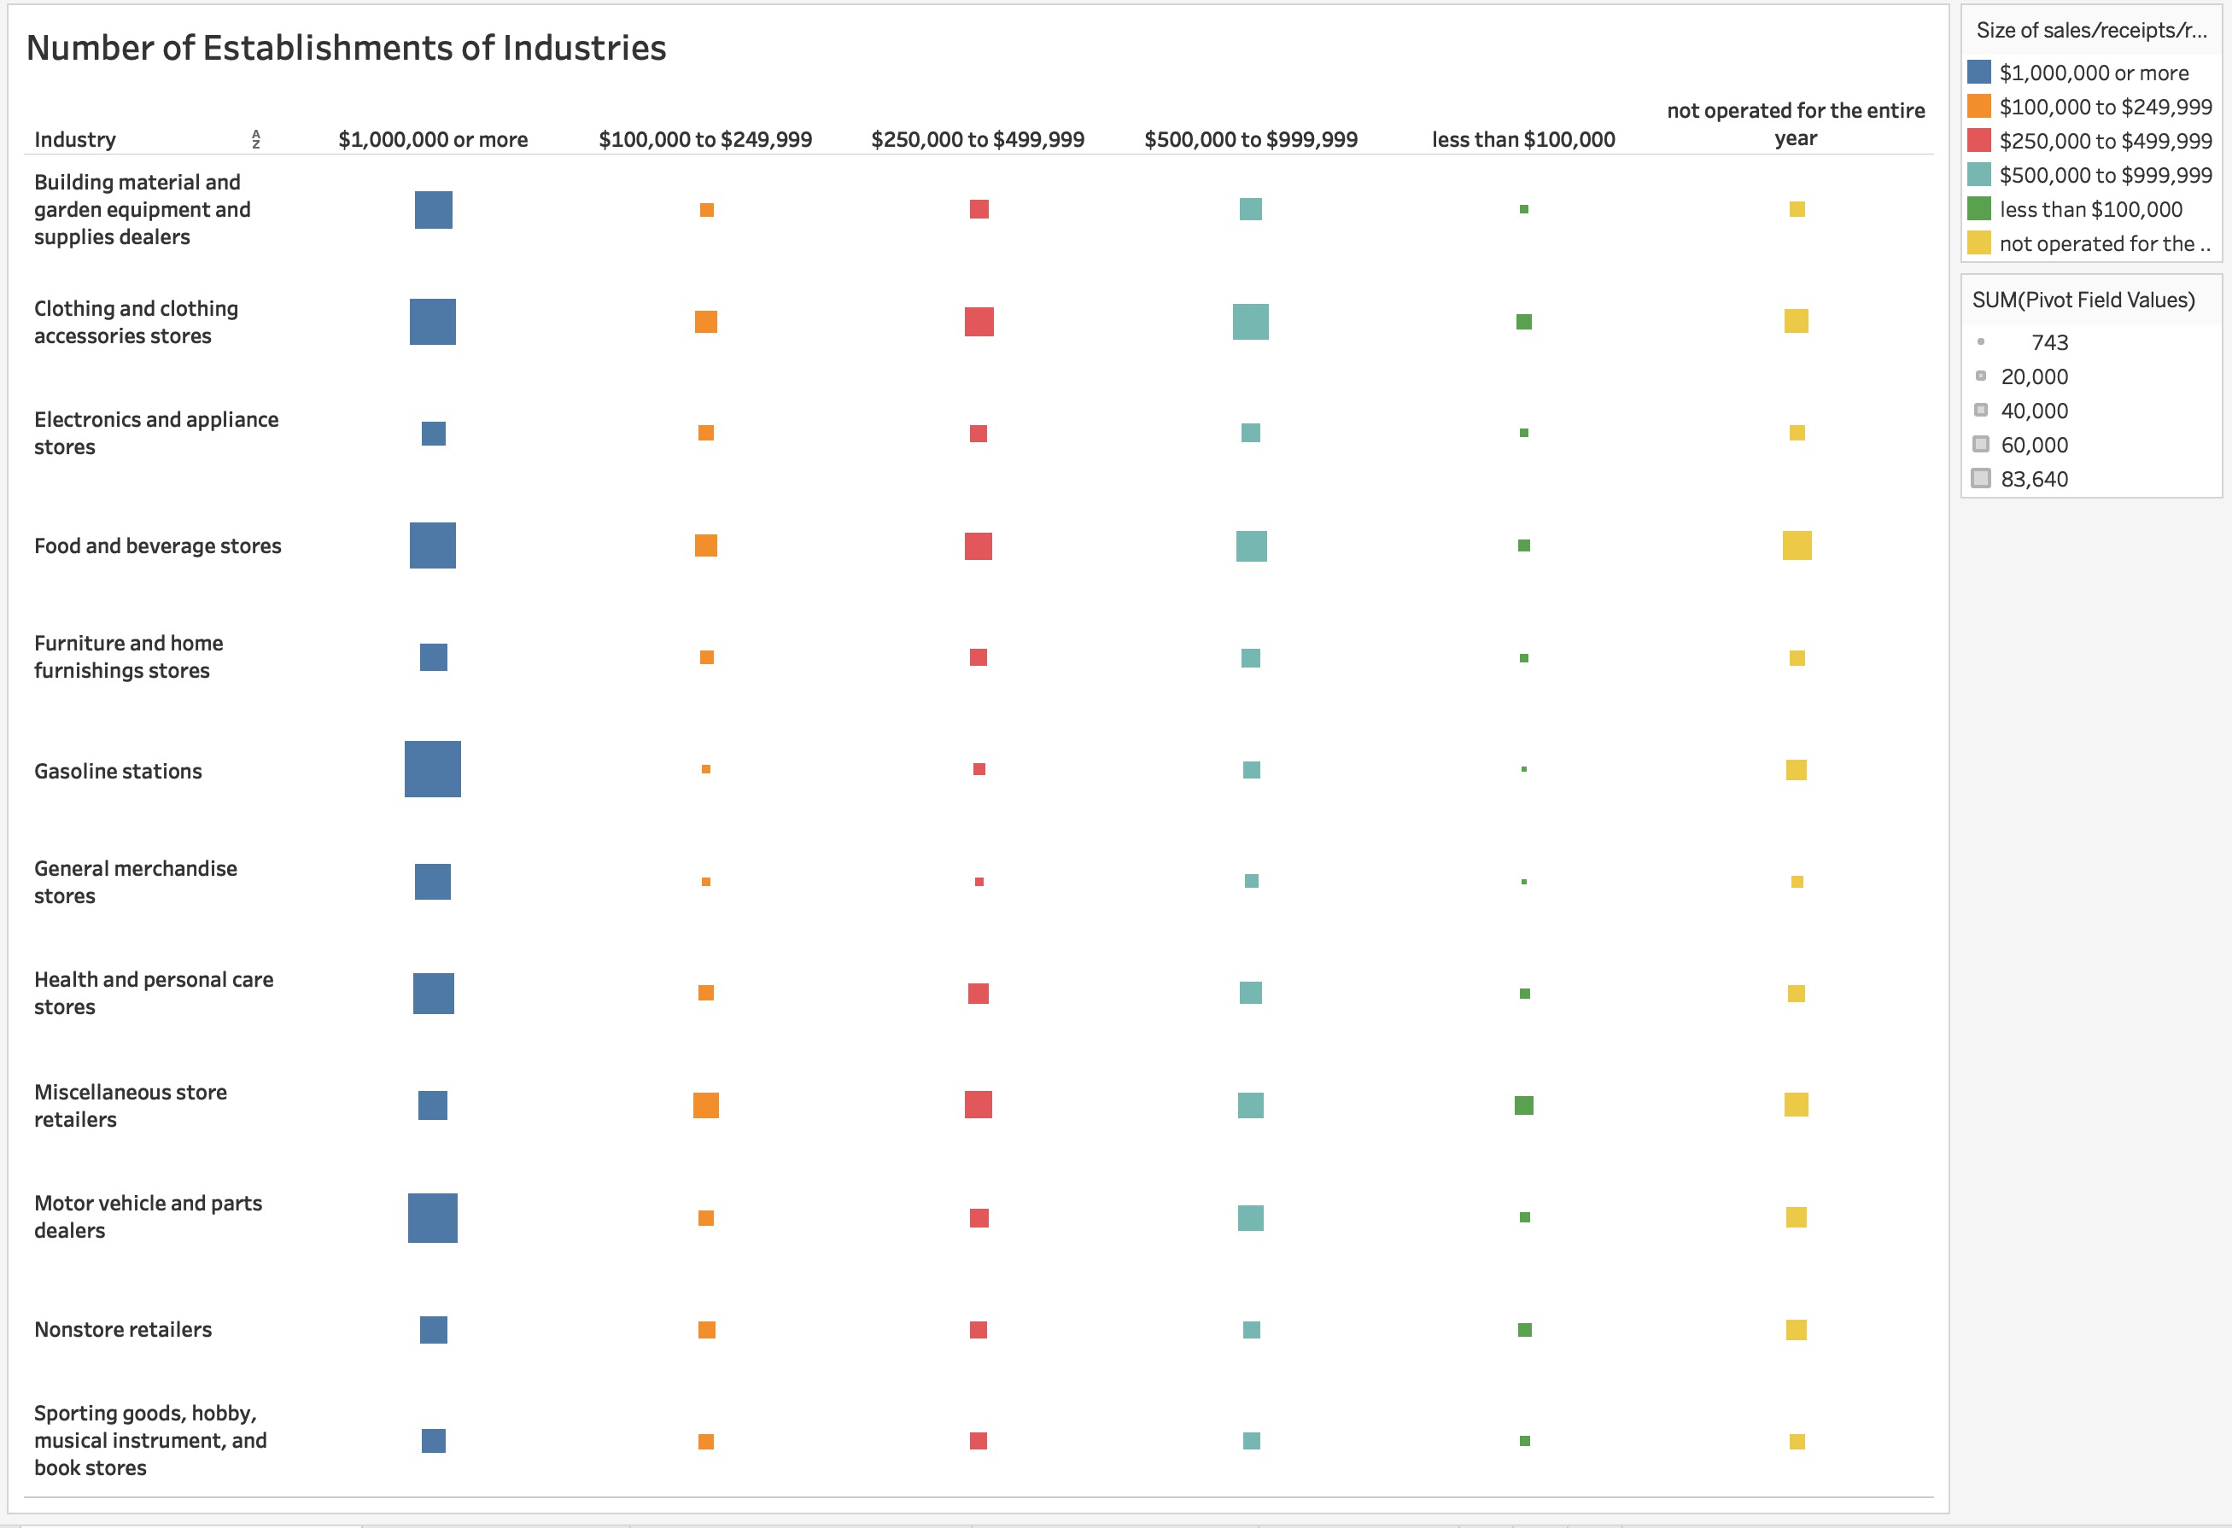

Slide 4
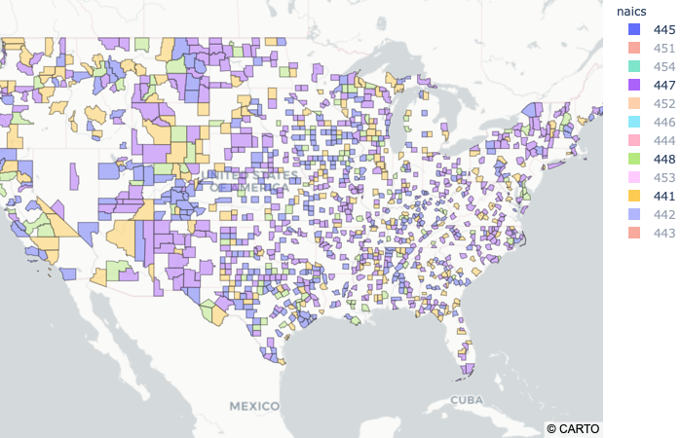
Four Dominant Industries Type in Each Area:
448: Clothing and Clothing Accessories Stores
447: Gasoline Stations
441: Motor Vehicle and Parts Dealers
445: Food and Beverage Stores

Slide 5
Data Collection
Unemployment rate
Population
Population Density
Average Income
Median age
Tax

Slide 6
Model: XGBoost
Mean Score Value | Training Error | Testing Error
14.6840 | 0.6589 | 0.7791

Slide 7
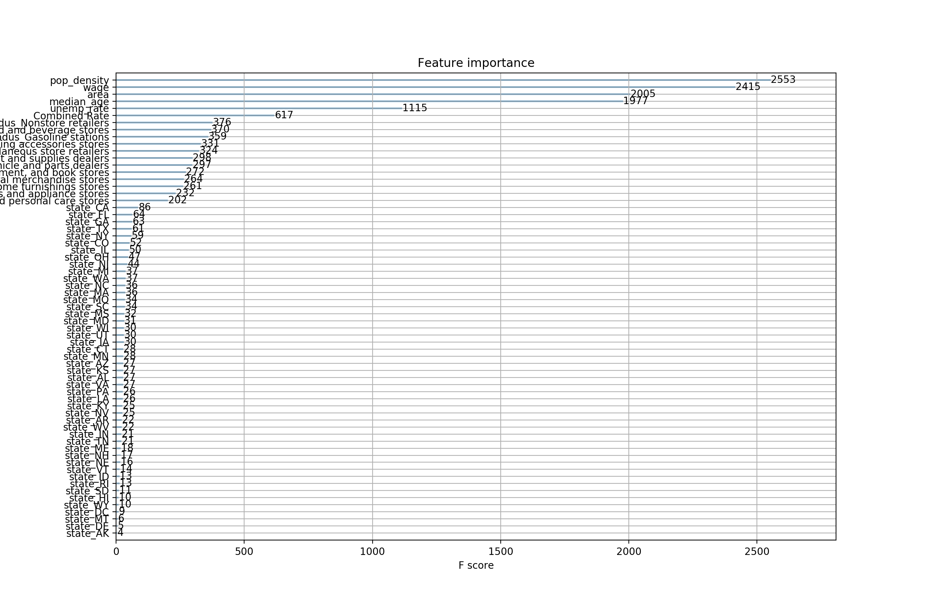
Importance Factors

Slide 8
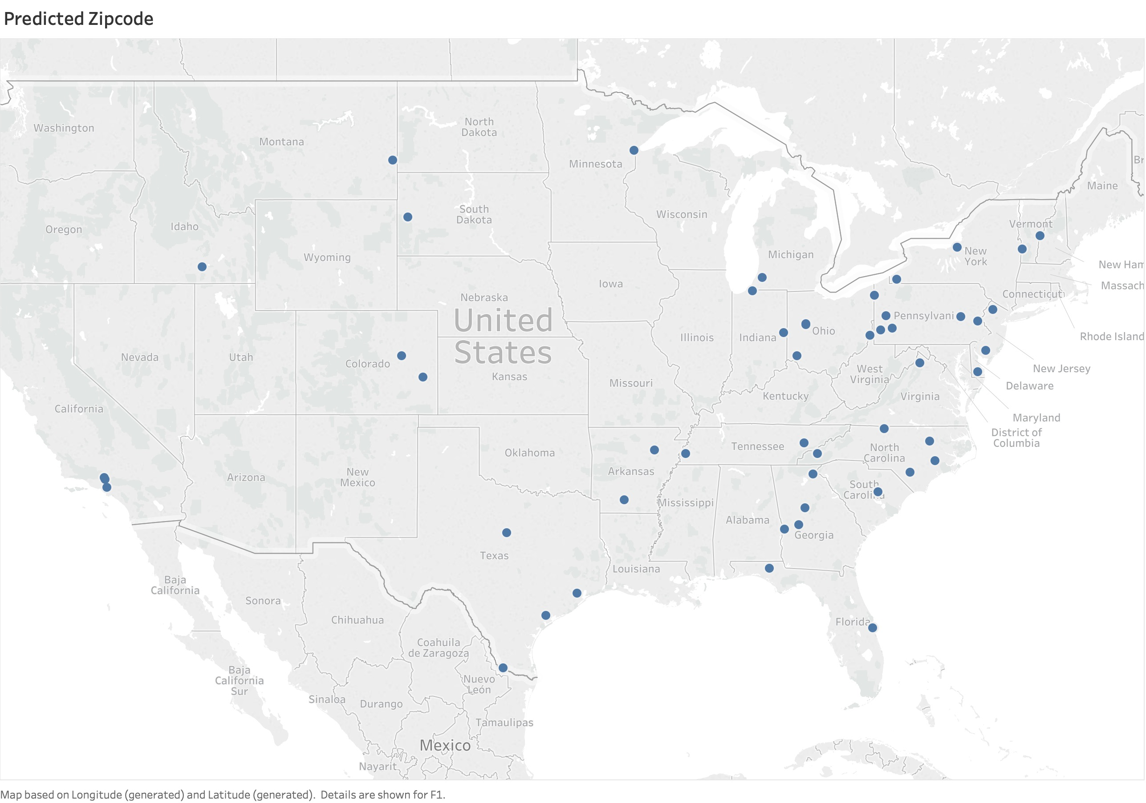
Predicted Zip Code

Slide 9
Appendix
Zip Code Tabulation Areas-ZCTA (https://data.world/nrippner/zip-code-tabulation-areas-zcta)
U.S. Population by zip code, 2012(https://data.world/lukewhyte/us-population-by-zip-code-2010-2016 )
Individual Income Tax Statistics - 2012 ZIP Code Data (SOI) (https://www.irs.gov/statistics/soi-tax-stats-individual-income-tax-statistics-2012-zip-code-data-soi)
ZIP Code and FIPS (https://www.kaggle.com/danofer/zipcodes-county-fips-crosswalk)
State Sales Tax 2012 (https://taxfoundation.org/state-and-local-sales-taxes-midyear-2012/)
Median Age 2014 (https://numeracy.co/public/2lZ9jKZoehr)
Local Area Unemployment Statistics 2012 (https://www.bls.gov/lau/#cntyaa)

Slide 10
Thank you !

