Slide 1

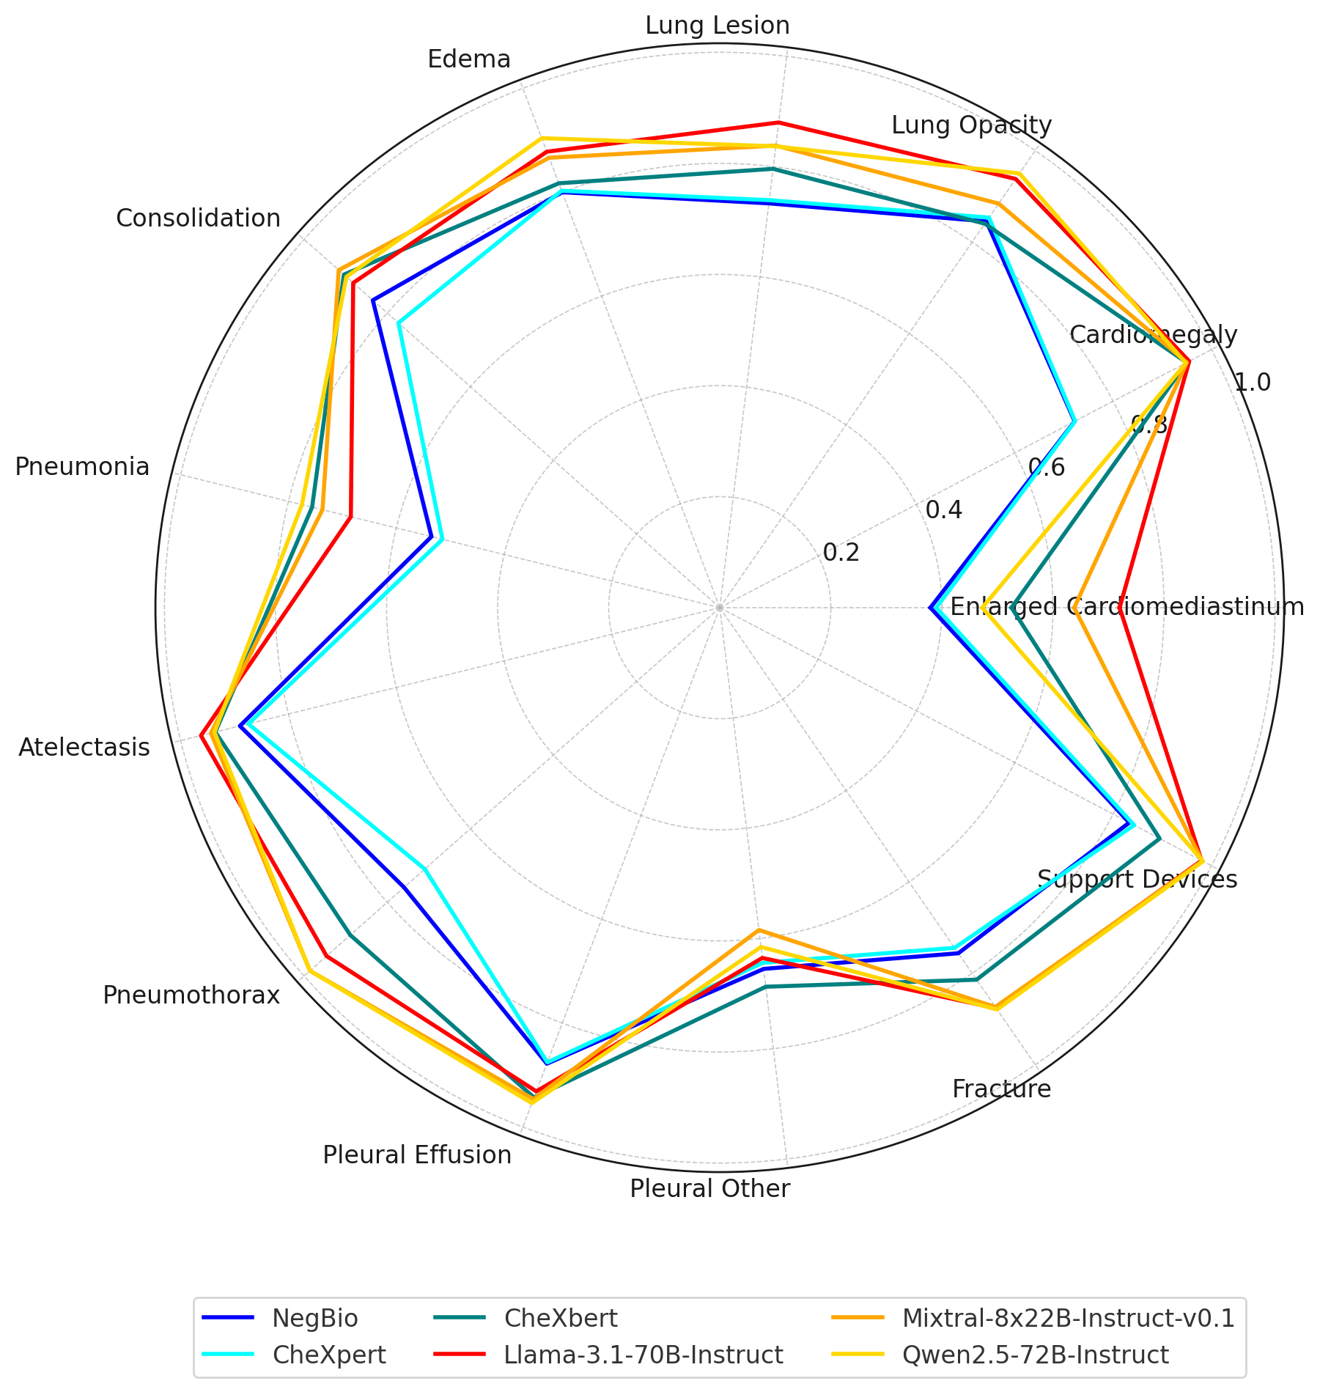


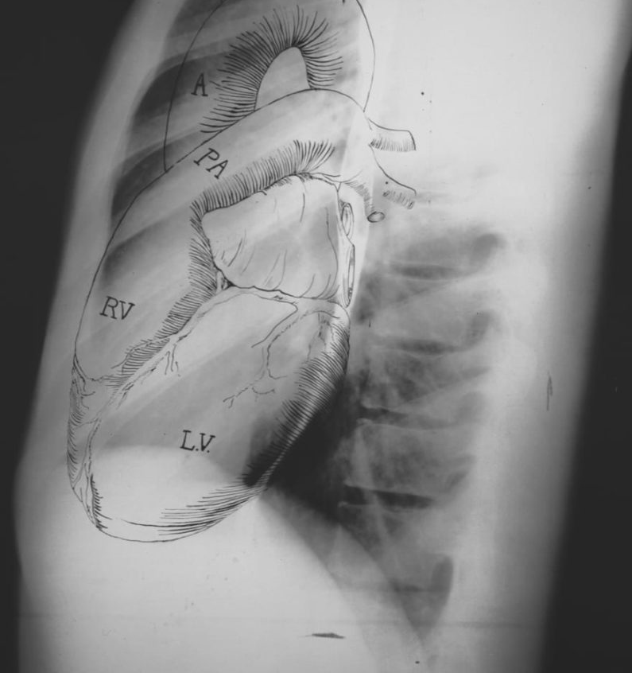
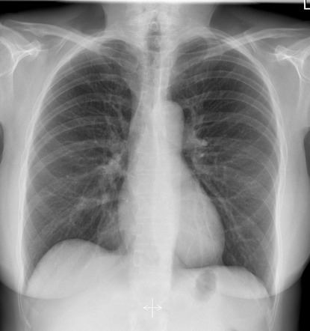

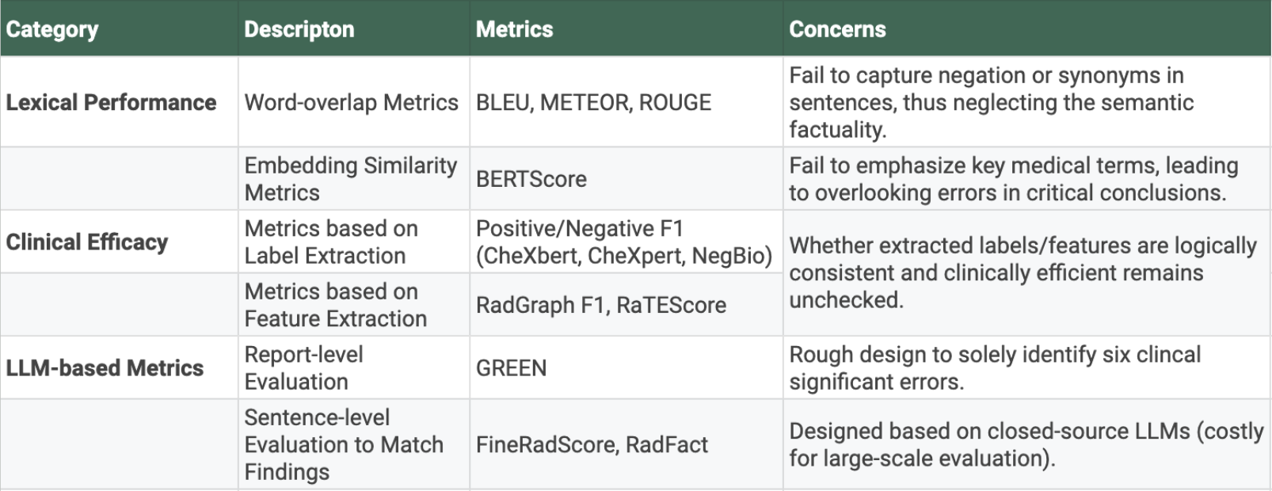
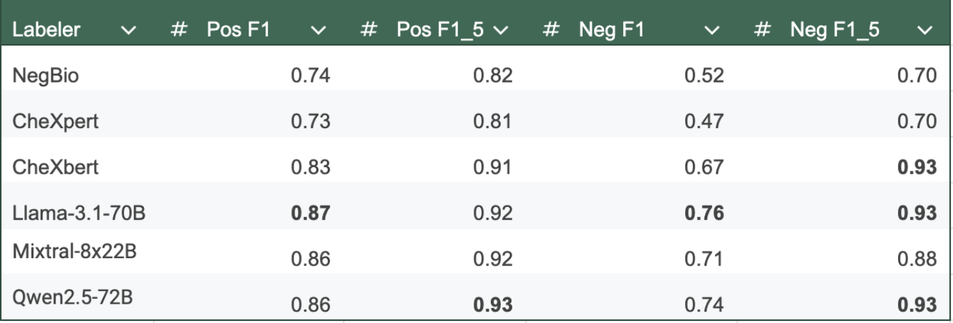
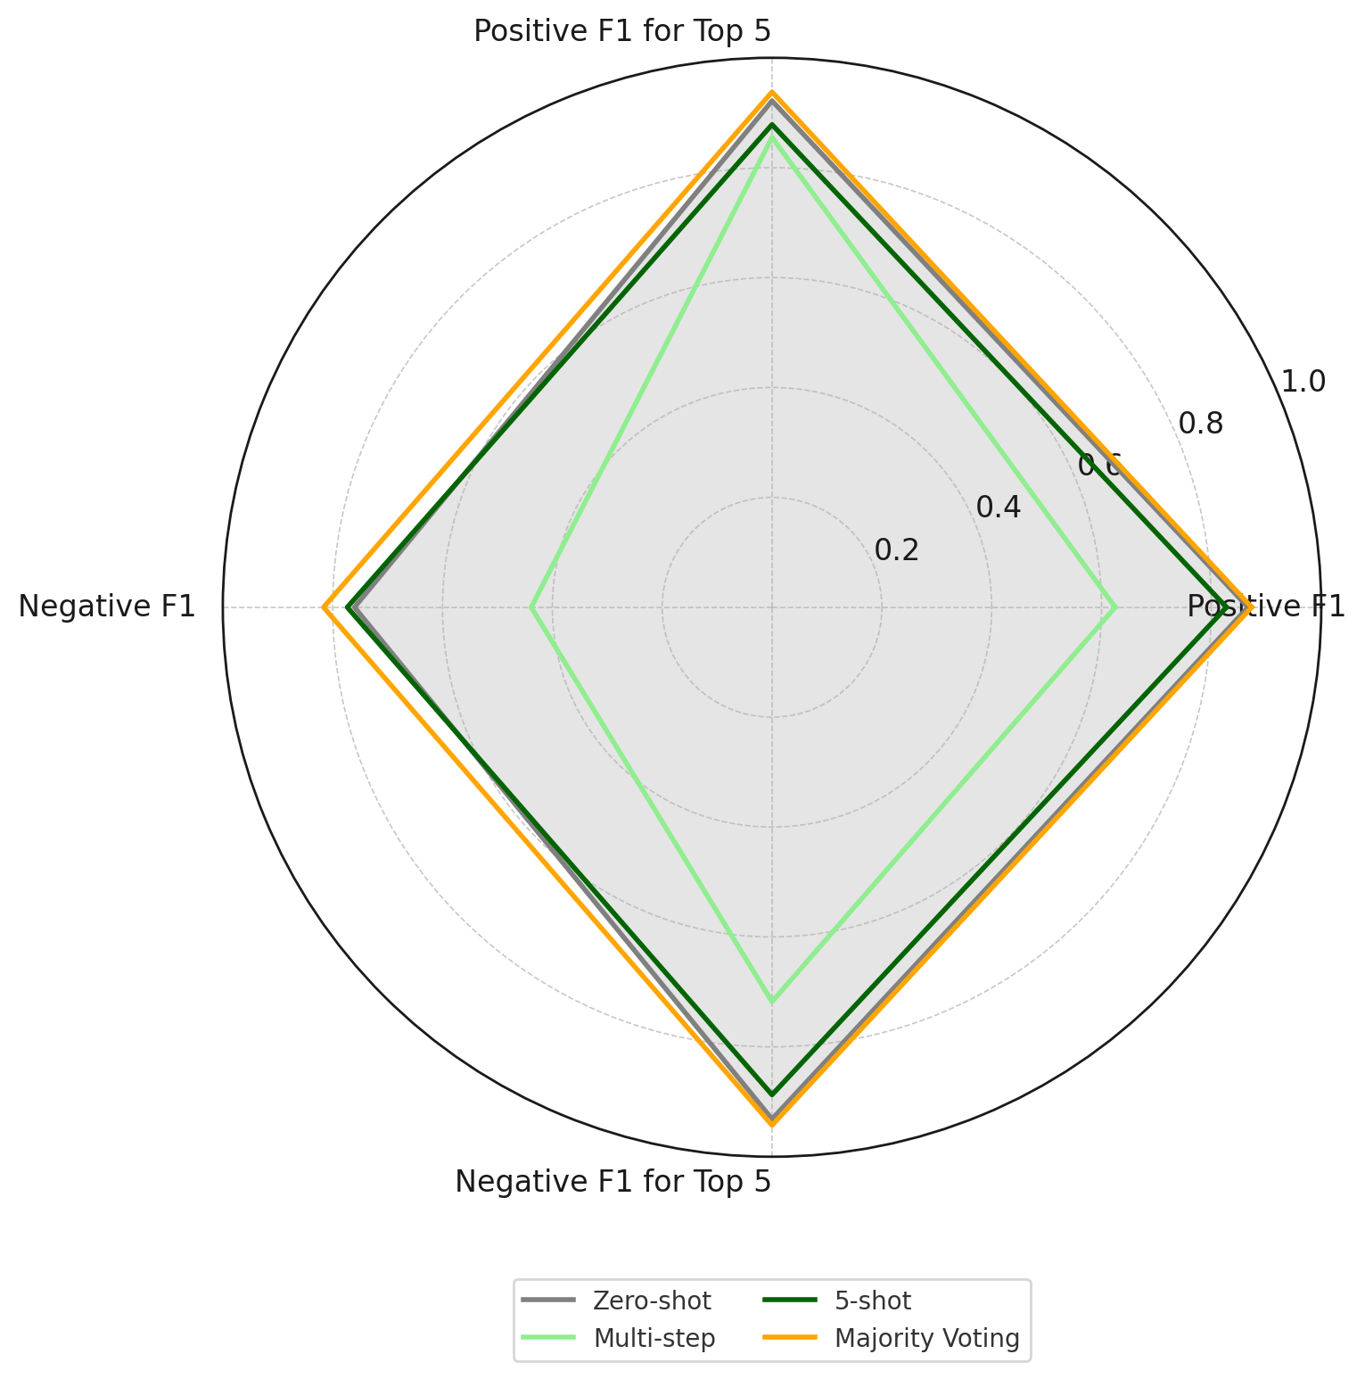
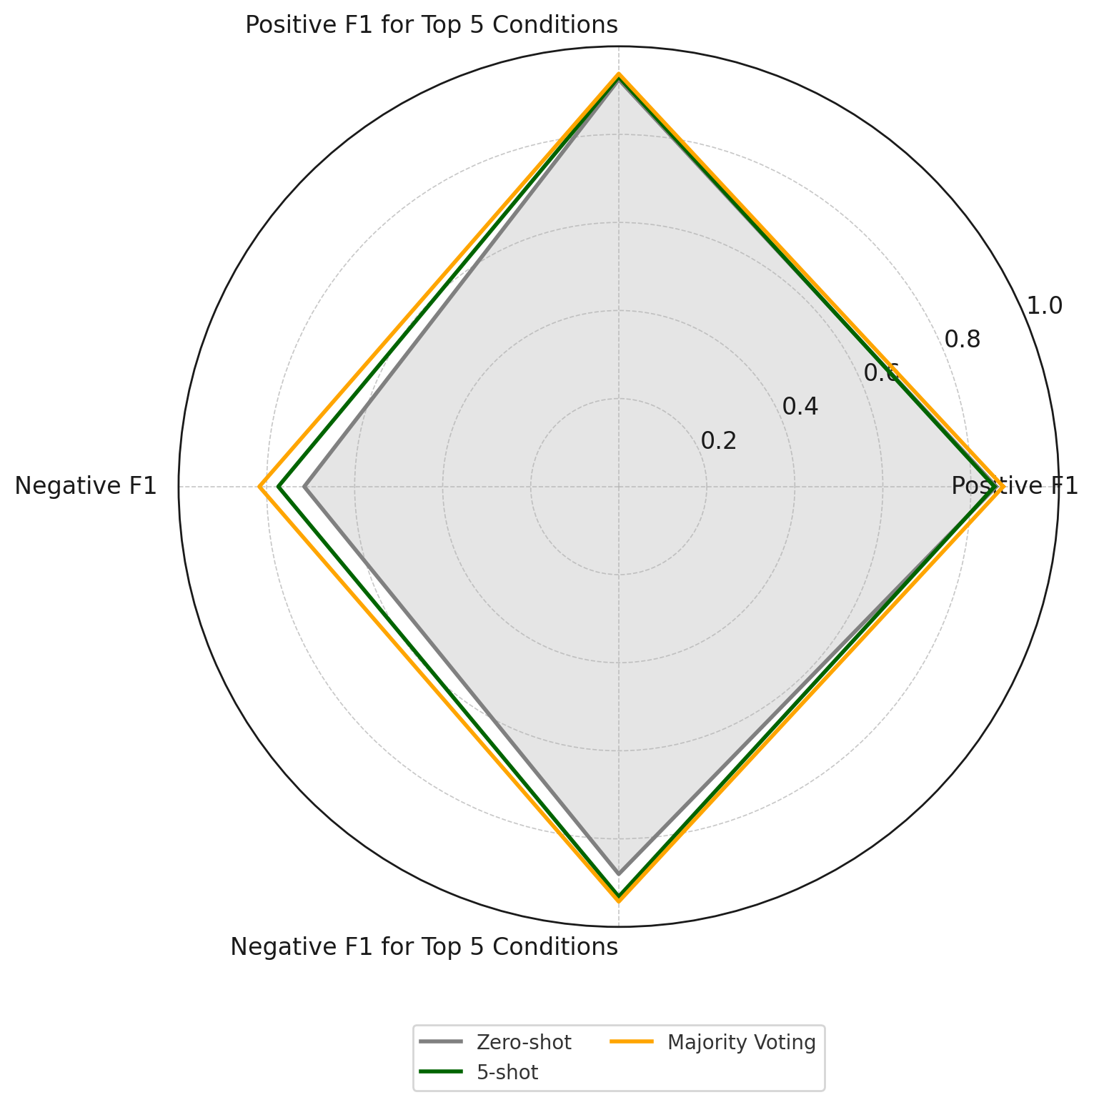
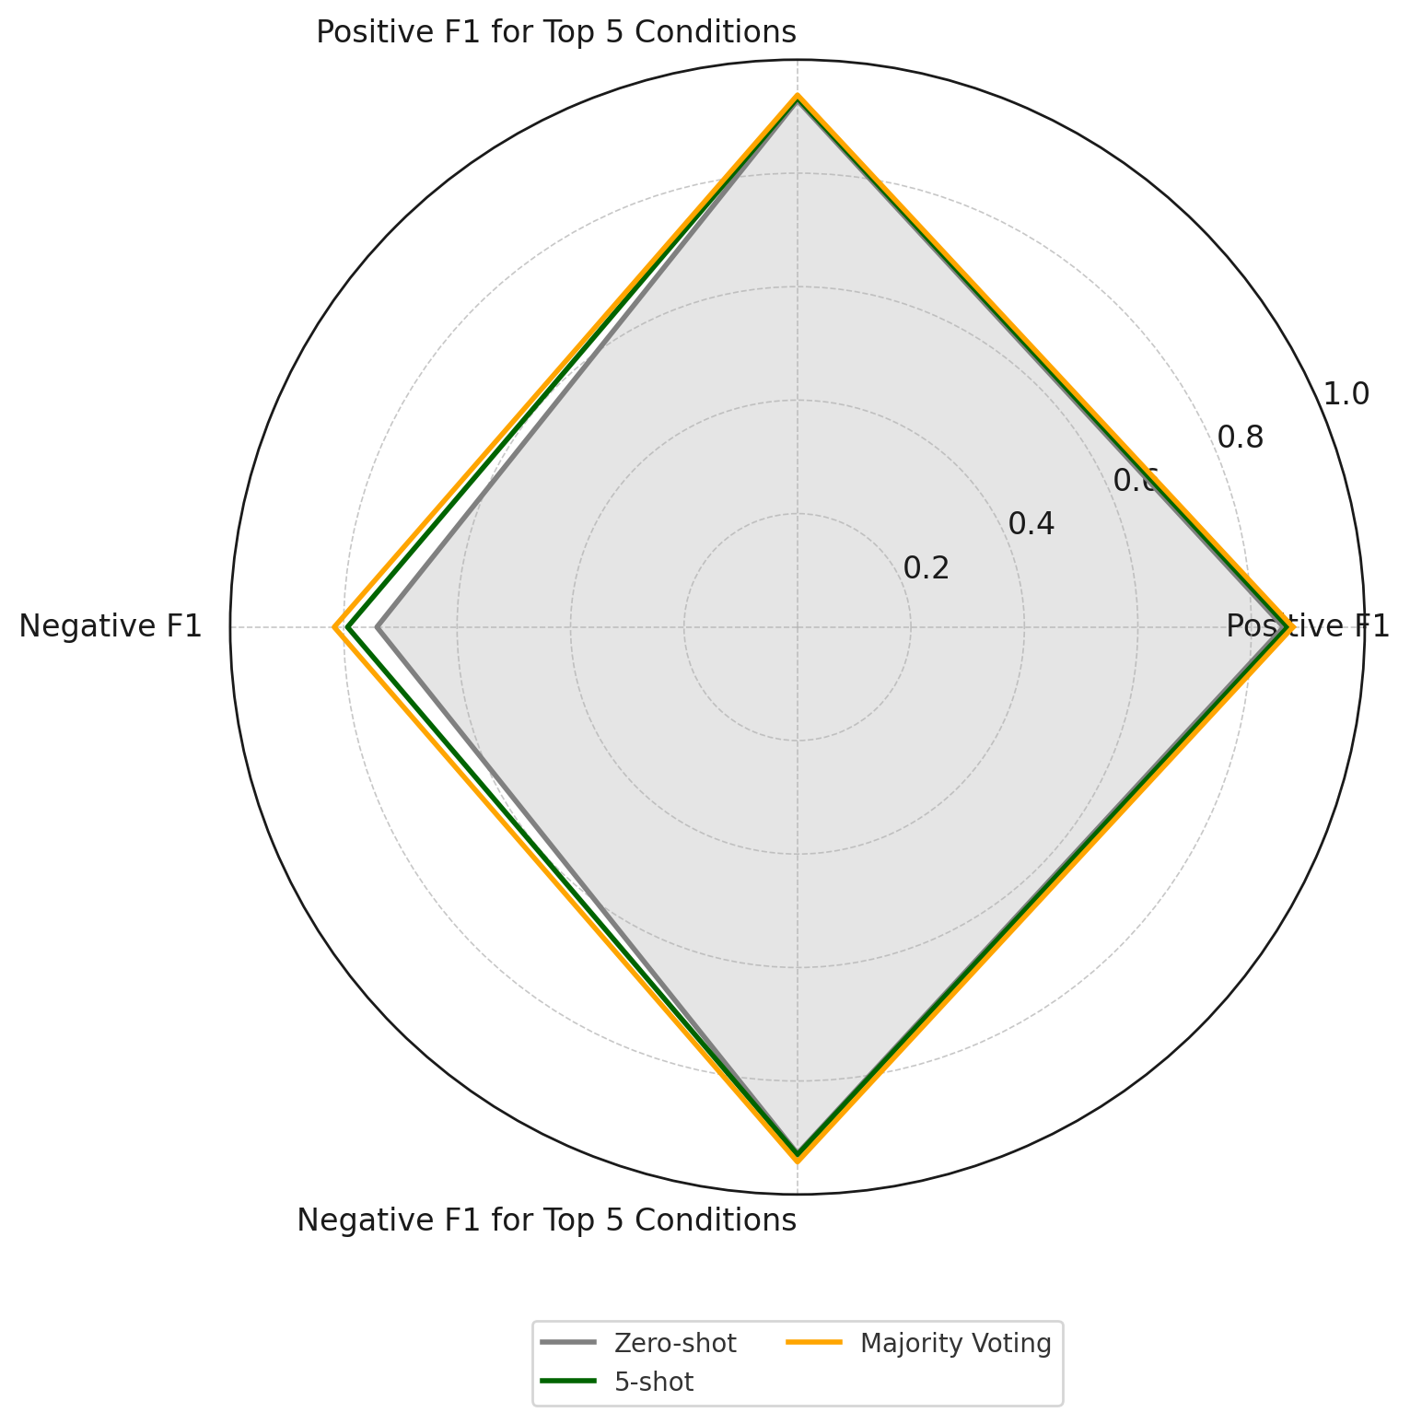

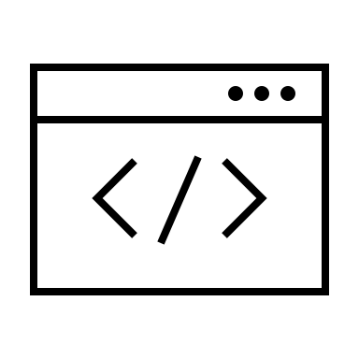




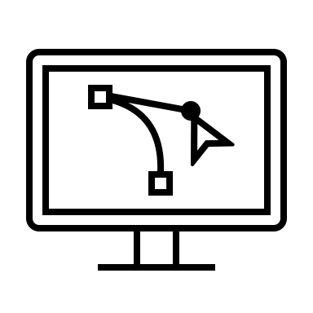


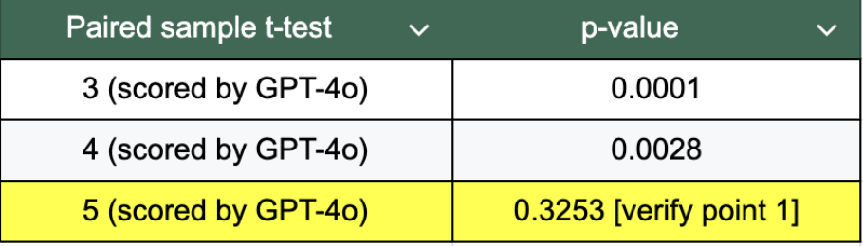
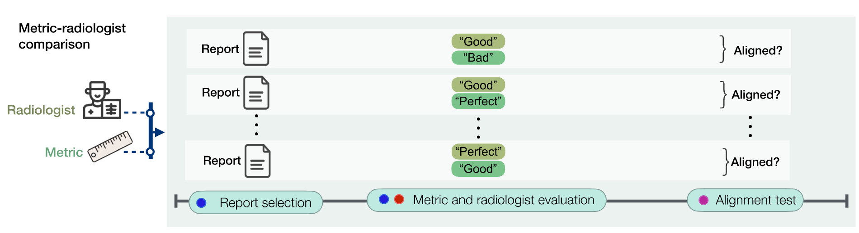
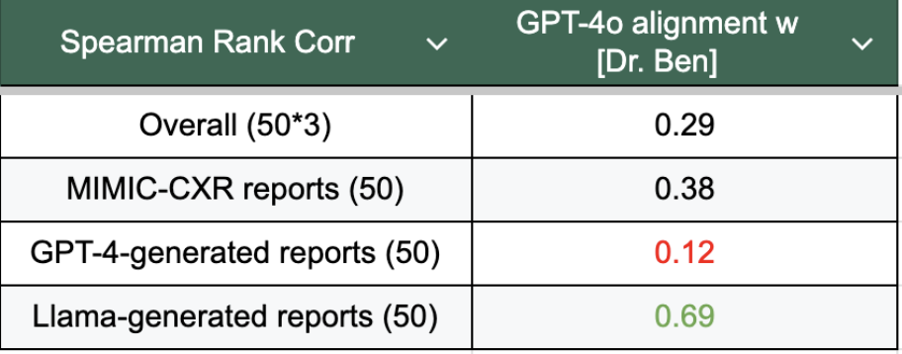
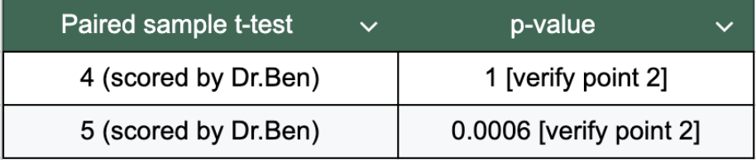
Yuyang Jiang
Department of Statistics, University of Chicago
Exploring the Potential of LLMs as Radiology Report Evaluator
Background: Radiology Report Evaluation
Task 1: How accurate can LLMs label radiology reports? (zero-shot)
Conclusions & Discussions
Upstream Task: Automated Radiology Report Generation
*️⃣ Research Question: Can current LLMs outperform existing labelers on pathology label extraction from chest radiograph reports?
*️⃣ Downstream Application: Establish accuracy metrics based on pathology labels to measure clinical efficacy of generated radiology reports.
*️⃣ Benchmark: Human Annotation from MIMIC-CXR (Curated, 557 samples) [2]
*️⃣ Baselines: (1) Rule-based Labeler (CheXpert [3], NegBio [4]); (2) Bert-based Labeler (CheXbert [5]).
🔊 Clinical Efficacy
🌟 Takeaways
Input
🤖
Output
🟢 LLMs explicitly outperform current SOTA labelers in labeling radiology reports.
🟢 Majority voting across different LLMs works well to improve model performance.
🟠 Few-shot prompting improves LLMs in identifying negative mentions but has limited effect on positive mentions.
🔴 Multi-step prompting fails terribly.
Prompt Instruction
Radiology Report📝
AI Radiologist 🤖
Core Task: How to Evaluate Generated Radiology Reports?🤔
🤔 Open Questions
*️⃣ Review for Current Radiology Report Evaluation Metrics
Few-shot prompting: How does different samples selected to construct few-shot examples affect LLMs’ performance?
Multi-step prompting: Does independent condition labeling that might lose in-context learning cause the failure?
🔊 Lexical Performance
🌟 Takeaways
Task 1 (Cont’d): How far can we push LLMs' performance forward
before turning to compute-intensive fine-tuning?
🟢 It’s reliable to use GPT-4o to filter llama-generated reports in lexical quality.
🟠 Looking into human-written reports:
High-score (5) reports filtered by GPT-4o are well aligned with radiologist preference;
GPT-4o tends to annotate high-quality (5) reports confirmed by radiologists as lower scores (3-4).
🔴 GPT-4o cannot filter its own generated reports.
*️⃣ Can we develop a unified, accurate and scalable radiology report evaluator based on LLMs?
🤔 Open Questions
Future To-Do: Does the result generalize across other LLMs or different settings (e.g. prompt engineering)?
Methodology
References
🔽 Design an Evaluator Pipeline
[1] Yu, Feiyang, et al. "Evaluating progress in automatic chest x-ray radiology report generation." Patterns 4.9 (2023).
[2] Johnson, Alistair EW, et al. "MIMIC-CXR, a de-identified publicly available database of chest radiographs with free-text reports." Scientific data 6.1 (2019): 317.
[3] Irvin, Jeremy, et al. "Chexpert: A large chest radiograph dataset with uncertainty labels and expert comparison." Proceedings of the AAAI conference on artificial intelligence. Vol. 33. No. 01. 2019.
[4] Peng, Yifan, et al. "NegBio: a high-performance tool for negation and uncertainty detection in radiology reports." AMIA Summits on Translational Science Proceedings 2018 (2018): 188.
[5] Smit, Akshay, et al. "CheXbert: combining automatic labelers and expert annotations for accurate radiology report labeling using BERT." arXiv preprint arXiv:2004.09167 (2020).
Task 1: Label Extraction
LLM Evaluator
Metric 1: Clinical Efficacy
Method 1:
Prompt Engineering
Llama-3.1-70B-Instruct
Mixtral-8x22B-Instruct-v0.1
Qwen2.5-72B-Instruct
Input
Output
Task 2: Can current LLMs rate Clarity/Readability on a likert scale (1-5) aligned with radiologist annotations? (zero-shot)
…
Method 2:
Fine-tuning
…
Radiology Reports
(Unstructured Data)
Method 3:
Agentic Collaboration
JSON Output
(Structured Data)
*️⃣ Downstream Application: Measure lexical performance of generated radiology reports.
*️⃣ Benchmark: Collected Annotations from Radiologists (150 samples)
Task n: Likert Rating
Metric m: Lexical Metrics
🔽 Evaluate an Evaluator [1]
Acknowledgements
⚠️ H0: GPT-4o score - Human score = 0
(the lower p-value the more significantly to reject H0)
We thank Prof. Samuel Armato and his lab members from Department of Radiology at UChicago for their support for data curation. We also thank Dr. Benjamin M. Mervak from Michigan Medicine for his support for human annotations. We also thank Prof. Chenhao Tan and Chacha Chen from Chicago Human+AI Lab for their thoughtful feedback for experiment design.

