Slide 1

React: A JS Library for Building User Interfaces
By Srinivas Lade and Peter Wu

Slide 2
Making User Interfaces
TEDIOUS
Complex and Intricate
Page Manipulation
Notes:
So why do we need a library for creating user interfaces? Whats wrong with the regular stuff like HTML, CSS, and Javascript?
Well basically because for a lot of people,
<Press>
It really does suck. And when I mean a lot of people, I mean both for hobbyistdevelopers or big companies. Managing a large frontend website was a huge struggle for two reason: <list reasons>
Now lets go into these points in detail.

Slide 3
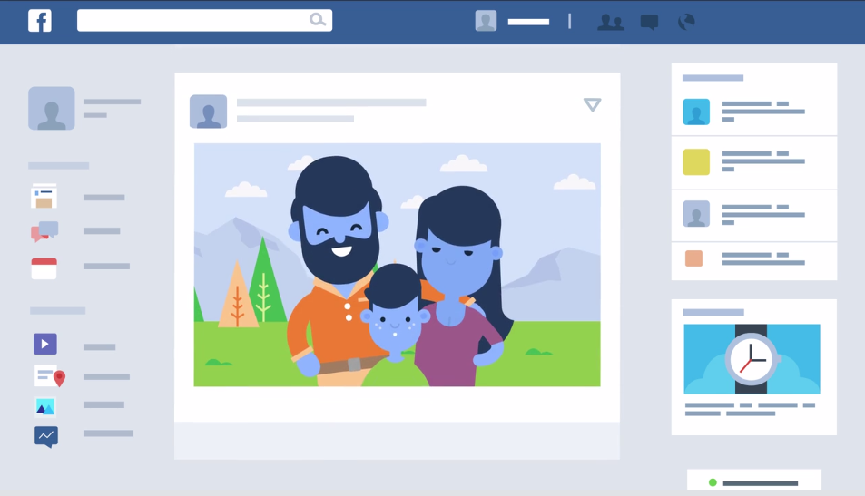
1) Complex and Intricate
Notes:
So why are user interfaces complex and intricate? Lets looks at an example. Take your facebook feed.
Now already we see that there are multiple parts that we can separate. First there is the header navigation bar.
There is the actual posts itself. Then there is the list of friends. There are ads, the groups you are part of, ad so much more.
Furthermore, you need to share information across the page, like how your name shows up in multiple pages.
Sometimes, one part of the page can trigger another part, like clicking on your friend brings up the chat history or clicking on a post redirects you to a new page with the same header.
There are a lot of parts and they interact with each other and can be reused.
Stuff to talk about:
Stuff is made up of smaller stuff
Reusable parts
Triggers between parts
Sharing data

Slide 4
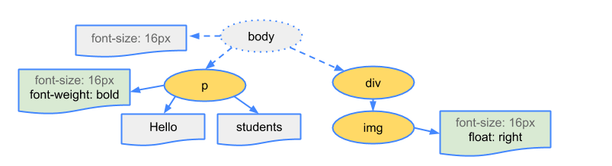
2) Page Manipulation

Slide 5
What is React?

Slide 6






Slide 7
What makes React special?
Virtual DOM
ES2016/7
Props
JSX
Components

Slide 8
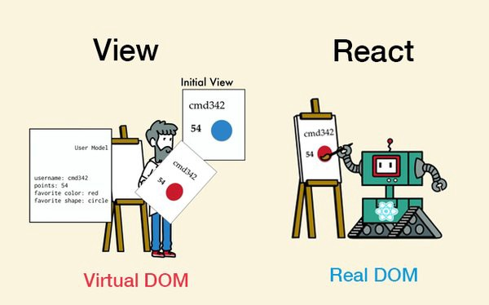
Virtual DOM

Slide 9
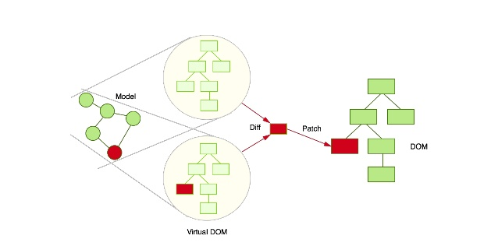

Slide 10
JSX
JavaScript XML (JavaScript and HTML)

Slide 11

JS...
Srinivas Lade
React.createElement(
'div',
null,
React.createElement('img', { src: url, className: 'avatar' }),
React.createElement(
'span',
{ className: 'full-name' },
fname + lname
)
);

Slide 12
JSX
Srinivas Lade
<div>
<img src={url} className='avatar' />
<span className='full-name'>{fname + lname}</span>
</div>
Insert JS code directly in HTML using {}

Slide 13
Components

Slide 14
Basic Components
const element = <h1>Hello World<h1/>;
function Panel(){ return (
<div className='panel’>
<img src=‘../assets/pauschtest1.jpg’ />
</div>
); }

Slide 15
Styles/CSS
const styles = {
backgroundColor: “red”,
}
function Panel(){ return (
<div style={styles} className='panel’>
<img src=‘../assets/pauschtest1.jpg’ />
</div>
); }

Slide 16
Action Handlers
const styles = {
backgroundColor: “red”,
}
function Panel(){ return (
<div onClick={function() {
console.log(“Clicked”);
}}>
<img src=‘../assets/pauschtest1.jpg’ />
</div>
); }

Slide 17
Props and Nesting Components
function Panel(props) { return <div className=“panel”
style={{
backgroundColor: props.color
}}>...</div>; }
function Panels() {
//React knows <Panel /> is a component because it’s a function that returns HTML.
return <Panel color=“red” />;
}

Slide 18
Looping
function Panels() {
let list = [];
for (let i = 0; i < 9; i++)
list.push(<Panel color=“red” />);
return <div id=“panels”>{list}</div>;
}

Slide 19
Class Components and State

Slide 20
Class Components
class App extends React.Component {
// Because this is the class, the HTML must be returned inside of a function. React decided to use the render function
render() { return <Header title={“Title”} />;
} }

Slide 21
Class Methods
class App extends React.Component {
newTheme = () => {
console.log(“This is a new theme”);
}
// Because this is the class, the HTML must be returned inside of a function. React decided to use the render function
render() { return <Header newTheme={this.newTheme}
title={“Title”} />;
} }

Slide 22
Class Constructor
class App extends React.Component {
constructor(props) {
super(props);
console.log(“This will run first”);
}
// More functions ...
// Render function
}

Slide 23
What are states?
class App extends React.Component {
constructor(props) {
super(props);
this.state = {title: “Title”};
}
render() { return <Header title={this.state.title} />;
}
}

Slide 24
setState
this.setState(
(prevState, props) => ({ title: “New Title”, })
);

Slide 25
Whole Class
export default class App extends React.Component {
constructor(props) {
super(props);
this.state = {
...
};
}
//Methods...
render() {
return (
<div style={appStyle}>
<Header ... />
<div id='content'></div>
</div>
);
}
}

Slide 26
Putting It All Together

