Slide 1
Acknowledgement
Kathy

Slide 2
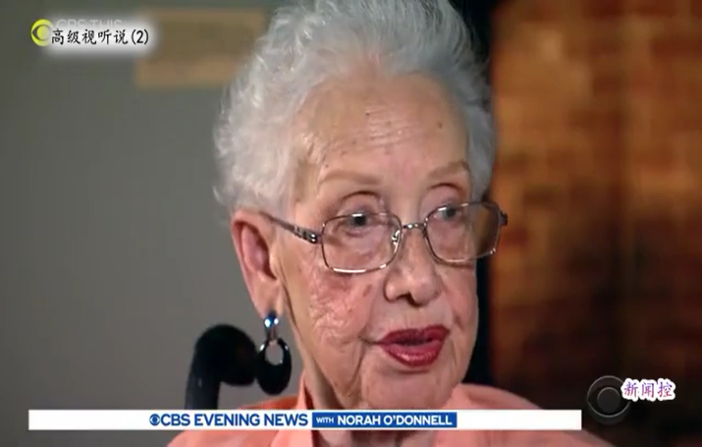
Listening-14
You are given 8 minutes to listen to the 1:51-min video and answer：
Questions:
  What is the main idea of the video clip?
  What is the name of her? How old was she on death?
  What did she do? (Briefly describe her contribution)
  What percentage could the African American women have college degree at that time?
  What about her education?
  What did Obama award her? When?
  What did her father influence her?
  Why do you think Kathy show you this lady?
legacy, indispensable, invisible,
recount, verify, segregated
Hard to catch: Jim Crow
Notes:
15th
19th early

Slide 3
可以第一人称或第三人称-Example I
I would like to express my gratitude to all those who helped me during the writing of this thesis. A special acknowledgement should be shown to Professor X, from whose lectures I benefited greatly. I am particularly indebted to Mr. X, who gave me kind encouragement and useful instructions all through my writing. Finally I wish to extend my thanks to the library assistants who supplied me with reference materials of great value.

Slide 4
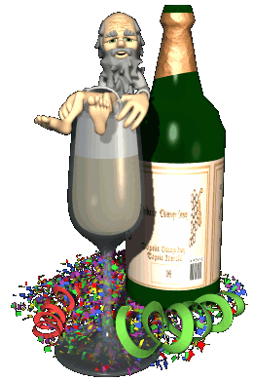
Example- II
The author is indebted to Mr. X for his constructive suggestions, to Mr. X who helped work out an outline of this paper, and kindly eliminated many of the errors in it. The author is also indebted to Miss X for permission to quote material from the past examination paper in the course of Advanced English.

Slide 5

Expressions
I would like to acknowledge my indebtedness to…
I should like to acknowledge with deep gratitude the assistance and guidance given to me by…
I gratefully acknowledge the help of…
I want to acknowledge the invaluable help of Mr. X, who has been my constant consultant in my writing this essay. If there are any errors, they are not his, but all mine.

Slide 6
I would like to thank Mr. X for his suggestions on my writing the first earlier draft.
I would extend my sincere thanks to my tutor…
I would like to take this opportunity to thank…
I especially appreciate the guidance of …
I wish to express my special appreciation of Mr. X’s help…

Slide 7
I have a real debt of gratitude to …
Likewise I am grateful to…
Most particularly, I must thank…
I am in debt to…
My gratitude also goes to…
My heartfelt thanks are also due to…
My work also owes much to… for his encouragement and great help.
The author is deeply indebted to…
The author’s special thanks should be given to…
This thesis would not have been possible without the support and assistance that I received from…

Slide 8
Translation
我要感谢X教授和Y教授，感谢他们的宝贵意见。还要感谢Z教授对我手稿的评价。同时我万分/不得不感谢我的朋友K他在我研究中对我的不懈帮助和支持。

Slide 9
English version
I wish to thank Professor Sheldon Grebstein and John Hagopian for their valuable suggestions. I also thank Professor Sylvis Bowman for her comments on the manuscript. In addition, I owe an obligation/be obliged to /grateful/appreciate to my friend Francis Hanks for his constant assistance in the course of the research.

Slide 10

Biodata作者简历

Slide 11
biodata作者简介
中国人在对外界事物评论时用含糊的零指称，或“我们”，但是在介绍自己的事时却喜用第一人称单数。而英美人恰好相反，在评论外界事物时喜用卷入性的第一人称单数，但对自己的事情介绍时却用客观的第三人称。

Slide 12


Christopher N Candling is Senior Research Professor in the Department of Linguistics, Division of Linguistics & Psychology, at Macquraied University, Sydney, and is a member of the Research Centre for Language in Social Life, which he established in 1994 and directed form 1994 to 1998. in addition, he was the Foundation Executive Director of the Australian Government’s National Centre for English Language Teaching & Research which he directed from 1987 to 1998.

Slide 13
Your Topic Goes Here
I was born in Jan. 12, 1960, I received my college education in Dalian Foreign Languages Institute, majoring in English Language and Literature and graduated in 1982. after graduation, I was assigned to work as a teacher in Dalian University. In 1986 I was sent to study the course in the Advanced English Training Program in Shanghai Foreign Language University.

Slide 14
作者简介几个方面内容
自大学起获得的学位名称，事件，专业，学校及其地点。（也有个别人在开头一句话写上自己的出生年月日和出生地。）
工作经历（包括时间，责任及工作单位和地点）。
目前工作的侧重点或科研的兴趣和方向。
突出的论文和著作，科研成果，重点工程及获奖情况等。如果是著名学会的会员，则也要写上。

Slide 15
用于写自传的常见句型：
1. 学历方面的句型
He attended XX University from 1996 to 2000, majoring /specializing in …
In 2000, he received (obtained/earned/was awarded) a (an/ the/his) x… degree in…from …Department at …University, …(city, state or province, country).
2. 学位名称有：
B.S.(B. Sc.) 理学学士; B.A. 文学学士;
B. Eng.工学学士; M.S. 理学硕士;
M.A. 文学硕士; M. Eng. 工学硕士;
Ph. D.（哲学）博士; Doctor of Engineering工程博士

Slide 16
用于工作经历的句型
He works (acts/serves) as …at (in/for)…
He is employed in the position of (holds the position of)… for (at)
He is an associate professor of …
He has been working (is/currently/presently working) towards (on) the Ph. D. degree in …

Slide 17
用于表示科研方向的句型：
His research interests (work) focus on (concentrate on/include/concern/are in) the area(s) (field(s)) of…
He is actively (has been) engaged in (research in the areas of)…
He is active in the areas of…
用于科研成果及获奖方面的句型：
He invented (has made contributions specially in)…
He received the medal (award) of …
He was awarded …
He is the recipient of…Award.
He has published …books and …papers.
He is the author (coauthor) of the book…
A 1999 paper was the winner of … Award.
A 1999 paper won the …Award.

Slide 18
Version 1:
Biography: Wang Lin, male, born in Dec.1965. Doctor and professor of communication and information system, doctor students’ tutor. Dean of School of Electronics and Information Engineering, Beihang University. Member of………

Slide 19
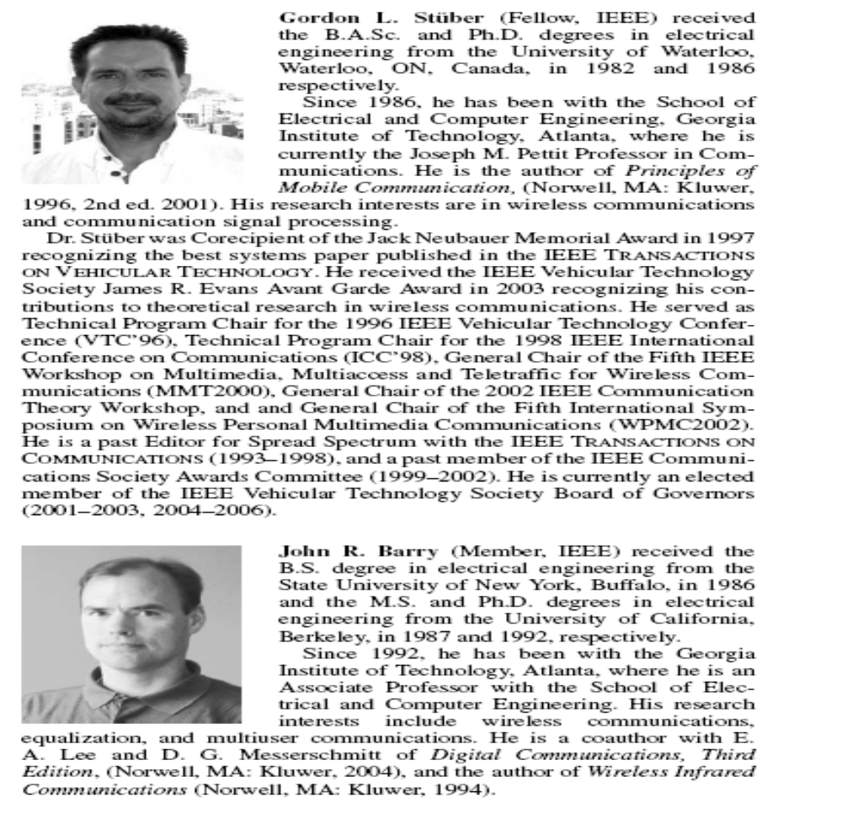

Slide 21

Make a biodata of your own!
Do it right now!
5min?

Slide 23




elements
www.animationfactory.com

