Slide 1
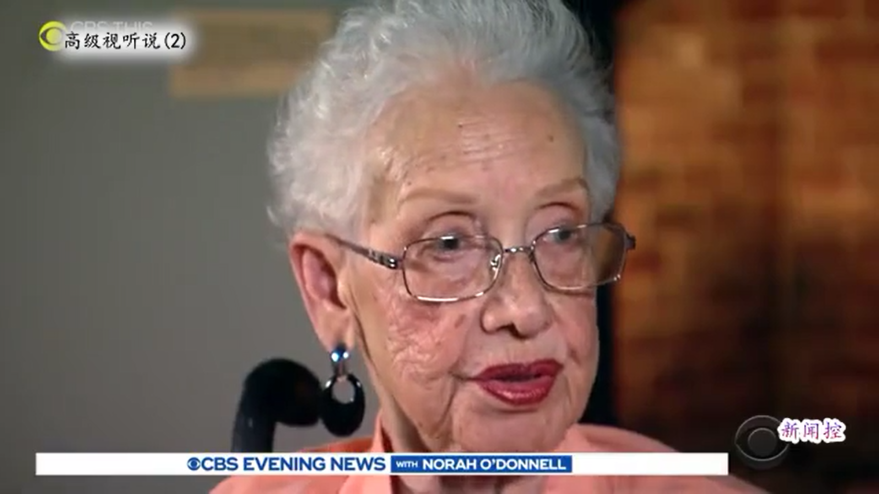
Listening-14
You are given 10 minutes to listen to the 1:51-min video and answer：
Questions:
  What is the main idea of the video clip?
  What is the name of her? How old was she when on death?
  What did she do? (Briefly describe her contribution)
  What percentage could the African American women have college degree at that time?
  What about her education?
  What did Obama award her? When?
  What did her father influence her?
  Why do you think Kathy show you this lady?
legacy, indispensable, invisible,
recount, verify, segregated
Hard to catch: Jim Crow
Notes:
15th
19th early

Slide 2

Lecture 15: letters
Submission letter+ follow-up
Resume/ CV. (Curriculum Vitae)
Invitation letter+2
Inquiry letter
Complaint letter
Recommendation letter
Application letter
Personal statement

Slide 3
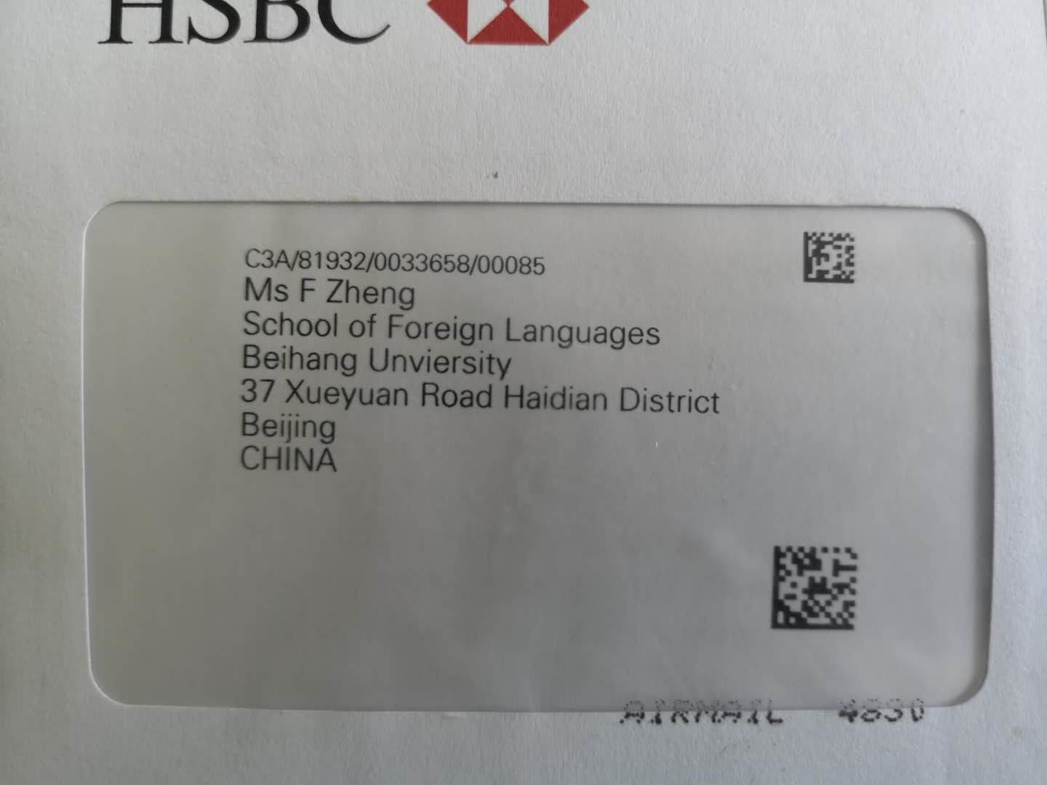
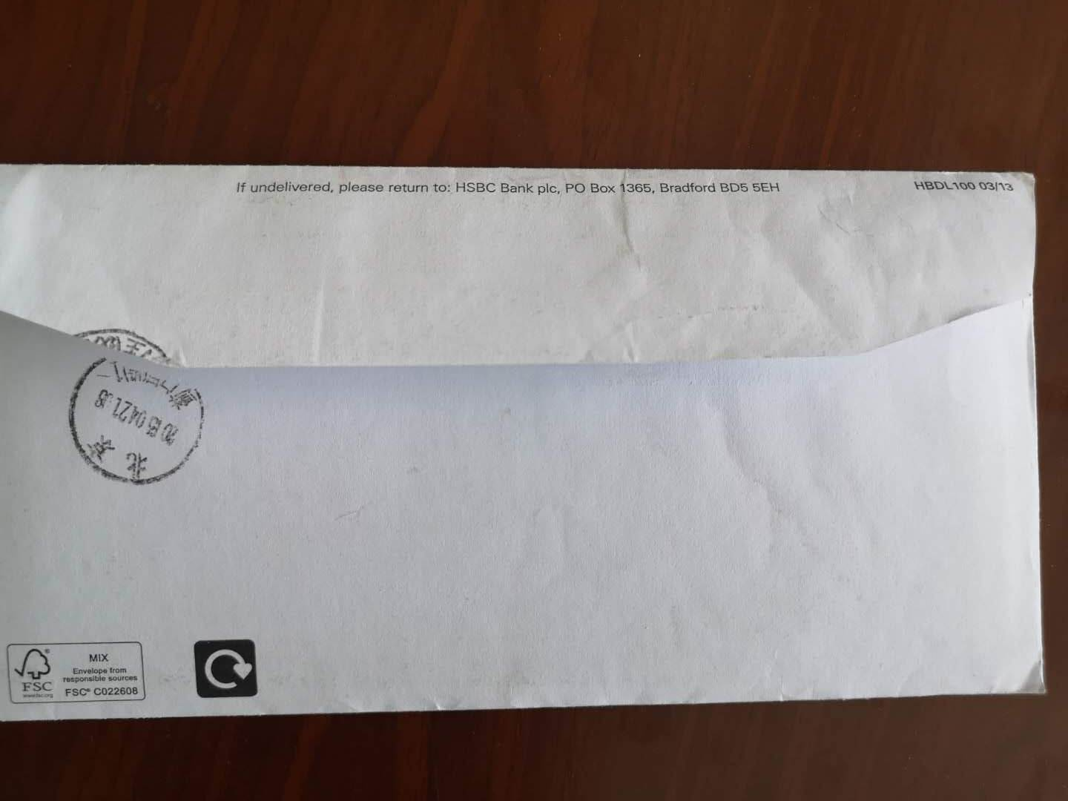
Envelope

Slide 4

1. Modified block
________________ Heading ________________ ________________ _______________ ________________ ________________ ------------- (Salutation) _________________________________________________________________________________________________________________ Body __________________________________________________________________________________________________ Closing______________ Signature____________

Slide 5

2. block
________________ ________________ Heading ________________ _______________ ________________ ________________ ------------- (Salutation) _________________________________________________________________________________________________________________ Body __________________________________________________________________________________________________ ______________ Closing ____________ Signature

Slide 6

3. Semi-block
________________ Heading ________________ ________________ _______________ ________________ ________________ ------------- (Salutation) ___________________________________________________ ________________________________________________________ Body ___________________________________________________ ________________________________________________ Closing______________ Signature____________

Slide 7
————————— __________________ Heading-return address Date______________ inside address_____ ________________ ________________ (single space) _____________salutation: (single space) ____________________________________________________________________________________ ____________________________________________________________________________________ ____________________________________________________________________________________ _________________________________________________________________________________________________________________________________________________________________________________________________________ Closing Handwritten signature Typed signature Official capacity(if any) (One Space) Enclosure:
Cover letter

Slide 8
Format of a personal letter
1. Heading: 23(rd) October, 2004--Br
October 23, 2004 ---Am.
23.10.(20)04
23/10/(20)04------Br
2. Salutation:
3. Body
4. Complimentary closing

Slide 9

Salutation
1. Dear Mother/father/mother and father/folks
2. Dear Aunt Helen/Uncle..
3. My dear Mother/Father/Henry
4. Dear Ann (given name)
5. Dear Dr. Thomas
6. Dear Mr./Mrs./Miss/Ms. Johnson
7. My dear Kathy
8. Dear Dr./Professor/Prof. Johnson

Slide 10

Complimentary closing
Sincerely (yours),
Yours (sincerely),
Very sincerely,
Fondly,
Cordially,
Affectionately,
Love,
Your friend,
With warmest regards,
With best wishes,
With love,
Lots of love,

Slide 11
————————— __________________ Heading-return address Date______________ inside address_____ ________________ ________________ (single space) _____________salutation: (single space) ____________________________________________________________________________________ ____________________________________________________________________________________ ____________________________________________________________________________________ _________________________________________________________________________________________________________________________________________________________________________________________________________ Closing Handwritten signature Typed signature Official capacity(if any) (One Space) Enclosure:

Slide 12
Types of letters
Submission letter+ follow-up
Resume/ CV. (Curriculum Vitae)
Invitation letter+2
Inquiry letter
Complaint letter
Recommendation letter
Application letter
Personal statement

Slide 13
Submission letter
Dear Dr. Gardener,
I would like to submit to your journal for possible publication the enclosed paper entitled “…”. The specific subject of this paper has not been submitted for publication elsewhere; it is based upon research performed for the completion of my Ph. D. thesis.
As per your journal’s instructions, I am enclosing three copies of my paper and also include a 50-word biological statement.
I would be pleased to give you any further information that you might request.
sincerely yours

Slide 14
Further correspondence-follow up
Dear Dr. Green,
Six months ago I submitted manuscript (“…”) to your journal, receipt of which was swiftly acknowledged. Given this considerable time, I am now wondering when you will be in a position to report on this manuscript. I can be most easily contacted at xxx@xyz.com.
with best wishes

Slide 15

Curriculum Vitae
(Latin) course of life
an account of one’s education and career

Slide 16
C.V.
Vitae: documents that give much more detail than does a resume about your academic and professional accomplishments.
are most often used for academic or research positions, whereas resumes are the preferred documents in business and industry.

Slide 17

Resume Curriculum Vitae
1 page of A4 size paper a personal summary of your professional history and qualifications. It includes information about your career goals, education, work experience, activities, honors, and any special skills you might have.
Be as concise as possible in stating information in each section of your resume.
Ph. D students: 2-3 pages
Academic staff: 3 or more pages

Slide 18
Resume/curriculum vitae
Name, address, phone
Immediate and long-range job objectives
Professional training
Specific skills
Pertinent personal information
Reference

Slide 19
Outline for an effective resume:
Heading: name address and phone number in the upper left/right hand corner or upper middle
Professional experience: Work experience in the same field in which the applicant is now seeking something.
Educational Background: Any college and advanced degrees and fields of specialization
Personal Data (if necessary): Immigration, residence status, and the languages the applicant is fluent in, etc.
References: A few people who can vouch for the applicant’s background experience, special abilities, and moral character.

Slide 20
Content included in CV
Education
Master's thesis or project
Dissertation title or topic
Course highlights or areas of concentration in graduate study
Teaching experience and interests
Research experience and interests
Internships or graduate practices
Fieldwork

Slide 21
Publications
Professional papers and presentations
Grants received
Professional association and committee leadership positions and activities
Certificates and licensure
Special training
Academic awards, scholarships, and fellowships
Foreign study and travel abroad
Language competencies
Technical and computer skills

Slide 22
Useful Educational Expressions
Courses completed, curriculum and grades, extracurricular activities,
foreign language proficiency,
G.P.A (grade point average),
optional course,
social practice,
specialized courses,
B.A (Bachelor of Arts), B.B.A (Bachelor of Business Administration), M.B.A (Master of Business Administration), LL. B (Bachelor of Laws), M.S./ M. Sc. (Master of Science), Litt. D. (Doctor of Literature or of Letters), LL. D. (Doctor of Laws, Ph. D. (Doctor of Philosophy), Post doctorate (Postdoc)

Slide 23
Specialization and Achievements
Advanced Worker of national Higher Education
Awarded the 2nd Prize of …
Excellent Prize Winner at… Contest (优胜奖)
Outstanding Dissertation Award
Overachievement Award （突出贡献）
The first Prize in Excellent Teaching Achievements of Jilin Province
Participated in and supervised the key project
Successful track record in （在…有成功记录）

Slide 24
Tips for CV
Sell yourself-marketing
Tailor your CV-format fits u best, it is targeted on the specific job or career area
Use action words such as developed, planned and organized
It is clearly laid out: logically ordered, easy to read
It is informative but concise, short and to the point. Bullets, hardly complete sentences
It is accurate in content, spelling and grammar.
It's a good idea to put your name in the footer area so that it appears on each sheet.
Be positive, concise and honest

Slide 25
reminder
CV-互评=>课程中心
Portfolio-听力+口语+最后视频=>课程中心

Slide 26
Personal statement
Tell a story
Be specific
Find an angle
Concentrate on your opening paragraph
Tell what you know
Don’t include some subjects, eg. religion
Do some research
Write correctly
Avoid clichés

Slide 27


Reading ex.

Slide 28
Invitation letter
Pleasure →on behalf →what、when、where
Condition
Hope/expectation: contact
Notes:
1. It is a pleasure for me to invite you on behalf of ==It is my great pleasure that I invite you to==I'm writing to you in my capacity as…
It gives me great pleasure to ask if =I am writing to ask whether
2. The University of Reading will pay you a salary of =We are offering a valuable program
3. We hope that you can accept this invitation and we ask you to contact ==I do hope that you can accept this invitation=I do very much
hope that you will …
Please send me a reply as soon as possible…

Slide 29
Request/inquiry letter
With reference to your advertisement (ad) in. =Regarding your advertisement (ad) in =I was excited to see your advertisement for a
2. Would (Could) you please send me ... ?==I would also like to know ...=Could you tell me whether ... ?
Source
Questions
expectation
Notes:
With reference to your advertisement (ad) in. =Regarding your advertisement (ad) in =I was excited to see your advertisement for a
2. Would (Could) you please send me ... ?==I would also like to know ...=Could you tell me whether ... ?
3. I look forward to hearing from you
I am writing to you in connection with….
I am writing to you with reference to… .
I was very interested to see your advertisement in ….
I would be grateful if you could (would) send me ….?
Could (Would) you please give me details of …?
I would like to know...

Slide 30
Format of a request
Dear Colleague,
I would gratefully appreciate a copy of your article/paper entitled:
____________________________________________________
from/at _______________________________________________
if available. Thank you for your courtesy.
Signed ____________________

Slide 31
Phrases for letter of request
I am writing to you in connection with….
I am writing to you with reference to… .
I was very interested to see your advertisement in ….
I would be grateful if you could (would) send me ….?
Could (Would) you please give me details of …?
I would like to know..

Slide 32
Complaint letter
I am writing to place/make a compliant
What
Expectation
Notes:
I am writing to make/ place a compliant
3. We trust that

Slide 33
Recommendation letter
How you know of the referrer
Details
Your expectation
#specific examples
#don’t praise all the time, relationship
#tone of your letter

Slide 34
Personal statement
Tell a story
Be specific
Find an angle
Concentrate on your opening paragraph
Tell what you know
Don’t include some subjects, eg. religion
Do some research
Write correctly
Avoid clichés

Slide 35
Application letter
Purpose
Background
expectation
Notes:
1. I am currently seeking a position as a=I am very interested in
2. My background includes
3. I would enjoy meeting with you to share what I can bring to=I look forward to
4. Enclosed are copies of my records=Enclosed please find

Slide 36
Useful phrases
I would like to apply for/to be considered as a candidate for the job/post /position/ scholarship advertised/that I saw advertised in../ I have just seen in …
I feel I am well qualified (to../for) for the following reasons.
I have enclosed/attached a copy of my resume for your consideration.
If such experience would be valuable to your office, I would appreciate an interview at your convenience.

Slide 37
Further correspondence with editor
Dear Dr. Green,
Six months ago I submitted manuscript (“…”) to your journal, receipt of which was swiftly acknowledged. Given this considerable time, I am now wondering when you will be in a position to report on this manuscript. I can be most easily contacted at xxx@xyz.com
with best wishes.

Slide 38

In-class writing-Invitation/Inquiry
Invitation letter: invite a distinguished scholar for dinner
Letter of request: you are about to pursue your doctor’s degree in a foreign University

Slide 39
Assignments
CV or resume
Application letter/ recommendation letter/ personal statement

