Slide 1
ENZORA / USER GUIDE
Enzora
User Guide
Mutation-library construction, evidence-informed screening and candidate delivery
A practical guide to the current web workspace
Start with your enzyme and substrate. Build a candidate library, compare predicted properties, then review a shortlist for the next experiment.
Website
https://enzora-agent.com
For researchers using the browser, follow Sections 1–13.
For local installation and model resources, see Section 14.
For recovery and interpretation checks, see Sections 15–16.
Enzora web platform • 16 October 2026
1
Notes:
Current Enzora UI and source contracts, 16 October 2026. Screenshots labelled as the verified run use ten real computational candidates. Demo values are simulated. Sources: https://enzora-agent.com/ ; https://github.com/YuzhangLi2281/Enzora ; https://github.com/YuzhangLi2281/PHENOM .

Slide 2
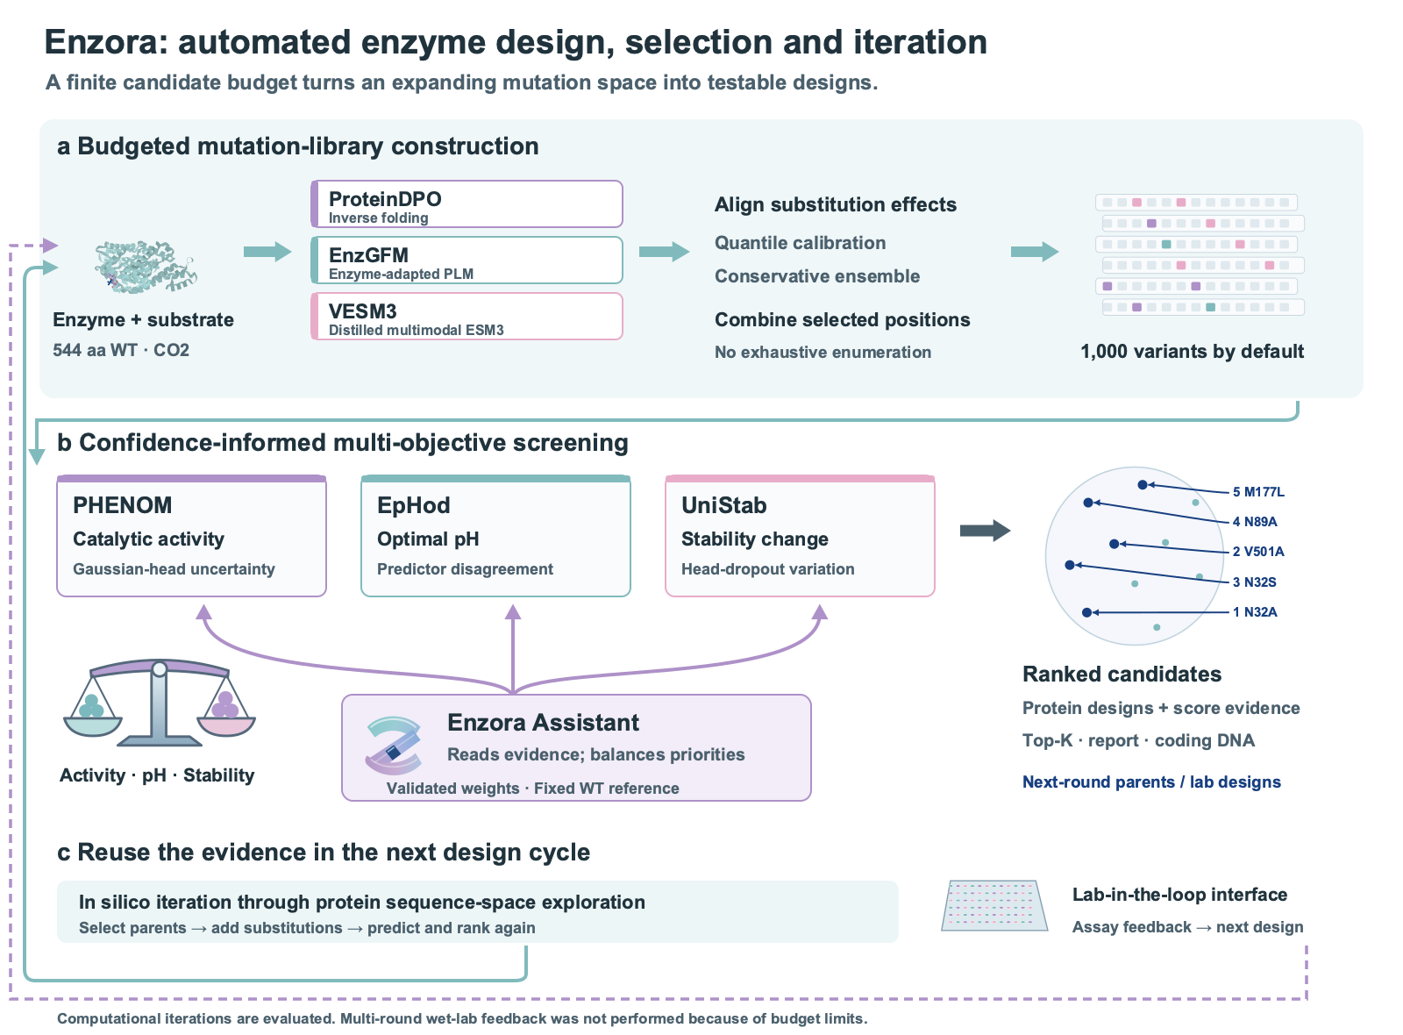
ENZORA / USER GUIDE
1. The three-stage workflow
Each stage has a clear input, action and saved result
Library: Build library
Supply the WT protein and substrate, then choose the mutation budget.
Screening: Start Screening
Run the three predictors. Review priorities and uncertainty before selection.
Output: Select Top-K & generate report, then inspect and export.
Enzora web platform • 16 October 2026
2
Notes:
Current Enzora UI and source contracts, 16 October 2026. Screenshots labelled as the verified run use ten real computational candidates. Demo values are simulated. Sources: https://enzora-agent.com/ ; https://github.com/YuzhangLi2281/Enzora ; https://github.com/YuzhangLi2281/PHENOM .

Slide 3
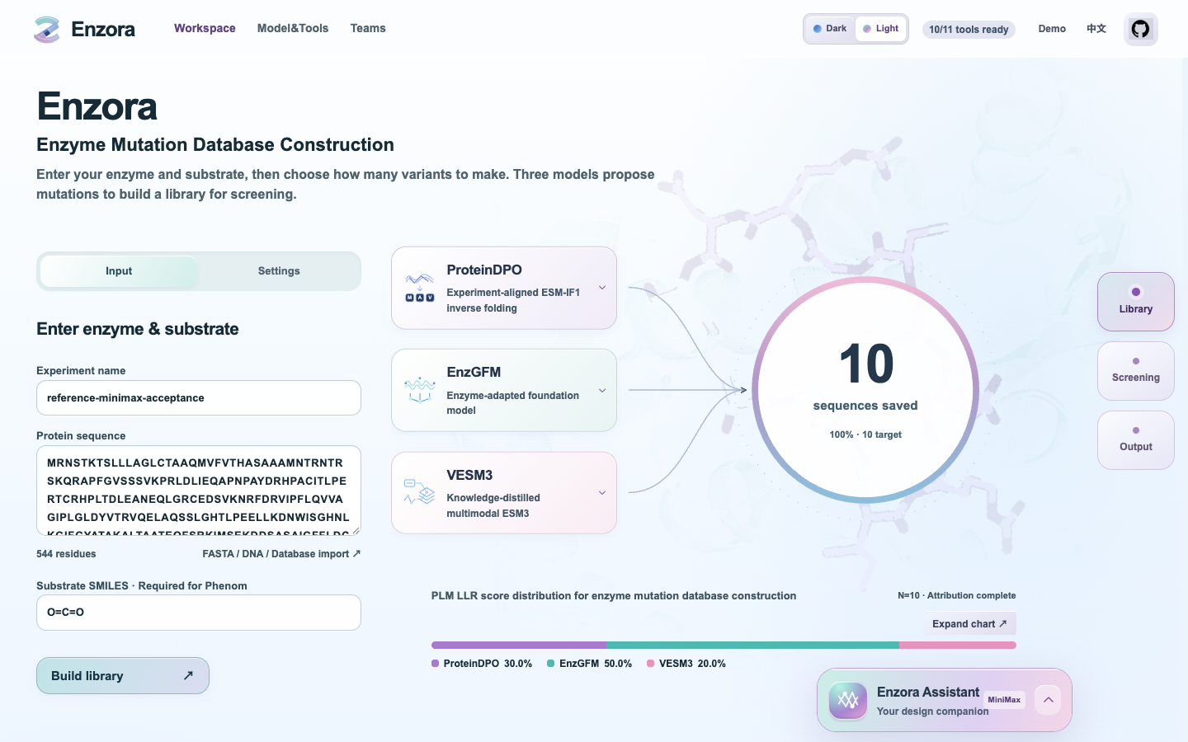
ENZORA / USER GUIDE
2. Access and Demo mode
The access code opens the workspace. Provider credentials stay on the server
Open the production platform
Visit enzora-agent.com. Enter the workspace access code when requested. The access code is separate from the MiniMax API credential.
Try the interface before submitting a real job
The Demo toggle runs local simulated data. Its fixed example is the project’s 544 aa carbonic anhydrase with CO2, entered as O=C=O. Demo predictions and its projection are simulated.
Scrolling changes the view. It does not authorize a new computation.
Enzora web platform • 16 October 2026
3
Notes:
Current Enzora UI and source contracts, 16 October 2026. Screenshots labelled as the verified run use ten real computational candidates. Demo values are simulated. Sources: https://enzora-agent.com/ ; https://github.com/YuzhangLi2281/Enzora ; https://github.com/YuzhangLi2281/PHENOM .

Slide 4
ENZORA / USER GUIDE
3. Enzyme and substrate inputs
Check the protein identity before starting a run
Protein sequence
Paste a canonical amino-acid sequence or use FASTA / DNA / Database import. The joint workflow accepts 1–1,000 residues. Translate DNA/RNA and confirm the protein before submission.
Substrate SMILES
PHENOM needs an enzyme–substrate pair. For the carbonic anhydrase example, carbon dioxide is O=C=O. A pH target alone does not replace the substrate.
Files and the unified object
The import route accepts FASTA, CSV, BioArtifact JSON, GenBank and sequence-bearing SBOL. Review the parsed records and choose the intended protein. The file-entry limit is 100 records.
Structure correspondence
The inverse-folding path needs the configured structure and chain to match the WT. Use a matching structure or ask the administrator to verify the mapping before a new enzyme is run.
Keep the original protein identifier. It links mutations, model predictions and exported files.
Enzora web platform • 16 October 2026
4
Notes:
Current Enzora UI and source contracts, 16 October 2026. Screenshots labelled as the verified run use ten real computational candidates. Demo values are simulated. Sources: https://enzora-agent.com/ ; https://github.com/YuzhangLi2281/Enzora ; https://github.com/YuzhangLi2281/PHENOM .

Slide 5
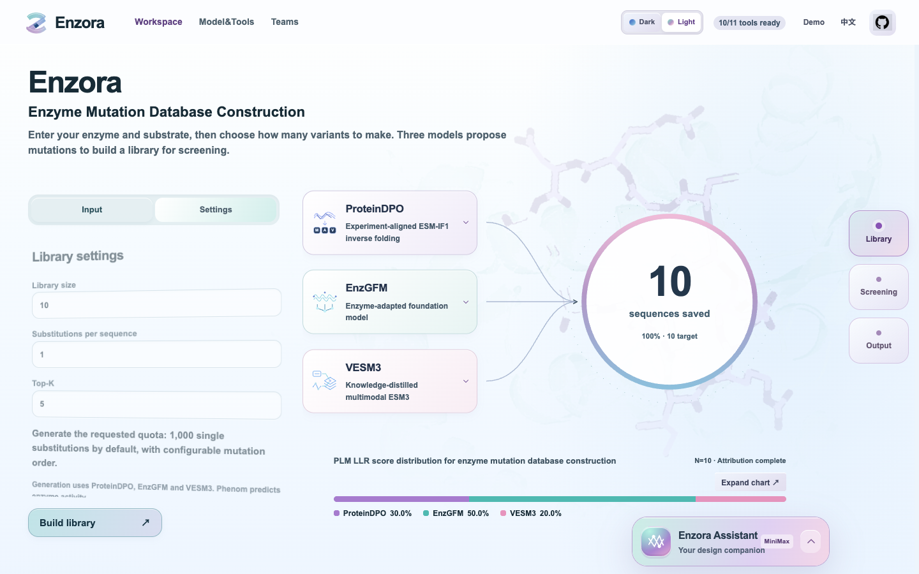
ENZORA / USER GUIDE
4. Library settings
The budget controls how many unique variants enter screening
Budget, mutation order and Top-K
The default library contains 1,000 single mutants, with five final candidates. The Settings tab changes library size, mutation order and Top-K. A double mutant changes two distinct residues.
Advanced restrictions
Allowed/excluded positions and mutation-order quotas are request fields. Review them in the preparation/parameter preview when used. Quotas must sum to the library size.
Enzora web platform • 16 October 2026
5
Notes:
Current Enzora UI and source contracts, 16 October 2026. Screenshots labelled as the verified run use ten real computational candidates. Demo values are simulated. Sources: https://enzora-agent.com/ ; https://github.com/YuzhangLi2281/Enzora ; https://github.com/YuzhangLi2281/PHENOM .

Slide 6
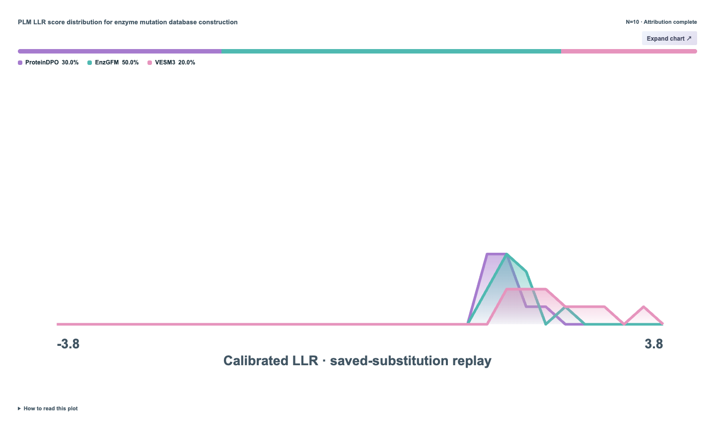
ENZORA / USER GUIDE
5. Construction progress and LLR
Saved records and model scores answer different questions
The circular counter
The ring tracks saved candidate sequences, not a benchmark of inference speed. Library completion enables Start Screening. Wait for completion before requesting the next computation.
The LLR distribution and attribution bar
The curves show calibrated model scores for saved substitutions. The bar assigns each substitution to its lowest-scoring model; ties share credit. The five-second animation replays saved data.
Enzora web platform • 16 October 2026
6
Notes:
Current Enzora UI and source contracts, 16 October 2026. Screenshots labelled as the verified run use ten real computational candidates. Demo values are simulated. Sources: https://enzora-agent.com/ ; https://github.com/YuzhangLi2281/Enzora ; https://github.com/YuzhangLi2281/PHENOM .

Slide 7
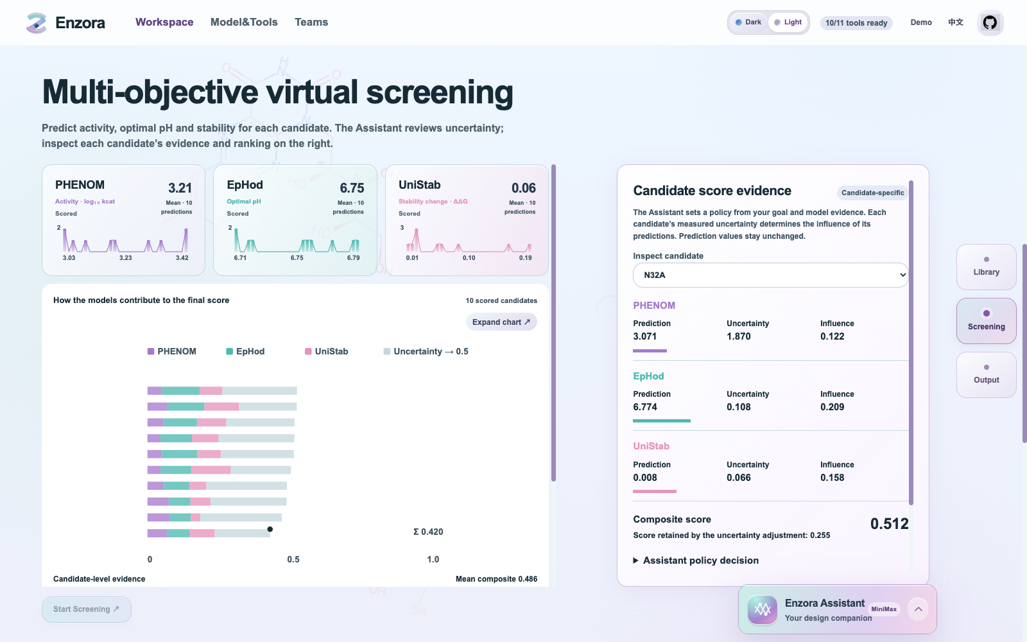
ENZORA / USER GUIDE
6. Virtual screening
Three predictors provide distinct biological quantities
PHENOM, EpHod and UniStab
PHENOM predicts log10(kcat) and a Gaussian standard deviation. EpHod predicts optimal pH and reports predictor disagreement. UniStab predicts WT-relative stability change and head-dropout variation.
Start Screening is an execution boundary
Scroll to Screening and click Start Screening after the library is ready. Queue time and model execution are separate states. Missing outputs are not zero scores.
Enzora web platform • 16 October 2026
7
Notes:
Current Enzora UI and source contracts, 16 October 2026. Screenshots labelled as the verified run use ten real computational candidates. Demo values are simulated. Sources: https://enzora-agent.com/ ; https://github.com/YuzhangLi2281/Enzora ; https://github.com/YuzhangLi2281/PHENOM .

Slide 8
ENZORA / USER GUIDE
7. Candidate score evidence
Inspect how uncertainty affects each candidate, without fixed percentage controls
The Assistant sets an evidence-informed policy
Choose a candidate in the right panel. Compare its model predictions, measured uncertainty and actual influence coefficients. The Agent sets a reliability policy; code applies uncertainty using each model’s own scale. Predictions remain unchanged.
Review the applied balance
Open Assistant policy decision to inspect the recorded tool explanation. The chart separates measured prediction evidence from the neutral baseline retained under uncertainty. Continue to Output when scores are ready.
Confidence is a control parameter, not an experimental success probability.
Enzora web platform • 16 October 2026
8
Notes:
Current Enzora UI and source contracts, 16 October 2026. Screenshots labelled as the verified run use ten real computational candidates. Demo values are simulated. Sources: https://enzora-agent.com/ ; https://github.com/YuzhangLi2281/Enzora ; https://github.com/YuzhangLi2281/PHENOM .

Slide 9
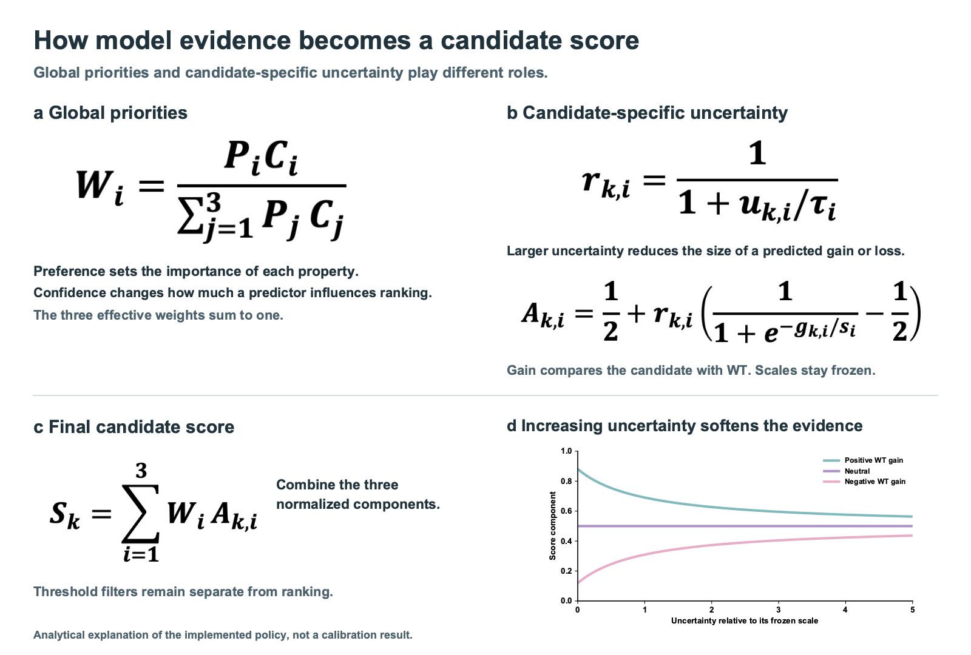
ENZORA / USER GUIDE
8. Reading the score
A fixed WT reference makes gains interpretable
Gain, uncertainty and the neutral point
Activity gain is candidate minus WT. pH gain is the reduction in distance to the target. Stability gain follows the configured lower-is-better ΔΔG convention. Uncertainty shrinks gains and losses towards 0.5.
Ranking and acceptance are separate
A high rank does not mean that a candidate meets the target. Review pH tolerance, minimum activity and stability thresholds alongside the composite score.
Enzora web platform • 16 October 2026
9
Notes:
Current Enzora UI and source contracts, 16 October 2026. Screenshots labelled as the verified run use ten real computational candidates. Demo values are simulated. Sources: https://enzora-agent.com/ ; https://github.com/YuzhangLi2281/Enzora ; https://github.com/YuzhangLi2281/PHENOM .

Slide 10
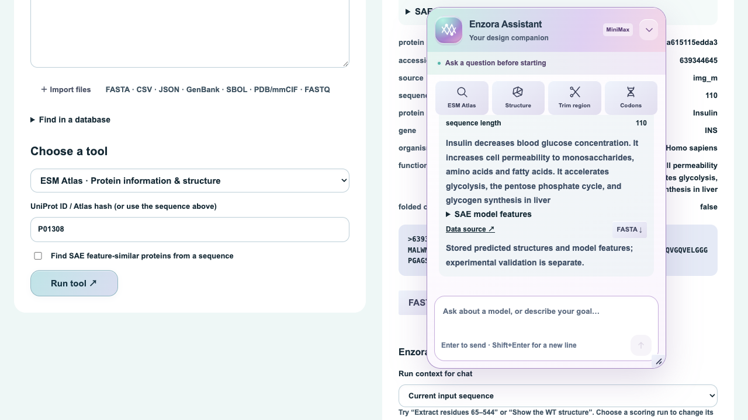
ENZORA / USER GUIDE
9. Enzora Assistant
Natural language requests call bounded, validated tools
Context and progress
Open the floating Assistant, drag its header or resize its edges. Follow the named tool steps and elapsed time during a request. Recent conversation turns help preserve context.
“Explain why this candidate ranks first.”
“Look up UniProt P01308 in ESM Atlas.”
“Extract residues 25–300 from the supplied protein.”
A residue interval must come from your instruction. The tool does not infer a cleavage site.
Enzora web platform • 16 October 2026
10
Notes:
Current Enzora UI and source contracts, 16 October 2026. Screenshots labelled as the verified run use ten real computational candidates. Demo values are simulated. Sources: https://enzora-agent.com/ ; https://github.com/YuzhangLi2281/Enzora ; https://github.com/YuzhangLi2281/PHENOM .

Slide 11
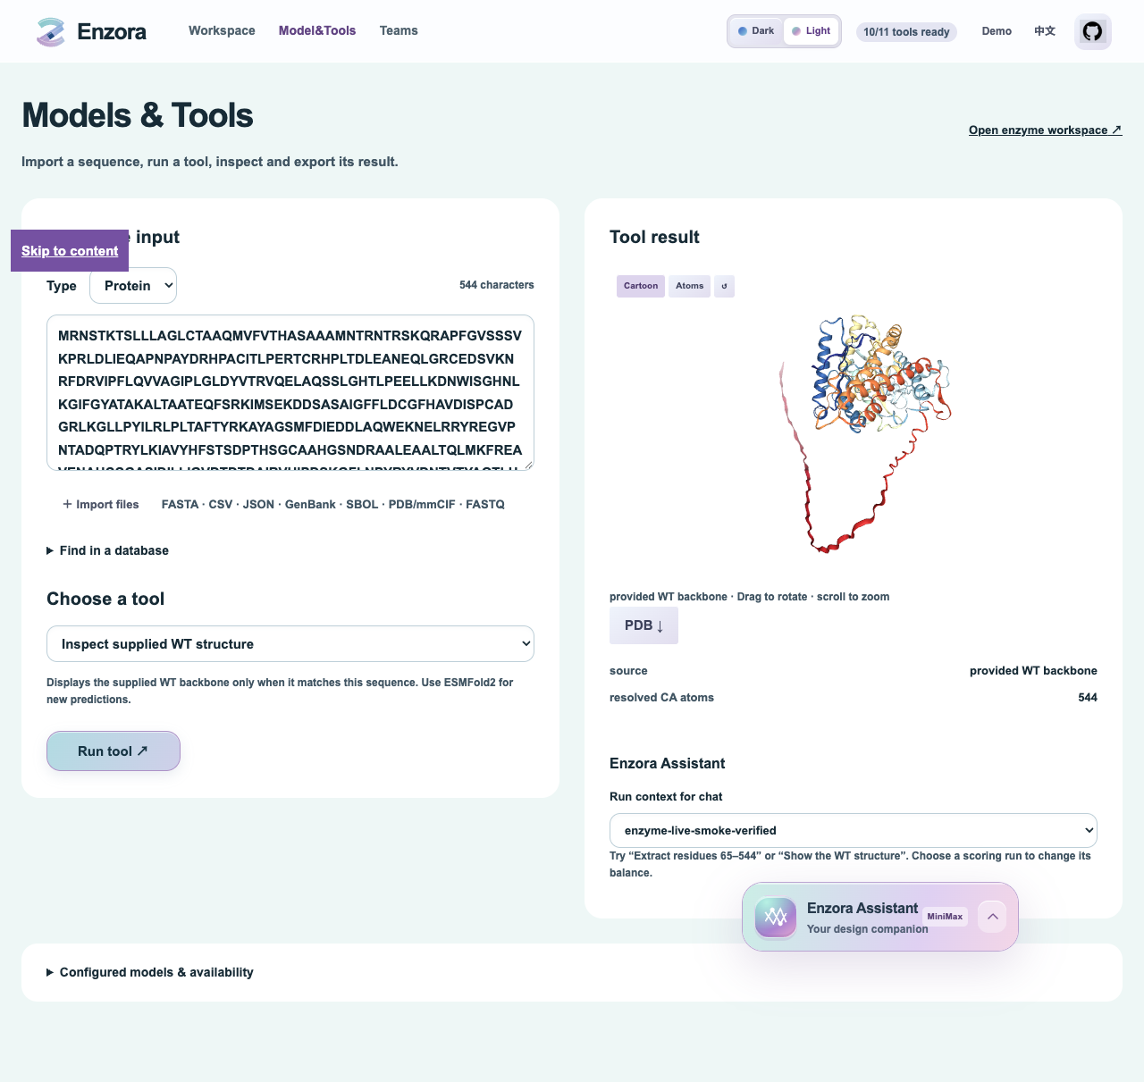
ENZORA / USER GUIDE
10. Structures and Model&Tools
Inspect the source and identity of every returned structure
ESM Atlas and the structure viewer
Atlas lookup retrieves metadata, sequence, SAE features and any stored prediction. The viewer supports rotation, zoom and representation changes. SAE feature similarity is not sequence identity.
Prediction is a separate request
Inspect structure displays the supplied WT structure. ESMFold2 prediction requires a separately configured Biohub token and an explicit request. The Tools page disables unavailable operations.
Enzora web platform • 16 October 2026
11
Notes:
Current Enzora UI and source contracts, 16 October 2026. Screenshots labelled as the verified run use ten real computational candidates. Demo values are simulated. Sources: https://enzora-agent.com/ ; https://github.com/YuzhangLi2281/Enzora ; https://github.com/YuzhangLi2281/PHENOM .

Slide 12
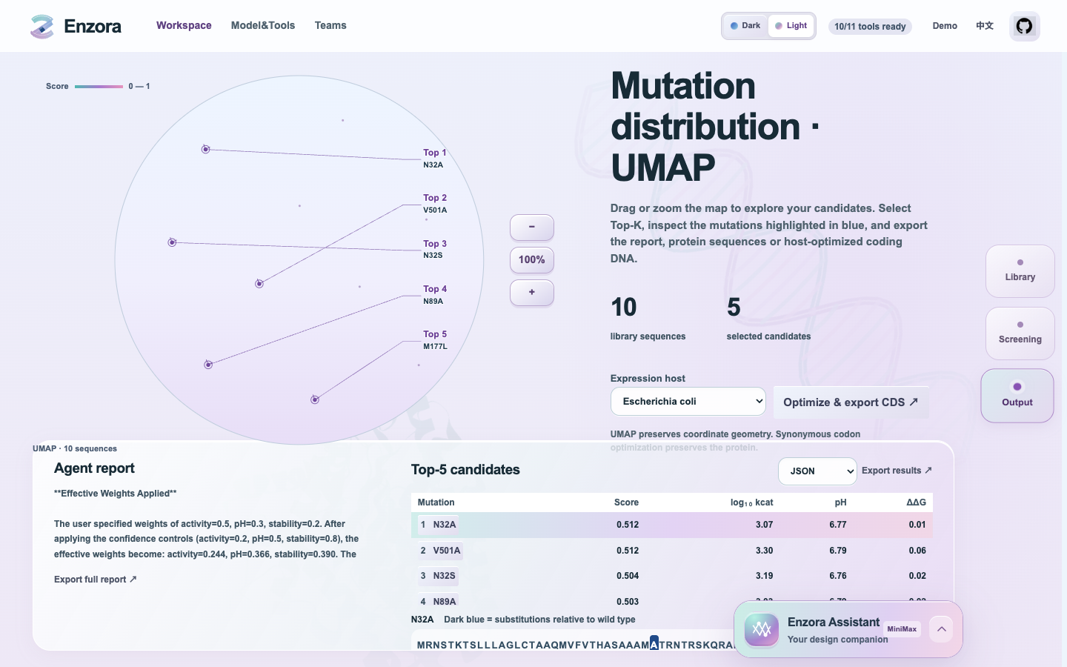
ENZORA / USER GUIDE
11. UMAP and the Top-K shortlist
The map helps you inspect sequence space, not measure experimental activity
Explore and select
Drag the map to pan and use the wheel or zoom buttons. Select a highlighted Top-K node to inspect its sequence. The dark-blue residues identify substitutions relative to the initial WT.
Generate the final result
After scoring is ready, go to Output and click Select Top-K & generate report. This starts final selection, UMAP and analysis. The report export becomes available when those steps finish.
Enzora web platform • 16 October 2026
12
Notes:
Current Enzora UI and source contracts, 16 October 2026. Screenshots labelled as the verified run use ten real computational candidates. Demo values are simulated. Sources: https://enzora-agent.com/ ; https://github.com/YuzhangLi2281/Enzora ; https://github.com/YuzhangLi2281/PHENOM .

Slide 13
ENZORA / USER GUIDE
12. Result formats and coding DNA
Choose a format that preserves the information you need
Proteins and prediction records
The result selector exports JSON, CSV, FASTA, GenBank or SBOL. JSON preserves the BioArtifact schema, predictions and provenance. FASTA carries sequence identity but does not preserve arbitrary prediction annotations.
Host-specific synonymous DNA
Choose the expression host, then use Optimize & export CDS. The export includes WT and selected candidates. Translate each DNA sequence back to the source protein before gene synthesis.
What codon optimization does
Eleven host usage tables are built in, including E. coli and Bacillus subtilis. The current method chooses preferred synonymous codons. It does not optimize mRNA folding, restriction sites, repeats or synthesis constraints.
Keep a traceable package
Save the protein FASTA together with JSON/CSV and the analysis report. Check candidate identifiers, sequence lengths, substitutions, substrate and host across all exported files.
Enzora web platform • 16 October 2026
13
Notes:
Current Enzora UI and source contracts, 16 October 2026. Screenshots labelled as the verified run use ten real computational candidates. Demo values are simulated. Sources: https://enzora-agent.com/ ; https://github.com/YuzhangLi2281/Enzora ; https://github.com/YuzhangLi2281/PHENOM .

Slide 14
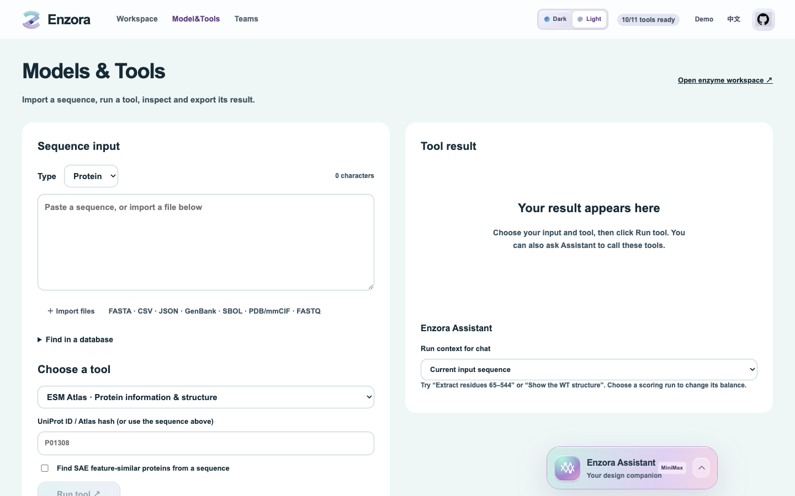
ENZORA / USER GUIDE
13. Model&Tools operations
Use a specific tool without starting the full mutation workflow
Choose the input and operation
Open Model&Tools. Enter a protein sequence or accession, choose the operation and inspect its returned card. Atlas queries include source links and sequence downloads. An active scientific run is not silently replaced.
Understand availability
Structure inspection, explicit sequence trimming and host codon conversion use the configured tools. External prediction needs its own resource setup. A disabled tool is not evidence of a completed calculation.
Enzora web platform • 16 October 2026
14
Notes:
Current Enzora UI and source contracts, 16 October 2026. Screenshots labelled as the verified run use ten real computational candidates. Demo values are simulated. Sources: https://enzora-agent.com/ ; https://github.com/YuzhangLi2281/Enzora ; https://github.com/YuzhangLi2281/PHENOM .

Slide 15
ENZORA / USER GUIDE
14. Local setup commands
Run commands from the repository root
git clone https://github.com/YuzhangLi2281/Enzora.git
cd Enzora
python3 -m venv .venv
source .venv/bin/activate
pip install -r src/Enzora_Software_Webs/utils/server/requirements.txt
npm --prefix src/Enzora_Software_Webs/web ci
Configure resources before launching
Edit config/server.yaml and config/mutation.yaml. Set model interpreters, repositories and weight paths. Configure MiniMax privately and run the path checks before submitting a real task.
API terminal
python src/Enzora_Software_Webs/utils/server/run.py \
--host 127.0.0.1 --port 8000
Frontend terminal
VITE_PROXY_TARGET=http://127.0.0.1:8000 \
npm --prefix src/Enzora_Software_Webs/web run dev
Enzora web platform • 16 October 2026
15
Notes:
Current Enzora UI and source contracts, 16 October 2026. Screenshots labelled as the verified run use ten real computational candidates. Demo values are simulated. Sources: https://enzora-agent.com/ ; https://github.com/YuzhangLi2281/Enzora ; https://github.com/YuzhangLi2281/PHENOM .

Slide 16
ENZORA / USER GUIDE
14. Local deployment and resources
For administrators and developers
Code and model environments
Clone the Enzora repository and install its API/web dependencies. Follow each model’s environment requirements. PHENOM inference also requires its checkpoint, ESMC and MolT5 resources. Enzora does not distribute all model weights.
Configuration entry points
config/server.yaml
config/mutation.yaml
config/request.example.yaml
Provider: MiniMax-M2.5
Base URL: https://api.minimax.cn/v1
Private credentials
Keep MINIMAX_API_KEY and the workspace access token in the server’s private environment/configuration. Never embed them in config.js, frontend code, screenshots or public repository history.
Execution and cache boundaries
The API submits model jobs to the configured scheduler. Shared weights remain separate from per-run data. Success, failure and cancellation clear disposable graphs/logits while retaining predictions, reports and audit records.
Enzora web platform • 16 October 2026
16
Notes:
Current Enzora UI and source contracts, 16 October 2026. Screenshots labelled as the verified run use ten real computational candidates. Demo values are simulated. Sources: https://enzora-agent.com/ ; https://github.com/YuzhangLi2281/Enzora ; https://github.com/YuzhangLi2281/PHENOM .

Slide 17
ENZORA / USER GUIDE
15. Recovery and interpretation checks
A completed interface action does not guarantee a completed model job
Login fails
Use the workspace access code, not the MiniMax provider key.
A job remains queued
Check the job status. Repeated submissions do not accelerate the current allocation.
A model fails
Read the stage error and retained logs. Verify its environment, weights and input contract.
The Assistant takes time
Watch actual tool progress. Network/provider delays can outlast a scientific tool call.
No candidate meets the target
Review acceptance filters separately from rank. Revise the design or use a new round.
The report is unavailable
Wait for selection/analysis to finish. A failed report is not an empty successful result.
A run is cancelled
Confirm the scheduler has stopped the job before cleaning active files.
Enzora web platform • 16 October 2026
17
Notes:
Current Enzora UI and source contracts, 16 October 2026. Screenshots labelled as the verified run use ten real computational candidates. Demo values are simulated. Sources: https://enzora-agent.com/ ; https://github.com/YuzhangLi2281/Enzora ; https://github.com/YuzhangLi2281/PHENOM .

Slide 18
ENZORA / USER GUIDE
16. Evidence and further reading
The guide follows the current browser and production code
Verified integration example
The screenshots use a real 544 aa WT / CO2 task with ten single-mutant candidates and Top-5 output. All three generators, all three scorers and MiniMax native balancing completed. This is an integration check, not 1,000-candidate performance or wet-lab validation.
Scientific interpretation
UMAP uses positional amino-acid identity with Hamming distance. It is a visualization. Model uncertainty proxies have different meanings and are not jointly calibrated success probabilities. Predicted candidates require experimental testing.
Further reading
https://enzora-agent.com
https://github.com/YuzhangLi2281/Enzora
https://github.com/YuzhangLi2281/PHENOM
https://github.com/ntranoslab/vesm
https://github.com/ai4protein/VenusFactory2
Project diagrams retain editable labels and vector components. Native formula sources remain available for editing.
Enzora web platform • 16 October 2026
18
Notes:
Current Enzora UI and source contracts, 16 October 2026. Screenshots labelled as the verified run use ten real computational candidates. Demo values are simulated. Sources: https://enzora-agent.com/ ; https://github.com/YuzhangLi2281/Enzora ; https://github.com/YuzhangLi2281/PHENOM .

