Slide 1
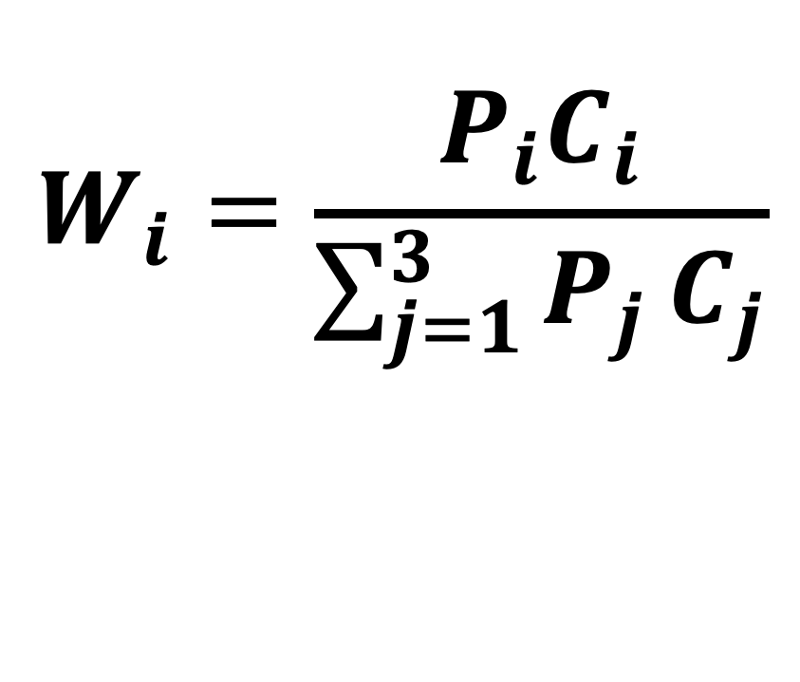
Effective model weights
$$W_{i}=\frac{P_{i}C_{i}}{\sum_{j=1}^{3}{P_{j}}C_{j}}$$

Slide 2
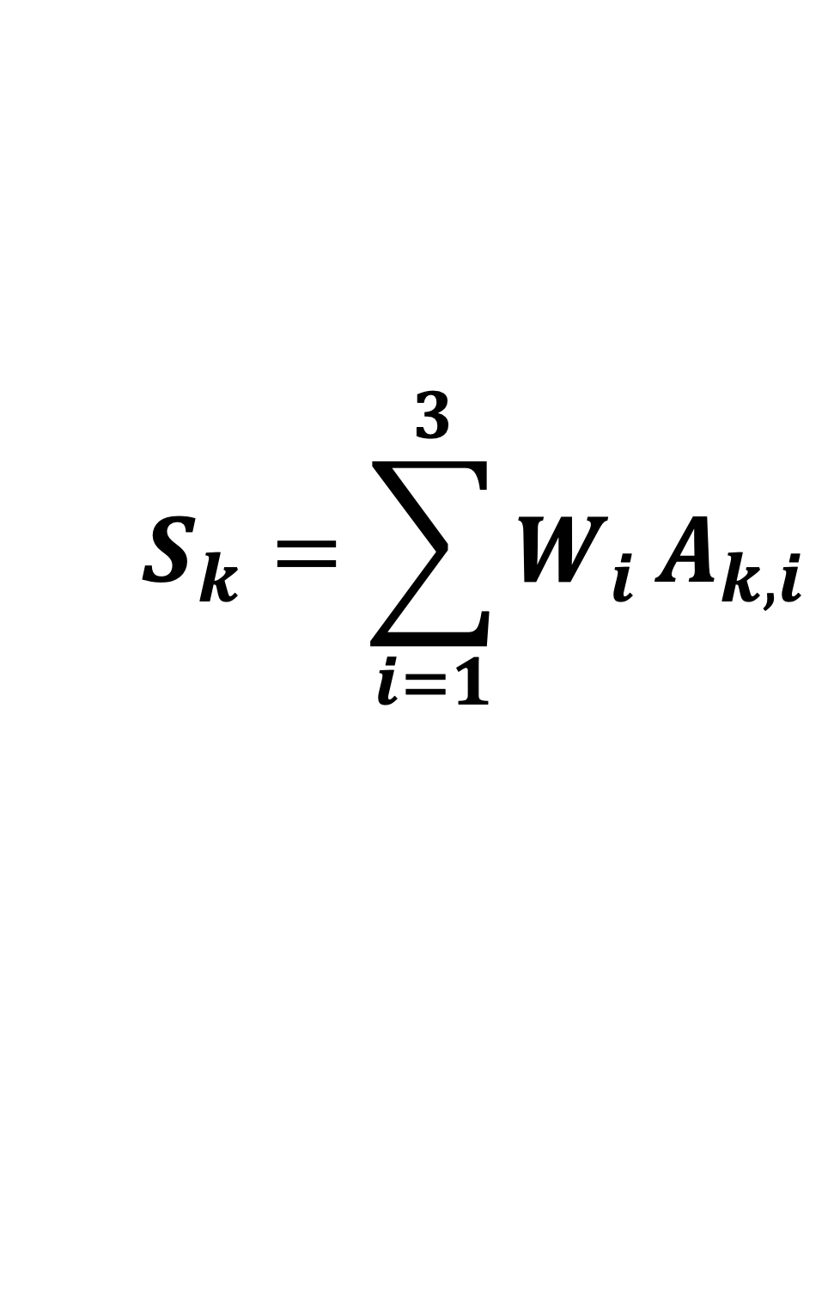
Composite candidate score
$$S_{k}=\sum_{i=1}^{3}{W_{i}}A_{k,i}$$

Slide 3
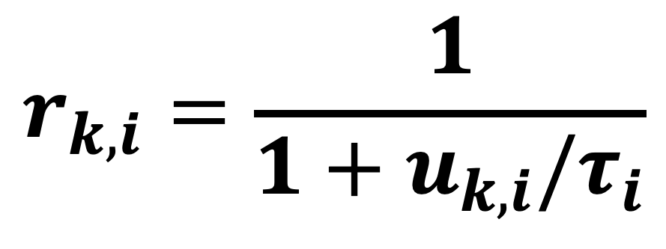
Uncertainty shrinkage
$$r_{k,i}=\frac{1}{1+u_{k,i}/τ_{i}}$$

Slide 4
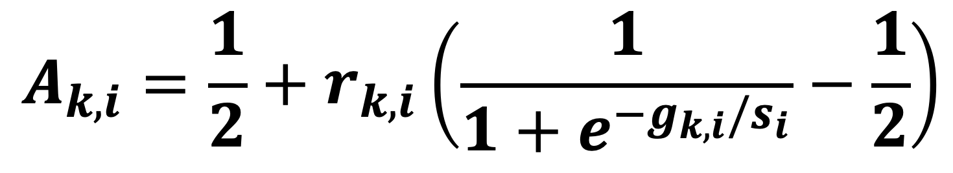
WT-reference component
$$A_{k,i}=\frac{1}{2}+r_{k,i}\left(\frac{1}{1+e^{−g_{k,i}/s_{i}}}−\frac{1}{2}\right)$$

